Slide 1
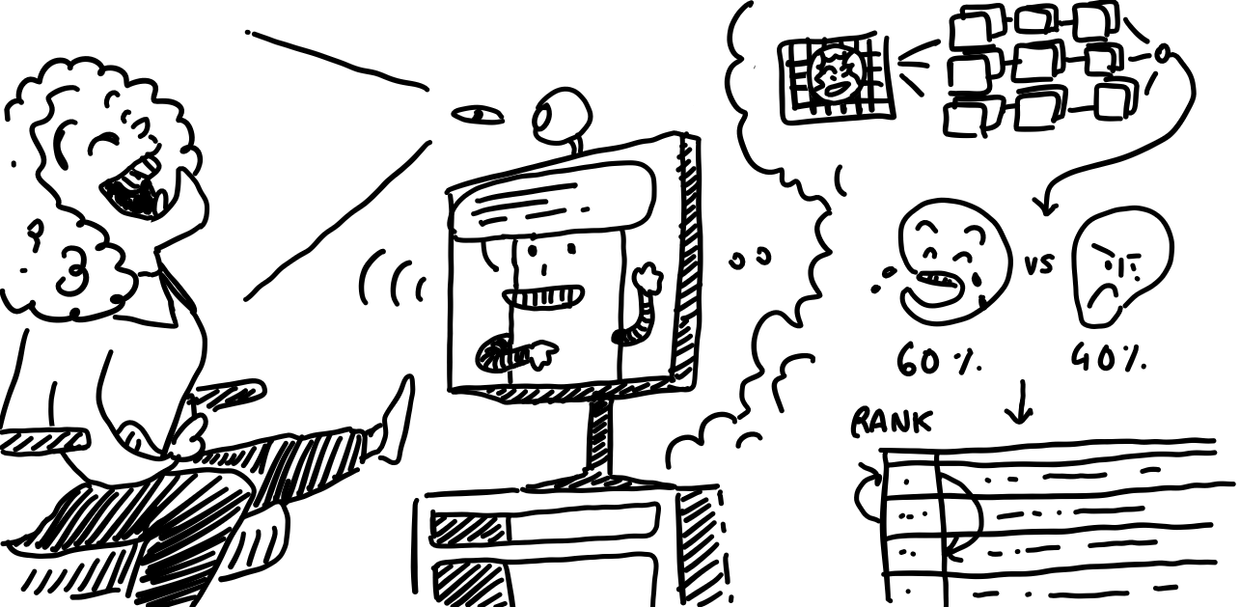
Can I joke on you?
Anicet Nougaret, Lena Ebner, Jens De Bock
6/11/2023
Notes:
A good, hearty laugh relieves physical tension and stress, leaving your muscles relaxed for up to 45 minutes afterwards In fact, one study suggests that healthy children may laugh as much as 400 times per day, but adults tend to laugh only 15 times per day.

Slide 2
Recap

Slide 3
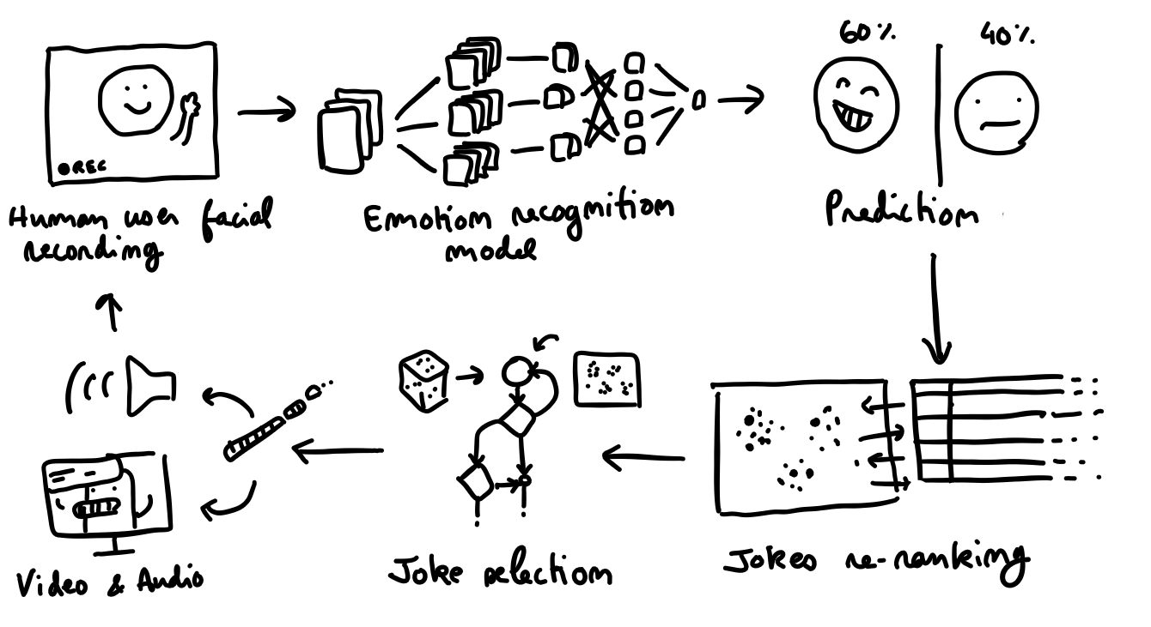
Idea
A robot that tells jokes to the user. Able to detect the user’s facial expressions, he learns to pick jokes the user seems to like.

Slide 4
Planning
Project Presentation (Midterm)
Status Update: What have we done so far and what are our next steps?
Project Presentation (Rehearsal)
Status Update: How is everything going? What’s left to do?
Project Presentation (Idea)
Final Presentation
Start Ideation Phase
01.11
01.12
05.01.2024
26.09
09.10
06.11
18.12
08.01.2024
Create Basic Components
Find Emotion Dataset + Train CNN + Classification Find Jokes Dataset + Train RS + Predict Jokes Find UI Engine + Create UI Robot + User Interactions
Connecting Components
Connect Emotion with Jokes and UI Robot to a complete UX
Final Project
Improve individual components by finetuning models and UI
Conduct experiment and analyze results
Notes:
that’s where we are right now

Slide 5
Research Question
Notes:
we tried to define our research question

Slide 6
Research Question
Is a robot UI with recommender more fun to use than telling random jokes?
Notes:
2 user groups in the experiment
one with laughing detecting, recommender and robot in ui
one with just telling random jokes without robot ui just jokes and yes or no buttons in UI
measure time a person spends
how often a person laughs
did you feel the jokes were becoming more towards your likings

Slide 7
Variables
3 Variables
Recommender is active or not (independent)
Facial expressions (independent)
User experience (dependent)
Notes:
2 user groups in the experiment
one with laughing detecting, recommender and robot in ui
one with just telling random jokes without robot ui just jokes and yes or no buttons in UI with recommender
UI: Empty UI with jokes written
Recommender system: jokes.random()
Facial expression: Same with UI + yes/no buttons

Slide 8
Status Update

Slide 9
Parts of the project
Identify emotions and gestures via camera
Recommender system for jokes
UI with virtual robot for user interaction
Jens
Anicet
Lena

Slide 10
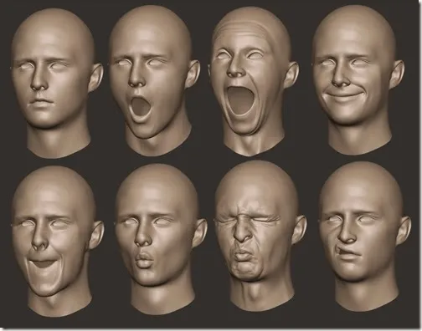
Emotion Detection
No more usage of keypoints
Use blendshapes to estimate laughing
Can be used directly in the front-end
2 calibration phases
Finetune and normalize output
Notes:
Last time, I mentioned that we used keypoints in combination with a neural network to estimate the laughing degree of the smiles.
However, this did not work as reliable as we wanted. And we discovered that blendshapes are also something that mediapipe is offering.
These blendshapes are the result of a pretrained model on these keypoints and represent certain facial regions.
An example of this is the upper corner of your mouth or the movement of your eyes.
Working with this is extremely easy, not only because it is way more explainable but also because it can be integrated into the front-end directly.
The final step was to finetune the values, by introducing 2 calibration phases: one for a neutral face and one for a smiling face and normalize these values as an input to the recommender system.

Slide 11
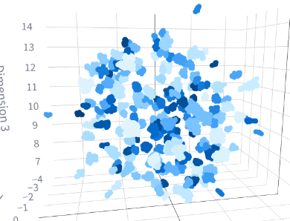
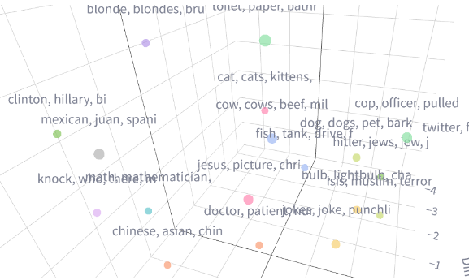
Joke Dataset (updates)
30 semantic categories of jokes obtained via embeddings clustering
Manually filtered down to 26 categories
Jokes with URIs, weird characters filtered out automatically

Slide 12
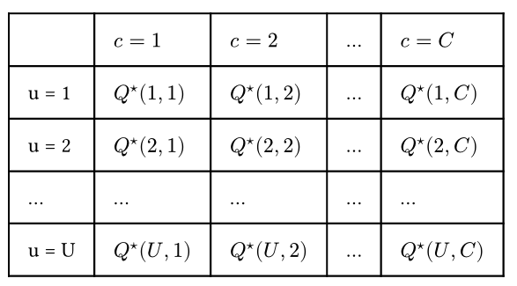


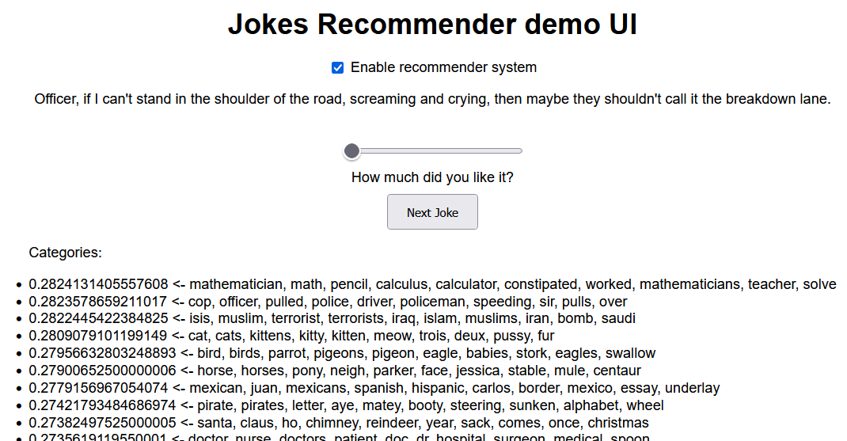
Joke Recommender (new)
Inspired by tabular Q-learning (Barto & Sutton, 1998) (learns a pool of favorite categories)
Fast convergence in less than 30 jokes tested using a test UI
Good at filtering out categories you don’t like early

Slide 13
Robot UI
Create UI Flow for Study Procedure
Integrate Emotion Recognition and Smile Detection in UI with Mediapipe
Communicate with Recommender
Implemented Logging of smile detection for each user
Deployment on VM to be reachable by domain https://joke.servegame.com/

Slide 14
Demo

Slide 15
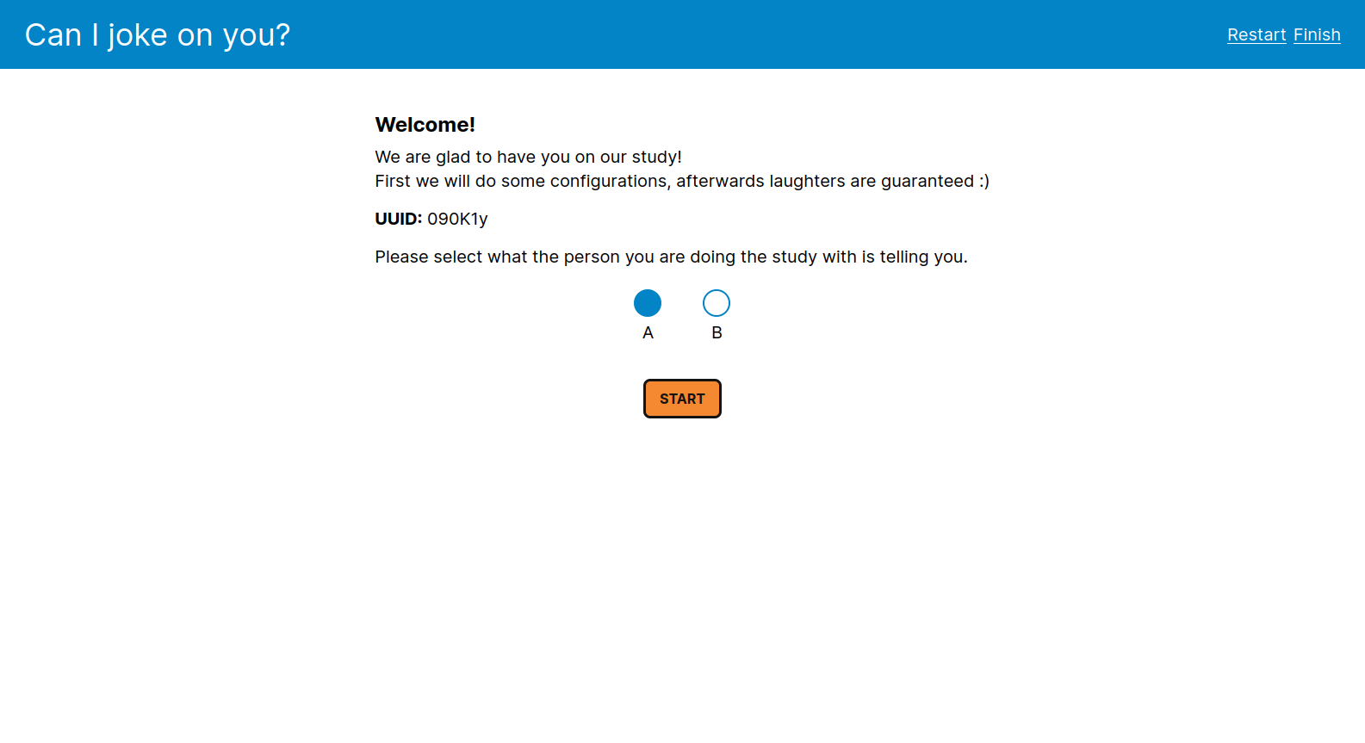
Demo

Slide 16
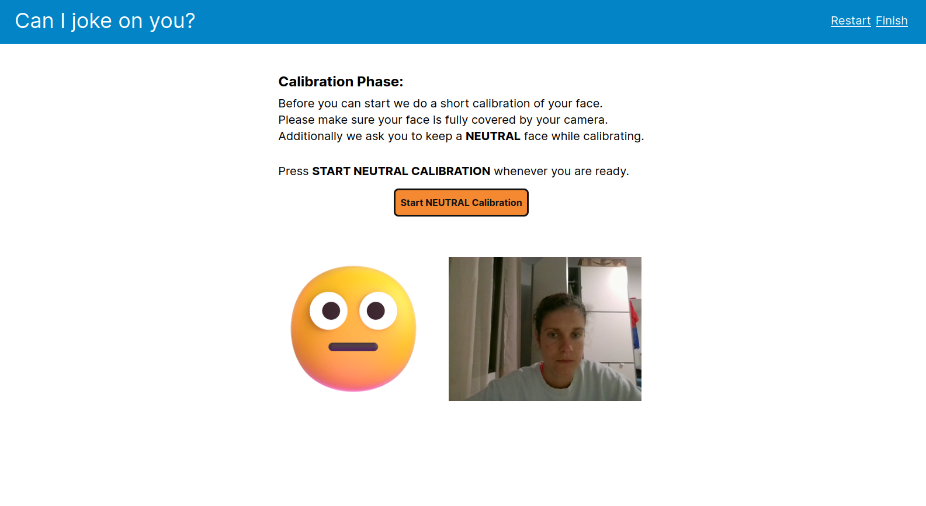
Demo

Slide 17
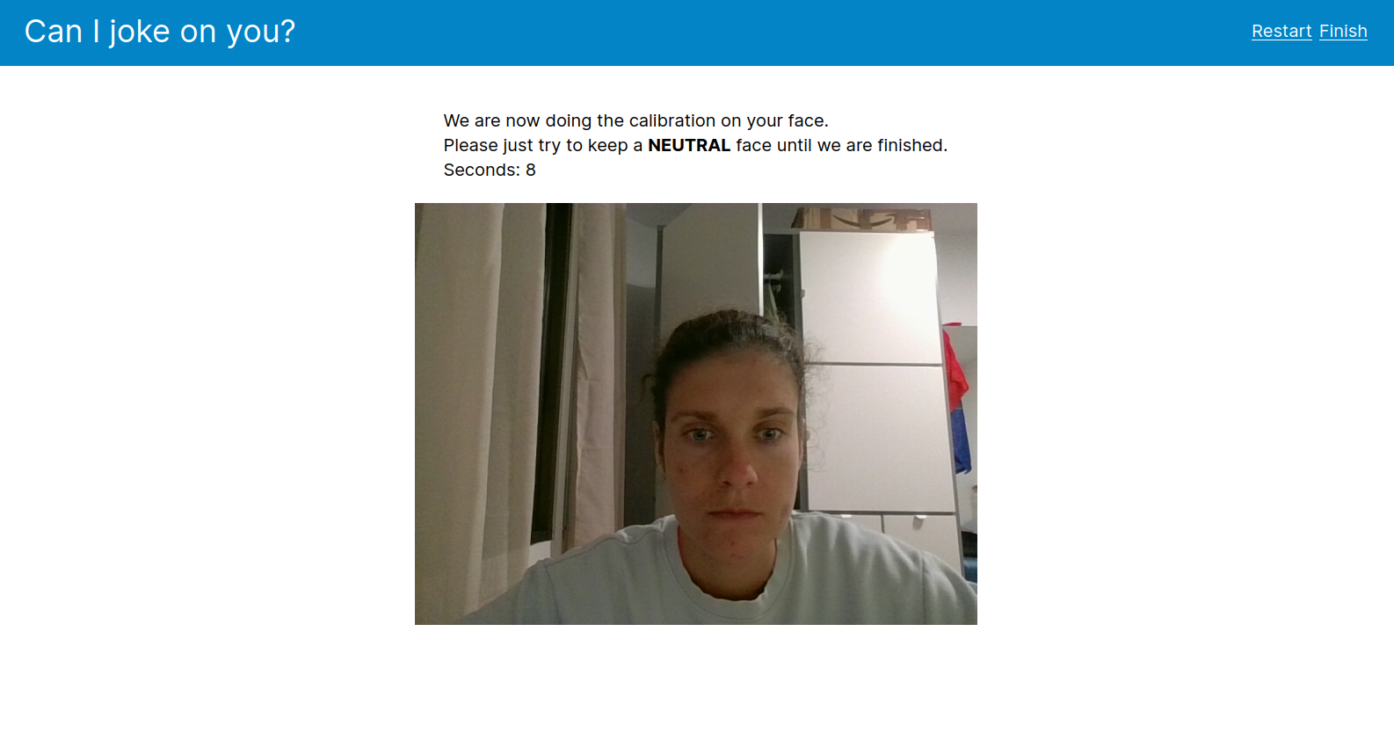
Demo

Slide 18
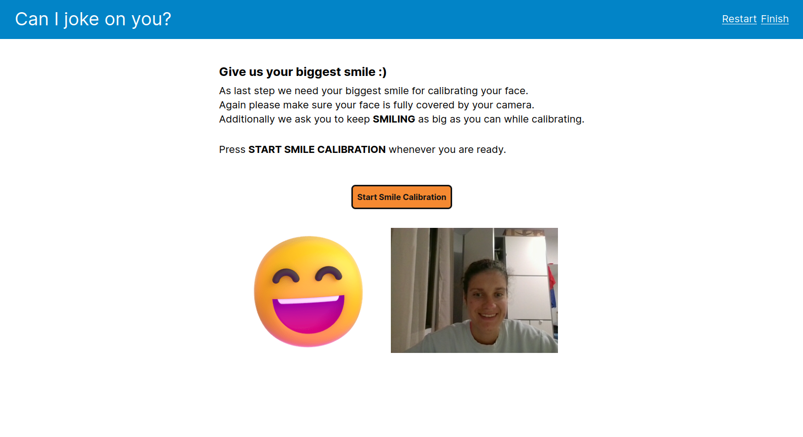
Demo

Slide 19
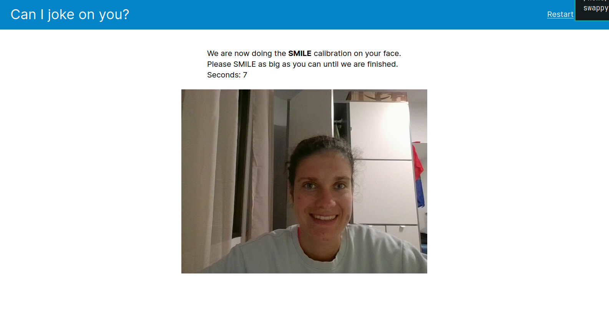
Demo

Slide 20
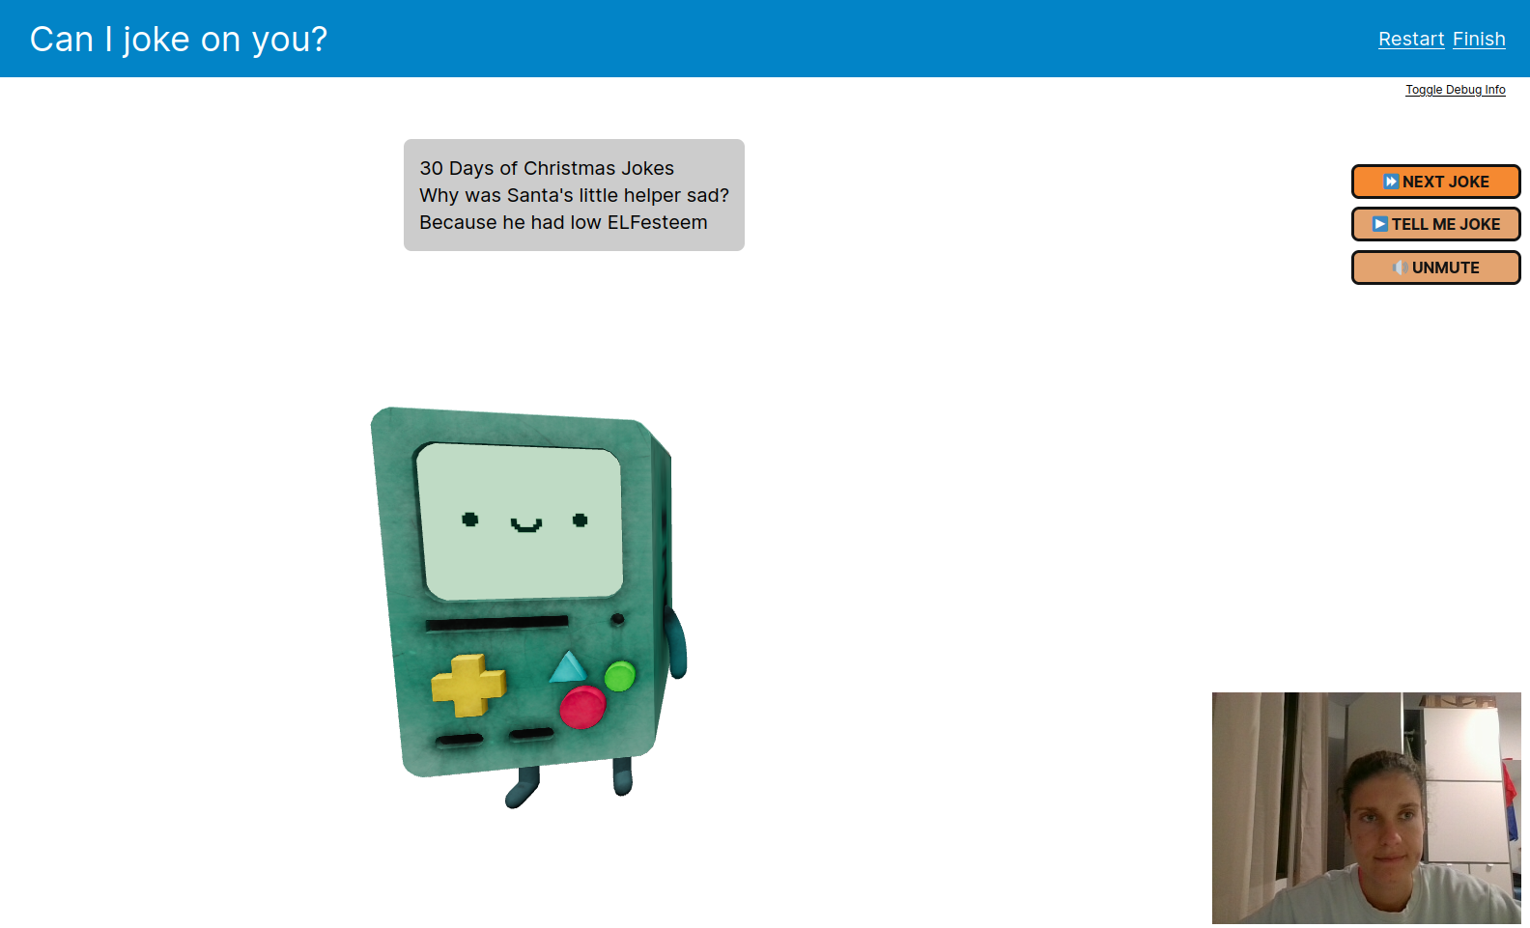
Demo

Slide 21
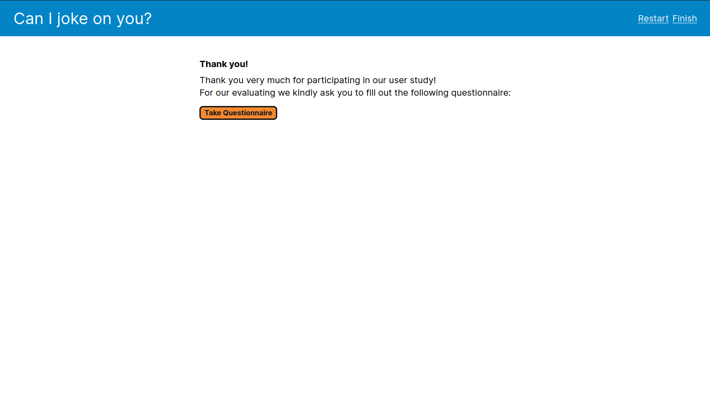
Demo

Slide 22
Evaluation

Slide 23
Evaluation
Prepared all files needed for evaluation
Godspeed questionnaire (without Antrophism)
Logs
Consent for participation
Study procedure
Excel for manual joke likeliness detection by us
Started with evaluation on the weekend
Doing evaluation with ~ 20 participants
Notes:
For the actual experiment, we have prepared the necessary files, including the Godspeed questionnaire (leaving out antrophism as one of these questions did not fit with our robot model at all), the logs representing the smile degree of the participants during the experiment.
Next also the consent files, a study procedure and excel files for our own manual likeliness detection such that we can compare the output from our application.
We started with evaluation last weekend and plan to gather around 20 participants.

Slide 24
Evaluation
Results we want to evaluate
How well learns the recommender system
Smile detection accuracy
User experience differences
Notes:
So in total we want to evaluate 3 main things.
How well does the recommender system learn. Does the smile degree go up.
How good is our smile detection. Is this comparable to what we as a user can see?
And what is the user experience when using a recommender system or not.

Slide 25
Questions? Feedback?

