Slide 1
College Canteen Ordering System
Team Members
Jenshi Patel | 12502080601047
Dharti Patel | 12502080601022
DBMS Project | Topic 11
Submitted to: Yamini Dubey, Information Technology
AD Patel Institute of Technology, CVM University
Notes:
Introduce the group, topic number and faculty. Replace the bracketed placeholders with real names and enrollment numbers.

Slide 2
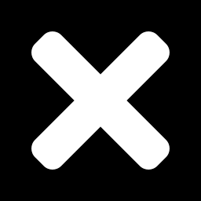
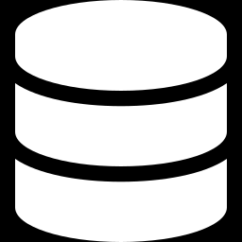
Problem Statement and Motivation
Current manual system
Need for a database system
Paper slips and cash cause long queues
Orders get mixed up or lost
No record of daily sales or best sellers
Stock runs out without any warning
Every order stored with a daily token
Bill calculated automatically
Stock reduced on each order, low-stock alert
End-of-day sales report in one call
Notes:
Explain what happens in a canteen today and why a database solves it.

Slide 3
Objectives and Requirements
1
Replace paper slips with a database-backed order flow
Hardware
Intel i3 or above, 4 GB RAM
500 MB free disk space
2
Issue a token per order, restarting every day
3
Track each order from Pending to Collected
Software
Windows 10/11
XAMPP: Apache, PHP, MySQL
phpMyAdmin and Chrome
4
Report daily orders, revenue and best sellers
Notes:
Four goals on the left; hardware and software needed on the right.

Slide 4
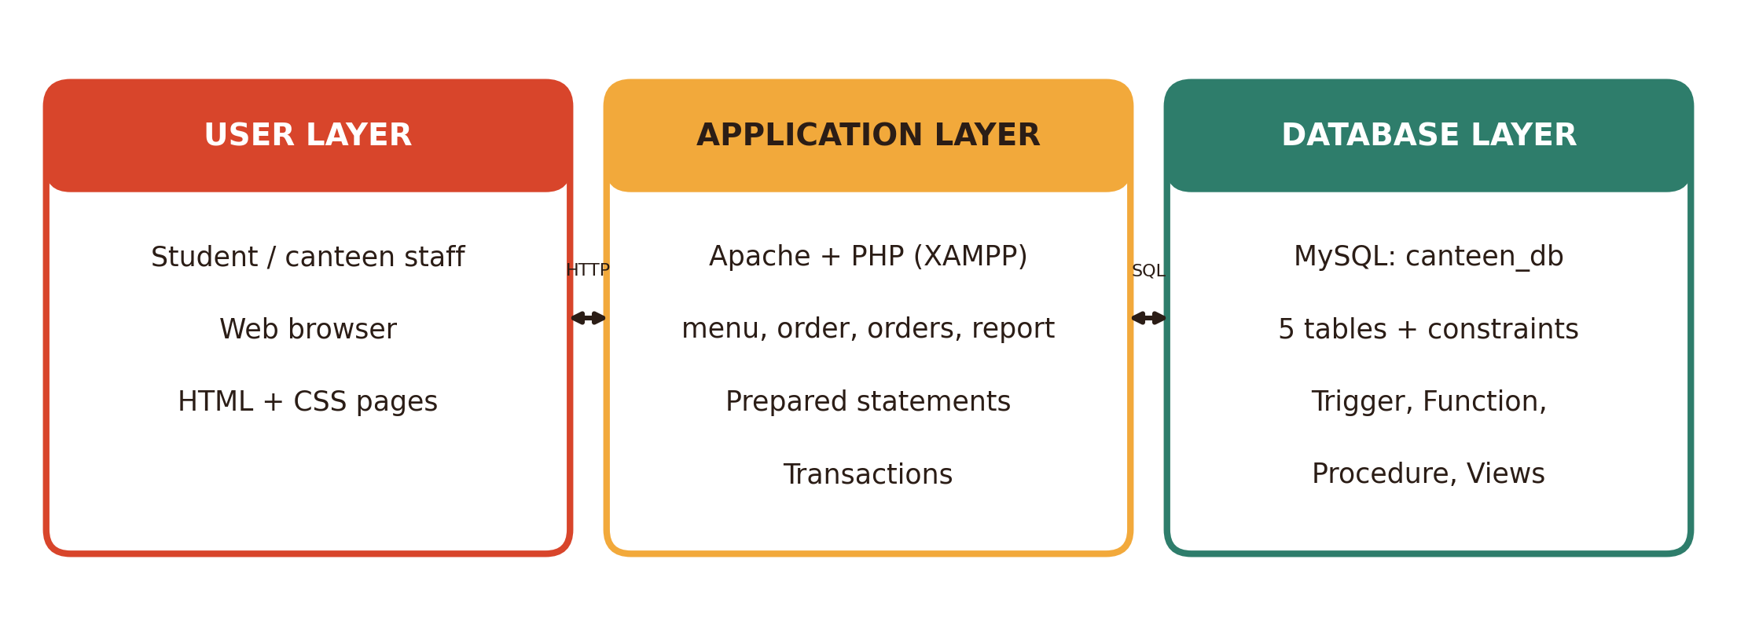
System Architecture
The business rules live in the database, so any front end can reuse them.
Notes:
Three layers: the user works in a web browser, PHP validates input and builds the bill, MySQL stores data and enforces rules with constraints, a trigger, a function, a procedure and views.

Slide 5
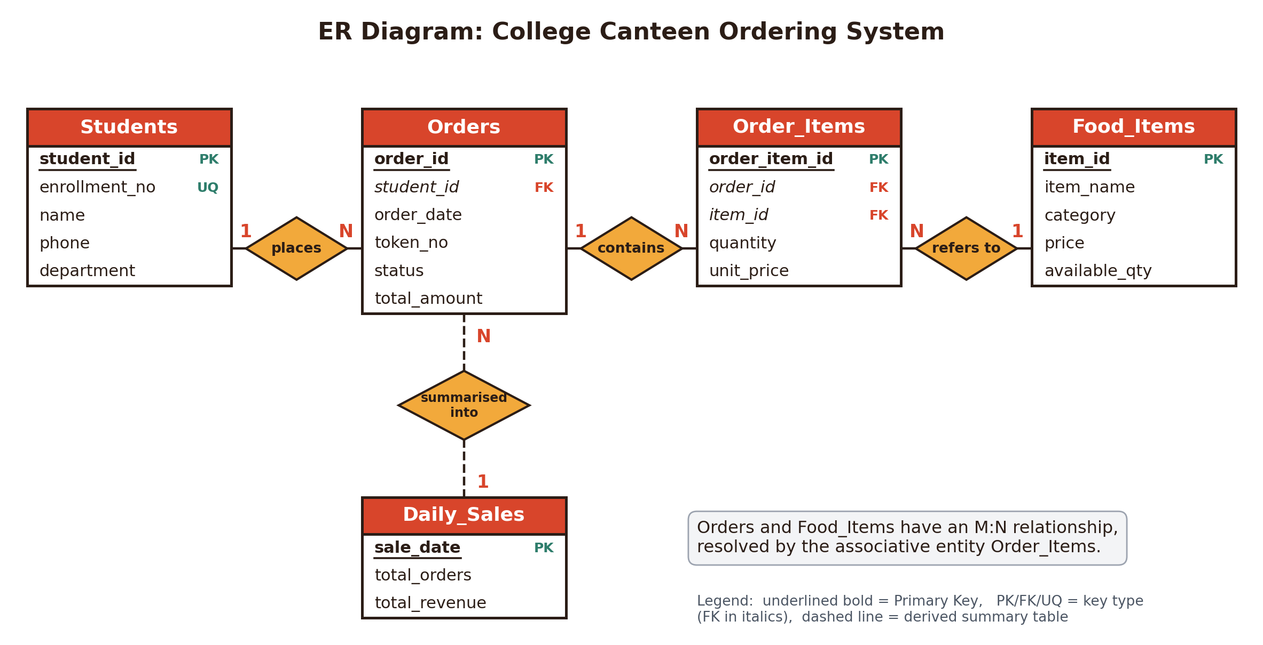
Entity-Relationship Diagram
Notes:
Students 1:N Orders, Orders 1:N Order_Items, Food_Items 1:N Order_Items. So Orders and Food_Items are M:N, resolved by Order_Items. Daily_Sales is a derived summary table.

Slide 6
Relational Schema and Normalization
Table | Keys and constraints
Students | PK student_id; UNIQUE enrollment_no
Food_Items | PK item_id; CHECK price > 0
Orders | PK order_id; FK student_id
Order_Items | PK order_item_id; FK order_id, item_id
Daily_Sales | PK sale_date
1NF
Atomic values, no repeating groups
2NF
No partial dependency on the key
3NF
No transitive dependency
Notes:
Total_amount in Orders is a deliberate derived column kept up to date by the trigger. unit_price in Order_Items freezes the price at order time, so later price changes do not alter old bills.

Slide 7
DDL: Keys and CHECK Constraints
CREATE TABLE Food_Items (
item_id INT AUTO_INCREMENT
PRIMARY KEY,
item_name VARCHAR(50)
NOT NULL UNIQUE,
category VARCHAR(20),
price DECIMAL(6,2)
CHECK (price > 0),
available_qty INT
CHECK (available_qty >= 0)
);
CREATE TABLE Order_Items (
order_item_id INT PRIMARY KEY
AUTO_INCREMENT,
order_id INT NOT NULL,
item_id INT NOT NULL,
quantity INT
CHECK (quantity > 0),
unit_price DECIMAL(6,2),
FOREIGN KEY (order_id)
REFERENCES Orders(order_id)
ON DELETE CASCADE,
FOREIGN KEY (item_id)
REFERENCES Food_Items(item_id)
);
Orders also has UNIQUE (order_date, token_no), so a token is never repeated on the same day.
Notes:
Show PRIMARY KEY, FOREIGN KEY with ON DELETE CASCADE, UNIQUE and CHECK. The CHECK on available_qty is what stops an order when stock is too low.

Slide 8
Queries, Trigger and Procedure
SELECT f.category,
SUM(oi.quantity) AS units,
SUM(oi.quantity*oi.unit_price)
AS revenue
FROM Order_Items oi
JOIN Food_Items f
ON oi.item_id = f.item_id
JOIN Orders o
ON oi.order_id = o.order_id
WHERE o.status <> 'Cancelled'
GROUP BY f.category;
CREATE TRIGGER
trg_after_order_item_insert
AFTER INSERT ON Order_Items
FOR EACH ROW
BEGIN
UPDATE Food_Items
SET available_qty =
available_qty - NEW.quantity
WHERE item_id = NEW.item_id;
-- also updates Orders total
END;
Also in the database: view v_todays_orders, function get_next_token(), procedure generate_daily_sales(date)
Notes:
Left: a three-table JOIN with GROUP BY. Right: the trigger that deducts stock. Also mention the view v_todays_orders, the function get_next_token and the procedure generate_daily_sales.

Slide 9
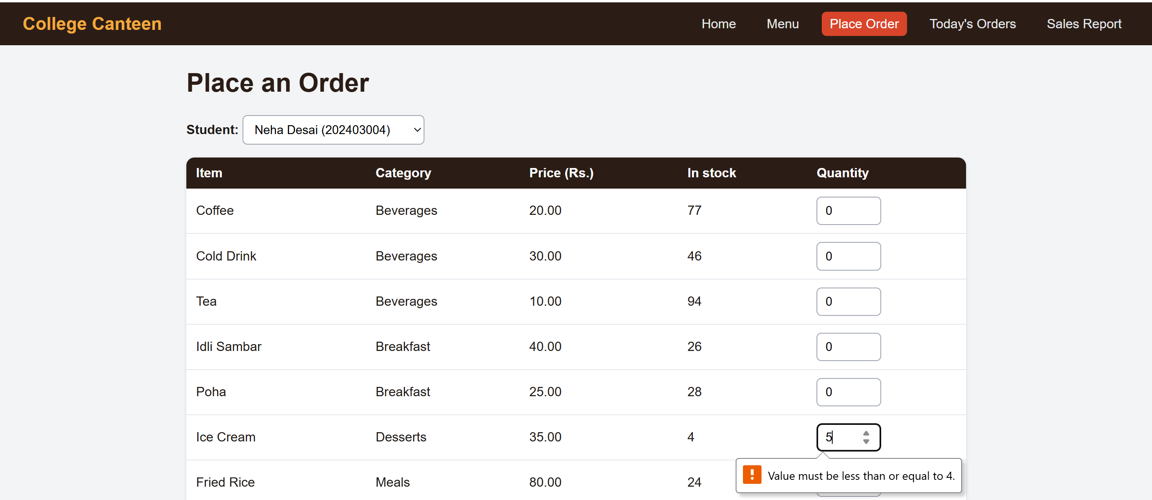
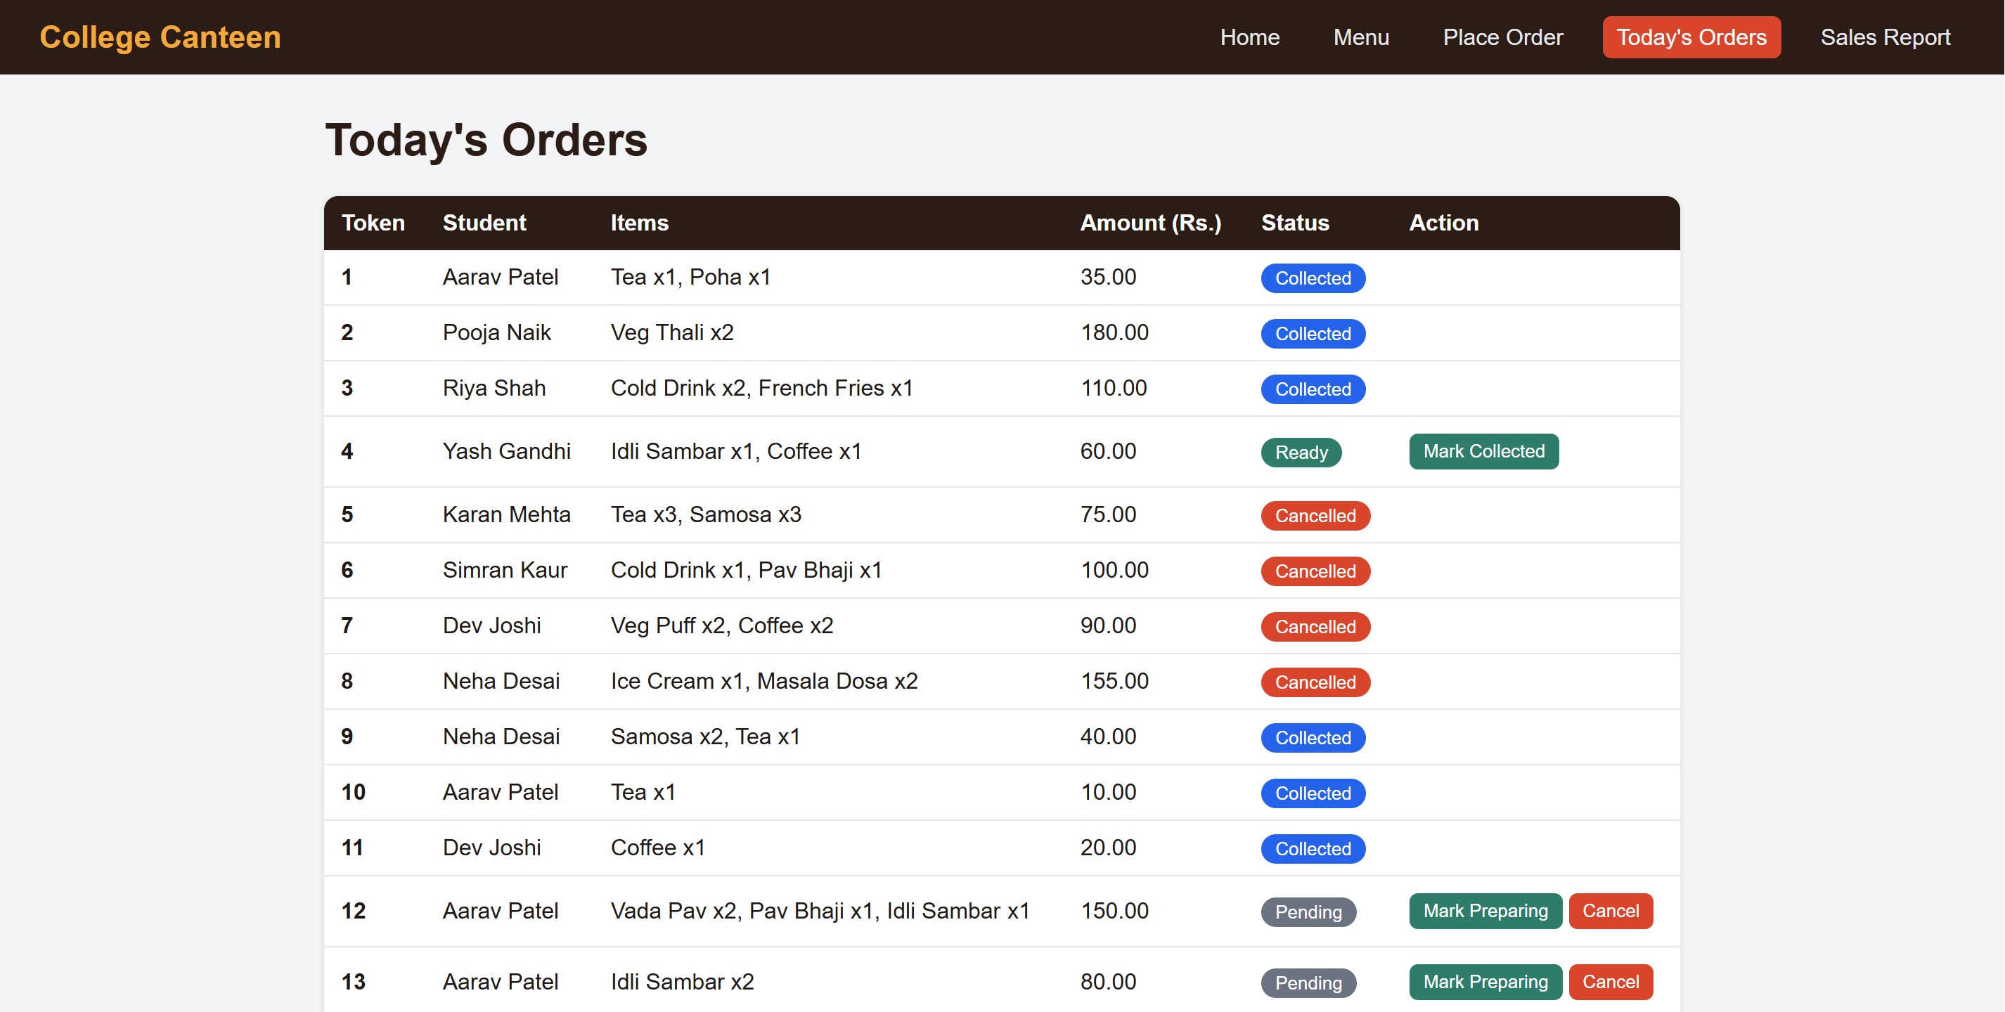
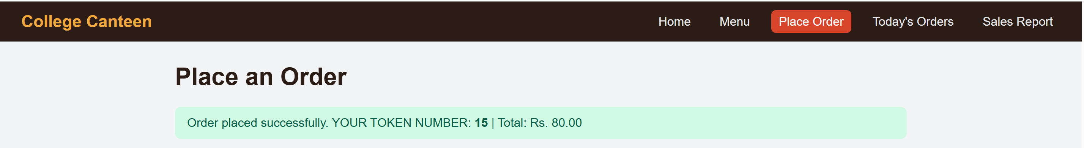
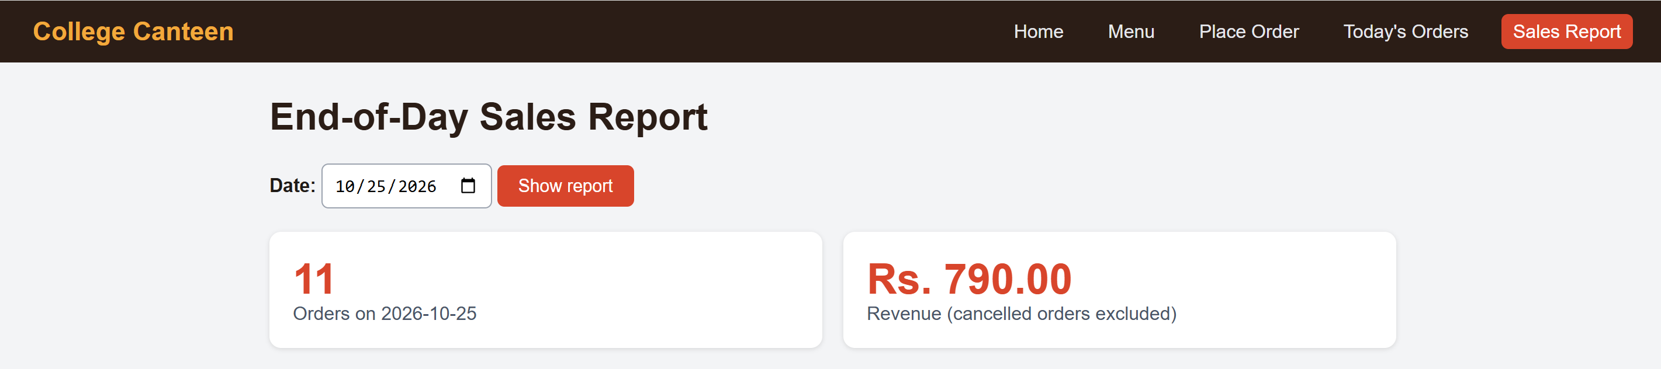
System Demonstration
Order form: quantity above stock is blocked
Today's orders: status flow and cancel
Order placed: token number and total
End-of-day sales report
Notes:
Walk through: the form blocks a quantity above stock, an order is placed and a token is issued, today's orders show the status flow, then the end-of-day report.

Slide 10
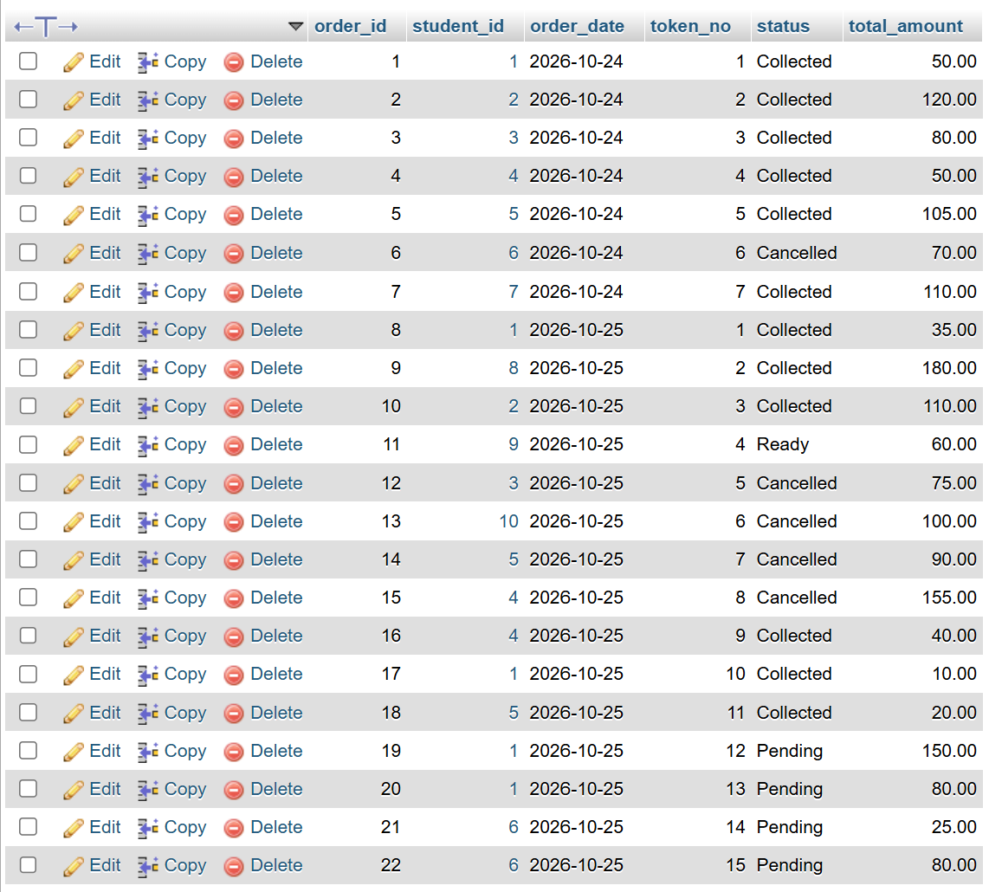
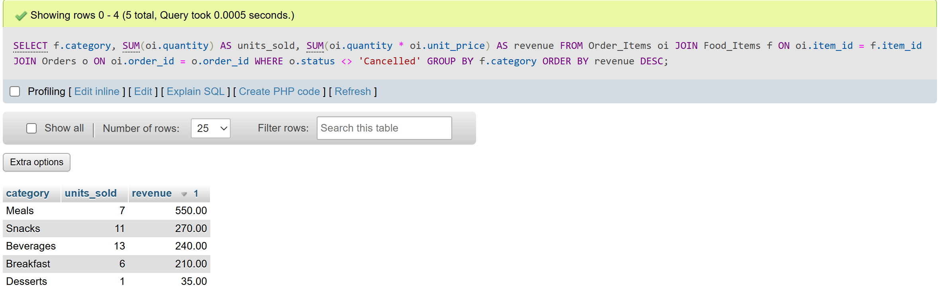
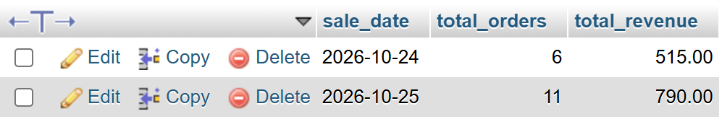
Database Snapshots and Query Results
Q2: revenue per category (GROUP BY)
daily_sales filled by the stored procedure
orders table: 22 rows, all statuses
Notes:
Orders table with all statuses, the revenue per category query, and the Daily_Sales table generated by the stored procedure.

Slide 11
Conclusion and Future Scope
5
tables in 3NF
4
analytical queries
5
web pages
Achieved
Future scope
Working order, token and status flow in the browser
Stock and totals kept correct by a trigger
Daily sales report from a stored procedure
Student login and mobile view
Prepaid wallet and online payment
Peak-hour analytics dashboard
Student feedback and ratings
Notes:
Summarise what was built in one day, then name realistic next steps.

Slide 12
Questions and Answers
Thank you
Notes:
Likely questions: why Order_Items, why unit_price is stored again, how the token resets daily, what happens when stock is zero, how a cancelled order is handled.

