Slide 1
Q1. What is LoRa?

Slide 2
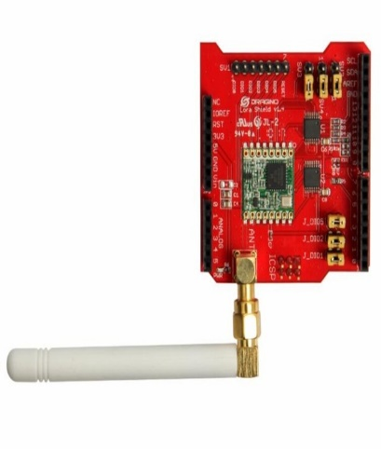
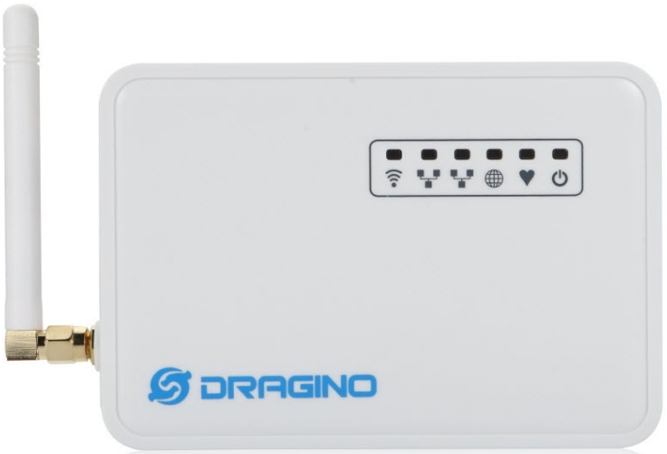
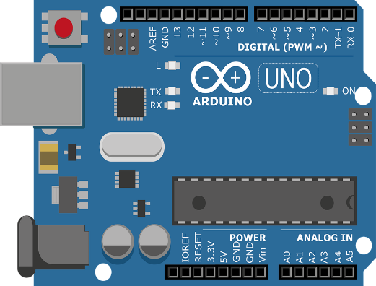
Q1. What is LoRa?
Arduino Uno + LoRa Shield
Dragino LG01

Slide 3
Q1. What is LoRa?
Q2. How do I store data?
Arduino Uno + LoRa Shield
Dragino LG01

Slide 4







Q2. How do I store data?
Frequency
POST
Arduino Uno + LoRa Shield
Dragino LG01
ThingSpeak
GET
Interconnect
Save
Apllication
Database
Web Server

Slide 5
Q2. How do I store data?
Frequency
POST
Q3. How to make it fast and simple?
Arduino Uno + LoRa Shield
Dragino LG01
ThingSpeak
GET
Interconnect
Save
Apllication
Database
Web Server

Slide 6
Q3. How to make it fast and simple?
Frequency
Arduino Uno + LoRa Shield
Dragino LG01
ThingSpeak
Curl POST
GET
Interconnect
Apllication
Database
Web Server

Slide 7
Q3. How to make it fast and simple?
Dragino LG01
Arduino Uno + LoRa Shield

Slide 8
Q3. How to make it fast and simple?
Apllication
Database

