Slide 1
header
banner
main
main
main
main
footer
footer

Slide 3
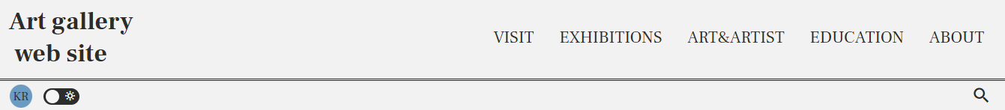
HEADER
ART GALLERY WEB SITE
visit
exhibition
art&artist
education
about
다크모드 버튼
언어변경 버튼

Slide 4
HEADER
-화면 가로 768px 이하-
ART GALLERY WEB SITE
visit
ART GALLERY WEB SITE
exhibition
art&artist
education
다크모드 버튼
about
언어변경 버튼
-펼쳤을 때-

Slide 5
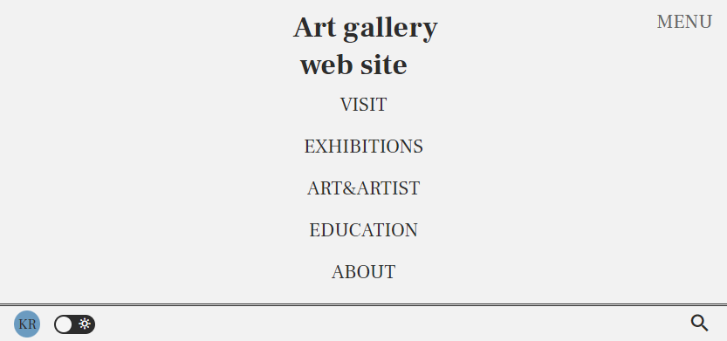
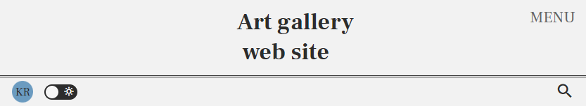
HEADER
-화면 가로 768px 이하-
-펼쳤을 때-

Slide 6

BANNER
banner

Slide 7
MAIN

Slide 8




FOOTER
VISITING US
ADMISSION
ABOUT THE MUSEUM
JOIN OUR MAIL LIST
ART GALLERY WEB SITE

Slide 9
FOOTER
VISITING US
-화면 가로 768px 이하-
-화면 가로 480px 이하-
VISITING US
ADMISSION
ADMISSION
ABOUT THE MUSEUM
ABOUT THE MUSEUM
JOIN OUR MAIL LIST
JOIN OUR MAIL LIST
ART GALLERY WEB SITE
ART GALLERY WEB SITE

Slide 10

LIGHT THEME
ART GALLERY WEB SITE
다크모드 버튼

Slide 11

DARK THEME
ART GALLERY WEB SITE
다크모드 버튼

Slide 12
Dothome: jsy020222.dothome.co.kr
GitHub: https://github.com/JeonSeungyeon
GitHub Page: https://jeonseungyeon.github.io/web_proj/

