Slide 1
Data Science 입문 with Python
2019.6 정용진
(*) Reference
Steven S. Skiena, The Data Science Manual, Springer, 2017
John Canny, Introduction to Data Science (lecture note), UC Berkeley, 2014
Wes Mckinney, Python for Data Analysis: Data Wrangling with Pandas, NumPy, and Ipython, O’Reilly, 2012
- 김화종, 데이터 사이언스 개론, 홍릉과학출판사, 2014
조재호, 모두의 딥 러닝, 길벗, 2017
Many Internet sites

Slide 2
What will be the core job of the future?
IT 전문매체 ‘매셔블(Mashable)’ 이 소개하는 고액연봉 IT 분야 (2019.3)
Cyber Security Engineer
AI, Machine Learning Engineer
Full-stack Developer
Data Scientist
Python Developer
Java Developer
Cloud Engineer
Scrum Master
DevOps Engineer
JavaScript Developer

Slide 3
What is Data Science?
Not yet well defined, but incorporates elements of
Exploratory Data Analysis and Visualization
Machine Learning and Statistics
High-Performance Computing Technologies for dealing with scale
Data Science
Software Programming -> Data mining, Database
Statistics/mathematical modeling -> Machine Learning, Scientific Computing
Domain Knowledge -> Data driven business analytics
Main applications
E-commerce,
Social media,
IoT,
Biometrics,
Sharing Economy, and many more

Slide 4
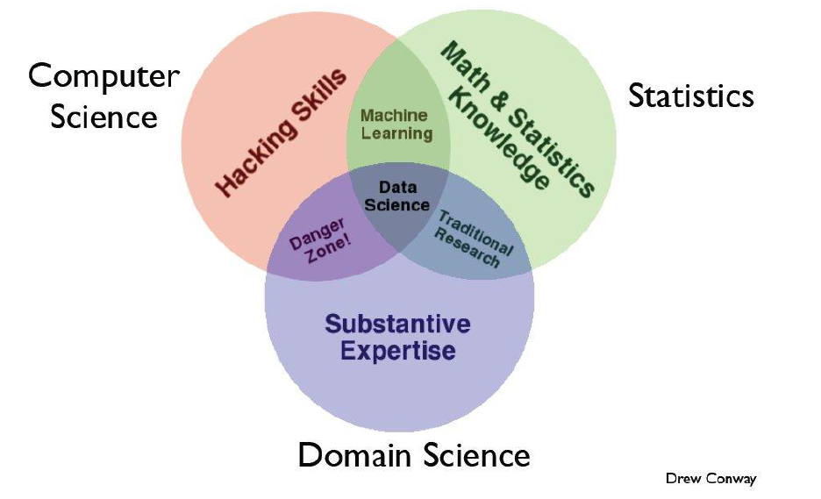
What is Data Science? – One definition

Slide 5
What is Data Science?
Contrast to Databases
 | Databases | Data Science
Data Values | “Precious” | “Cheap”
Data Volume | Modest | Massive
Examples | Bank Records, Personal Records, Census, Medical Records | On line clicks, GPS logs, Tweets, Web surfing, building censor readings
Structured | Strongly (Schema) | Weak or None (Text)
Realizations | SQL | No SQL Python, R, TensorFlow, Keras
 | Querying the Past | Querying the Future

Slide 6
What is Data Science?
Good data scientist must first learn to think like a real scientist.
Computer Science | Real Science
Algorithm is the first! Data is just stuff to test algorithm performance. Mostly use random data to test algorithm performance. | Appreciate and respect Data.
Try to build their own clean and organized virtual world. -> Everything is either TRUE or FALSE. | Try to understand the complicated and messy natural world. -> Nothing is ever completely true or false.
Algorithm-Driven | Data-Driven
Try to invent rather than discover. | Try to discover things.
For the result, they care what a number is. | Care what it means.
Software Developers are hired to produce code. | Hired to produce insights.
Genius (finding the right answer) | Wisdom (avoiding the wrong answers)

Slide 7
What is Data Science?
Contrast to Machine Learning
Machine Learning | Data Science
Develop new (individual) models | Explore many models, build and tune hybrids.
Prove mathematical properties of model. | Understand empirical properties of models.
Improve/validate on a few, relatively clean, small datasets. | Develop/use tools that can handle massive datasets
Publish a paper | Take action!

Slide 8
What is Anaconda?
What is Anaconda?
Very popular Python development platform package for mathematics and science, and specially for data science and machine learning
Includes useful packages like SciPy, NumPy, Matplotlib, Pandas, etc.
Why Anaconda?
> 400 packages available, 150 automatically installed
Free, open source
Support all major platforms
Very reliable and easy to use
Scale up to professional and commercial use (with fee)

Slide 9
Anaconda Overview
Installation
Download Anaconda from https://www.anaconda.com/download/
- Select Python 3.7 version (for Windows)
Where to start?
Command line
Launcher: Jupyter notebook, Spyder, Ipython console
Relevant libraries
Pandas (http://paandas.pydata.org)
Numpy (http://www.numpy.org)
SciPy (http://www.scipy.org)
Matplotlib (http://matplotlib.org)

Slide 10
Anaconda Packages
Over 150 packages are automatically installed with Anaconda
Over 250 additional open source packages can be individually installed from the anaconda repository at the command line, by using the “% conda install” command.
Thousands of other packages are available from Anaconda.org site
Others can be downloaded using “% pip install” command that is included and installed with Anaconda.
You can also make your own custom packages using the “% conda build” command, and upload them to Anaocnda.org or other repositories.

Slide 11
Essential Python Modules
package | Modules with description
NumPy |  | Foundational Package for scientific computing Multidimensional array objects and computational functions
pandas |  | Rich data structures and functions to facilitate data processing and analysis: DataFrame
SciPy |  | Collection of packages for performing linear algebra, statistics, optimization, and more
matplotlib | Pyplot | Data visualization
sklearn (scikit-learn) | linear_model, cluster metrics model_selection | LinearRegression, SGDVassifier, LogisticRegression Kmeans accuracy_score, classification_report, confusion_matrix roc_curve, auc train_test_split

Slide 12
What is Python Language?
Completely open source, started in early 1990
Script language (interpreter) , i.e. no compiler
Development environment = execution environment
Converted to (platform-independent) bytecode (and Python Virtual Machine(PVM) interprets and executes it – slow)
Very portable, mostly runnable on all supported platforms
Object-oriented and Functional
Large standard libraries with huge set of external modules

Slide 13
Python Scripts
Use any editor to create a Python script, say, myscript.py
No compilation needed
Python script is interpreted. More precisely, it is converted to byte code (.pyc), and then executed.
Python is considered a mixture of complied and interpreted.
Run script from command line
> python myscript.py
(ex) calculator, running scripts, test environment
Run script in Notebook or IDE
Jupyter or Spyder, or other IDE
(ex) work processes (ideal for data processing and analysis), documentation, teaching and presentation

Slide 14
IPython (Interactive Python)
Established in 2001
Aims to extend Python’s interactive capabilities beyond those shipped by default with the language
Major features
Access to all session state: Ipython stores a session’s inputs and outputs into a pair of numbered tables called In and Out. All outputs are also accessible as _N, where N is the number of results.
IPython offers a set of control commands (or magic commands)
Operating system access
Dynamic introspection and help
Access to program execution

Slide 15
(Ipython or Jupyter) Notebook
Convenient web-based executable script files
Interactive code development
Cell-wise execution
No reloading of script (.py) files necessary
Easy to share
Excellent teaching tool
Project Jupyter was born out of the IPython Project in 2014
Jupyter can support (or be interfaced with) other languages (Ruby, R, Julia, etc.)
Requires Google Chrome or Mozilla Firefox
On-line examples
https://nbviewer.jupyter.org

Slide 16
Jupyter notebook
To start, from command line, enter “jupyter notebook” or click the icon “Jupyter Notebook” from startup menu and set the type as “Python 3”.
Create or Open a new notebook, from the editor window
File> New Notebook or File> Open
To add new contents, first select content type, then insert a cell and input the material
Markdown, code, heading, or Raw NBConvert
To edit the contents, use the Edit command to cut/copy/paste
To control code execution, use the cell commands

Slide 17
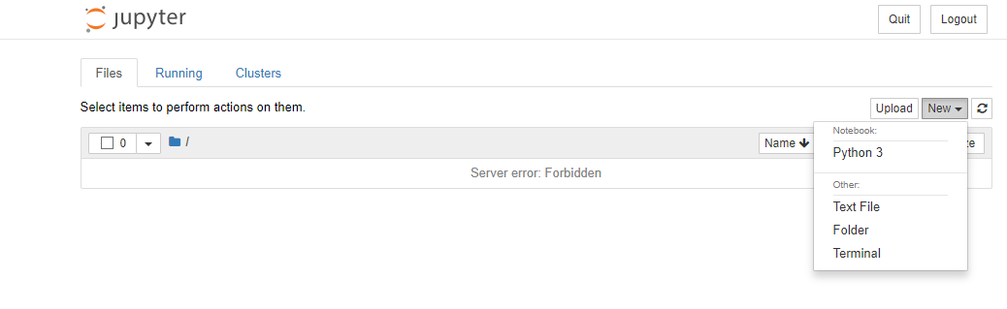
Jupyter notebook Python 3

Slide 18
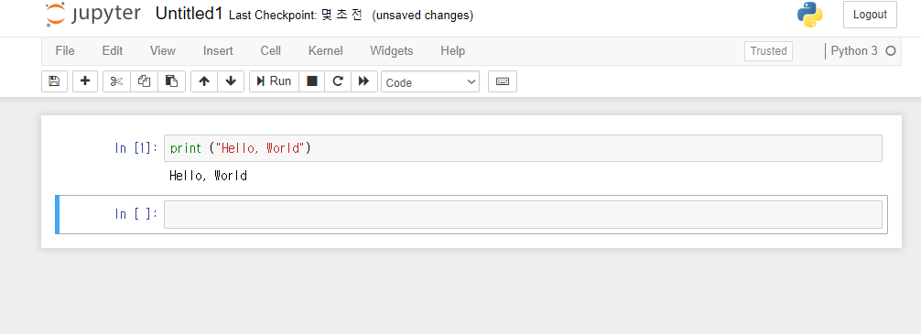
Jupyter notebook Python 3
In place: Ctrl + Enter
To execute cell and move to next cell: Shift + Enter
Create new cell if necessary
To execute and insert new cell: Alt + Enter

Slide 19
Convenient Features
Syntax Highlighting
Automatically highlights standard functions (e.g. for, range), keywords (e.g. in, and), special characters (e.g. #)
Auto Indent
Primarily driven by the colon operator (:)
Automatically indents blocks after if, for, while, etc.
Helps with debugging
Parentheses Matching
Helps with debugging

Slide 20
Tab Completion
Type part of the name and then press <Tab> to see options
The more you type, the more specific the matches are
Auto-completes if there’s only one option
Use to learn about useful attributes and methods
Us as much as possible… saves time !
Variable names
Function names, keywords, and descriptions
File directions and names
Objects, attributes, and methods
Need to assign to variables first in this case
Insert ? after a variable, function, or object to find out more information (e.g. sum?)

Slide 21
Keyboard Shortcuts - Jupyter
Command mode (press ESC to enable)
In command mode
Shift-Enter | run cell, select below
Ctrl-Enter | run selected cells
Alt-Enter | run cell and insert below
a/b | insert cell above/below
x/c | cut selected cells / copy selected cells
Shift-v / v | paste cells above/below
Shift-m | merge selected cells, or current cell with the cell below if only one cell is selected
In command mode
l | toggle line numbers
o | toggle output of selected cells
h | show keyboard shortcuts
Shift-Space | scroll notebook up
Space | scroll notebook down
Window-/ | toggle comment
In edit mode (press Enter)
Ctrl-Shift-Minus | Split cell at cursor

Slide 22
Notebook Cell Types
Code cells
Edit and execute cells inline, generates output as text, figures, HTML tables
Syntax highlighting, tab completion, introspection
Default for inserted cells
Markdown cells
Rich text input, including HTML and LaTex
Cell replaced by text output when executed (Documents)
Raw text cells
Executed as input (no formatting)
Cell remains in place
Heading cells
Levels 1 through 6, similar to Microsoft Word
Can be used to generate Table of Contents

Slide 23
Python Language
Objects, attributes, and methods
Functions vs. object methods
Object references
Mutable and immutable objects

Slide 24
Data types
Basic Data types
Int, float, boolean(bool), string(str)
List - mutable
Tuple – can read, but can not overwrite (to make computation fast), immutable
Dictionary – only access by keys
(NumPy) array (formally called ndarray)
Although Core Python has an array data structure, but it’s not efficient and useful. Instead we use “NumPy array” which is referred to by “array”.
Similar to list, but all the elements are of the same type (int, float, Boolean, string, or other object)

Slide 25
Objects, attributes, and methods
Everything in Python is an object.
Scalars, sequences, dictionaries, functions, DataFrames, modules, and more
Each type of object has a set of
Attributes: Characteristics of the object
Methods: Functions that operate on the object (and possibly other objects)
Atrtributes and methods are accessible by:
obj.attr_name or getattr(obj, ‘attr_name’)
obj.method_name()

Slide 26
Functions vs. Object Methods
Functions and object methods are essentially the same…
One or more bundled steps performed on some input
In some cases, there will be a function and an object method that do the same thing (e.g., sum)
…BUT, they differ in how they are used
Functions are called on zero or more objects and return result(s) that can be assigned to a variable
Object methods are called by an object and can either update the calling object or return results

Slide 27
Mutable and Immutable Objects
Mutable Objects
Can be modified via assignment or a function/method
Lists, dictionaries, ndarrays, class instances
Immutable Objects
Can not be modified
Strings, tutples, int, float, boolean

Slide 28
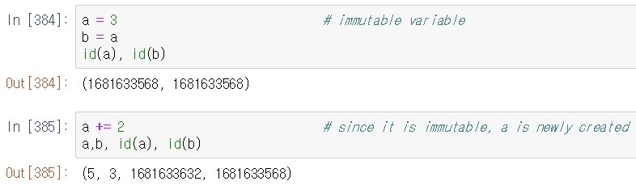
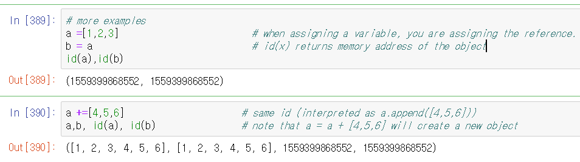
Mutable and Immutable (examples)
a
5
a
3
3
b
b
a
[1,2,3]
b
a
[1,2,3,4,5,6]
b

Slide 29
Object References
Call-by-value? or Call-by-reference?
>>> def test(a):
a = 2
>>> a = 1
>>> test(a); a
1
>>> def test2(a):
a.append(‘world.’)
>>> b = ‘Hello’
>>> test2(b); b
[‘Hello’, ‘World.’]
>>> a = 10
>>> b = a
>>> a += 100
>>> a, b
(110, 10)
>>> id(a), id(b)
(14073…7824, 1407…624)
>>> a = [1,2,3]
>>> b = a
>>> a += [4,5,6]
>>> a,b
([1,2,3,4,5,6],[1,2,3,4,5,6])
>>> id(a), id(b)
(225009…832, 225009…832)

Slide 30
Object References (2)
Call-by-Object (or call-by-Object Reference or call-by-sharing)
If you pass immutable arguments like integers, strings or tuples to a function, the passing acts like call-by-value. The object reference is passed to the function parameters. They can't be changed within the function, because they can't be changed at all, i.e. they are immutable.
If mutable arguments are passed, they are also passed by object reference, but they can be changed in place in the function. If we pass a list to a function, we have to consider two cases: Elements of a list can be changed in place, i.e. the list will be changed even in the caller's scope. If a new list is assigned to the name, the old list will not be affected, i.e. the list in the caller's scope will remain untouched.

Slide 31
Importing Modules and Scripts
Modules and Python scripts are loaded in the same manner. For a module or Python script P (.py):
(ex) import P [as p]
Loads the module or script into the workspace, with an optional shorter name
Can use any functionality in an OOP fashion (e.g., P.method())
(ex) from python_module import *
Imports all of the functionality directly into workspace
(ex) from python_module import f, g, h
Imports specific functions

Slide 32
NumPy
Numerical Python
Foundation for scientific computing
Linear algebra and random number generation
Integration with C/C++. Fortran for fast execution
Provides foundation for Pandas (Series and DataFrame) structures
ndarray : similar to lists, but much more powerful
Vectorization: fast operations on arrays of data without the need for loops
Primary Use:
Fast vectorized array operations for data munging, cleaning, filtering, transforming
Built-in common array algorithms
Efficient descriptive statistics
Data alignment and relational data manipulations for merging and joining multiple data sets
Expressing conditional logic ad array expressions instead of loops

Slide 33
Slicing: list and array
1-D array slicing (quite often used)
a = np.arrange(10) # a = array([0,1,2,3,4,5,6,7,8,9])
a[start:end] # items start through end-1
a[start:] # items start through the rest of the array
a[:end] # items from the beginning through end-1
a[:] # a copy of the whole array
a[start:end:step] # start through not past end, by step
a[-1] # last item in the array
a[-2:] # last two items in the array
a[:-2] # everything except the last two item
a[::-1] # all items in the array, reversed
a[1::-1] # the first two items, reversed
a[:-3:-1] # the last two items, reversed
a[-3::-1] # everything except the last two items, reversed

Slide 34
Slicing: list and array
2-D array slicing (to split loaded data into input(X) and the output(y))
X = [:, :-1] # select al the rows and all columns except the last one
y = [:, -1] # select all rows again, and index just the last column

Slide 35
Some NumPy functions
Extensive library of mathematical functions
Sqrt(x), exp(x), log(x), log10(x), degree(x), radians(x), sin(x), cos(x), tan(x)
Arcsin(x), arccos(x), arctan(x), fabs(x), round(x), floor(x), ceil(x), sign(x)

Slide 36
Pandas
Pandas
Provides data processing and analysis capabilities
Built on top of Numpy functionality
Two data structures: Series and DataFrames
Important statements
from pandas import Series, DataFrame
import pandas as pd
What can be done?
Creating Series and DataFrame objects
Basic Series and DataFrame methods
Indexing/reindexing, slicing, and filtering
Mathematical operations
Missing data

Slide 37
Pandas - Series
Similar to an ndarray…
Easy to perform computation
Indexing, slicing, filtering
With some additional features
Comes with an associated array of data labels, called an index object
Access values using integer indices (like an array) or specified indices (like a dict)
Easy merging of data sets

Slide 38
Pandas - DataFrames
2-D tabular-like data structure
Similar to a dictionary of Series objects with the same indices
Hierarchical indexing or panel for higher dimensions
Access rows or columns by index
Built-in methods for data processing, computation, visualization, and aggregation
Creating DataFrames
From a dictionary of equal-length sequences or Series objects
frame = DataFrame(D)
Froma 2-D ndarray or list of lists or tuples
frame = DataFrame(arr)

Slide 39
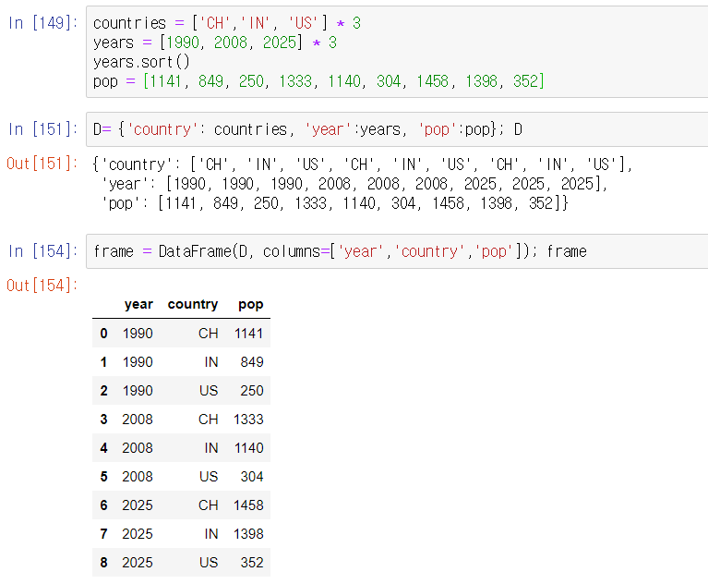
Pandas – DataFrames (example)
From dictionary

Slide 40
Pandas - DataFrames
Basic DataFrame Methods
Indexing: columns returned as a Series
Frame[‘year’] or frame.year; frame[[‘year’,’pop’]]
Frame.columns: returns array of column names
Index([year,country,pop], dtype=object)
.name, .index.name, .columns.name, and .values similar to Series
Functions
df.sort_index(), df.sort_index(axis=1, ascending=False) // 인덱스 기준, 열 기준
df.sum(), df.mean()
df.idmax(), df.idmin() // 최대치, 최소치가 있는 위치
df.value_counts() // 빈도수
df.isin([‘b’,’c’]) //특정 항목이 들어 있는지 확인
df.fillna(), df.dropna() // NA 가 들어 있는 행 삭제, NA 항목에 채우기

Slide 41
Data Wrangling (Data Munging)
Process of transforming and mapping data from one “raw” data form into another format.
원래의 데이터를 또다른 형태로 전환하거나 매핑하는 과정
Data does not always come in a nice format, ready for pd.read_csv or pd.read_table
In many cases, we will need to perform several tasks in order to get data in the exact format we want
Typical tasks:
Combining and Merging Data Sets
Reshaping and Pivoting
Data Transformation
Removing duplicates
Cleaning and filtering

Slide 42
Feature Engineering (특성공학)
Process of using domain knowledge of the data to create features that make machine learning algorithms work.
이미 존재하는 변수로부터 새로운 변수들을 만들어내는 과정 (ex: from Weight, Price features -> create Price_per_Weight feature)
Process of feature engineering
Brainstorming or testing features
Deciding what features to create
Creating features
Checking how the features work with your model
Improving your features if needed
Go back to brainstorming/creating more features until the work is done

Slide 43
Data visualization - matplotlib
Use:
%matplotlib inline magic command (once Jupyter is open)
import matplotlib.pyplot as plt
Basic template
Create a new figure
fig = plt.figure()
fig = plt.figure(figsize = (12,8))
Add subplots (if necessary)
ax1 = fig.add_subplot(2,1,1) # 2x1 arrangement, first figure
ax2 = fig.add_subplot(2,1,2)
Create plot (plt or ax1…axN methods)
Label, annotate, format plot
Copy or save plot

Slide 44
Matplotlib - Common plot types
Line plots – trends:
plt.plot (x, y, ‘-’)
Scatter plots – comparison between lots of data
plt.plot (x, y, ‘.’)
Bar plots – comparison between few data
Bar (horizontal): plt.barh (x, y, width)
Column (vertical): plt.bar (x, y, width)
Histogram plots – single distributions
plt.hist (x, bins)
Boxplots – one or more distributions
plt.boxplot (x)

Slide 45
Matplotlib - Colors, Markers, and Line Styles
All specified as special string characters in plot call
Colors - Many plot types
Basic colors: g(reen), r(ed), b(lue), (blac)k, m(agenta), y(ellow), c(yan), w(hite)
For more, see http://matplotlib.org/api/colors_api.html
Markers and Line Styles - Mostly relate to plt.plot
Markers: ., o, +, * (star), 1, 2, 3, 4 (triangles), s(quare), D(iamond)
Line styles: solid (-), dashed (--), dotted (:), dash-dot (-.)
linewidth keyword (float value)
Usage
Style string: Combines all three (e.g., ‘k.’, ‘g--’, ‘ro-’)
Separate keyword arguments: color, linestyle, marker

Slide 46
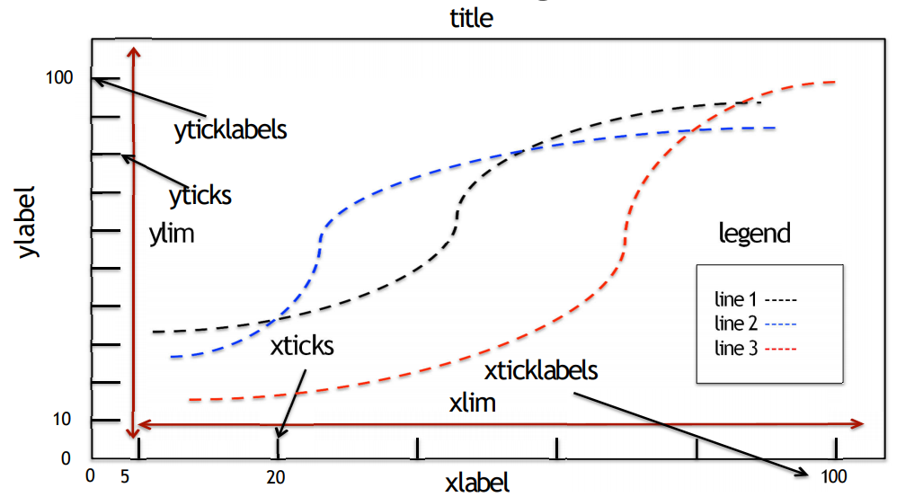
Formatting plots

Slide 47
Formatting plots
Title
title(‘Title’)
Axis labels
xlabel (‘Time’), ylabel (‘Price)
Axis limits
xlim([0,10]0, ylim
Ticks
xticks([0,60,70,80,90,100]), yticks
Tick labels – combine with ticks for text labels
xticklabels([‘F’,’D’,’C’,’B’,’A’]), yticklebals
Legends
List of labels for each series: legend((‘one’,’two’,’three’))
Use legend()
Location keyword: loc = ‘best’, 1-10 (upper right, left, center, etc.)

Slide 48
Annotating plots
Text
text(x, y, text, fontsize)
arrow(x, y, dx, dy) # draws arrow from (x,y) to (x+dx, y+dy)
annotate (text, xy, xytext) # annotate the xy point with text positioned at xytext
shapes
Rectangles, circles, polygons
Location, size, color, transparency (alpha)

Slide 49
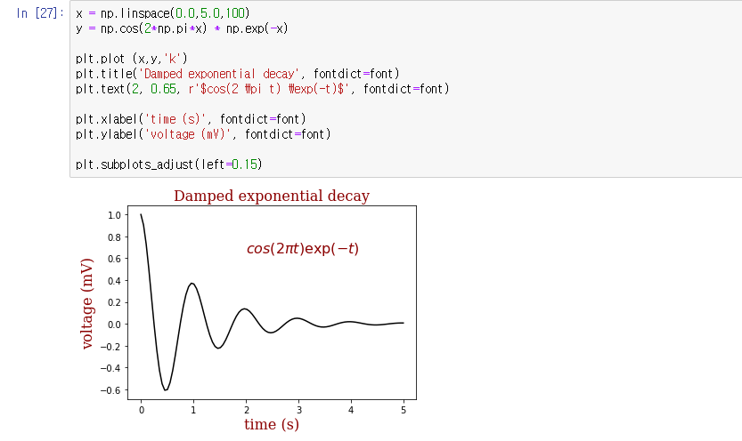
Matplotlib - Example(1)

Slide 50
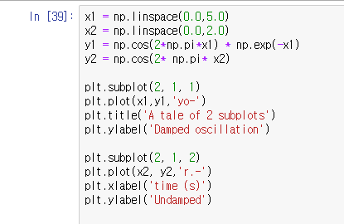
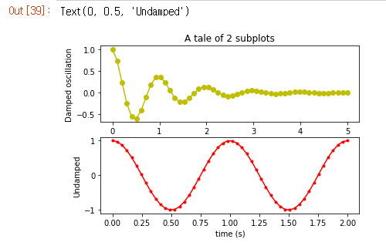
Matplotlib - Example(2)

Slide 51
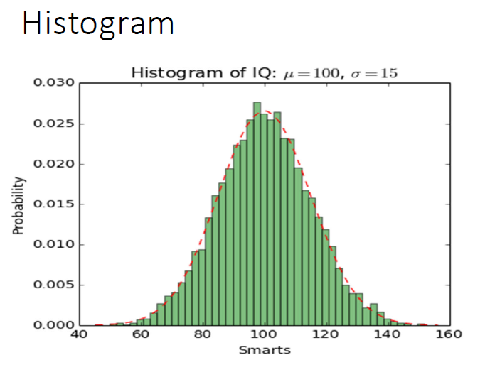
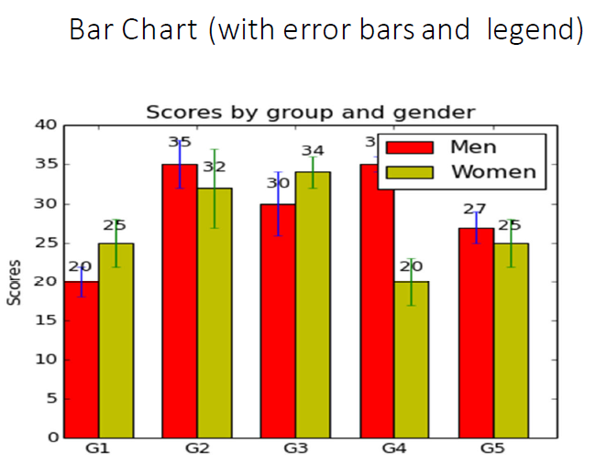
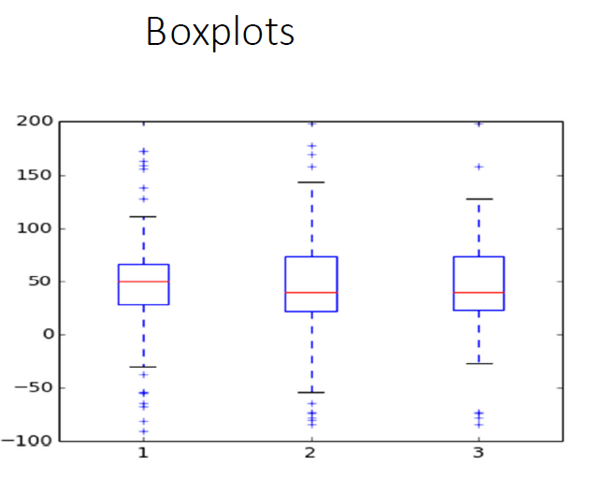
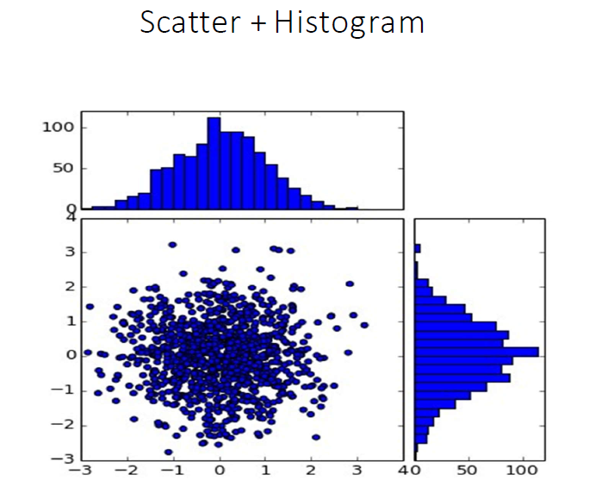
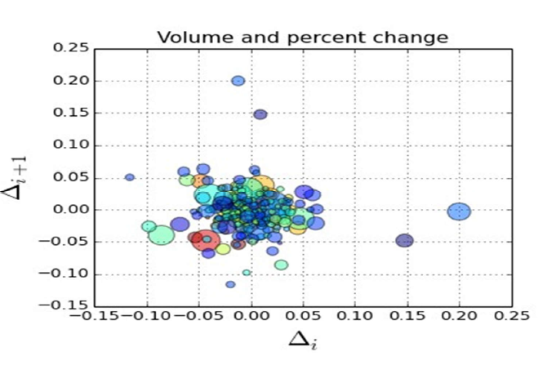
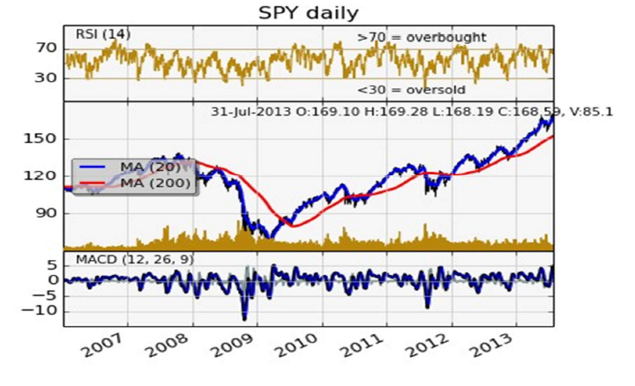
Many more examples…

Slide 52
데이터 수집
데이터 수집 (Data Munging or Data Wrangling)
데이터를 획득하고 분석에 맞게 준비하는 작업
데이터는 어디에?
데이터 분석에 맞는 적당한 데이터를 찾는 것이 중요함
찾아진 데이터를 목적에 맞게 재조정(repurposing) 할 때 창의성 필요
데이터 소스
Proprietary data source: Facebook, Google, Amazon etc.
Government data sets: data.gov or data.go.kr
Academic data sets: track down from relevant papers, and ask
Web Search/Scraping: fine art of stripping text/data from webpage
Sensor data sets: IoT do amazing things (image,video,…)
Crowdsourcing: Wikipedia/Freebase, IMDB
Sweat equity: you must work for your data instead of stealing it

Slide 53
데이터 수집
데이터 클리닝 (Data Cleaning)
Garbage in, garbage Out
데이터 정리 과정 필요
Distinguishing errors from artifacts
Data compatibility
Imputation of missing values (결손값의 대체)
Estimating unobserved (zero) counts
Outlier detection
Errors and Artifacts
Errors: 수집 과정에서 원천적으로 빠진 것 (복구 불가능)
Artifacts: 데이터를 처리하는 과정에서 발생한 문제 (복구 가능)

Slide 54
Data Analysis Model (Jeff Hammerbacher)
Identify the Problem
Instrument Data Sources / Collect Data
(*) integrate, transform,
clean, aggregate, alter
Prepare Data
Build Model
Evaluate Model
Communicate Results

Slide 55
Machine Learning (머신러닝)
What is ML?
데이터로부터 학습하도록 컴퓨터를 프로그래밍하는 과학 또는 예술
명시적인 프로그래밍 없이 컴퓨터가 학습하도록 능력을 갖추게 하는 연구 분야
어떤 작업 T(task) 에 대해 컴퓨터 성능을 P(performance)로 측정했을 때 경험 E (experience) 로 성능이 향상됐다면, 이 컴퓨터 프로그래밍은 작업 T 와 성능 측정 P 에 대해 경험 E로 학습한 것이다. (Tom Mitchell, 1997)
(ex) T: 스팸 메일 필터, E: 일반 및 스팸 메일 샘플, P: (분류) 정확도
머신러닝 시스템의 종류
훈련 여부: supervised(지도학습), un-supervised(비지도), semi-supervised(준지도)
실시간 점진적인 학습여부: on-line(온라인학습), batch(off-line, 배치학습)
새로운 데이터에 대한 일반화(ex. 예측): instance-based(사례기반), model-based(모델기반)

Slide 56
Machine Learning
Supervised Learning
Training Data 에 Feature(or attributes) 와 Label(or Target) 포함
분류(Classification): feature 를 이용해 taget 의 class 예측 (ex: 스팸메일 분별)
회귀(Regression): feature 를 이용해 target 수치 예측 (ex: 중고차 가격 예측)
(ex) KNN(K-Nearest Neighbor), Linear Regression, Logistic Regression, SVM(Support Vector Machine), Decision Tree, Random Forest, Neural Networks
Unsupervised Learning
실시간 점진적인 학습여부: on-line(온라인학습), batch(off-line, 배치학습)
새로운 데이터에 대한 일반화(ex. 예측): instance-based(사례기반), model-based(모델기반)
(ex) Clustering, PCA(Principal Component Analysis), Kernel-PCA
Reinforcement Learning
Reward 와 penalty 를 기반으로 학습

Slide 57
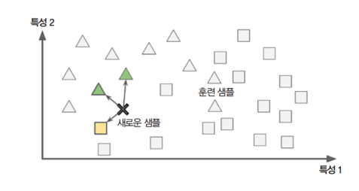
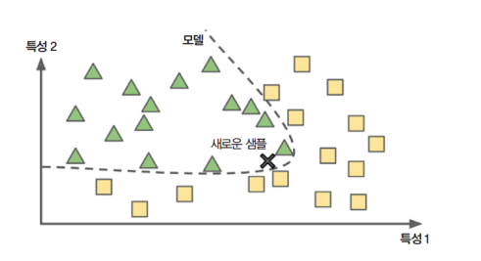
Machine Learning
Instance-based Learning
Model-based Learning

Slide 58
Machine learning (기계학습) Model
모델
- 구조
- 파라미터
손실?
확정
훈련 데이터
- 학습데이터
- 검증데이터
테스트 데이터
최적화
모델
- 구조
- 파라미터
성능평가
리포트/적용

Slide 59
Clustering (군집)
What is Clustering (군집)?
각 객체의 유사성을 측정하여 유사성이 높은 집단으로 나눔
그룹에 대한 사전 정보 없음.
그룹의 개수나 특성에 대한 사전 정보가 주어지면 -> Classification (분류) 사용
군집의 개수나 구조에 대한 가정 없이 각 데이터 간의 거리를 기준으로 나눔
Similarity or Proximity (유사도)
항목 간의 유사한 정도를 수치로 표현
Euclid Distance (유클리드 거리), Manhattan Distance(맨하탄 거리), etc.
범주형 – Jaccard Distance (자카드 유사도)
What is Hierarchical/Agglomerative Clustering (계층적/응집형군집)?
객체간의 유사도를 계산해 가장 가까운 것들부터 차례로 군집화
Dendrogram 을 사용해 군집 형성 과정 파악
방법: Single, Complete, Average, Ward(군집간 정보 손실 최소화)

Slide 60
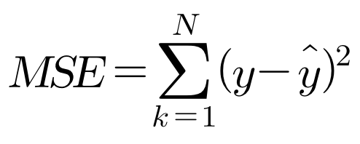
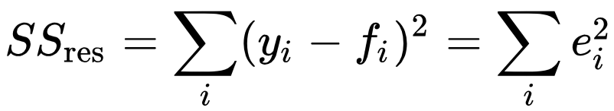
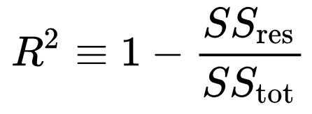
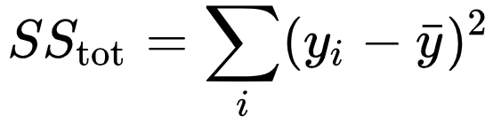
Regression (회귀) – 예측, 분류
What to reduce? (Loss Function: 손실함수)
MSE (Mean Square Error)
How Good it is? (Performance: 성능지표)
R² (R-Squared)

Slide 61
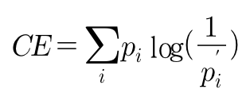
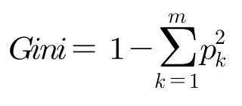
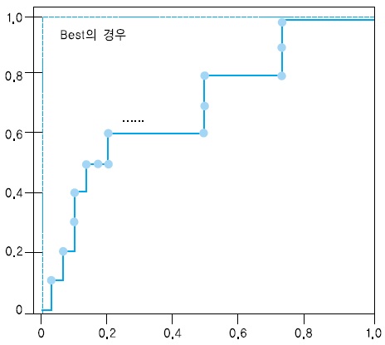
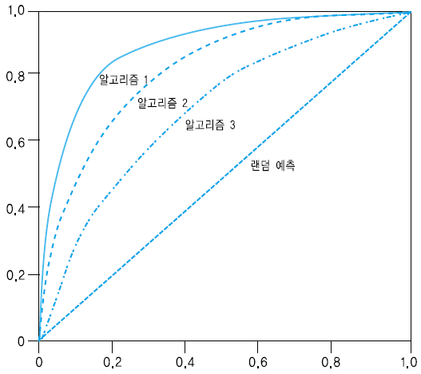
Classification (분류)
What to reduce? (Loss Function: 손실함수)
Cross Entropy (CE)
Gini (지니계수)
How Good it is? (Performance: 성능지표)
Confusion Matrix: Accuracy, Recall, Precision, F-1 Score
Ranking(순서): ROC (Receiver Operating Characteristic), AUC (Area Under Curve)
Best의 경우

Slide 62
Schedule for Module1
 | Contents | Lab | Pages
Day 1 | What is Data Science? Probability and Statistics review Introducing Python language | extra_lab1
Day 2 | Numpy Pandas Data reading and cleaning | 1,2 3,4,5 6,7,8
Day 3 | Crawling Bayes algorithm | 9,10,11,12,13 14
Day 4 | Machine learning concept (Gradient Descent) Review and Exam | extra_lab2

Slide 63
M1 Programming Labs(1/3)
chap | lab | title | contents | pages
Ch_3 | gg01 | Basic Python | Introducing Python Data types: Int, float, Boolean, string, list, tuple, dictionary Block (for, if) Functions, plotting Random numbers | 53-76
 | gg02 | Numpy (numerical python) | Ndarrays: array Zeros(), ones(), arrange() Slicing, reshape(), mean(), sort(), permutation() | 77-83
Ch_4 | gg03 | Pandas (panel data analysis) | DataFrame and Series Index and columns Column access (df[‘column’]), row access(df.loc(), df.iloc()) Drop(), apply() | 85-96
 | gg04 | plotting | Graphs display (visualization) Subgraphs Histogram, scatter graphs, bar graphs texting | 97-108
 | gg05 | DataFrame exercise | Series & DataFrame Sort_index(), sort_values(by=), rank(), sum(), mean(), idxmax(), idxmin(), unique(), value_counts(), isin(), apply(), dropna(), notnull(), fillna() | 109-130

Slide 64
M1 Programming Labs(2/3)
chap | lab | title | contents | pages
Ch_5 | gg06 | Data Processing | File handling Open(), strip(), split() (example) radishsurvey vote | 132-152
 | gg07 | File handling | File handling Open(), read_csv() Managing directories Os.getcwd(), listdir(), chdir(), mkdir(), rename(), remove(), rmdir() Json file and csv file read (example) airplane routes distance | 153-169
 | gg08 | Programming exercise (Dates for stock markets) | Datetime package Regular expression | 170-177
Ch_6 | gg09 | Web crawling | Crawling examples Regular expression: re.findall(pattern, string) Json: json_normalize() – flatten json data into dataframe Request: reguests.get() - download a file Urllib: request.urlretrieve(url, file) – download data, request.urlopen(url) parse.urlencode() | 178-193

Slide 65
M1 Programming Labs(3/3)
chap | lab | title | contents | pages
 | gg10 | Data Scraping | Beautifulsoup: HTML documents parsing Soup.find() Soup.prettify() Soup.select_one() : CSS query Soup.select() Soup.findall()
 | g11 | Programming exercise (Real-estate read) | Seoul city information access Requests.get(url) Pd.read_csv(url) Pd.read_html(url)

Slide 66
Schedule for Module2
 | Contents | Lab | Pages
Day 1 | What is Data Science? Introducing Python language | extra_lab1
Day 2 | Data Manipulation, analysis, munging, viewing Scaling Clustering | 17,18,25 26
Day 3 | Machine learning concept (Gradient Descent) Linear Regression Linear Classification | extra_lab2 29,30,31 32
Day 4 | Logistic Regression Review and Exam | 33

