Slide 1
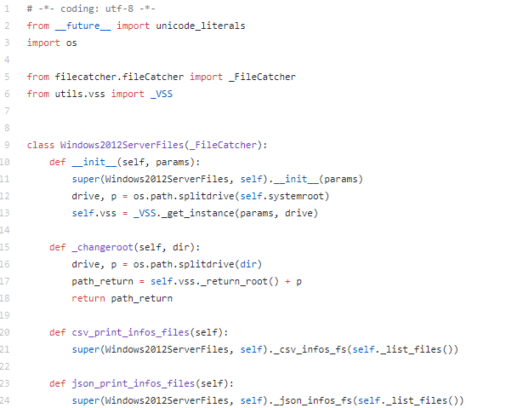
Fastir_Collector/filecather/windows2012ServerFiles.py
from __future__ import Unicode_literals
: can be run in previous versions
like python 2.1
os.path.splitdrave(self.systemroot)
: path divided into drive and tail
drive could be vacant or not
drive + tail > path
super(A, self)__init__()
: when tackling several classes, parent class might be referenced several times
> reference parent class just once
> don’t need to understand entire
class structure, no mess up

