Slide 1
2025 Winter Internship: Final Presentation
Diabetes Diagnosis
(binary classification problem)
using public ECG dataset
Main Reference
"The impact of heart rate variability for classifying diabetes based on machine learning (Hanbeen Jung, Cheol Song).“
Pan, J., & Tompkins, W. J. (1985). A Real-Time QRS Detection Algorithm. IEEE Transactions on Biomedical Engineering, BME-32(3), 230–236.
School of Undergraduate Studies, DGIST
Intelligent Bio-OptoMechatronics Lab.
Jeong-Ho SEO, Intern Student
Feb. 05, 2025

Slide 2
Contents: Project during this internship
  I. 1st week
    A. Project Subject
    B. Search Public ECG dataset
  II. 2nd & 3rd week
    A. Selection of ECG dataset
    B. Architecture of model
    C. Python code for extracting input features
  III. 4th week
    A. NEW ECG dataset: Extracting input features
    B. Machine Learning Algorithm
  IV. Raw ECG visualization
    A. Wearable device ECG dataset
    B. 60 Male Diabetes Type 2 ECG dataset visualization

Slide 3
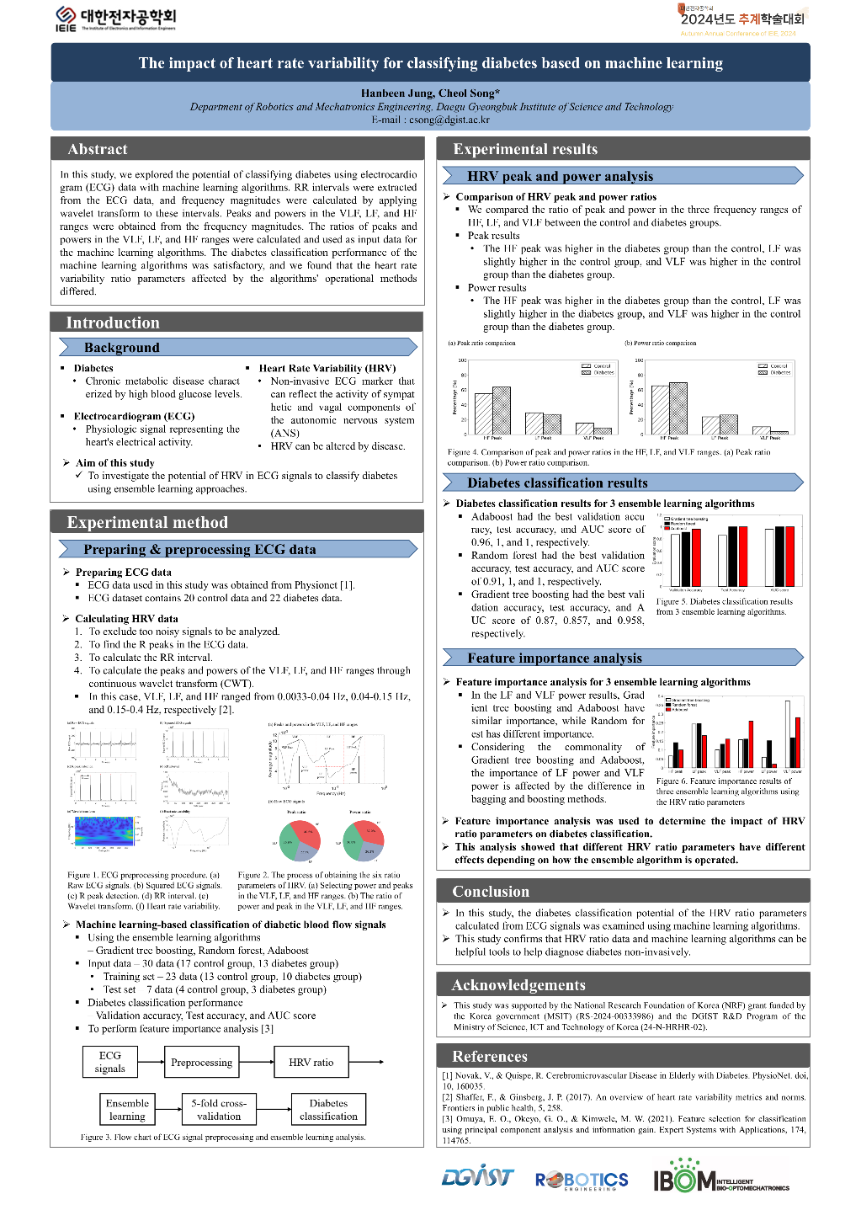
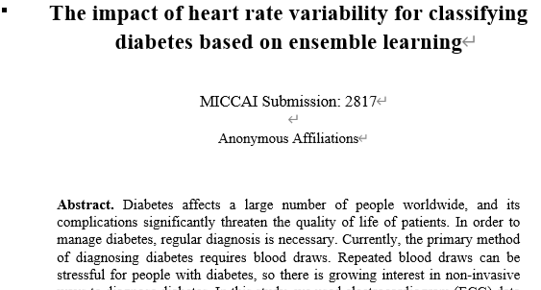
I. 1st week
A. Project Subject
Diabetes Diagnosis
using public ECG dataset.
Reference
"The impact of heart rate variability for classifying diabetes based on machine learning (Hanbeen Jung, Cheol Song).“

Slide 4
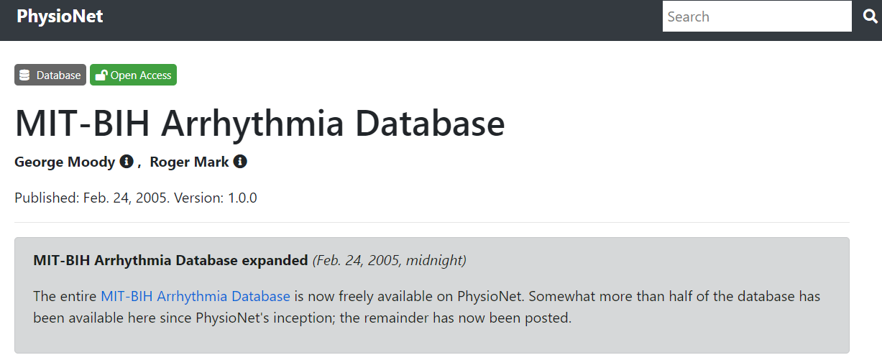
I. 1st week
B. Search Public ECG dataset
Candidate 1. MIT-BIH Arrhythmia Database
Most Popular ECG dataset
However, Non-related to diabetes. (Arrhythmia 부정맥 dataset)
=> Not used.
source: https://physionet.org/content/mitdb/1.0.0/

Slide 5
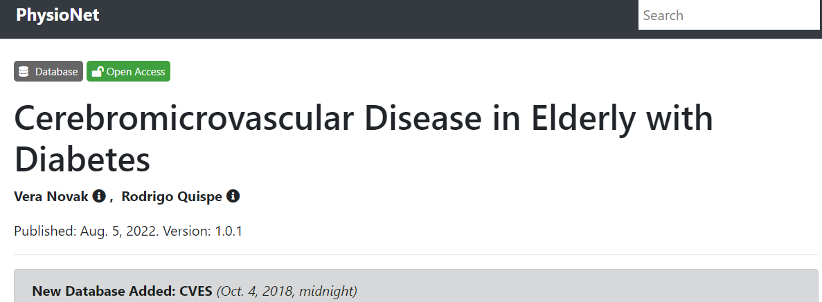
I. 1st week
B. Search Public ECG dataset
Candidate 2. Cerebromicrovascular Disease in Elderly with Diabetes
Previous used in conference paper (reference 9)
  "The impact of heart rate variability for classifying diabetes based on machine learning (Hanbeen Jung, Cheol Song).“
However, I hope to find another dataset & merge them all
=> Keep.
source: https://physionet.org/content/cded/1.0.1/

Slide 6
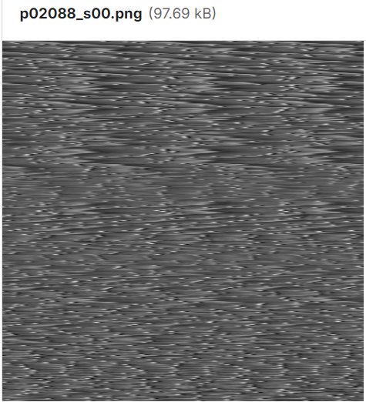
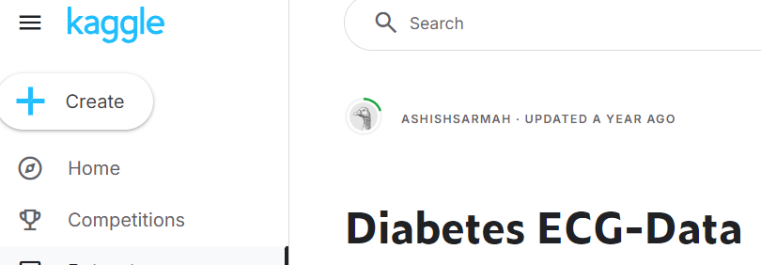
I. 1st week
B. Search Public ECG dataset
Candidate 3. Diabetes ECG-Data
ECG data are expressed as image
However, there are no description of the dataset
I cannot convert these images to available ECG dataset
=> Not used.
source: https://www.kaggle.com/datasets/ashishsarmah/diabetes-ecg-data

Slide 7
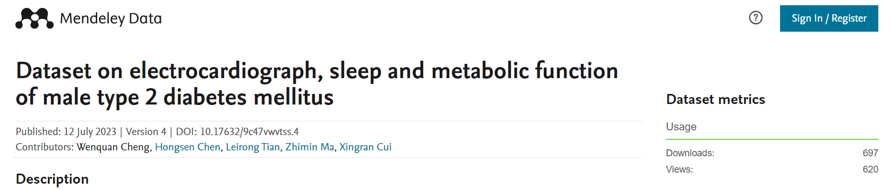
I. 1st week
B. Search Public ECG dataset
Candidate 4. Dataset on electrocardiograph, sleep and metabolic function of male type 2 diabetes mellitus
24-hour ECG dataset with sleep/non-sleep conditions.
Collected from 60 male type 2 diabetes (T2DM) hospitalized patients
ECG dataset & RR-interval dataset
However, there are no healthy ECG dataset (Non-diabetes dataset)
=> Not used.
source: https://data.mendeley.com/datasets/9c47vwvtss/4
article: https://www.frontiersin.org/journals/physiology/articles/10.3389/fphys.2023.1157270/full
paper: https://www.sciencedirect.com/science/article/pii/S235234092300522X

Slide 8
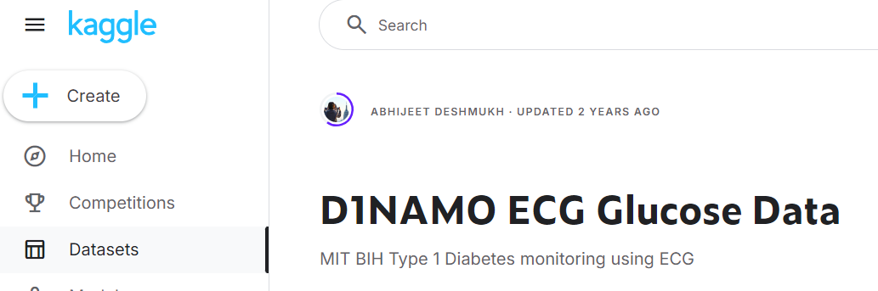
I. 1st week
B. Search Public ECG dataset
Candidate 5. D1NAMO ECG Glucose Data, MIT BIH Type 1 Diabetes monitoring using ECG
The open D1NAMO dataset
A multi-modal dataset for research on non-invasive type 1 diabetes management
wearable device ECG dataset (Zephyr BioHarness 3 wearable device)
measures the ECG at a rate of 250Hz and up to 54.89mV
=> Used.
source: https://www.kaggle.com/datasets/sarabhian/d1namo-ecg-glucose-data
Data description: https://www.sciencedirect.com/science/article/pii/S2352914818301059?via%3Dihub

Slide 9
II. 2nd & 3rd week
A. Selection of ECG dataset
I searched for several ECG dataset as I hoped to merge them all
i.e, A large integrated ECG dataset
(Problem) The ECG data measurement devices are all different
=> Merging and using an integrated ECG dataset: contaminated dataset.
=> Select only one dataset.(below)
Selection
Candidate 5. D1NAMO ECG Glucose Data, MIT BIH Type 1 Diabetes monitoring using ECG
Diabetes or Healthy
Binary classification Problem

Slide 10
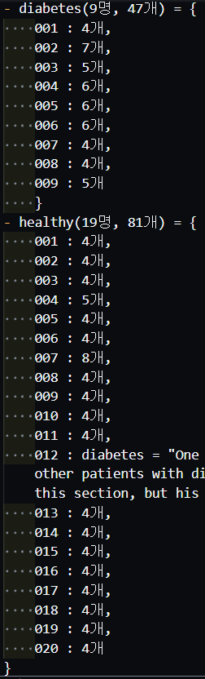
II. 2nd & 3rd week
A. Selection of ECG dataset
Diabetes: 9명, 1인 4-7개 ECG dataset
Healthy: 19명, 1인 4-5개 ECG dataset
Exception: 1명, 제외처리.
# of dataset is low
Not use Deep Learning Model
=> Traditional Machine Learning Model
=> Select Input features: HRV analysis
HF, LF, VLF peak & power: 6 input features

Slide 11
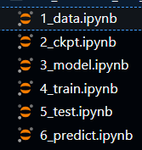
II. 2nd & 3rd week
B. Architecture of model
Extracting input features
R peaks detection from (Time, ECG) dataset
RR intervals from R peaks
HRV analysis from RR intervals (using Fast Fourier-Transform, i.e, FFT)
RR intervals: Time domain
HRV analysis: Frequency domain
=> Need FFT.
Python Code design
(Result) Failed Machine Learning Code
Too much noise in Raw dataset
Used another dataset (below)
Candidate 2. Cerebromicrovascular Disease in Elderly with Diabetes

Slide 12
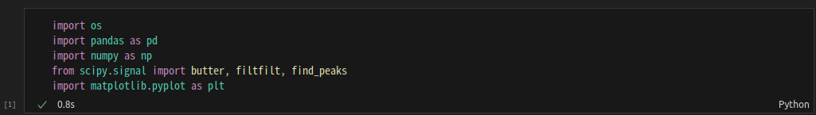
II. 2nd & 3rd week
C. Python code for extracting input features
1_data.ipynb Architecture
Library & Module

Slide 13
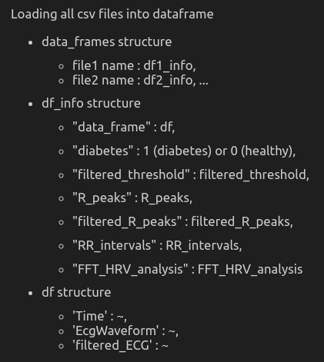
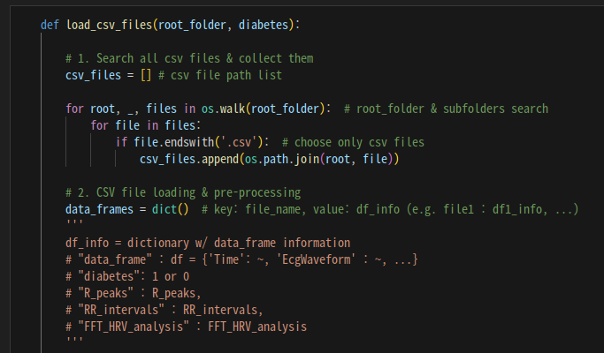
II. 2nd & 3rd week
C. Python code for extracting input features
1_data.ipynb Architecture
Loading: csv files to data frames

Slide 14
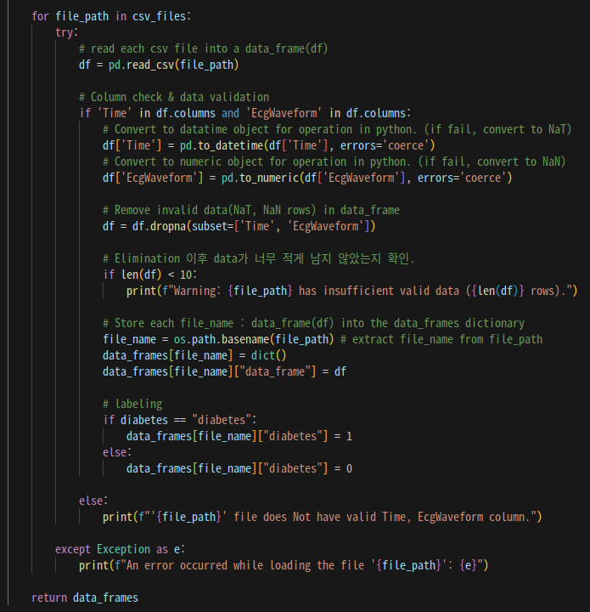
II. 2nd & 3rd week
C. Python code for extracting input features
1_data.ipynb Architecture
Loading: csv files to data frames

Slide 15
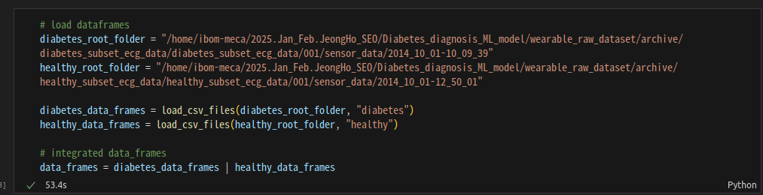
II. 2nd & 3rd week
C. Python code for extracting input features
1_data.ipynb Architecture
Loading: csv files to data frames

Slide 16
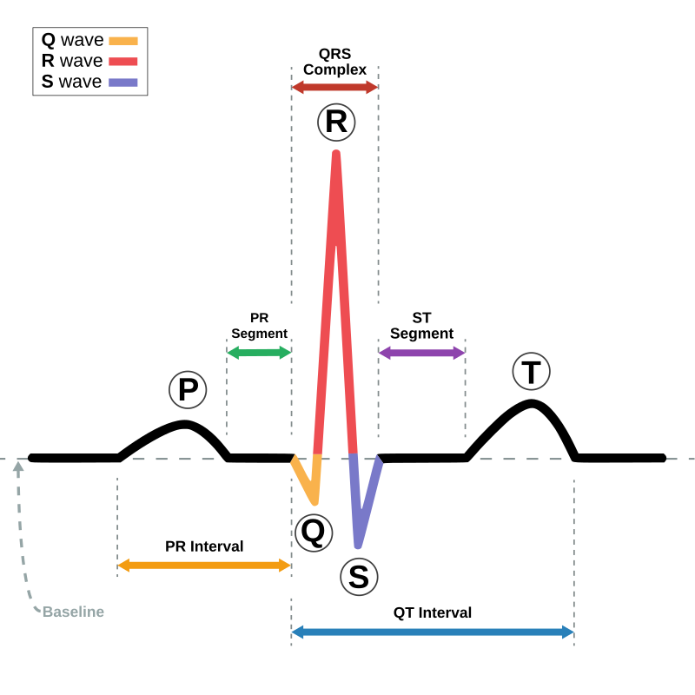
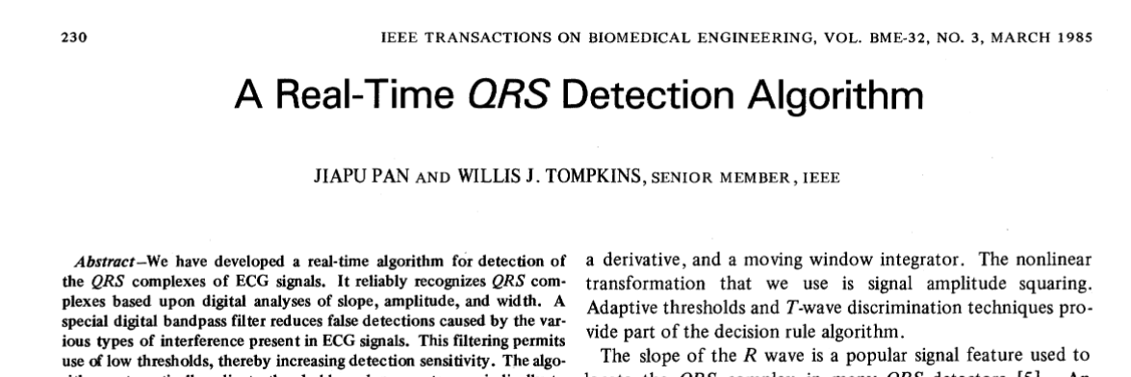
II. 2nd & 3rd week
C. Python code for extracting input features
1_data.ipynb Architecture
R peaks detection from (Time, ECG) dataset
modified & simplified Pan-Tompkins Algorithm
Reference
Pan, J., & Tompkins, W. J. (1985). A Real-Time QRS Detection Algorithm. IEEE Transactions on Biomedical Engineering, BME-32(3), 230–236.
Pan–Tompkins algorithm. (2024, 12월 4일). Wikipedia. https://en.wikipedia.org/wiki/Pan%E2%80%93Tompkins_algorithm

Slide 17
II. 2nd & 3rd week
C. Python code for extracting input features
1_data.ipynb Architecture
R peaks detection from (Time, ECG) dataset
modified & simplified Pan-Tompkins Algorithm
My Idea
R peaks satisfy
local maxima, sign of derivative changes + to –
average norm of derivative: enough large
=> derivative threshold
find_peaks function detects peaks
: P, R, T and some peak noise
use derivative threshold
Reference
Pan–Tompkins algorithm. (2024, 12월 4일). Wikipedia. https://en.wikipedia.org/wiki/Pan%E2%80%93Tompkins_algorithm

Slide 18
II. 2nd & 3rd week
C. Python code for extracting input features
1_data.ipynb Architecture
R peaks detection from (Time, ECG) dataset
modified & simplified Pan-Tompkins Algorithm
Normalization & Bandpass filter (Butterworth filter)
Emphasize QRS frequency band
Derivative Filter: derivative change + to –
R_peaks indices candidate (1)

Slide 19
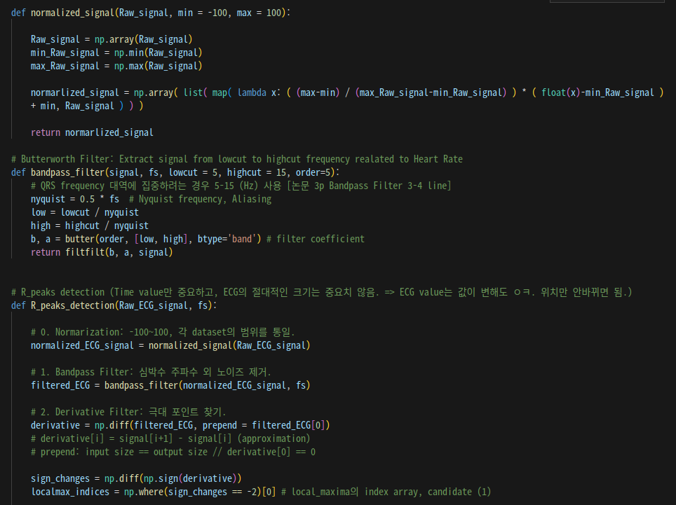
II. 2nd & 3rd week
C. Python code for extracting input features

Slide 20
II. 2nd & 3rd week
C. Python code for extracting input features
1_data.ipynb Architecture
R peaks detection from (Time, ECG) dataset
modified & simplified Pan-Tompkins Algorithm
Moving Average Filter: derivative_threshold from Moving Average
R_peaks indices candidate (2)
find_peaks
R_peaks indices candidate (3)
Refine peaks
R_peaks indices intersection of three candidates (1), (2) and (3)

Slide 21
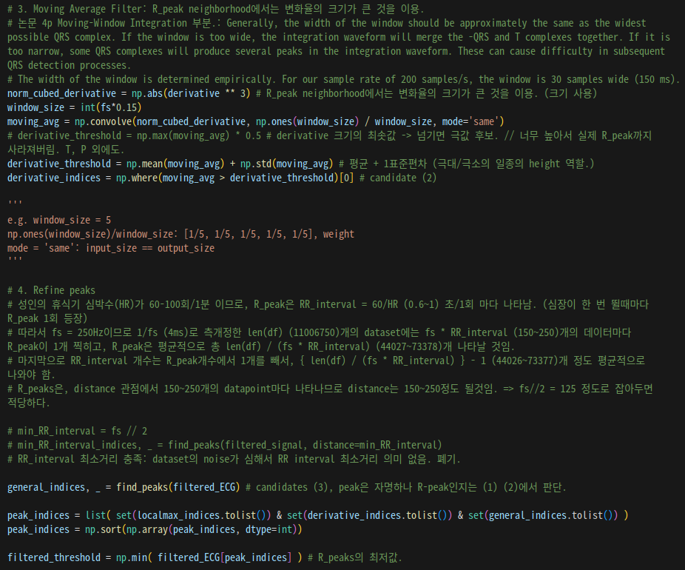
II. 2nd & 3rd week
C. Python code for extracting input features

Slide 22
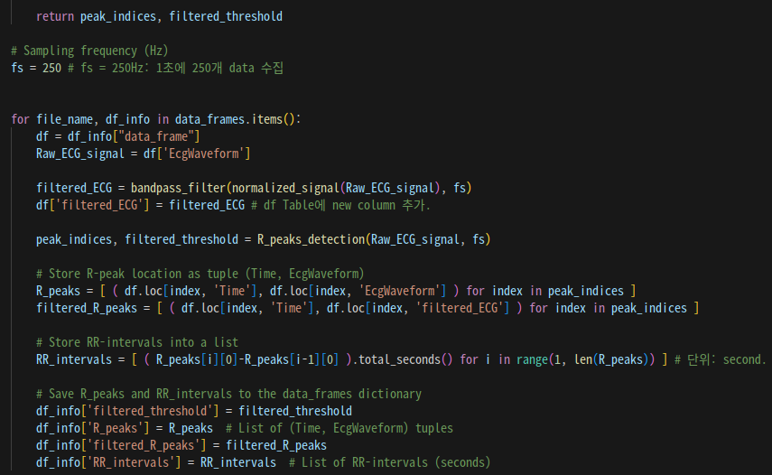
II. 2nd & 3rd week
C. Python code for extracting input features
Sampling Frequency fs = 250 (below)
Data description: https://www.sciencedirect.com/science/article/pii/S2352914818301059?via%3Dihub

Slide 23
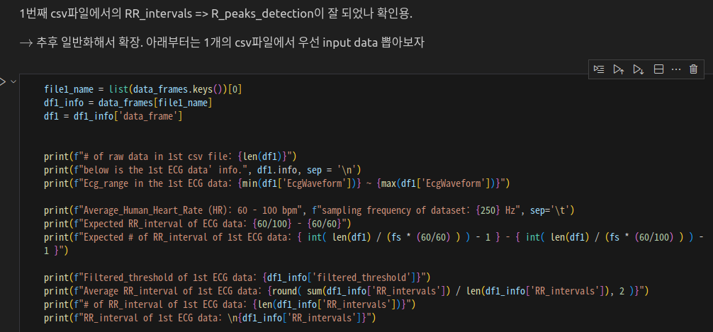
II. 2nd & 3rd week
C. Python code for extracting input features
1_data.ipynb Architecture
Visualization

Slide 24
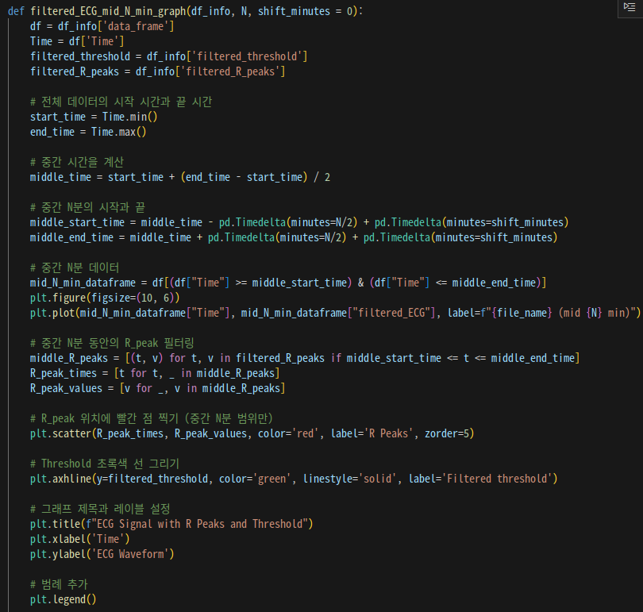
II. 2nd & 3rd week
C. Python code for extracting input features
1_data.ipynb Architecture
Visualization

Slide 25
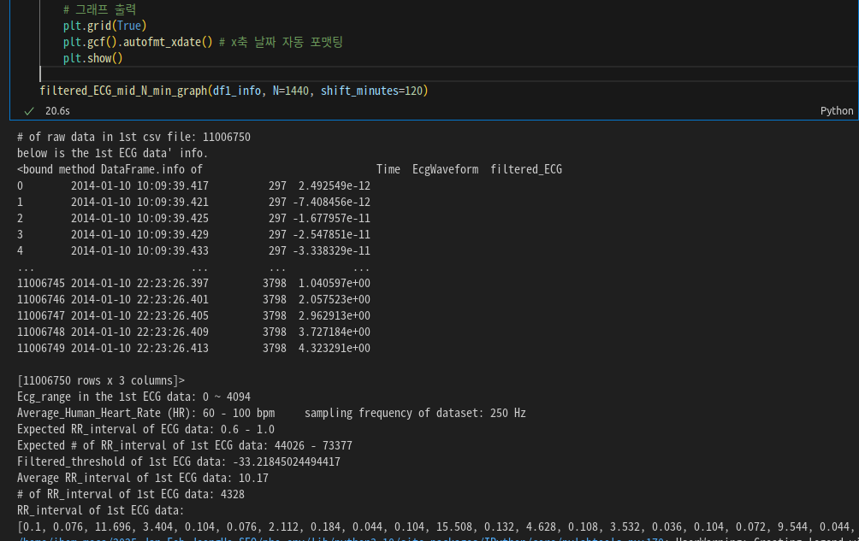
II. 2nd & 3rd week
C. Python code for extracting input features
1_data.ipynb Architecture
Visualization
Failed to R peaks detection
RR intervals are not periodic

Slide 26
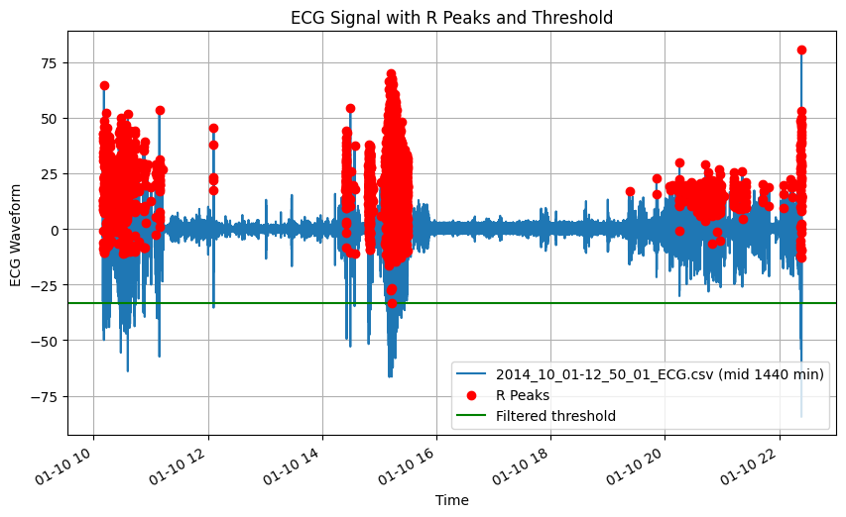
II. 2nd & 3rd week
C. Python code for extracting input features
1_data.ipynb Architecture
Visualization

Slide 27
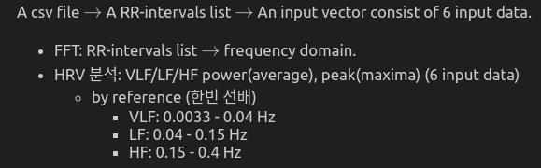
II. 2nd & 3rd week
C. Python code for extracting input features
1_data.ipynb Architecture
HRV analysis

Slide 28
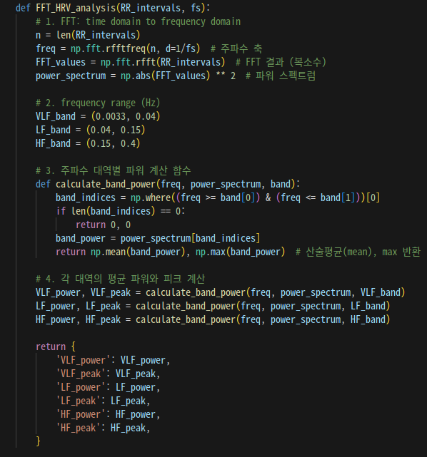
II. 2nd & 3rd week
C. Python code for extracting input features
1_data.ipynb Architecture
HRV analysis

Slide 29
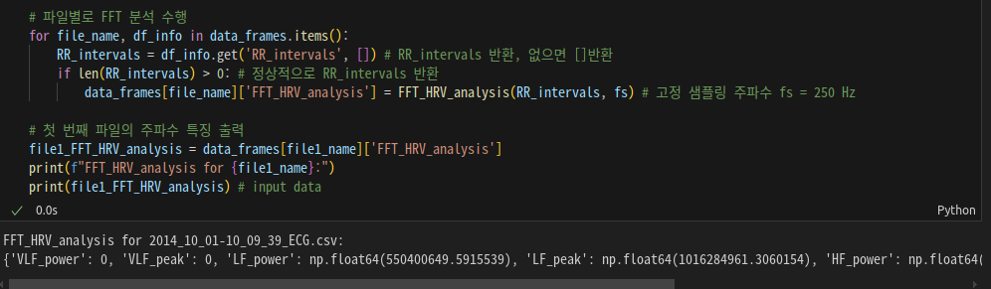
II. 2nd & 3rd week
C. Python code for extracting input features
1_data.ipynb Architecture
HRV analysis

Slide 30
II. 2nd & 3rd week
C. Python code for extracting input features
1_data.ipynb Architecture
Too much noise
Adjusting hyper-parameters,
But failed.
=> Change ECG dataset
Hyper-Parameters (Below)
bandpass filter: lowcut, highcut, order
moving average filter: window size
Etc.

Slide 31
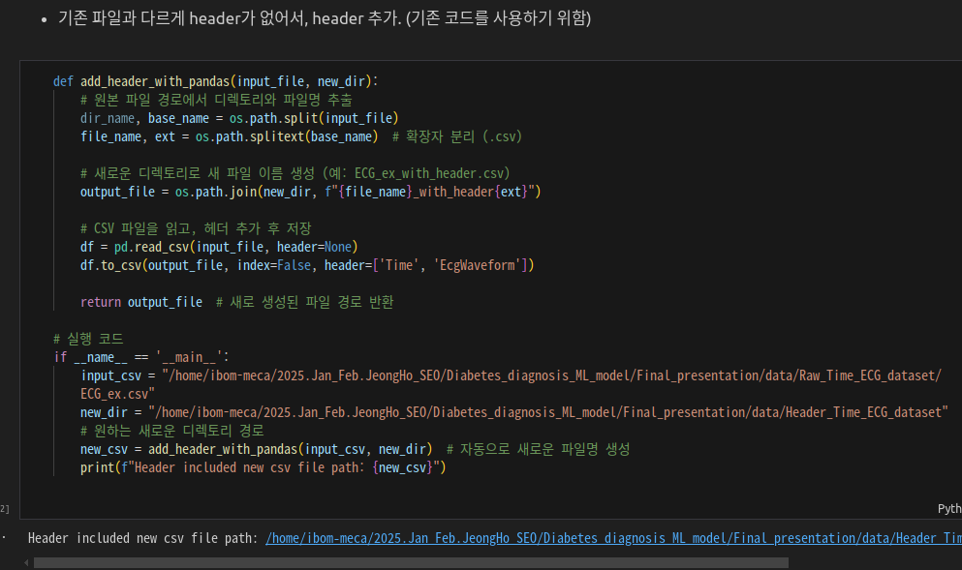
III. 4th week
A. NEW ECG dataset: Extracting input features
Change ECG dataset from wearable device dataset to my mentor’s dataset
Reuse previous python code & Some addition
Addition (1)
Add Header at RAW ECG dataset

Slide 32
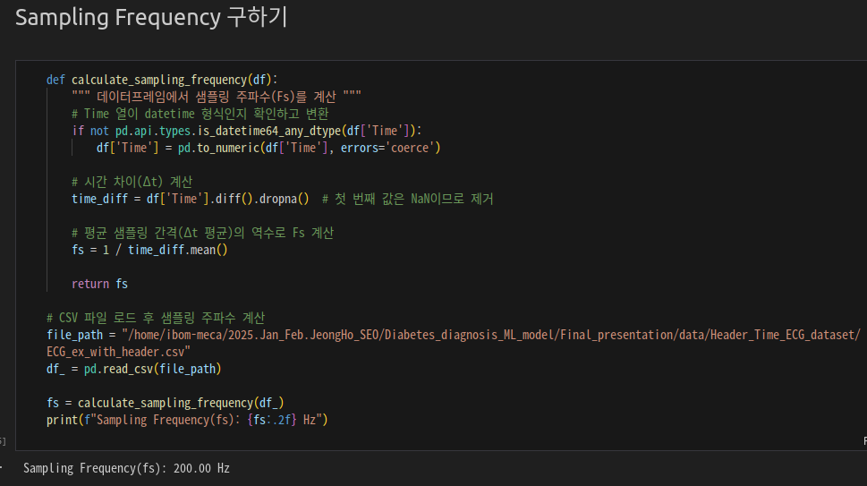
III. 4th week
A. NEW ECG dataset: Extracting input features
Change ECG dataset from wearable device dataset to my mentor’s dataset
Reuse previous python code & Some addition
Addition (2)
Sampling Frequency Calculation

Slide 33
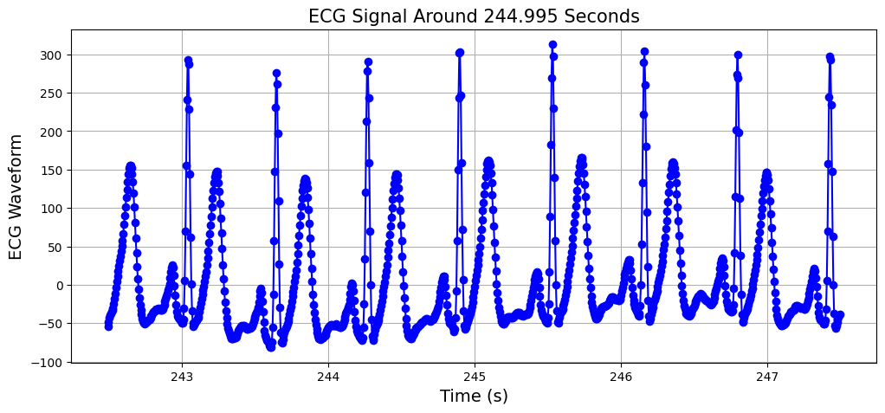
III. 4th week
A. NEW ECG dataset: Extracting input features
Change ECG dataset from wearable device dataset to my mentor’s dataset
Reuse previous python code & Some addition
Raw ECG data Visualization (mid 5 second)

Slide 34
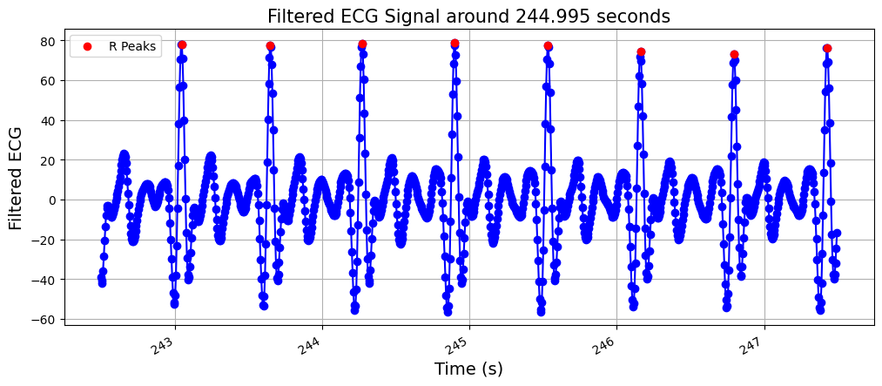
III. 4th week
A. NEW ECG dataset: Extracting input features
Change ECG dataset from wearable device dataset to my mentor’s dataset
Reuse previous python code & Some addition
Filtered ECG data Visualization (mid 5 second) & R peaks detection

Slide 35
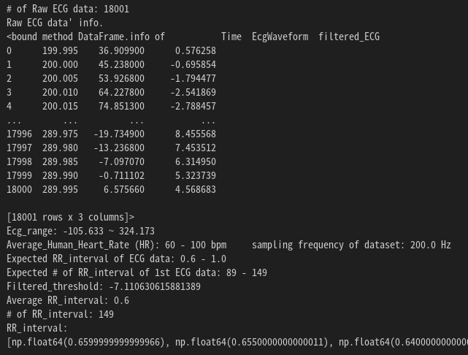
III. 4th week
A. NEW ECG dataset: Extracting input features
Change ECG dataset from wearable device dataset to my mentor’s dataset
Reuse previous python code & Some addition
Filtered ECG data Visualization (mid 5 second) & R peaks detection
Successful R peaks detection
Periodic RR intervals

Slide 36
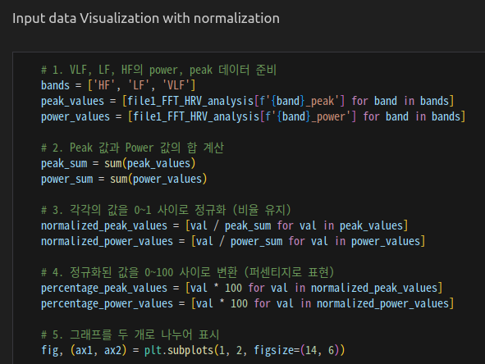
III. 4th week
A. NEW ECG dataset: Extracting input features
Change ECG dataset from wearable device dataset to my mentor’s dataset
Reuse previous python code & Some addition
HRV analysis

Slide 37
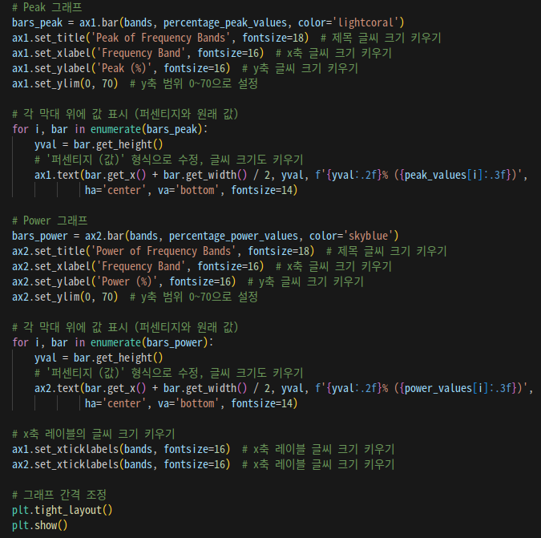
III. 4th week
A. NEW ECG dataset: Extracting input features

Slide 38
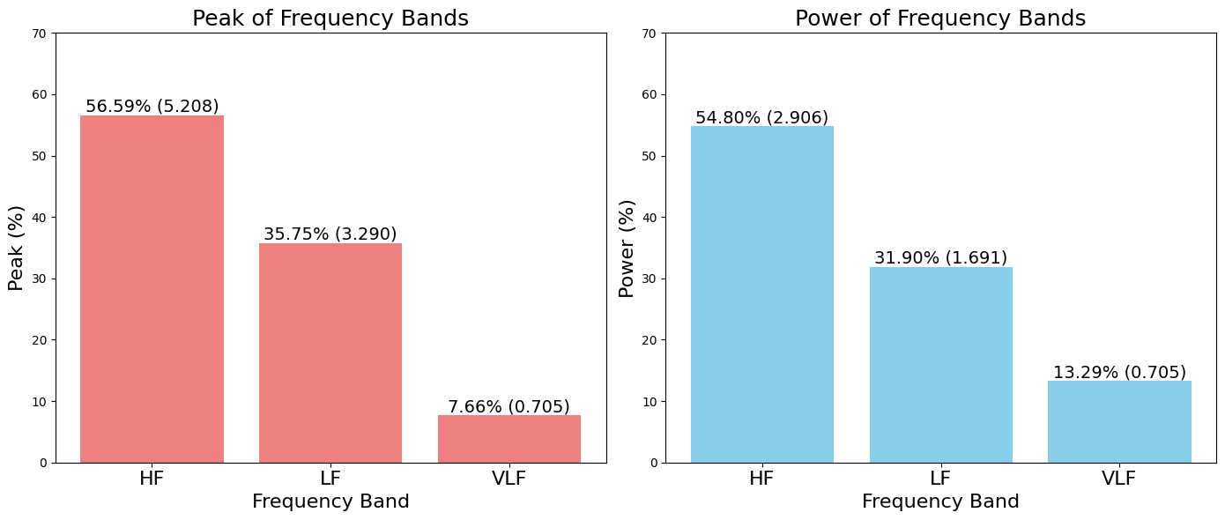
III. 4th week
A. NEW ECG dataset: Extracting input features
Change ECG dataset from wearable device dataset to my mentor’s dataset
Reuse previous python code & Some addition
HRV analysis

Slide 39
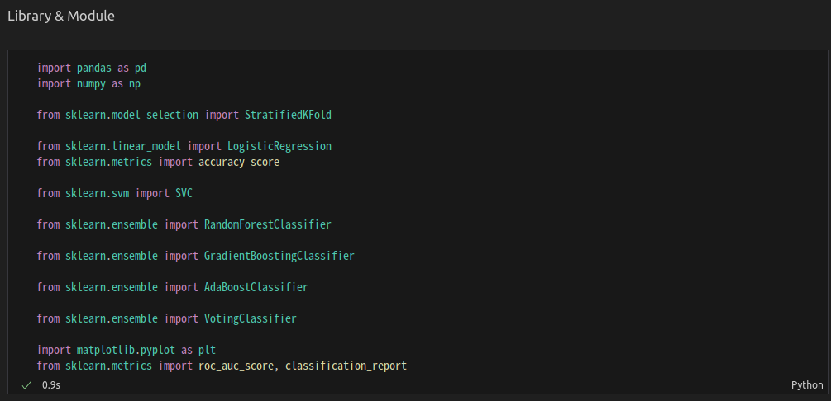
III. 4th week
B. Machine Learning Algorithm
Library & Module

Slide 40
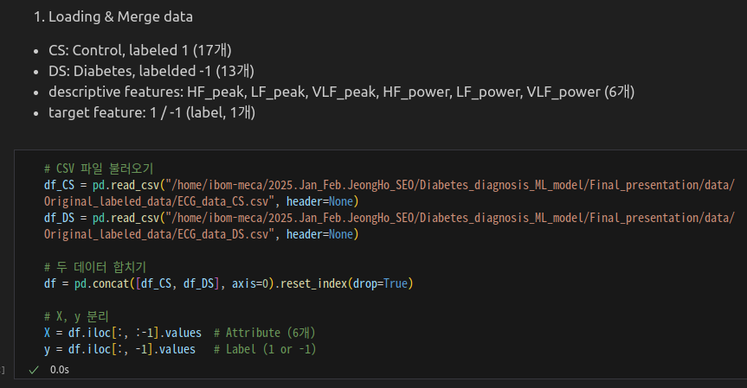
III. 4th week
B. Machine Learning Algorithm
1. Loading & Merge data

Slide 41
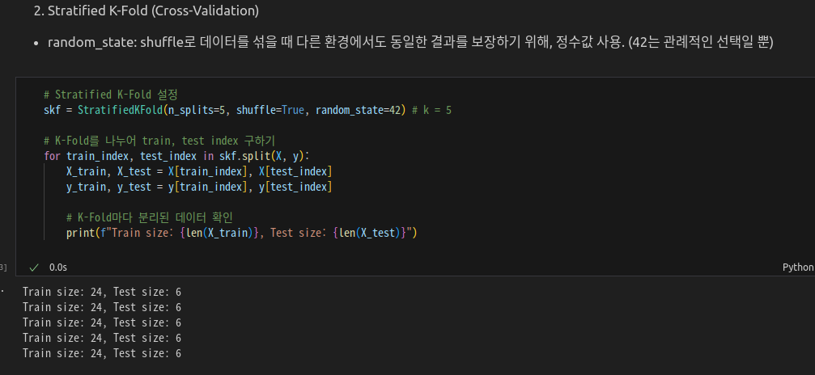
III. 4th week
B. Machine Learning Algorithm
2. Stratified K-Fold (Cross-Validation)

Slide 42
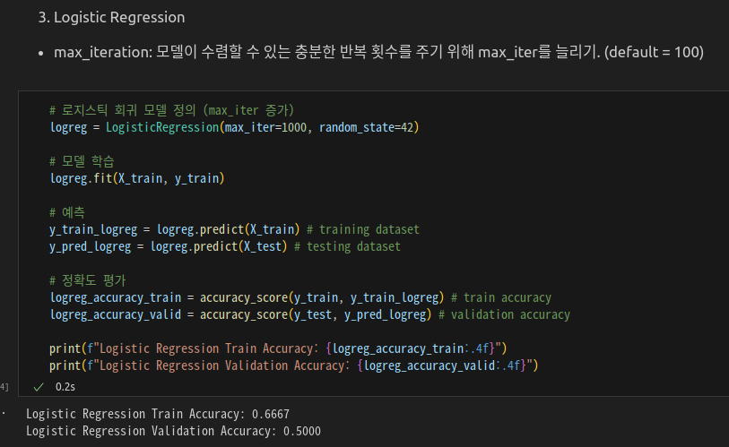
III. 4th week
B. Machine Learning Algorithm
3. Logistic Regression (1)

Slide 43
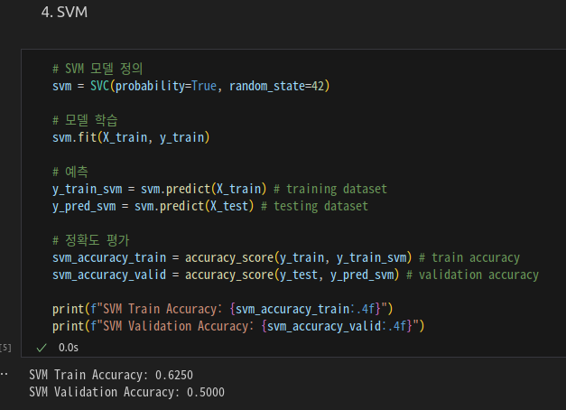
III. 4th week
B. Machine Learning Algorithm
4. SVM (2)

Slide 44
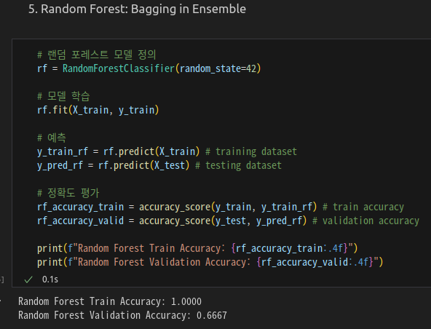
III. 4th week
B. Machine Learning Algorithm
5. Random Forest (3)

Slide 45
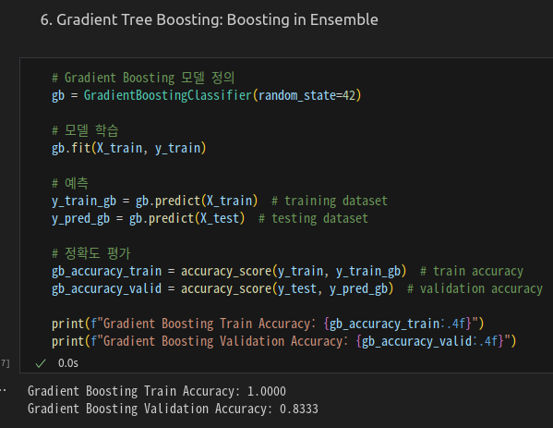
III. 4th week
B. Machine Learning Algorithm
6. Gradient Tree Boosting (4)

Slide 46
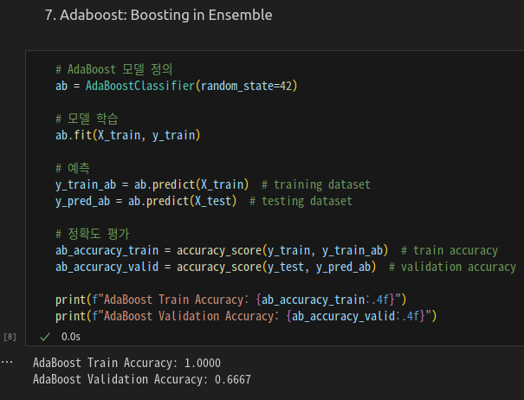
III. 4th week
B. Machine Learning Algorithm
7. Adaboost (5)

Slide 47
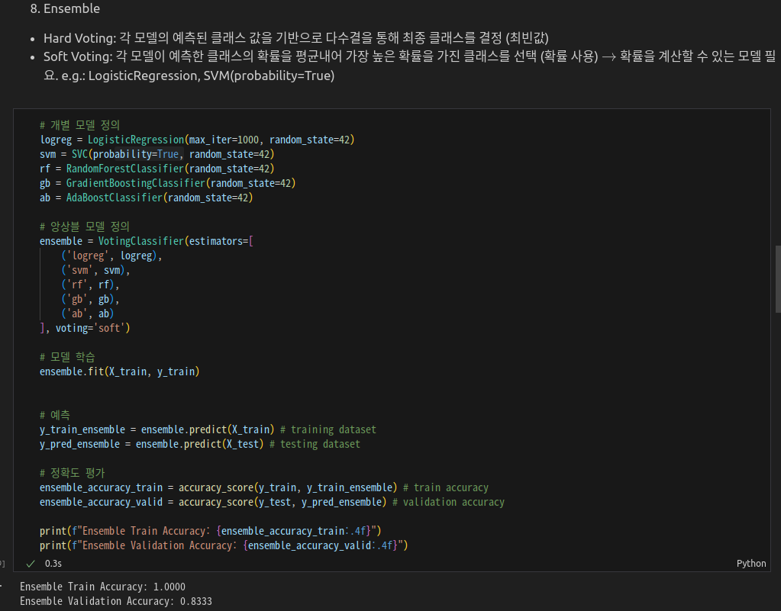
III. 4th week
B. Machine Learning Algorithm
8. Ensemble (6, Final model)

Slide 48
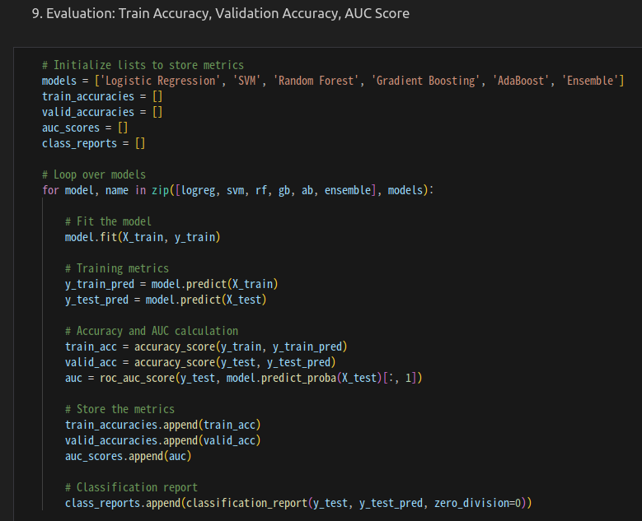
III. 4th week
B. Machine Learning Algorithm
9. Evaluation: Train Accuracy, Validation Accuracy, AUC Score

Slide 49
III. 4th week
B. Machine Learning Algorithm
9. Evaluation: Train Accuracy, Validation Accuracy, AUC Score

Slide 50
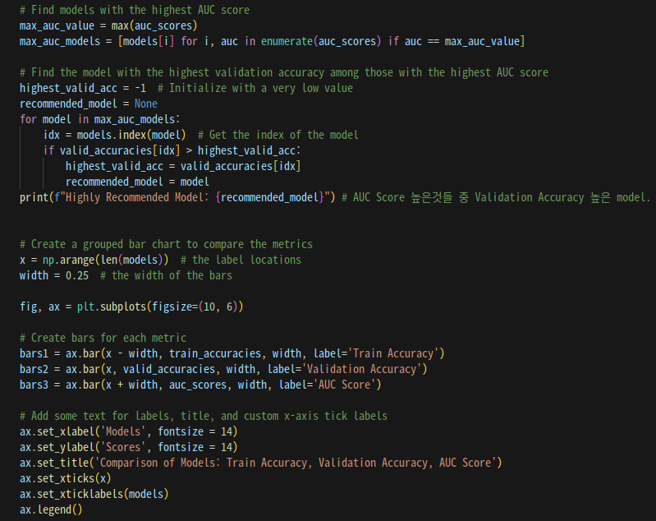
III. 4th week
B. Machine Learning Algorithm
9. Evaluation: Train Accuracy, Validation Accuracy, AUC Score

Slide 51
III. 4th week
B. Machine Learning Algorithm
9. Evaluation: Train Accuracy, Validation Accuracy, AUC Score

Slide 52
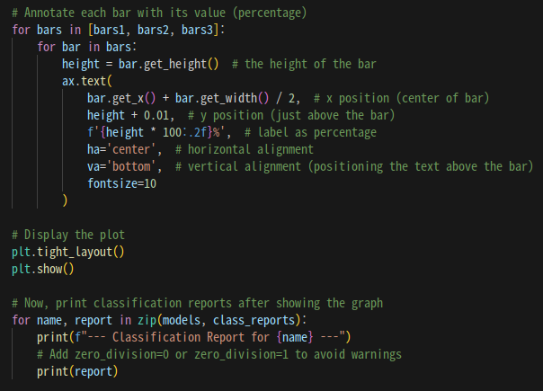
III. 4th week
B. Machine Learning Algorithm
9. Evaluation: Train Accuracy, Validation Accuracy, AUC Score

Slide 53
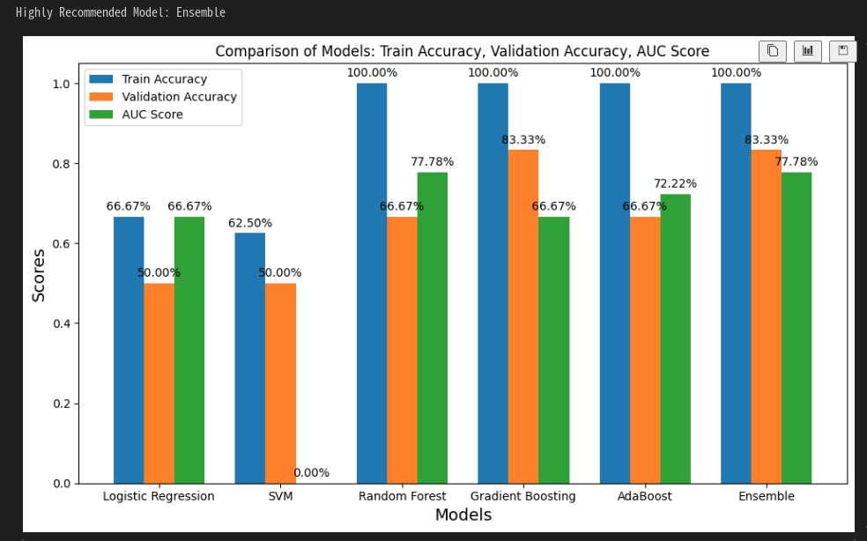
III. 4th week
B. Machine Learning Algorithm
9. Evaluation: Train Accuracy, Validation Accuracy, AUC Score
Train Accuracy
100%
Overfitting
Insufficient data

Slide 54
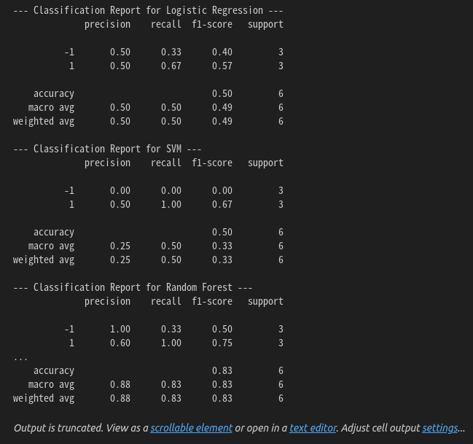
III. 4th week
B. Machine Learning Algorithm
9. Evaluation: Train Accuracy, Validation Accuracy, AUC Score

Slide 55
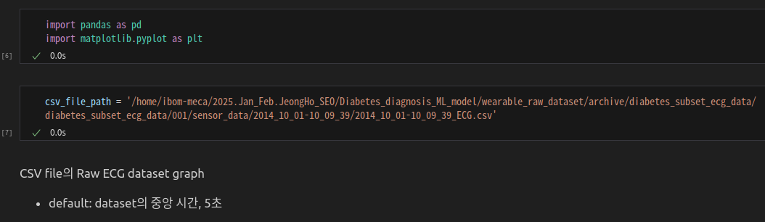
IV. Raw ECG visualization
A. Wearable device ECG dataset visualization
Candidate 5. D1NAMO ECG Glucose Data, MIT BIH Type 1 Diabetes monitoring using ECG
csv dataset file loading

Slide 56

IV. Raw ECG visualization
A. Wearable device ECG dataset visualization
Candidate 5. D1NAMO ECG Glucose Data, MIT BIH Type 1 Diabetes monitoring using ECG
csv dataset file graph

Slide 57

IV. Raw ECG visualization
A. Wearable device ECG dataset visualization
Candidate 5. D1NAMO ECG Glucose Data, MIT BIH Type 1 Diabetes monitoring using ECG
전체 Raw dataset graph

Slide 58

IV. Raw ECG visualization
A. Wearable device ECG dataset visualization
Candidate 5. D1NAMO ECG Glucose Data, MIT BIH Type 1 Diabetes monitoring using ECG
mid_time: dataset의 중앙
center_time: mid_time에서 shift_time만큼 shifting한 시각
duration_seconds: center_time을 중심으로 duration_seconds만큼 dataset 사용.

Slide 59

IV. Raw ECG visualization
A. Wearable device ECG dataset visualization
Candidate 5. D1NAMO ECG Glucose Data, MIT BIH Type 1 Diabetes monitoring using ECG
Raw ECG data visualizaton

Slide 60

IV. Raw ECG visualization
A. Wearable device ECG dataset visualization
Candidate 5. D1NAMO ECG Glucose Data, MIT BIH Type 1 Diabetes monitoring using ECG
Mid_time 기준 5초

Slide 61

IV. Raw ECG visualization
A. Wearable device ECG dataset visualization
Candidate 5. D1NAMO ECG Glucose Data, MIT BIH Type 1 Diabetes monitoring using ECG
Mid_time 기준 30초

Slide 62

IV. Raw ECG visualization
A. Wearable device ECG dataset visualization
Candidate 5. D1NAMO ECG Glucose Data, MIT BIH Type 1 Diabetes monitoring using ECG
Mid_time -1500초 기준 5초

Slide 63

IV. Raw ECG visualization
A. Wearable device ECG dataset visualization
Candidate 5. D1NAMO ECG Glucose Data, MIT BIH Type 1 Diabetes monitoring using ECG
Mid_time +1500초 기준 5초

Slide 64

IV. Raw ECG visualization
A. Wearable device ECG dataset visualization
Candidate 5. D1NAMO ECG Glucose Data, MIT BIH Type 1 Diabetes monitoring using ECG
Mid_time -3000초 기준 5초

Slide 65

IV. Raw ECG visualization
A. Wearable device ECG dataset visualization
Candidate 5. D1NAMO ECG Glucose Data, MIT BIH Type 1 Diabetes monitoring using ECG
Mid_time +3000초 기준 5초

Slide 66
IV. Raw ECG visualization
A. Wearable device ECG dataset visualization
Candidate 5. D1NAMO ECG Glucose Data, MIT BIH Type 1 Diabetes monitoring using ECG
Raw ECG dataset 전체를 visualization했을 때에는 전반적으로 noise가 심하다고 판단되어 사용하지 않았는데, (below image)
사수(정한빈 박사과정) 선배님 방식대로 Raw data graph를 가시화해서 noise가 적은 부분만 crop한 후, noise가 적은 부분들만 collect해서 사용할 수 있을 것 같습니다.
다만 Raw ECG가 0~4094 범위이기 때문에 2050~2100 사이 값을 R peaks으로 인정할 수 있는지는 확인이 필요할 것 같습니다.
Raw data에서 RR interval의 예상치와 개수가 algorithm 결과와 1:10 정도
Algorithm 결과에서 RR interval의 값이 일정하지 않음

Slide 67

IV. Raw ECG visualization
B. 60 Male Diabetes Type 2 ECG dataset visualization
Candidate 4. Dataset on electrocardiograph, sleep and metabolic function of male type 2 diabetes mellitus
mat dataset file loading

Slide 68

IV. Raw ECG visualization
B. 60 Male Diabetes Type 2 ECG dataset visualization
Candidate 4. Dataset on electrocardiograph, sleep and metabolic function of male type 2 diabetes mellitus
mat dataset file loading

Slide 69

IV. Raw ECG visualization
B. 60 Male Diabetes Type 2 ECG dataset visualization
Candidate 4. Dataset on electrocardiograph, sleep and metabolic function of male type 2 diabetes mellitus
mat dataset file graph

Slide 70

IV. Raw ECG visualization
B. 60 Male Diabetes Type 2 ECG dataset visualization
Candidate 4. Dataset on electrocardiograph, sleep and metabolic function of male type 2 diabetes mellitus
전체 24H

Slide 71

IV. Raw ECG visualization
B. 60 Male Diabetes Type 2 ECG dataset visualization
Candidate 4. Dataset on electrocardiograph, sleep and metabolic function of male type 2 diabetes mellitus

Slide 72

IV. Raw ECG visualization
B. 60 Male Diabetes Type 2 ECG dataset visualization
Candidate 4. Dataset on electrocardiograph, sleep and metabolic function of male type 2 diabetes mellitus

Slide 73

IV. Raw ECG visualization
B. 60 Male Diabetes Type 2 ECG dataset visualization
Candidate 4. Dataset on electrocardiograph, sleep and metabolic function of male type 2 diabetes mellitus
Mid_time 기준 3초

Slide 74

IV. Raw ECG visualization
B. 60 Male Diabetes Type 2 ECG dataset visualization
Candidate 4. Dataset on electrocardiograph, sleep and metabolic function of male type 2 diabetes mellitus
Mid_time 기준 5초

Slide 75

IV. Raw ECG visualization
B. 60 Male Diabetes Type 2 ECG dataset visualization
Candidate 4. Dataset on electrocardiograph, sleep and metabolic function of male type 2 diabetes mellitus
Mid_time 기준 30초

Slide 76

IV. Raw ECG visualization
B. 60 Male Diabetes Type 2 ECG dataset visualization
Candidate 4. Dataset on electrocardiograph, sleep and metabolic function of male type 2 diabetes mellitus
Mid_time -1500초 기준 5초

Slide 77

IV. Raw ECG visualization
B. 60 Male Diabetes Type 2 ECG dataset visualization
Candidate 4. Dataset on electrocardiograph, sleep and metabolic function of male type 2 diabetes mellitus
Mid_time +1500초 기준 5초

Slide 78

IV. Raw ECG visualization
B. 60 Male Diabetes Type 2 ECG dataset visualization
Candidate 4. Dataset on electrocardiograph, sleep and metabolic function of male type 2 diabetes mellitus
Mid_time -3000초 기준 5초

Slide 79

IV. Raw ECG visualization
B. 60 Male Diabetes Type 2 ECG dataset visualization
Candidate 4. Dataset on electrocardiograph, sleep and metabolic function of male type 2 diabetes mellitus
Mid_time +3000초 기준 5초

Slide 80
IV. Raw ECG visualization
B. 60 Male Diabetes Type 2 ECG dataset visualization
Candidate 4. Dataset on electrocardiograph, sleep and metabolic function of male type 2 diabetes mellitus
사수(정한빈 박사과정) 선배님과 상의 후 남성 diabetes patients 중 Type 2 환자들의 Raw ECG dataset이기 때문에, (gender, type)이 모두 특정되었으므로 그렇지 않은 다른 dataset과 병합할 수 없을 것이라 생각했습니다.
다만 Diabetes Diagnosis model에서 data의 개수 자체가 현저히 부족한 상황이므로, 필요하다면 합쳐서 사용하는 것이 더 괜찮을 것 같습니다.
24H 전체 dataset을 visualization했을 때 30,000을 넘어가는 ECG값은 모두 noise인 것 같아 삭제해서 사용하면 될 것 같습니다.
다만 ECG 값에서 12,000 부근이 R peaks의 값인지, 아니면 25,000 부근이 R peaks의 값인지는 확인이 필요할 것 같습니다.
이후에는 사수(정한빈 박사과정) 선배님 방식대로 Raw data graph를 가시화해서 noise가 적은 부분만 crop한 후, noise가 적은 부분들만 collect해서 사용할 수 있을 것 같습니다.

Slide 81
Thank you for your attention
  Q&A

