Slide 1
NeurIPS 2017
Attention Is All You Need
  Authors: Ashish Vaswani, Noam Shazeer, Niki Parmar, Jakob Uszkoreit, Llion Jones, Aidan N Gomez, Łukasz Kaiser, Illia Polosukhin
  Main Affiliation: Google Brain
2025.07.22
서정호

Slide 2
Proposal
Model Architecture
Why Self-Attention

Slide 3
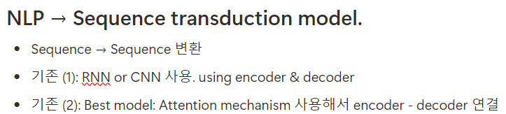
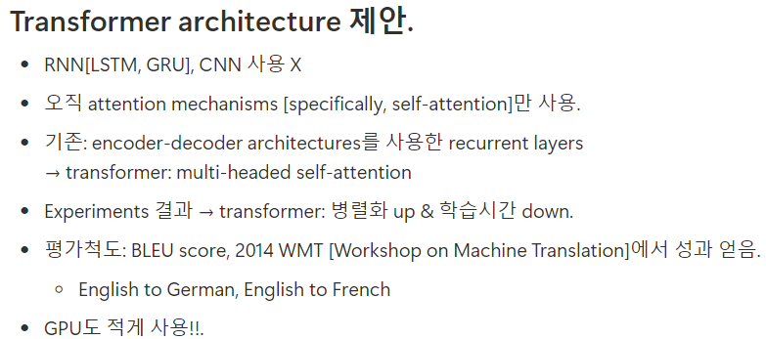
Proposal

Slide 4
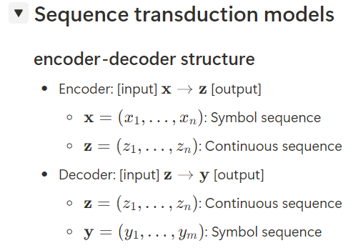
Model Architecture

Slide 5
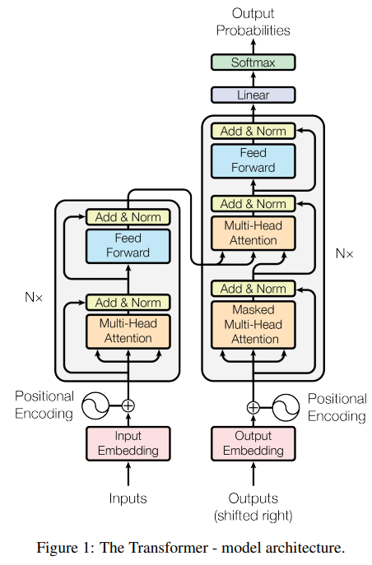
Model Architecture
다음 token 예측
Total Architecture
예. Eng. -> French.
“I am a student” -> “Je suis étudiant »
Input token: [I, am, a, student]
Target token: [Je, suis, étudiant]
Encoder Input
Decoder Input

Slide 6
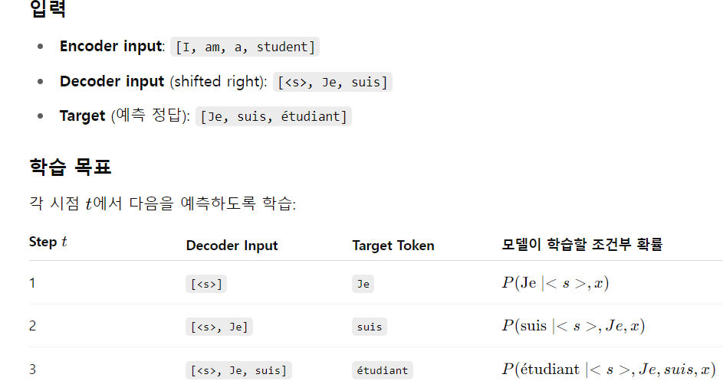
Model Architecture
예. Eng. -> French.
“I am a student” -> “Je suis étudiant »
Input token: [I, am, a, student]
Target token: [Je, suis, étudiant]
Learning
maximized
Loss ftn.
시작 token

Slide 7
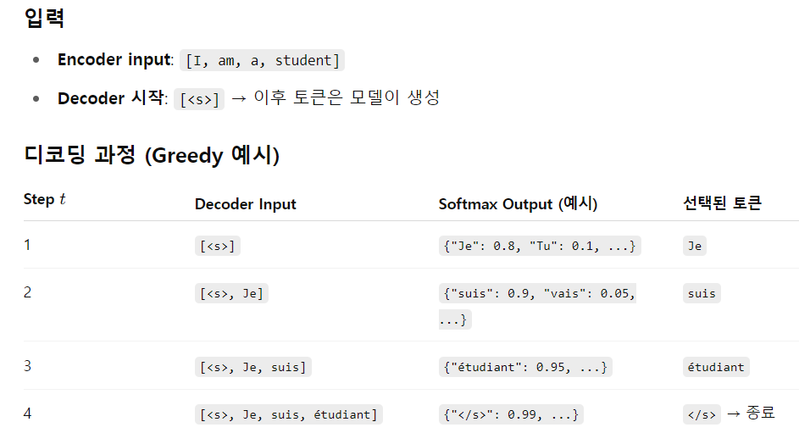
Model Architecture
예. Eng. -> French.
“I am a student” -> “Je suis étudiant »
Input token: [I, am, a, student]
Target token: [Je, suis, étudiant]
Inference
종료 token

Slide 8
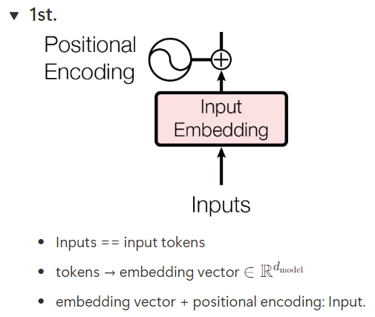
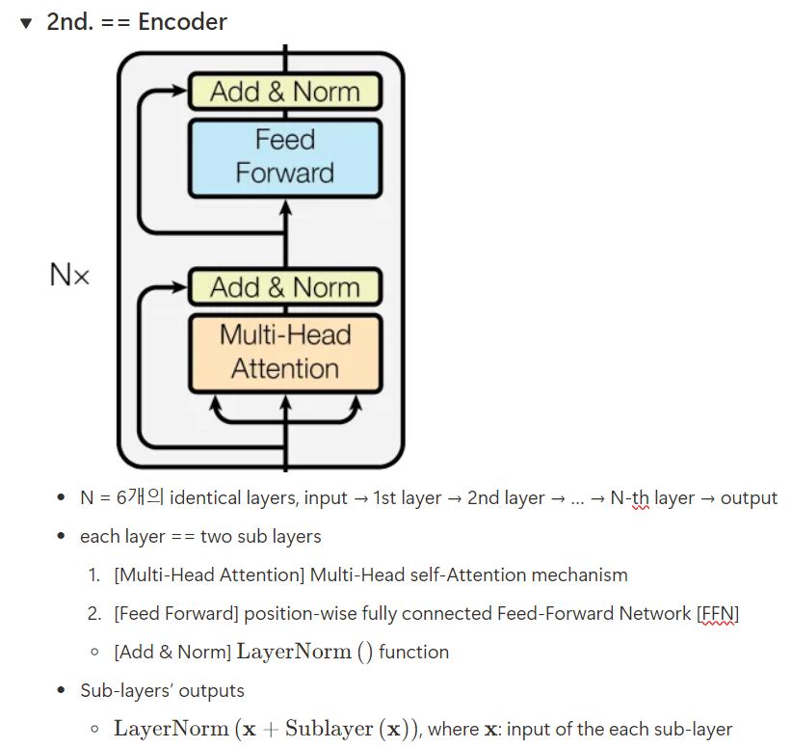
Model Architecture

Slide 9
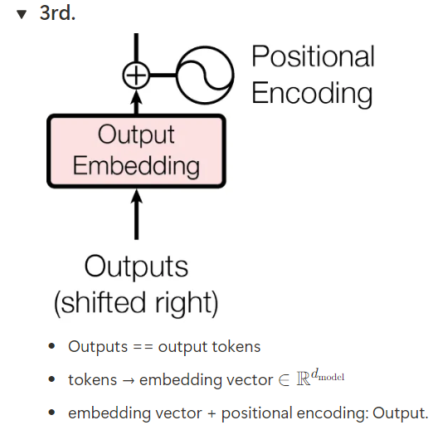
Model Architecture

Slide 10

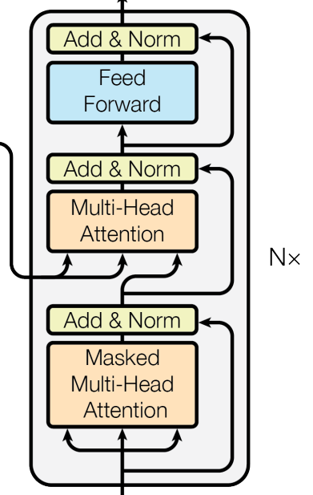
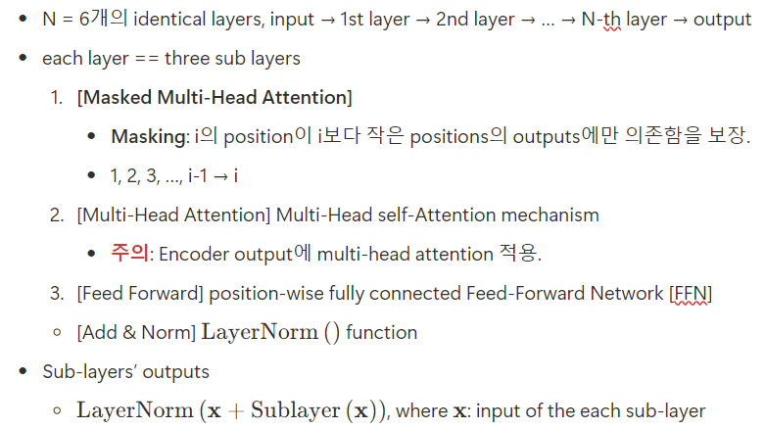
Model Architecture

Slide 11
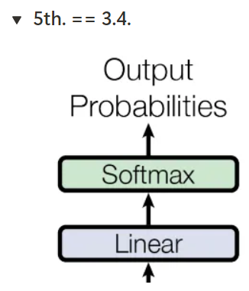
Model Architecture
Total Architecture

Slide 12
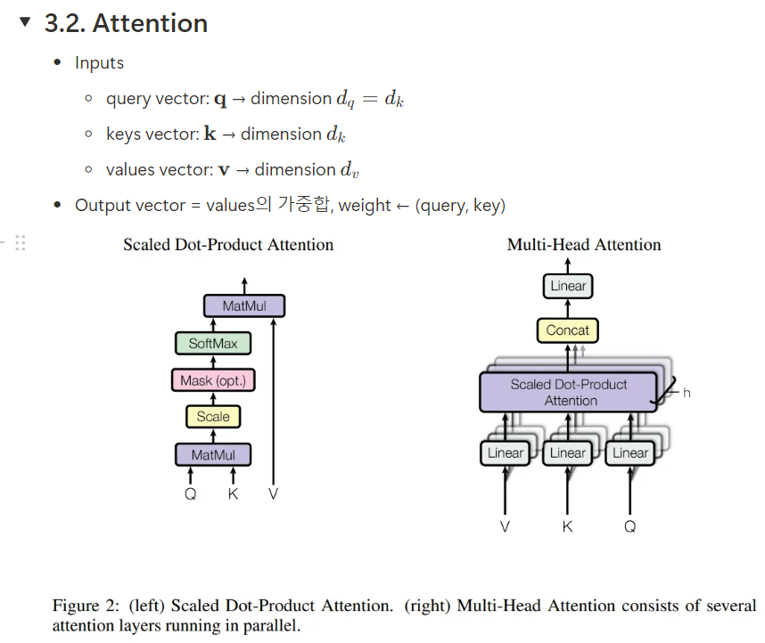
Model Architecture

Slide 13
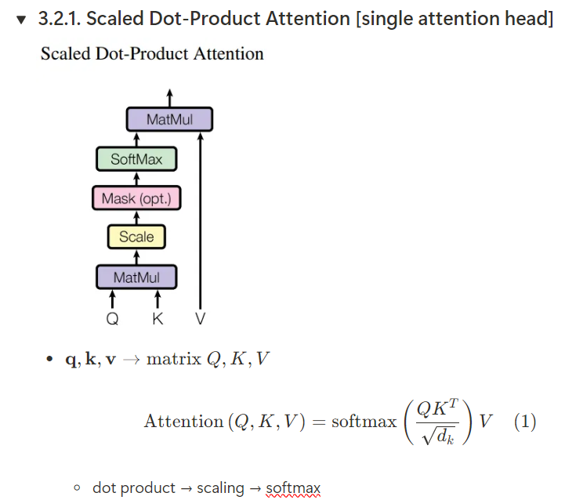
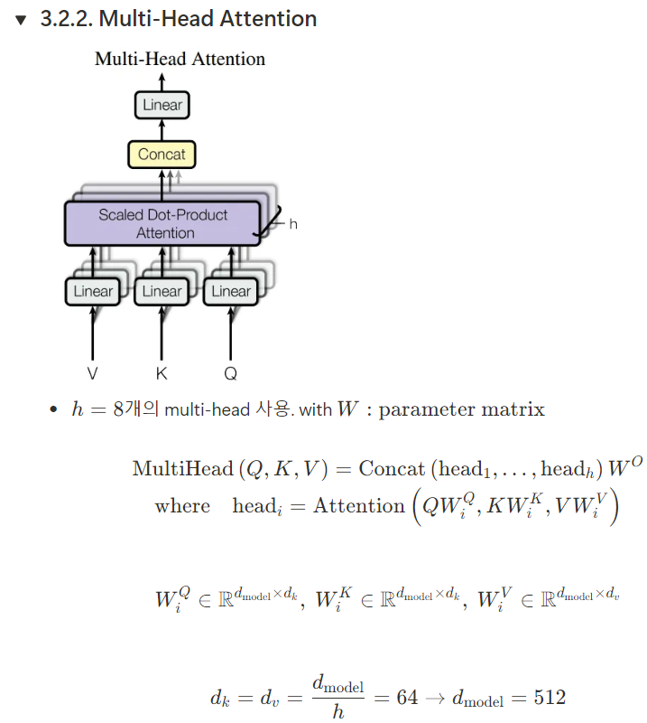
Model Architecture

Slide 14
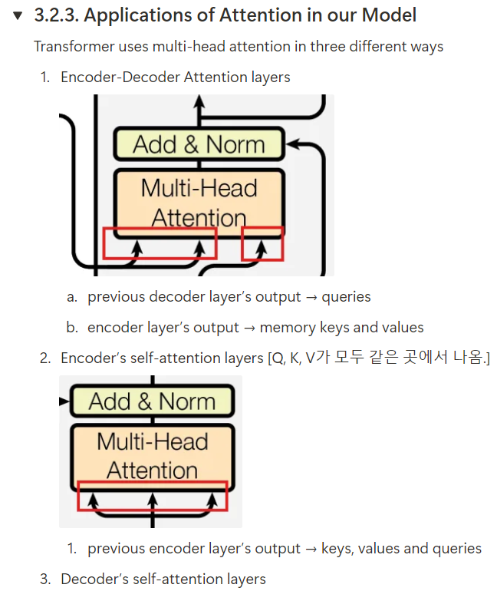
Model Architecture
K V
Q
K V
Q

Slide 15
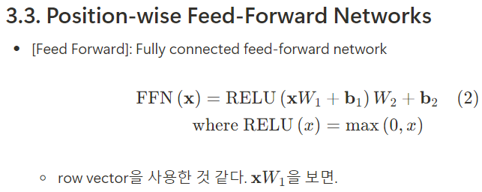
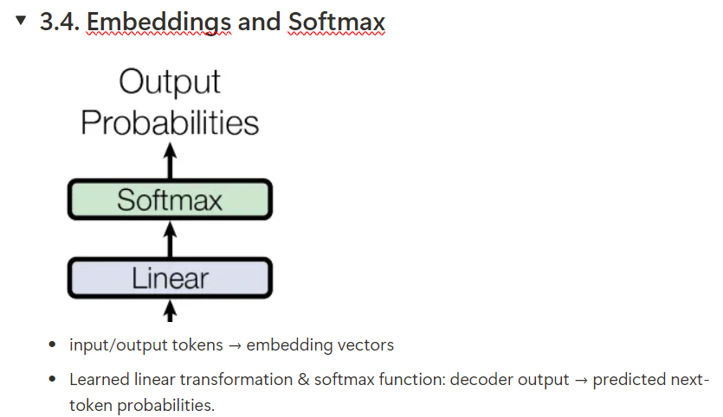
Model Architecture

Slide 16
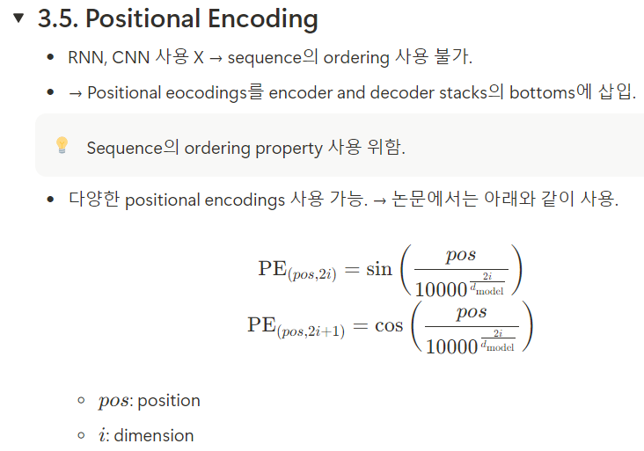
Model Architecture
Total Architecture

Slide 17
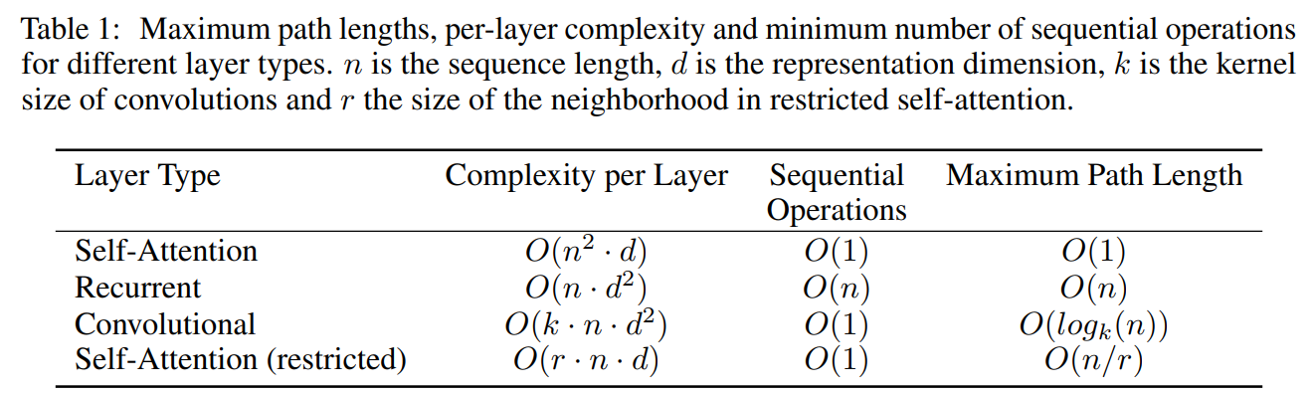
Why Self-Attention

