Slide 1
SIGIR 2021
Intervention for Leveraging Popularity Bias
in Recommendation
  Authors: Yang Zhang et al.
  Main Affiliation: University of Science and Technology of China
2025.07.24
서정호

Slide 2
Proposal
Primary Knowledge
Framework
Experiments

Slide 3
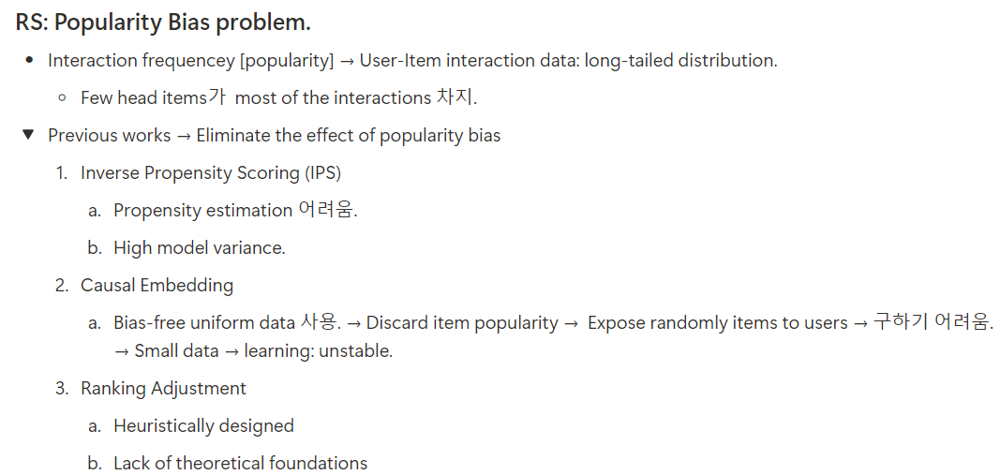
Proposal
3

Slide 4
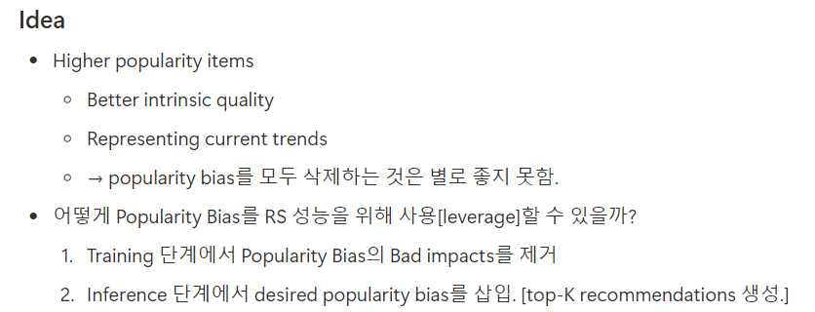
Proposal
4

Slide 5
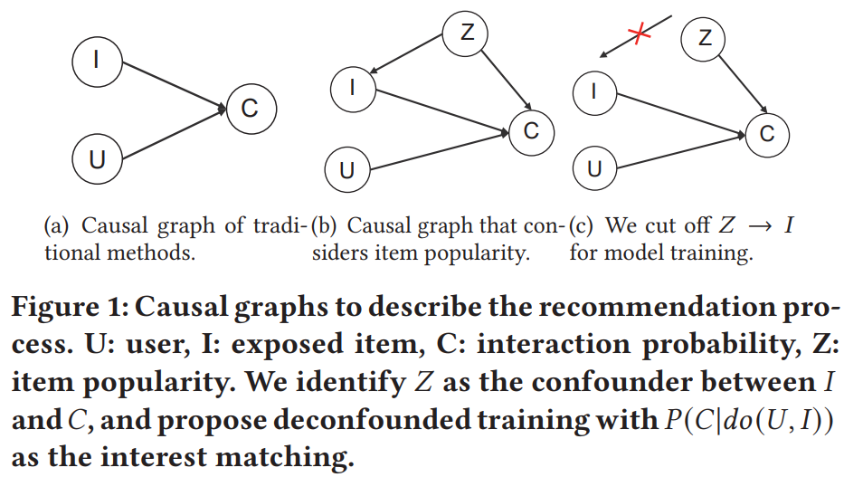
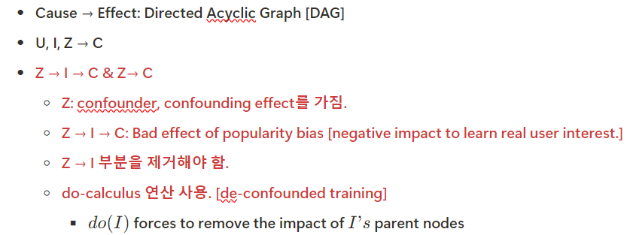
Proposal
U: User
I: Item Exposure
C: Interaction Prob.
Z: Item Popularity
5

Slide 6
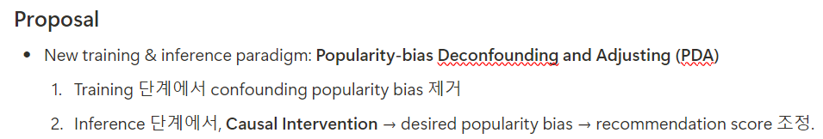
Proposal
6

Slide 7
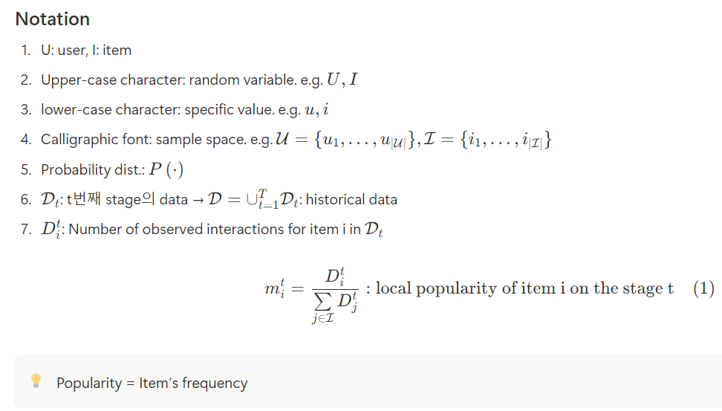
Primary Knowledge
If whole training set,
Global popularity

Slide 8
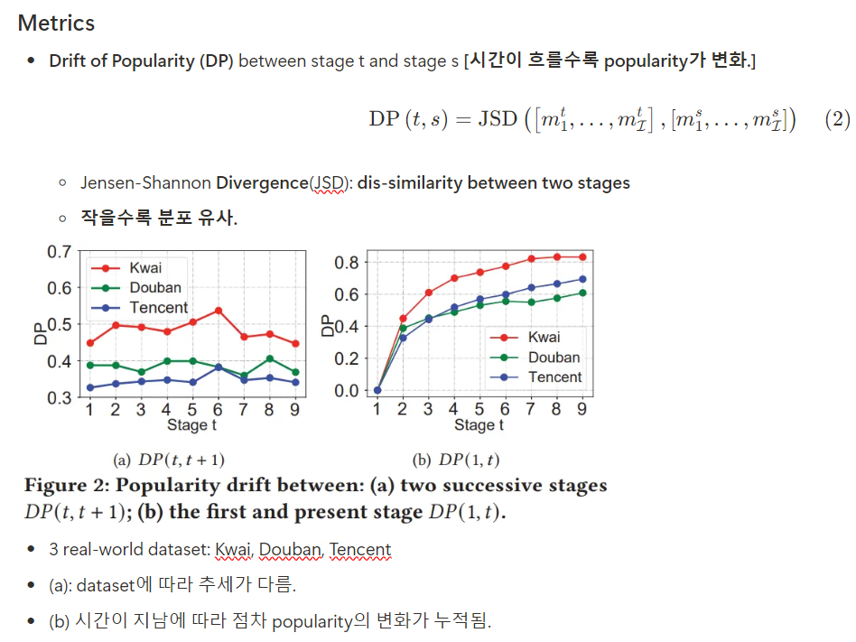
Primary Knowledge
Popularity 차이가 크다.

Slide 9
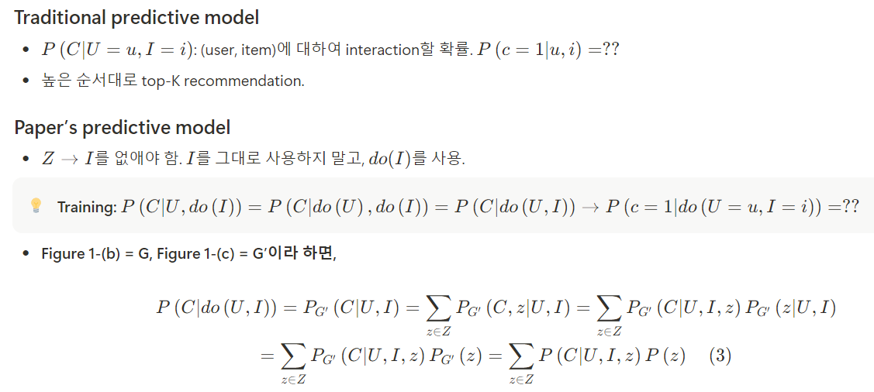

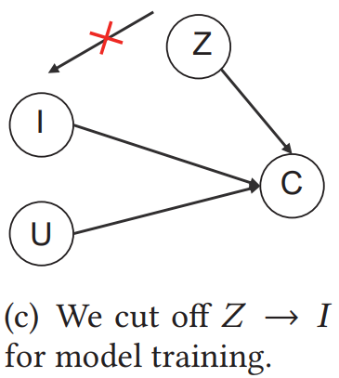
Framework
Deconfounded Training
G
G’

Slide 10
Framework
Deconfounded Training
G
G’

Slide 11
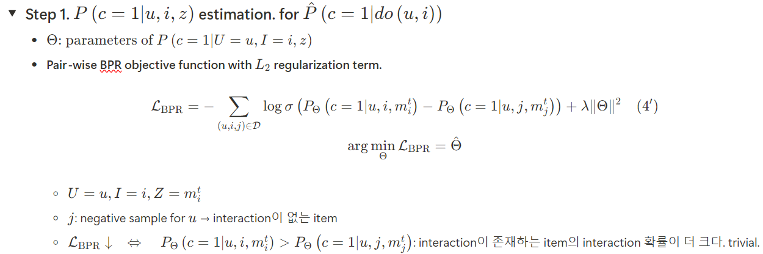
Framework
Deconfounded Training

Slide 12
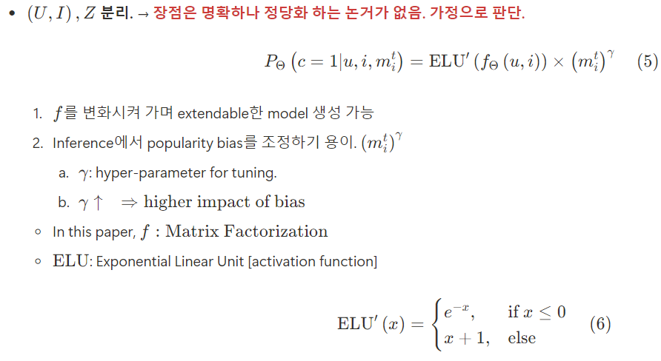
Framework
Deconfounded Training

Slide 13
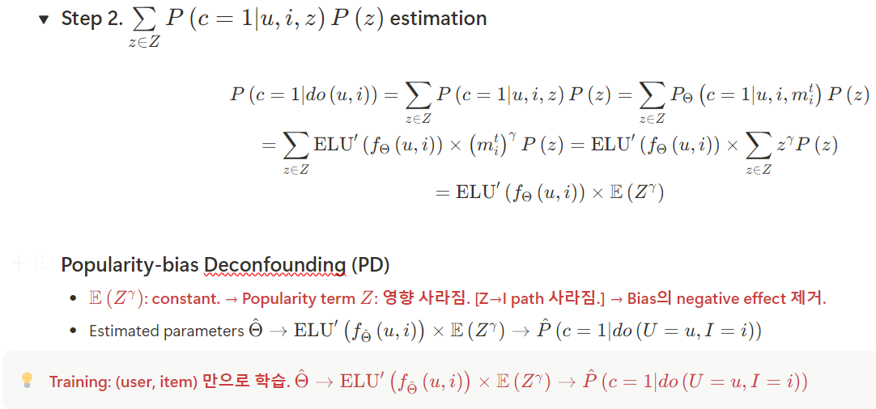
Framework
Deconfounded Training

Slide 14
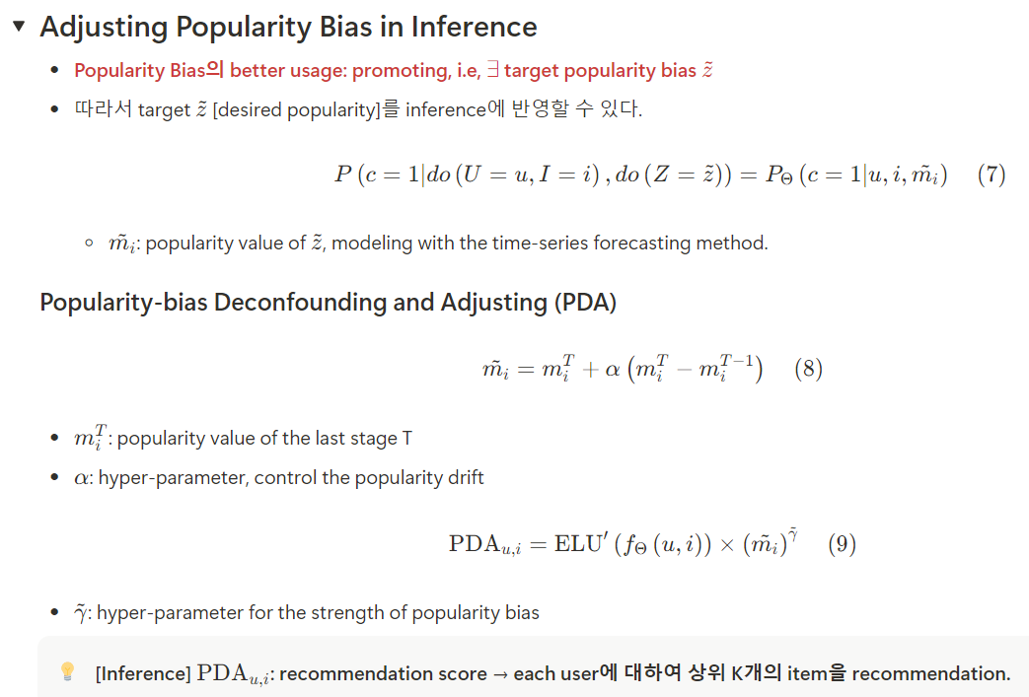

Framework
Adjusting Popularity Bias in Inference

Slide 15
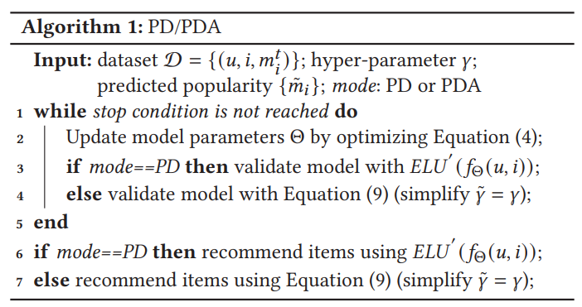
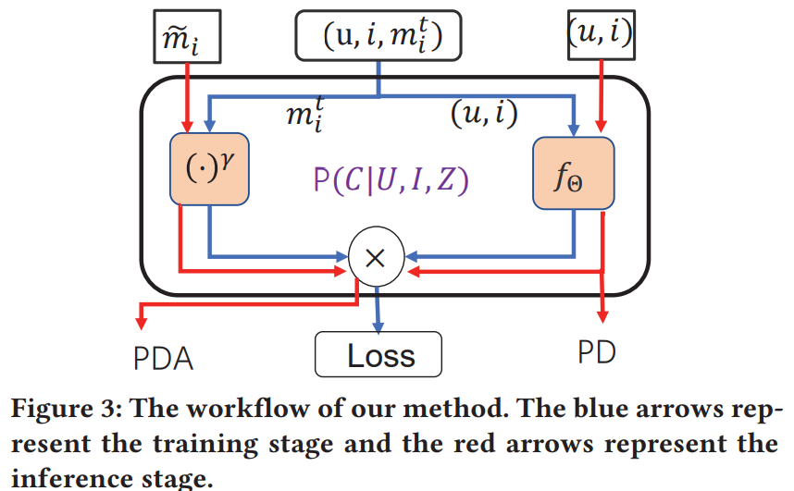
Framework
Adjusting Popularity Bias in Inference

Slide 16
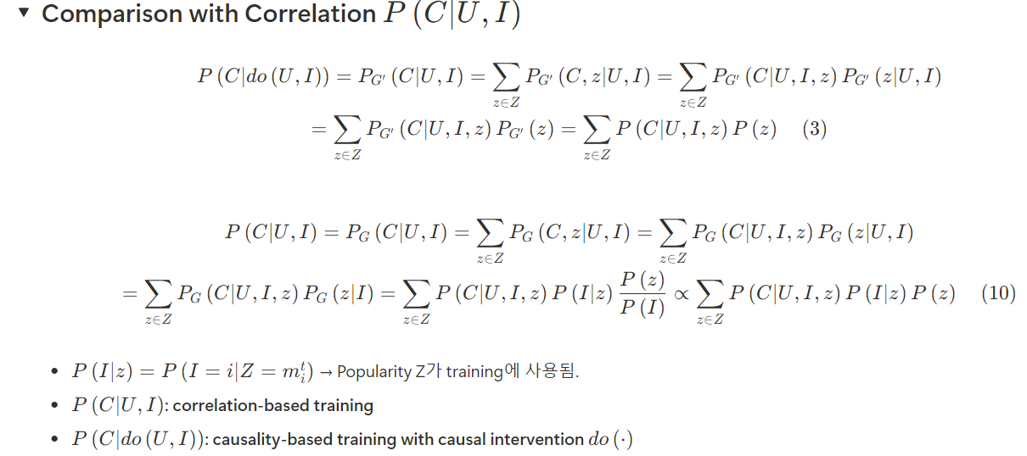

Framework
Comparison with Correlation $P\left(C|U,I\right)$

Slide 17
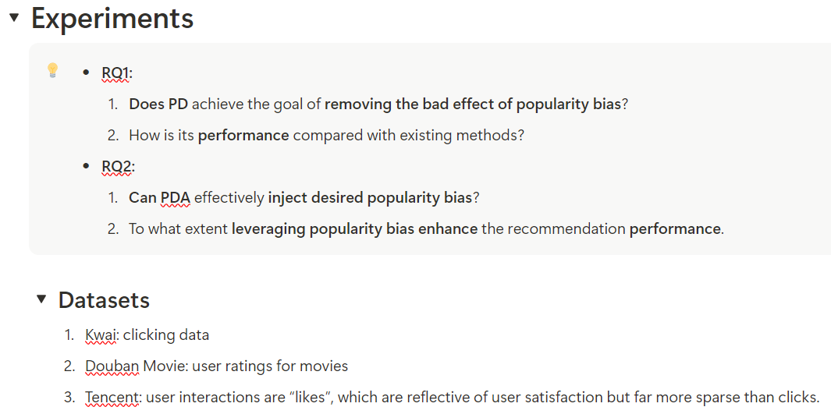
Experiments

Slide 18
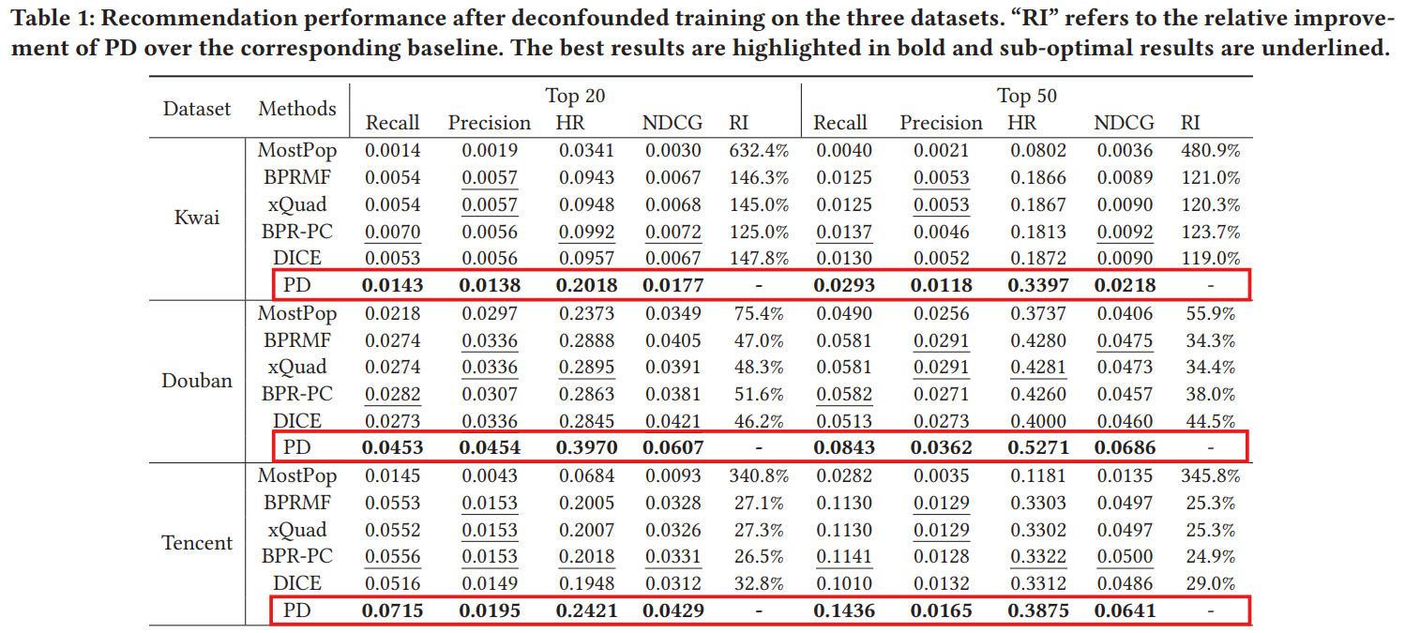
Experiments
Baselines vs PD

Slide 19
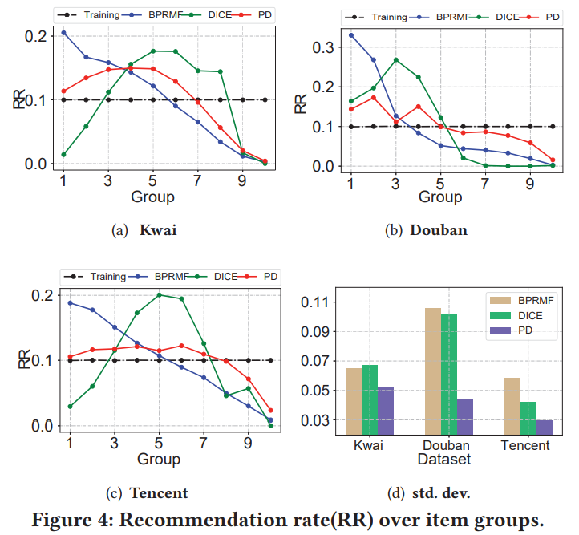
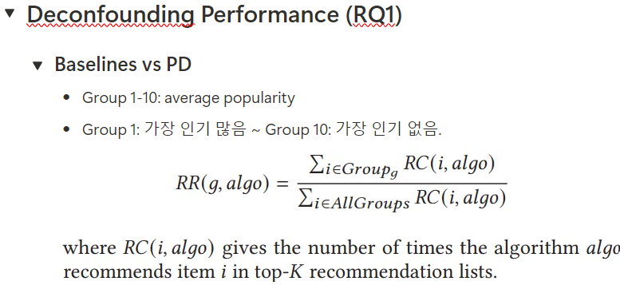
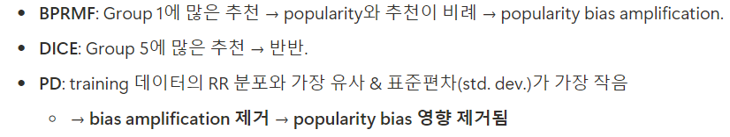
Experiments
Deconfounding Performance (RQ1)

Slide 20
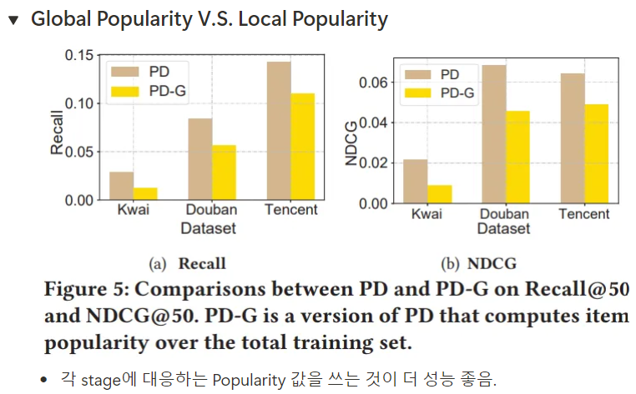
Experiments
Deconfounding Performance (RQ1)

Slide 21
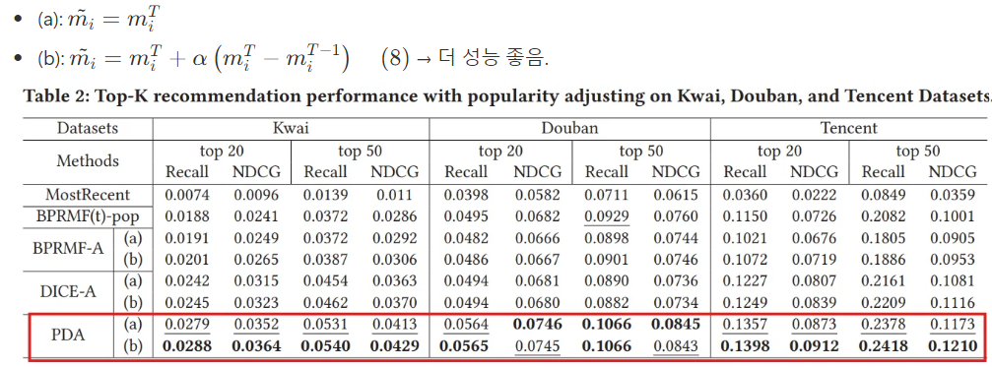
Experiments
Performance of Adjusting Popularity (RQ2)
desired [target] popularity

Slide 22
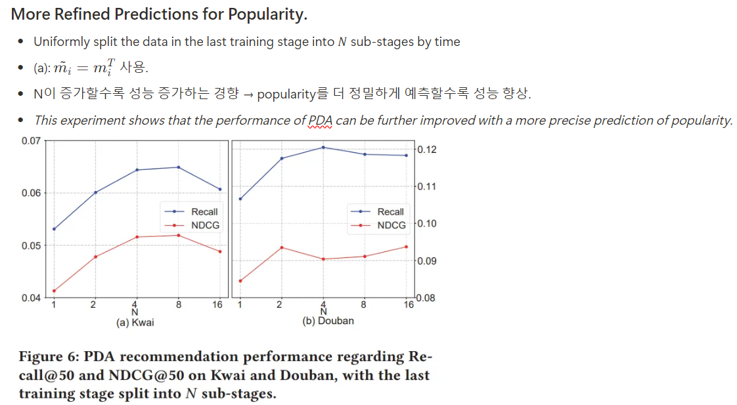
Experiments
Performance of Adjusting Popularity (RQ2)

Slide 23
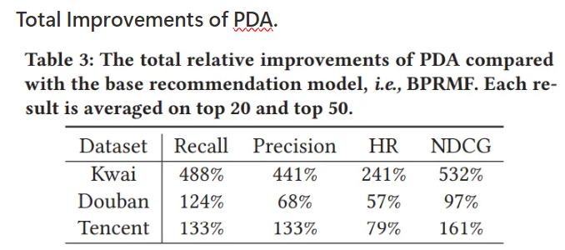
Experiments
Performance of Adjusting Popularity (RQ2)

