Slide 1
ICDE 2023
Influential Recommender System
  Authors: Haoren Zhu, Hao Ge, Xiaodong Gu, Pengfei Zhao, Dik Lun Lee
  Main Affiliation: Hong Kong University of Science and Technology
2025.07.22
서정호

Slide 2
Proposal
Influential Recommender System
Evaluation Metrics
Results

Slide 3
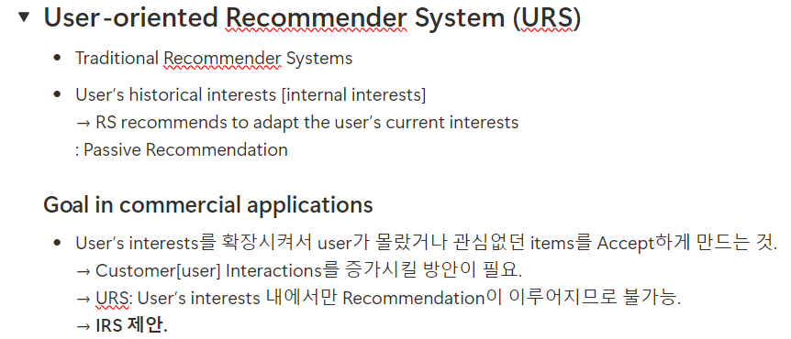
Proposal

Slide 4
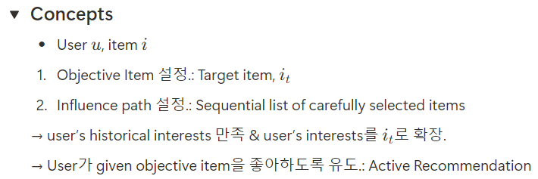
Proposal
Influential Recommender System (IRS)

Slide 5
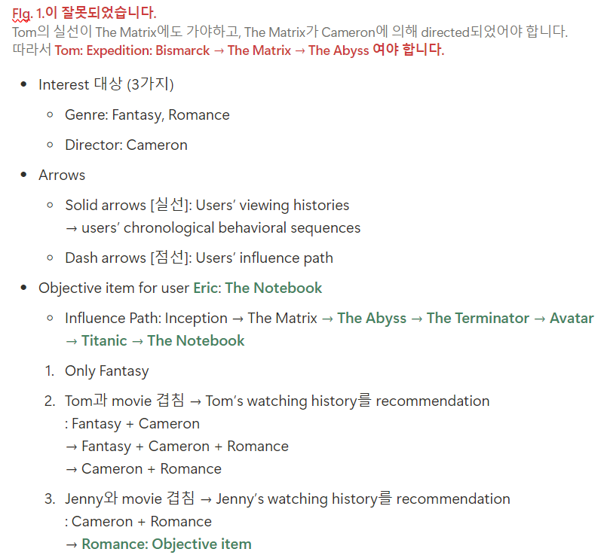
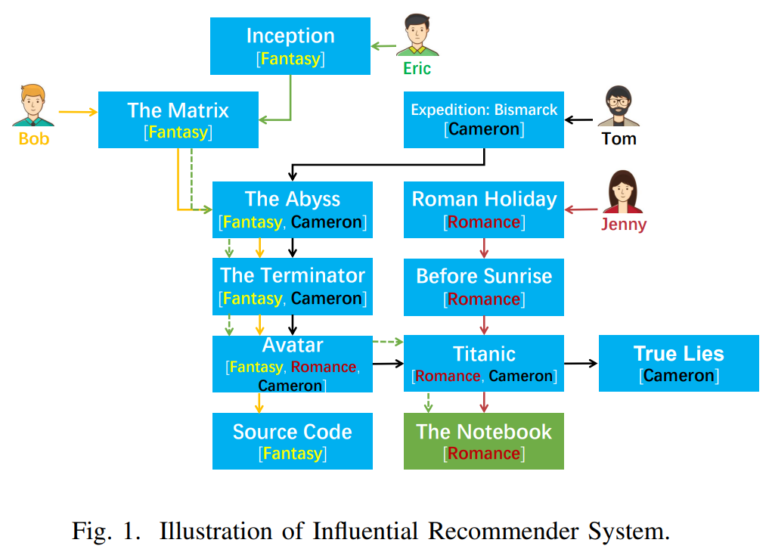
Proposal
Example with watching movies

Slide 6
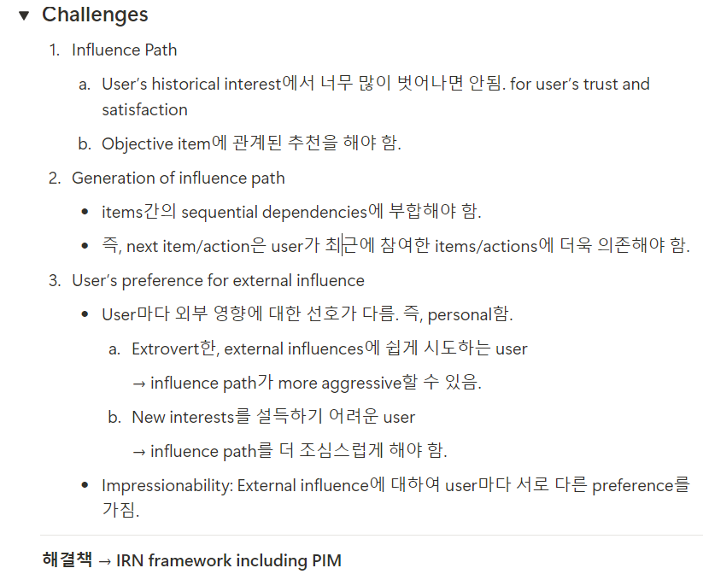
Proposal

Slide 7
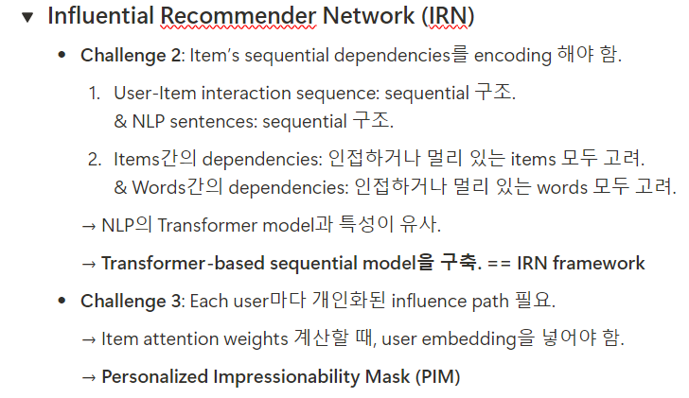
Proposal
Idea

Slide 8
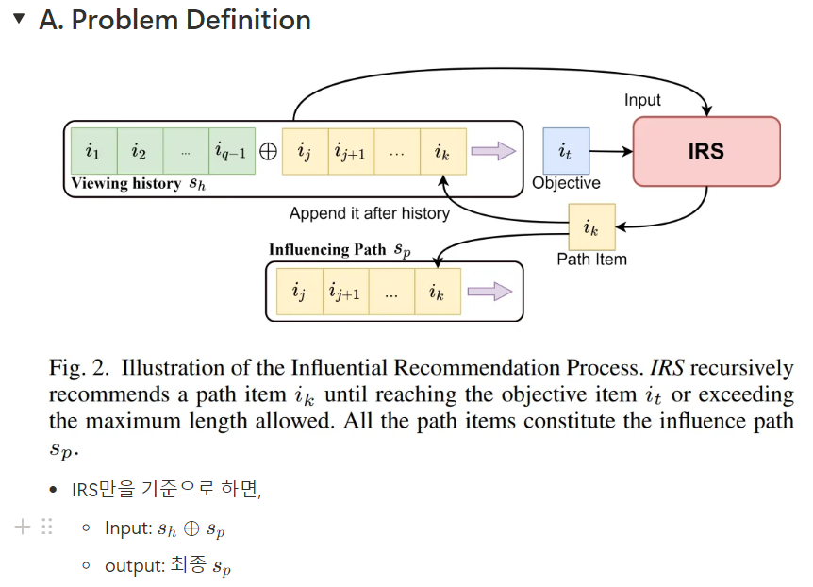
Influential Recommender System

Slide 9
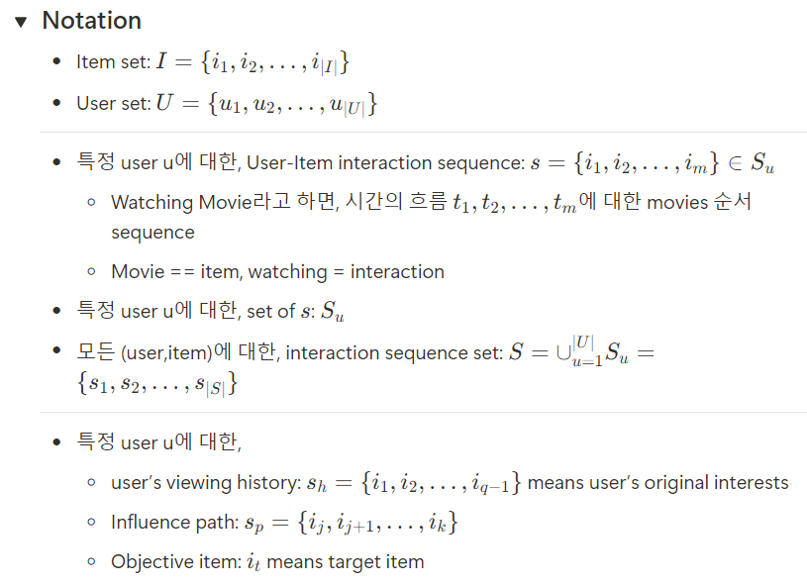
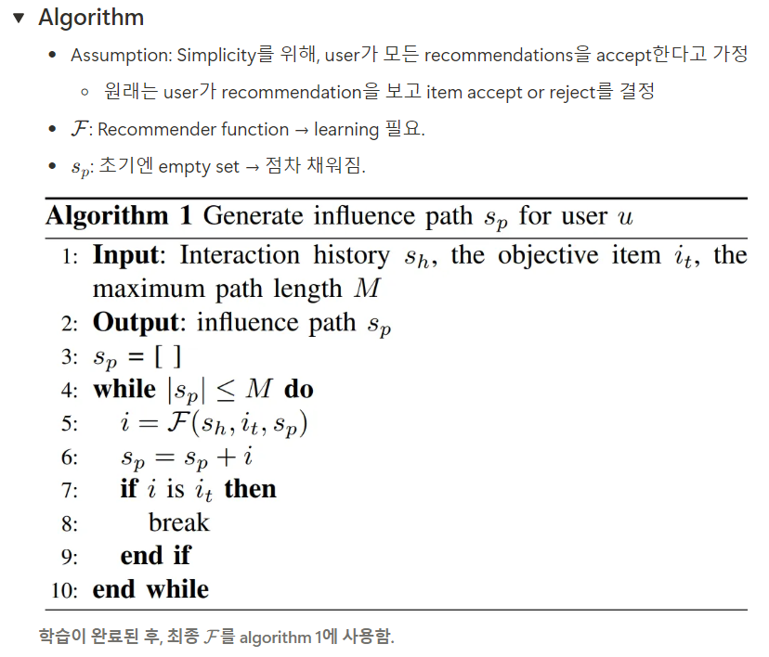
Influential Recommender System

Slide 10
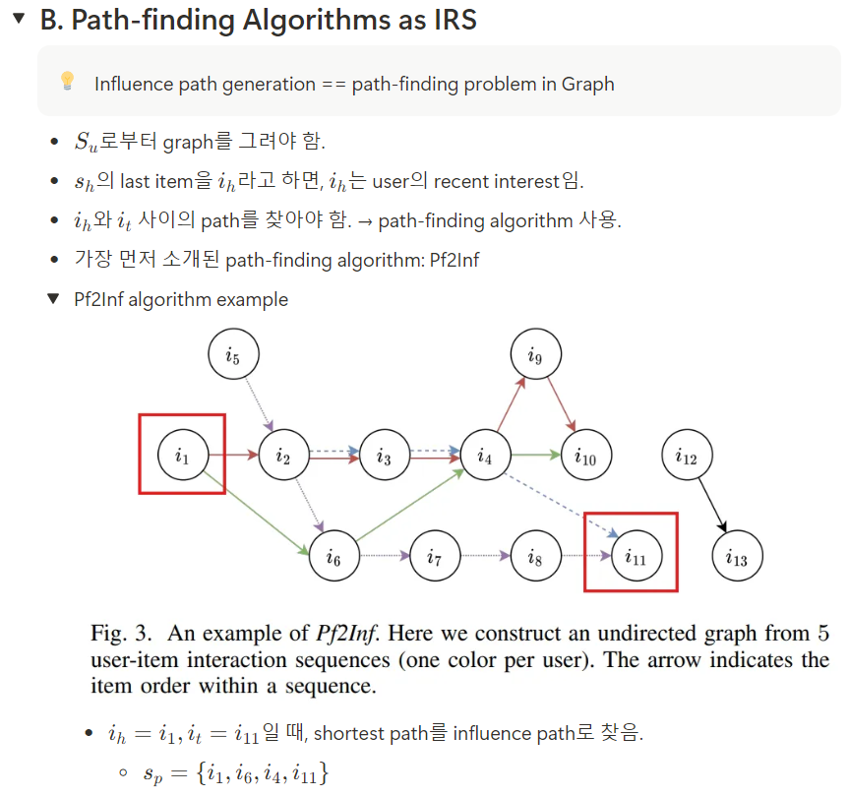
Influential Recommender System
Previous Trials (1)

Slide 11
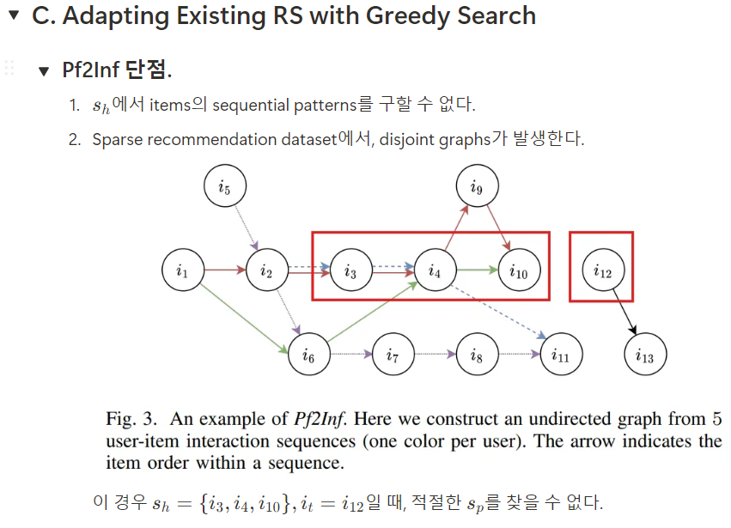
Influential Recommender System
Previous Trials (1)

Slide 12
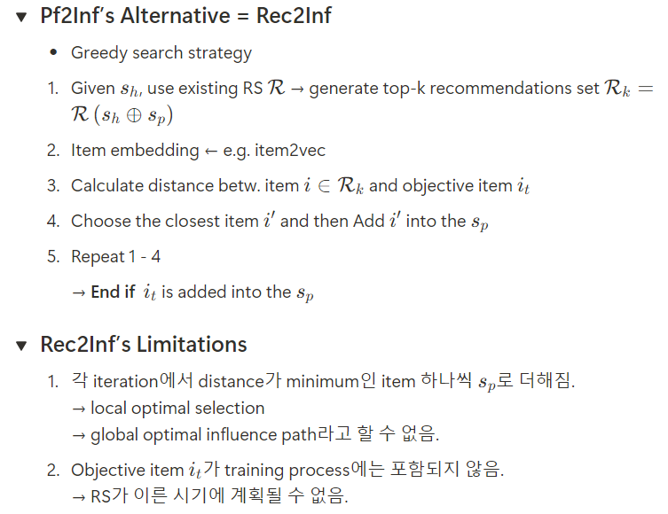
Influential Recommender System
Previous Trials (2)

Slide 13
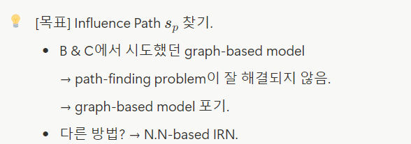
Influential Recommender System

Slide 14
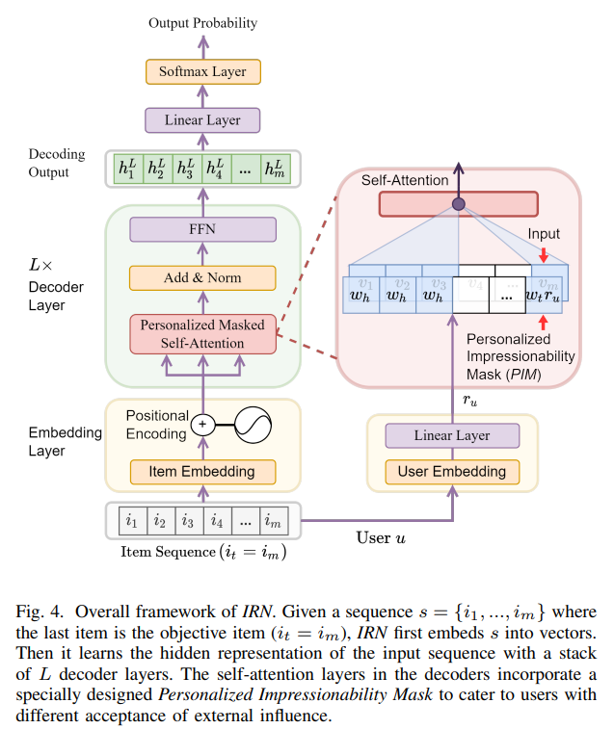
Influential Recommender System
Influential Recommender Network (IRN)
Next item
From the idea,
Transformer structure
PIM for personalized

Slide 15
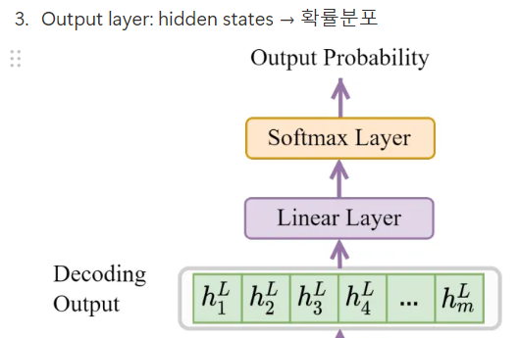
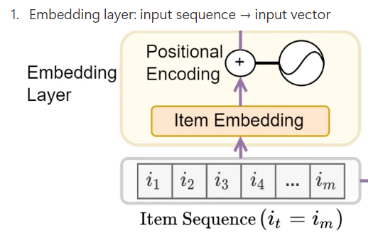
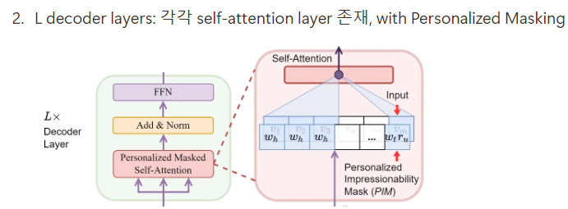
Influential Recommender System
Influential Recommender Network (IRN)

Slide 16
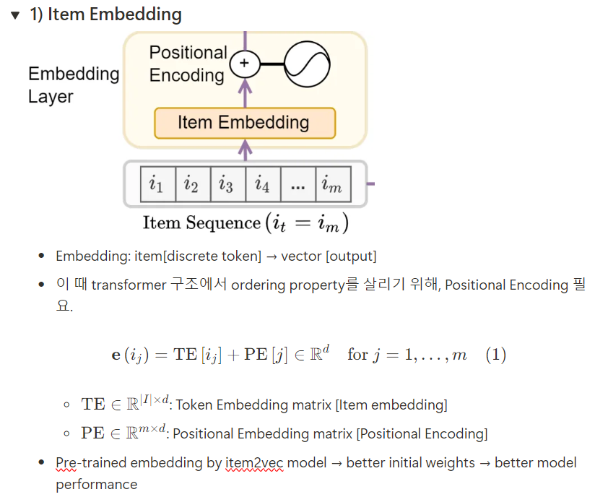
Influential Recommender System
Influential Recommender Network (IRN)

Slide 17
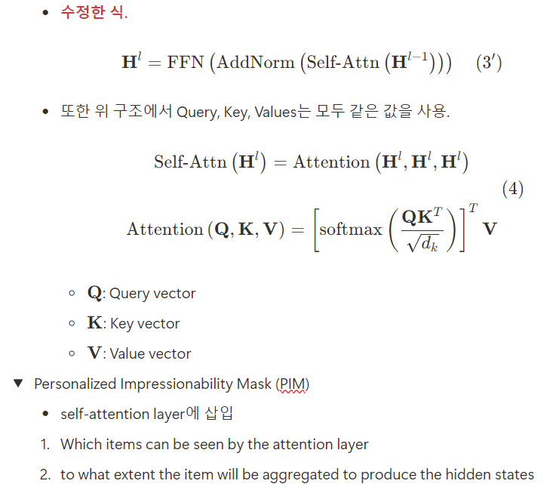
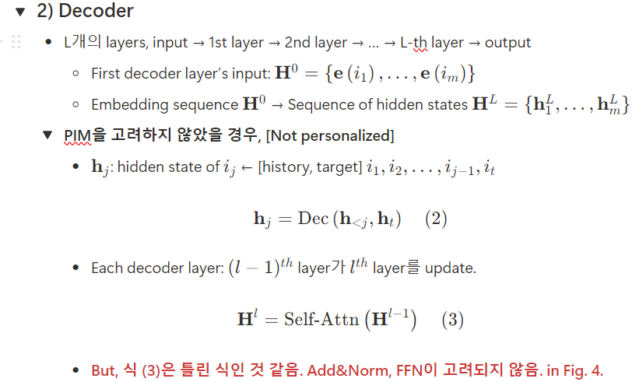
Influential Recommender System
Influential Recommender Network (IRN)

Slide 18
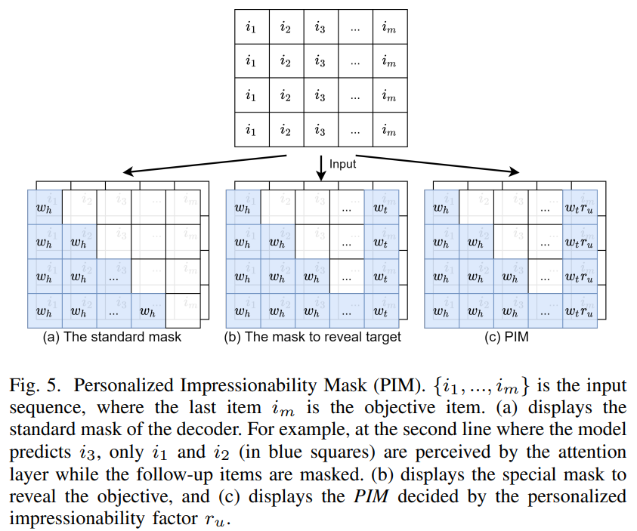
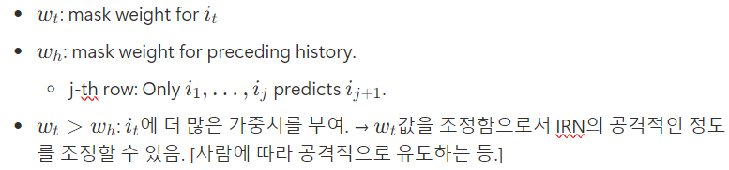
Influential Recommender System
Influential Recommender Network (IRN)

Slide 19
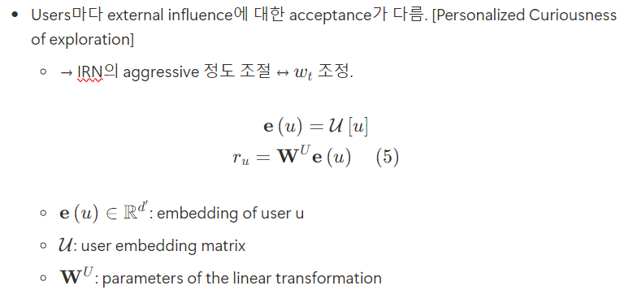
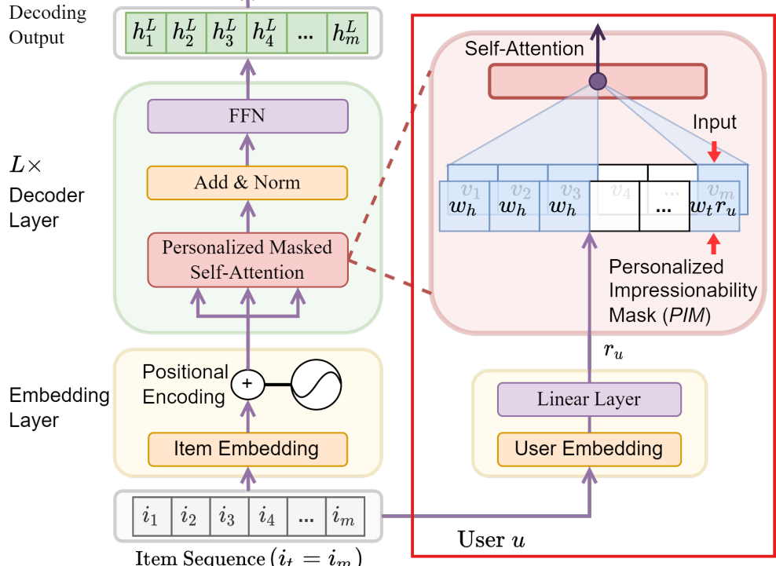
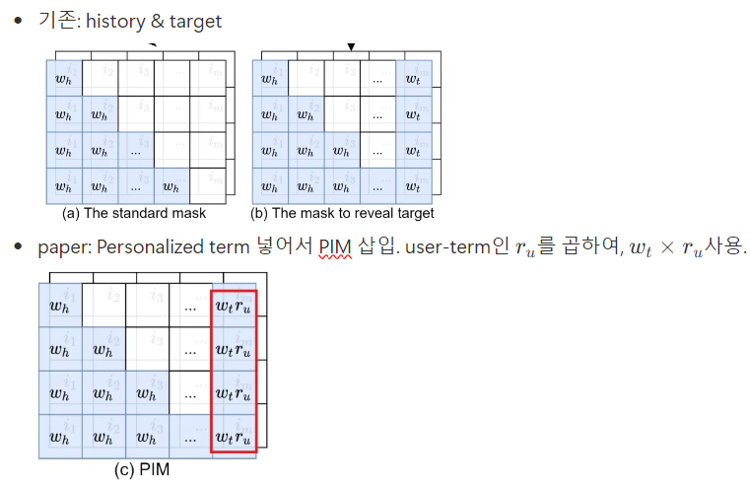
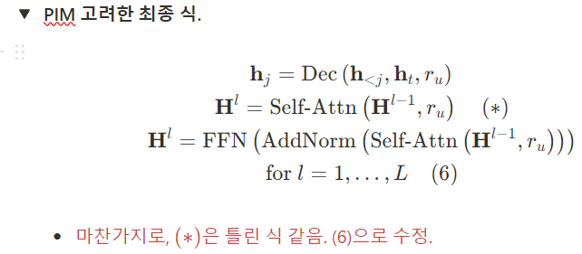
Influential Recommender System
Influential Recommender Network (IRN)

Slide 20
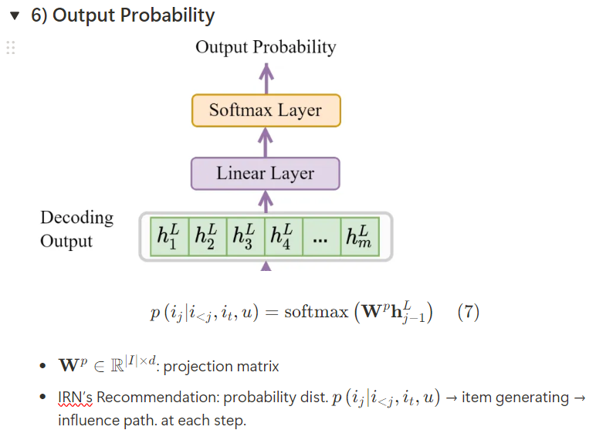
Influential Recommender System
Influential Recommender Network (IRN)
Next item

Slide 21
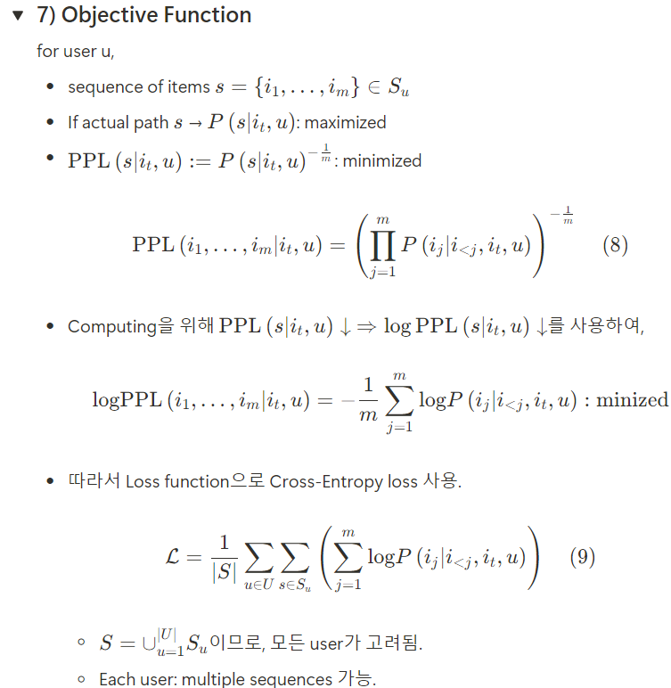
Influential Recommender System
Influential Recommender Network (IRN)
Learning: Loss를 minimize하는 parameter
Inference: below algorithm iteration

Slide 22
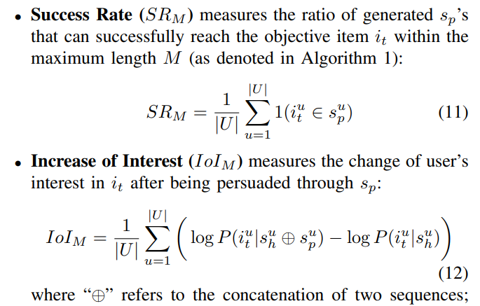
Evaluation Metrics
Evaluation Metrics
Target item이 influence path에 포함된
user의 성공비율
Influence path로 인한 target item의 user interest 변화량. [prob. ~ interest]

Slide 23
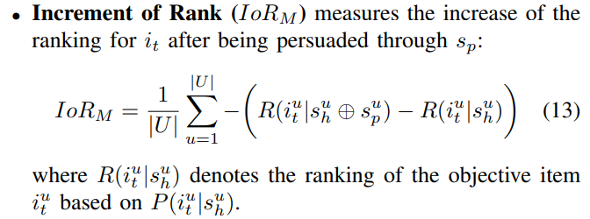
Evaluation Metrics
Evaluation Metrics
Target item이 influence path에 포함될 때,
target item의 ranking 증가량.
R값이 작아진 것 == ranking 증가

Slide 24
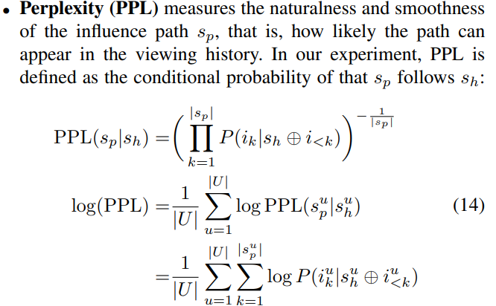
Evaluation Metrics
Evaluation Metrics
Influence path의 smothness

Slide 25
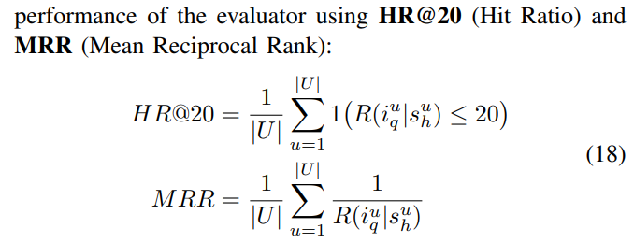
Evaluation Metrics
Evaluation Metrics

Slide 26
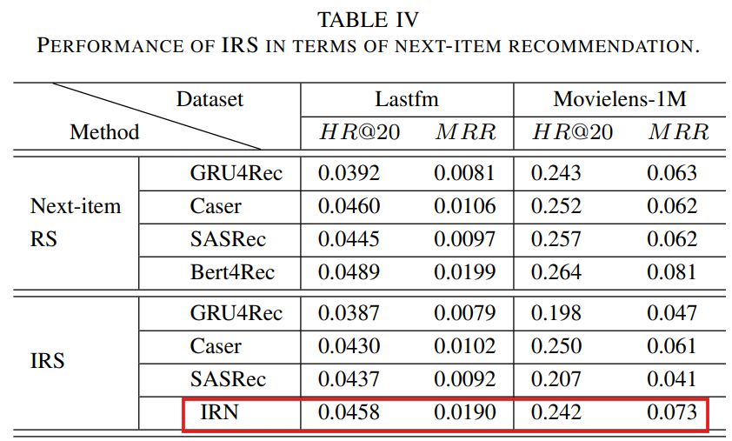
Results

