Slide 1
Optimizing Dynamic Lending Policies for Bank Asset Liquidity Stability and Profit
DGIST CSE402 Reinforcement Learning — Team 04
서정호 (2020-11101)
김재환 (2021-11038)
조후연 (2022-11195)

Slide 2
Background
Importance of liquidity stability of the bank’s assets
Maximizing the bank’s loan-derived profit

Slide 3
Purpose
Goal: Derive an optimal lending policy that simultaneously maximizes long-term cumulative returns and preserves the bank’s liquidity stability.
P1. Asset transition process based on monthly inflow/outflow
P2. [ML1] Borrower features → Total Risk Score (single scalar)
P3. [ML2] Total Risk Score → Loan condition recommendation
P4. [RL] Optimal policy balancing stability and profitability

Slide 4
Research Questions
RQ1. How does the risk-score-to-loan-condition mapping curve dynamically change as the bank’s budget state varies?
RQ2. Is an RL agent based on monthly aggregated data more effective at preventing asset depletion than per-customer-level modeling?

Slide 5
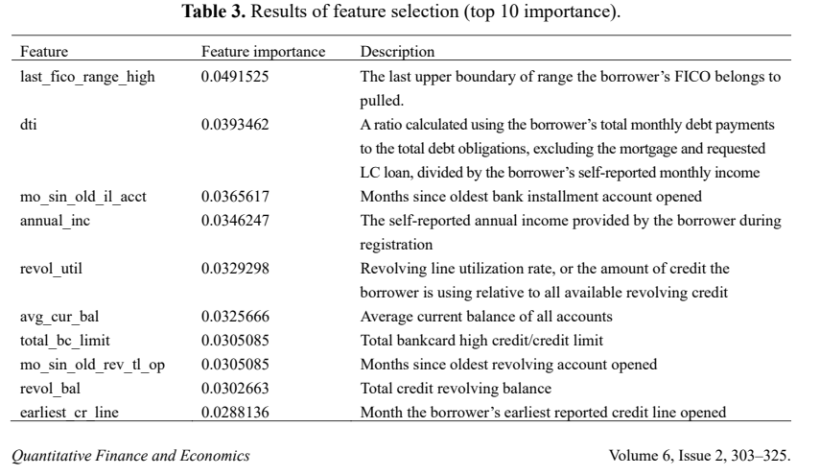
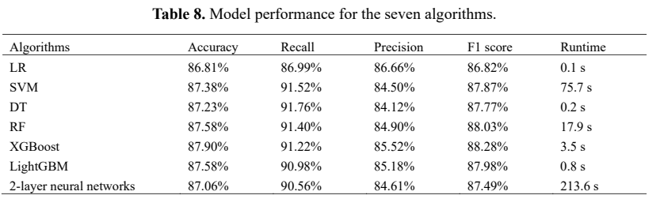
Key Literature Reviews
Chang et al. (2022) — P2P Lending Credit-Scoring Model using Lending Club data

Slide 6
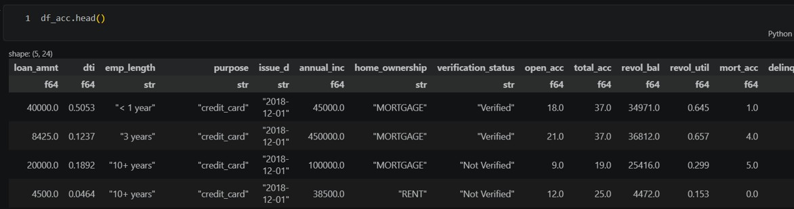
Dataset: Lending Club

Slide 7
ML Part
[ML1] Borrower features $→$ Total Risk Score
[ML2] Total Risk Score $→$ Loan condition recommendation (interest rate, loan period, …)

Slide 8
RL Part — State ($S_{t}$)
$B_{t}$: Bank’s available budget at time $t$ (monthly unit)
$x_{t}^{pool}$: Total Risk Scores $P^{t}$ of applicants arriving in month $t$
$L_{t}$: Total outstanding (un-received) loan repayments after time $t$

Slide 9
RL Part — Action ($A_{t}$)
$$A_{t}:P_{i}→{\text{Loan} \text{Condition}}_{i}$$
Input: Borrower $i$’s Total Risk Score $P_{i}$
Output: Recommended loan condition (e.g., interest rate, credit limit)

Slide 10
RL Part — Transition
$$B_{t+1}=B_{t}+∑{\text{Inflow}}_{t}−∑{\text{Outflow}}_{t}$$
${\text{Inflow}}_{t}$: Total repayments received during month $t$
${\text{Outflow}}_{t}$: Total disbursed as new loans during month $t$

Slide 11
RL Part — Reward ($R_{t}$)
$$R_{t}=\left(B_{t+1}−B_{t}\right)−λ⋅\text{Penalty}\left(B_{t+1}\right)$$
$$\text{Penalty}\left(B_{t+1}\right)=exp\left[−α⋅\left(B_{t+1}−C_{min}\right)\right], α>0$$
$C_{min}$: Minimum budget the bank must maintain
$λ$: Stability–profit tradeoff (hyperparameter)
$α$: Sharpness of penalty curve (hyperparameter)

Slide 12
RL Part — Policy ($π^{∗}$)
$$π^{∗}=arg\max_{π} 𝔼\left[\sum_{t=0}^{T}{γ^{t}}R_{t}\right]$$
$γ∈\left(0,1\right)$: discount factor
Selects actions maximizing expected long-term cumulative return

Slide 13
Future Works
Simulation-based data augmentation (if real data proves insufficient for training)

Slide 14
References
Chang et al. (2022). Machine learning and ANN to construct P2P lending credit-scoring model. Quantitative Finance and Economics, 6(2), 303–325. doi: 10.3934/QFE.2022013
Brini, Tedeschi & Tantari (2023). Reinforcement learning policy recommendation for interbank network stability. Journal of Economic Dynamics and Control, 152, 104678.

