Slide 1

DGIST • CSE402 • Reinforcement Learning
Optimizing Dynamic
Lending Policies
Bank liquidity stability + long-term profit
Team 04
서정호 (2020-11101) 김재환 (2021-11038) 조후연 (2022-11195)

Slide 2


Background & Motivation
Static credit scoring
Bank's Dual Goal
ignores the bank's liquidity state
STABILITY
PROFIT
Approvals affect future bank’s asset flow.
⇄
→ sequential/dynamic decision problem
trade-off
2 / 8

Slide 3




Solution Pipeline
ML scoring → RL policy → decision
INPUT
ML
RL
OUTPUT
▶
▶
▶
User Features
Total Risk Score
Policy
Loan Decision
Agent = Bank. Decisions update each month given current cash on hand.
3 / 8

Slide 4



Purpose & Research Questions
GOAL Maximize long-term profit + preserve liquidity
P1
Asset Transition
P2
ML1 — Total Risk Scoring
Bank’s view: Monthly inflow / outflow process.
Borrower’s Features → Total Risk Score.
P3
ML2 — Recommendation
P4
RL — Optimal Policy
Total Risk Score → Loan Conditions.
Balance stability and profit.
RQ1 Total Risk Score → loan-condition recommendation shifts as budget changes?
RQ2 Monthly RL > per-customer ML at preventing depletion?
4 / 8

Slide 5
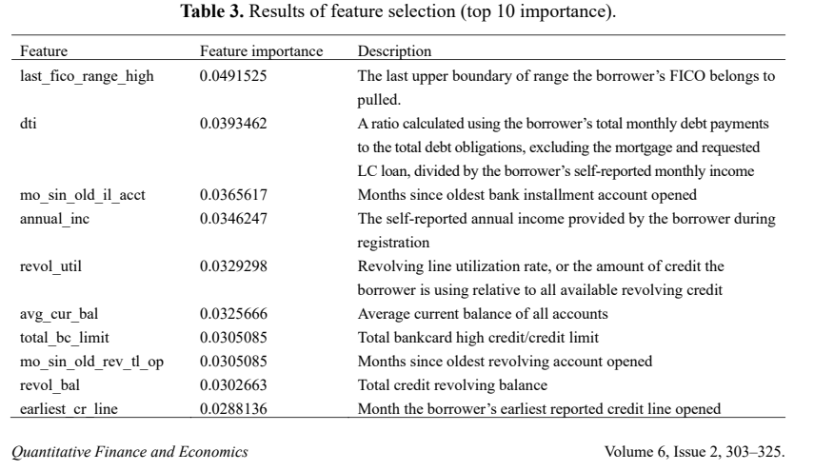
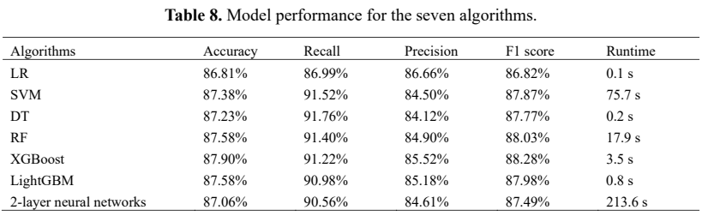
Key Literature Reviews
Chang et al. (2022) — P2P Lending Credit-Scoring Model using Lending Club data
[ML] Which Features are better?
[ML] Which models are better?

Slide 6
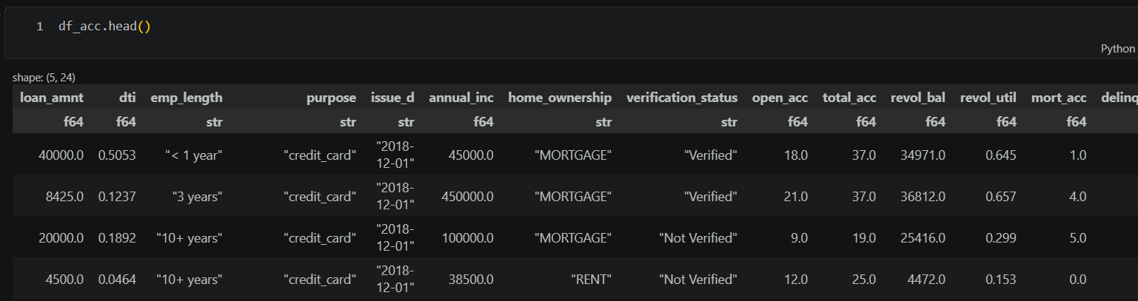
Dataset — Lending Club
Real P2P loan records, aggregated monthly
df_acc.head() —features per loan record
1
Group by issue_d
2
State features
3
Inflow / Outflow
monthly buckets
score dist. + balance
repayments – disbursed
5 / 8

Slide 7


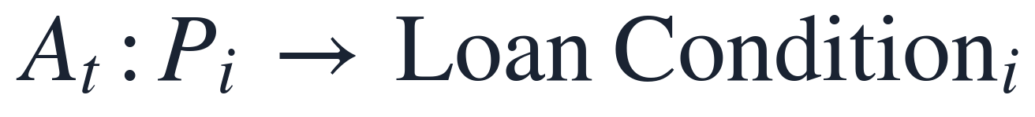
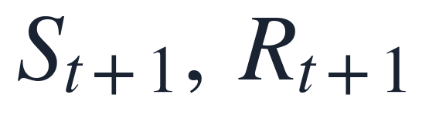
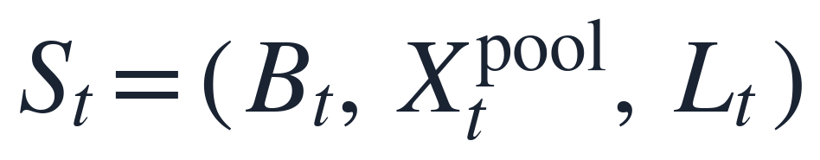
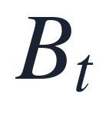

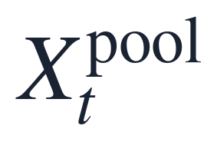


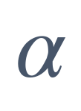

Sequential Decision Framework
Agent ⇄ Environment, every month
ACTION
AGENT
ENVIRONMENT
Bank
Market
STATE + REWARD
policy π( A | S )
borrowers, defaults
STATE
REWARD
TRANSITION
: budget
model-free
stochastic defaults
: min budget for bank stability
: borrowers with Total Risk Score
: Budget Penalty term
: Total unreceived repayments after time $t$
: sharpness
6 / 8

Slide 8

Methodology & Timeline
ML PART
RL PART
Per-borrower loan scoring
Bank-level policy
Borrowers features → total risk score → loan conditions
Find optimal policy for both of them: Asset Stability and Profit.
PROJECT TIMELINE
WEEK 1
WEEK 2
WEEK 3
WEEK 4
Data + ML
Environment
RL Training
Analysis
Aggregate; train loan scoring.
Train and tune policy.
Mapping curves; report.
7 / 8

Slide 9


Optimal Policy
Future Work
Synthetic-data simulation when real data is insufficient.
TAKE-HOME Lending as a sequential decision: ML scoring + RL policy, balancing liquidity and profit.
Thank you — Questions?

Slide 10
References
Chang et al. (2022). Machine learning and ANN to construct P2P lending credit-scoring model. Quantitative Finance and Economics, 6(2), 303–325. doi: 10.3934/QFE.2022013
Brini, Tedeschi & Tantari (2023). Reinforcement learning policy recommendation for interbank network stability. Journal of Economic Dynamics and Control, 152, 104678.

