Slide 1

DGIST · CSE402 · REINFORCEMENT LEARNING
Reinforcement Learning for
Bank Capital Allocation
A stress-aware lending simulator and a segment-attention PPO policy that stays safe and profitable under stress.
Team 04
Seo Jeong-ho (2020-11101)
Kim Jae-hwan (2021-11038)
Cho Hu-yeon (2022-11195)
Instructor
Prof. Lee, Doo Seok
June 02, 2026
Notes:
- 1~3 page: 서정호
- 4~7 page: 조후연
- 8~13 page: 김재환
발표 예정.

Slide 2



PROJECT OVERVIEW
01
The problem every lender faces each month
Given limited cash and binding capital & liquidity constraints, how should new capital be allocated across borrower segments of differing risk, size, and maturity?
The temptation
The catastrophe
Higher-risk borrowers carry higher rates and larger short-term margins — pulling capital toward risky, high-yield segments.
Concentration is exactly what destroys a bank under stress: clustered defaults erode capital, and a cash drain forces fire-sale liquidation — a non-linear collapse.
Not a one-shot optimization. Capital deployed today stays on the loan book for months — shaping future liquidity, capital ratios, and risk. This is a sequential decision under uncertainty, which is exactly what reinforcement learning is built for.
RL × Capital Allocation
2 / 14

Slide 3



APPROACH
01
Two design principles that frame the work
ML predicts risk · RL allocates capital
1
A supervised model estimates borrower default risk; that signal calibrates the segment economics. The RL policy then makes the monthly bank-level allocation. RL never prices individual loans.
Calibration, not counterfactual evaluation
2
Treating historical logs as action–reward trajectories suffers severe distribution shift. We use Lending Club data only to calibrate the simulator — never to directly evaluate the policy.
What we deliver — a stress-aware lending simulator, a segment-attention PPO policy with a primal-dual liquidation constraint, benchmarked against a full baseline suite under normal and stressed conditions.
RL × Capital Allocation
3 / 14

Slide 4
METHODOLOGY · MDP
03
Formalizing the monthly allocation as an MDP
STATE — four concatenated blocks
FINITE-HORIZON MDP
16
Global risk state
36
month decision horizon
cash & capital ratios, LCR, CAR, RWA, regime multipliers, stress intensity, mean fatigue
60
month terminal run-off
30
Per-segment demand
406
state dimensions
new applications across 5 risk × 3 amount × 2 term = 30 segments
31
action dimensions
180
Segment × maturity exposure
outstanding balance remaining to maturity (30 × 6)
OBJECTIVE
max E[ profit / initial cash ]
180
Segment calibration params
s.t. liquidation rate ≤ 3%
EPR, risk-adjusted EPR, stress sensitivity, duration pressure, readiness, fatigue (6 × 30)
RL × Capital Allocation
4 / 14

Slide 5





METHODOLOGY · ENVIRONMENT
03
An environment built to defeat myopia
TWO FAILURE MODES — liquidation on breach
Capital-adequacy liquidation
Liquidity-shortfall liquidation
CAR = capital / RWA falls below 8% (BIS-style floor).
Cash falls below required liquidity — a 60% haircut on current assets.
DYNAMICS THAT PUNISH SHORT-SIGHTED CONCENTRATION
AR(1) macro regime (ρ = 0.85)
Stochastic stress shocks
Demand & default risk move with a persistent cycle; downturns linger. High-risk segments react hardest.
Liquidity drain, funding-cost spike, capital hit, and — most dangerously — super-linear default clustering.
Post-crisis recovery
Segment fatigue
Demand concentrates in low-risk, positive-EPR segments — upside only a surviving bank can capture.
Concentrating on one segment raises its future default risk and lowers margin — forcing rotation.
RL × Capital Allocation
5 / 14

Slide 6





METHODOLOGY · ALGORITHM
03
A Transformer policy trained by PPO
30 segments are treated as tokens and encoded by a Transformer (4 heads · 3 layers · hidden 384). The Transformer makes each decision; PPO trains its weights from reward.
POLICY ARCHITECTURE
PPO LEARNING LOOP
30 segment tokens
Collect rollouts of the policy in the simulator
1
Transformer encoder
Estimate advantages via GAE — critic V(s) vs realized reward
2
3 shared heads
Clipped surrogate step raises better-than-expected actions
3
segment_actor — per-segment score
γ 0.99 · λ 0.95 · clip 0.2 · lr 1e-5 · 4096 ep.
deploy_actor — global deploy scalar
Primal-dual constraint. A learned dual λ tracks constraint violation; grid search set λ=1, training converged to λ≈1.26.
critic V(s) — advantage only
RL × Capital Allocation
6 / 14

Slide 7
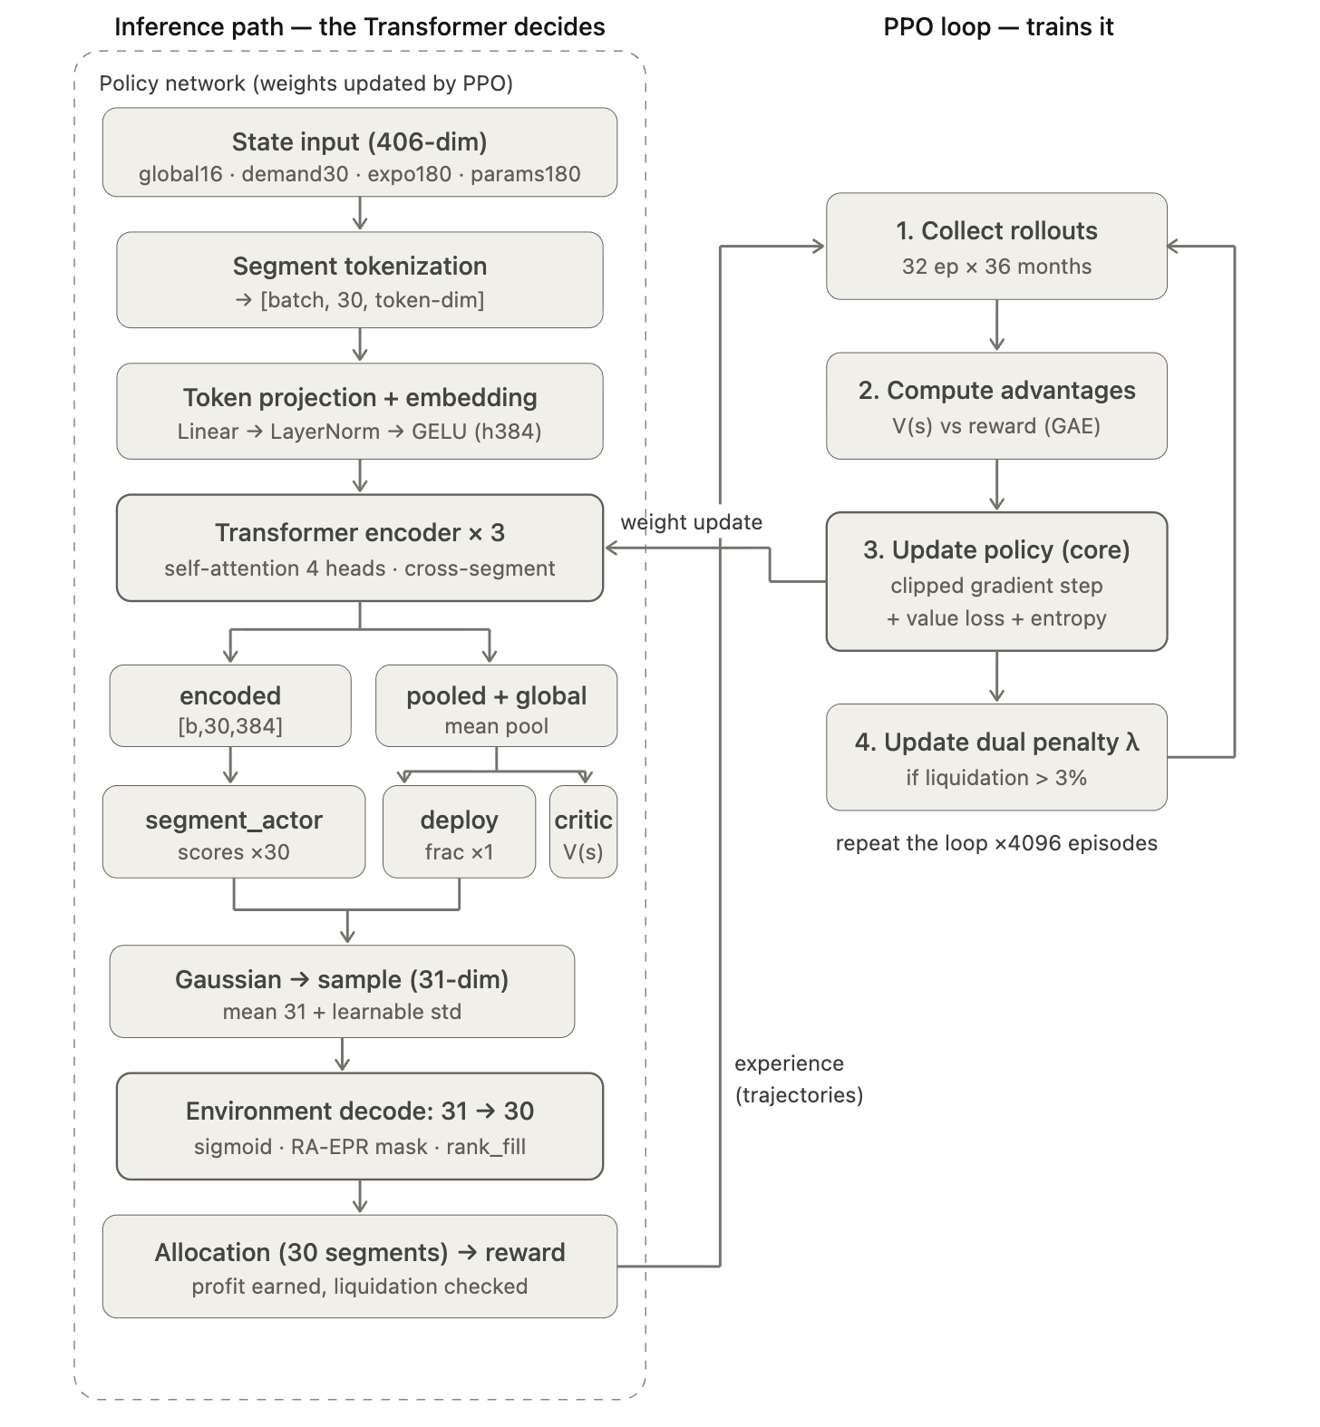
METHODOLOGY · ALGORITHM
03
A Transformer policy trained by PPO
RL × Capital Allocation
7/ 14

Slide 8

METHODOLOGY · DATA & BASELINES
03
Leakage-aware calibration · honest baselines
Baseline suite
Data & calibration
Leakage-aware risk model
Baseline | Behavior
reject_all | Zero capital every month — lower bound; idle-cash drag
fixed_conservative | Lowest two risk buckets · 55% deployment
fixed_aggressive | Broader buckets · 90% deployment, lower-risk weighted
budget_aware_heuristic | Adjusts risk range & deploy fraction by liquidity ratio
greedy / one-step LP | Greedy by expected profit rate until safe capacity hit
Time-ordered logistic regression. Post-decision variables (rate, installment, grade) excluded — using them would leak the answer.
Chronological split
Train 2007-06 → 2015-06 · Val → 2017-10 · Test → 2018-12. Never evaluate the past with future data.
Segment-level calibration
Default probabilities from empirical bad rates, not a scaling of the mean score.
Validation AUC 0.695 · Test AUC 0.677 — honest, by design
RL × Capital Allocation
8 / 14
Notes:
김재환님~

Slide 9
EXECUTION · EXPLORATION
04
Why a naive PPO is not enough
Before the final design, we compared policy methodologies, actor architectures, and risk scorers (800 episodes each, low-stress conditions). At this stage, allocation scoring used raw EPR (expected-profit rate).
CUMULATIVE PROFIT (M$) — RL / ML variants vs baselines · scoring criterion: EPR
BC (MLP) = 3.23M. Best of the learned policies — but it just imitates the heuristic, still below it.
PPO GRU = 0.98M. Captured temporal structure, yet tuning alone never overturned the heuristic edge.
BC (XGB) collapsed
−10.13M with 44 liquidations (5.5%) — XGBoost decomposes the 31-dimensional continuous output into 31 isolated regression problems
RL / ML policy
Baseline
Liquidated (BC-XGB)
RL × Capital Allocation
9 / 14

Slide 10
EXECUTION · FINAL MODEL
04
Training converges: profit up, liquidations down
4,096 episodes, averaged into 8 blocks. Profit rises ~27%, in-training liquidation falls from 8.6% toward 2–4%, and the dual λ climbs as the constraint tightens. Scoring criterion now uses risk-adjusted EPR (RA-EPR), not raw EPR — the upgrade from the exploration phase.
MEAN CUMULATIVE PROFIT (M$) PER BLOCK
+27%
mean cumulative profit
(≈8.46M → 10.76M)
8.6% → 2–4%
in-training
liquidation rate
IN-TRAINING LIQUIDATION RATE (%) PER BLOCK
1.05 → 1.25
dual variable λ
rising monotonically
Individual episodes range −8M to +35M — the environment itself is volatile; the point is block averages rise while liquidations fall.
RL × Capital Allocation
10 / 14

Slide 11

RESULTS · LOW-STRESS CONDITIONS
05
Even under low stress, myopia liquidates
Low-stress test set, 1,000 episodes. PPO leads on profit — but the more important reading is failure behavior.
Policy (low-stress test) | Cumulative profit | Liquidation
transformer + ppo_rl | 12,061,410 | 0.6%
budget_aware_heuristic | 8,279,435 | 0.0%
fixed_conservative | 7,604,152 | 0.0%
fixed_aggressive | 7,316,093 | 0.0%
greedy / one-step LP | 2,821,473 | 21.8%
reject_all | −3,577,121 | 0.0%
21.8%
of greedy / one-step-LP episodes liquidate — even in a low-stress market
Why they fail
The textbook single-period optimizers ignore the liquidity and capital consequences of concentration — so they collapse on their own.
RL × Capital Allocation
11 / 14

Slide 12
RESULTS · STRESS
05
PPO wins in all 8 environments
Across validation, test, low-stress, and five explicit stress scenarios, PPO beats the best baseline by a positive margin every time — holding liquidation between 0.0% and 1.7%.
PPO MARGIN OVER BEST BASELINE (M$)
+4.44M
High-risk demand ×1.5 — PPO's largest margin. It best resists the volume temptation that destroys myopic strategies.
+355
Default ×2 — smallest margin. When defaults double, barely lending is near-optimal, so every sensible policy converges; PPO still edges ahead at 0% liquidation.
RL × Capital Allocation
12 / 14

Slide 13

RESULTS · CORE EVIDENCE
05
The non-trivial solution: profit and safety
On the stress-inclusive test set, the contrast is stark. PPO's 5% CVaR is ~5× better than the myopic optimizers', whose profit nearly vanishes.
Policy (test) | Cum. profit | Liq. | 5% CVaR
transformer + ppo_rl | 10,039,693 | 0.1% | −6,204,228
budget_aware_heuristic | 6,494,083 | 0.0% | −6,176,771
fixed_conservative | 5,813,232 | 0.0% | −6,269,750
fixed_aggressive | 5,464,896 | 0.0% | −7,207,517
greedy / one-step LP | 433,248 | 22.5% | −30,432,738
reject_all | −3,577,121 | 0.0% | −3,577,121
The middle path
PPO's default loss ($8.99M) exceeds the conservative policies' ($6.11M) — it did not simply avoid risk.
It deployed more capital, more aggressively, while managing risk precisely enough to keep liquidation near zero.
High profit and safety at the same time — between the safe-but-low and the high-yield-but-catastrophic corners.
RL × Capital Allocation
13 / 14

Slide 14



CONCLUSION
Why reinforcement learning belongs here
A bank is obliged to be conservative — it must preserve both safety and profitability even under stress, not only in low-stress markets.
In low-stress markets
Under stress
The structural edge
A strong heuristic — or a BC model imitating it — is competitive, and a naive PPO is not obviously better.
The upgraded PPO + LP framework is the only approach that sustains profit and avoids the liquidation catastrophe.
RL's ability to internalize future, non-linear risk wins precisely in the stress-aware regime of responsible banking.
Limitations. Results hold within a calibrated simulator, not the real market; risk-scorer AUC (≈0.68) is modest by design; some environment parameters are reasoned assumptions. Future work: data-identify parameters, optimize CVaR directly, extend to multi-institution settings.

