Slide 1
Memory Hierarchy

Slide 2
Memory Hierarchy
Multiple levels of memory with different speeds and sizes
memory: any medium that can store data (e.g., DRAM, disk …)
faster, smaller
registers
0.5~2.5 ns
CPU Cache
L1/L2/L3
SRAM
$500~$1000 per GB
50~70 ns
(Main memory)
DRAM
$10~$20 per GB
(Secondary Storage)
Flash Drive (SSD)
Magnetic disk
$0.75~$1.0 per GB
cheaper
5-50 µs
5-20 ms
$0.05~$0.10 per GB
(Archival Storage)
Tape drive

Slide 3
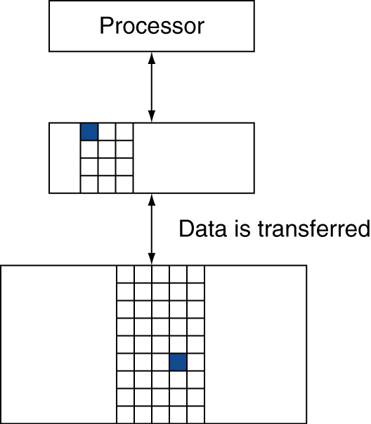
Data in Memory Hierarchy
Block (or line)
Minimum unit of information
Hit
When data is present in the upper level
Hit rate (hit ratio)
Fraction of memory access that is ‘hit’
Miss, miss rate
Miss penalty
Time to copy a block from the lower level
In this chapter, cache lies between CPU and the main memory
Cache can exist in many levels

Slide 4
Cache Memory
Cache memory
Faster but smaller memory that holds data temporarily to improve the access time of a slower memory
Underlying principle of Cache
Principle of Locality
Programs tend to access the same data in a near future
Temporal locality
If data is accessed, it is likely that it will be access again soon
Spatial locality
If data is accessed, it is likely that near-by data will also be accessed soon
Cache memory is smaller than the lower level memory
Select only a small set of data to store in the cache

Slide 5
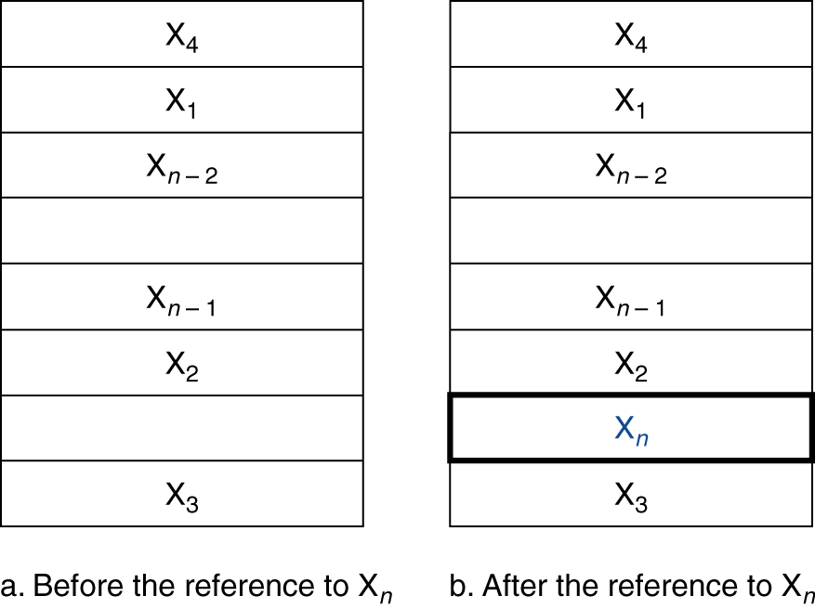
Cache Access
Assume that:
CPU requests one word at a time
Block size is one word
Memory access: X₁, …, X_{n–1}, X_{n}
Cache placement issue

Slide 6
Direct-mapped Cache
In direct-mapped cache:
Cache location is determined as a function of the memory address
A block (word) can go into only one place in the cache
fully associative cache
Cache slot = (word address) mod (# of cache blocks)
# of cache blocks are in power of 2
Blocks that go into location 001
00001
01001
10001
11001
000
001
010
011
100
101
110
111
00001
00101
01001
01101
10001
10101
11001
11101

Slide 7
Direct-mapped Cache
Multiple block maps to one location in the cache
How do we know which address the block came from?
Block in 001 comes from 00001, 01001, 10001, 11001
Tags
High-order bits of the address – 00001, 01001, 10001, 11001
value
tag
valid
000
0
001
010101…110111
??
1
010
0
011
0
100
0
101
000001…110001
??
1
110
0
111
0
010101…110111
000001…110001
00001
00101
01001
01101
10001
10101
11001
11101

Slide 8
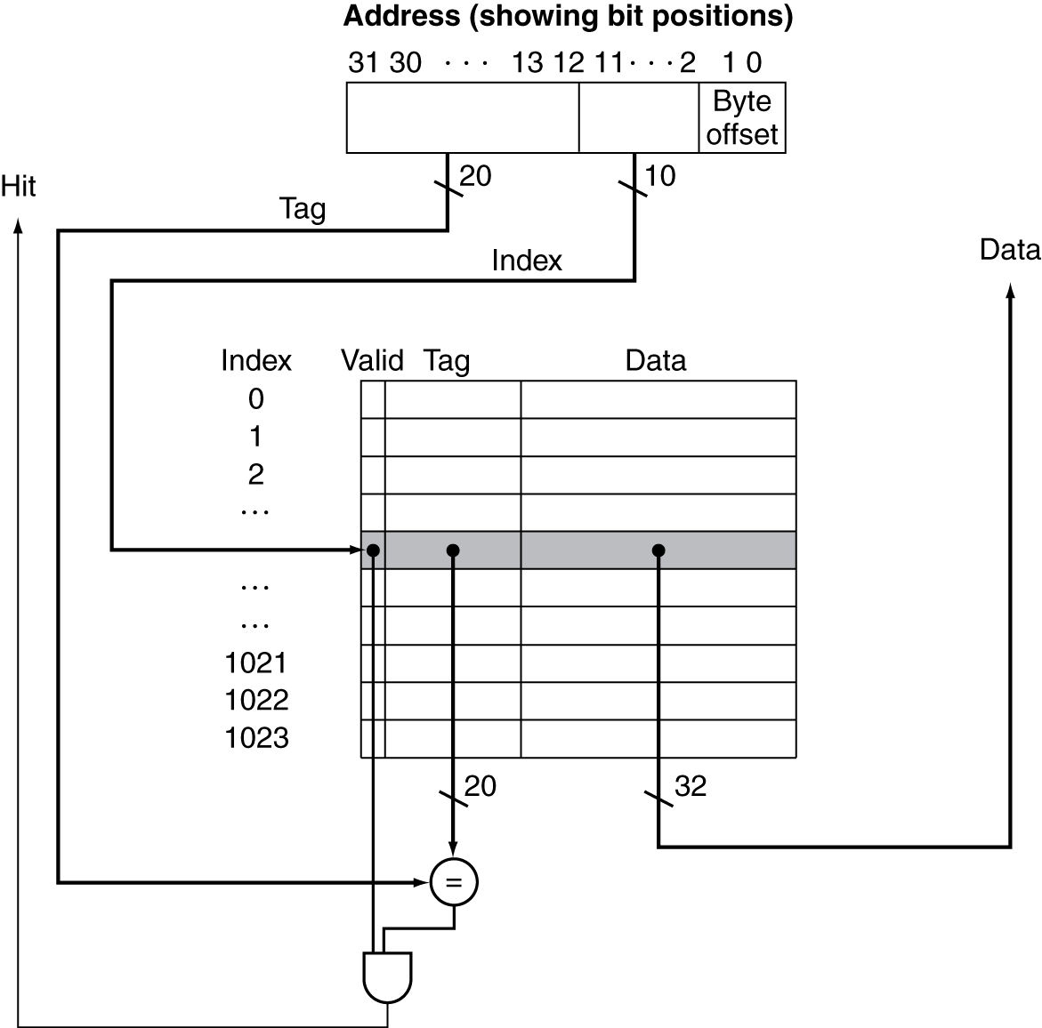
Address Subdivision
Address is divided into tag part and index part
tag part: 20 bits
index part: 10 bits
Total number of bits in the cache
valid bit: 1
tag bits: 32-(n + m + 2)
data bits: 2^{m}x32
n: number of index bits
m: 2^{m} is the # of words
$$Σ$$
$$2^{n}×$$
4KB cache

Slide 9
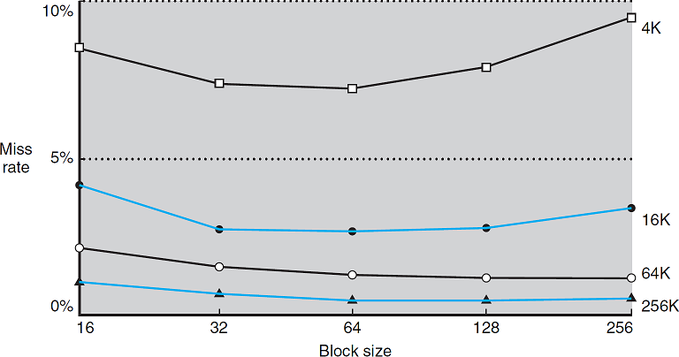
Block Size and Miss Rate
Larger block size
Miss rate:
increase/decrease?
* What about larger cache size?
Miss penalty
Time to load load a block from MM(Main memory) to Cache
Set-up time + transfer time
Reducing the miss penalty (by hiding the transfer time)
“early-restart” → more effective for instruction than data
“critical word first”

Slide 10
Cache Miss Handling in Processor
Separate cache for instruction and data stream
Instruction and data cache at L1
Cache miss on instruction
Send PC-4 to memory unit
Instruct MM (main memory) to perform read
Wait until data is ready
Write data to cache entry, fill up the tag and valid fields
Re-send instruction address to the memory – hit!
(advanced) Improving the cache performance
Out-of-order execution: non-blocking cache
Victim cache – small (fully associative) cache holding the replace blocks
Processors | MIPS32 74K Atheros AR9344 | Intel i7-4770 | Apple A10 | ARM Cortex-A57
Instruction cache | 32KB, 32B line, 4-way | 32KB, 64B line, 8-way | 64KB, 64B line, 4-way | 48KB, 64B line, 3-way
Data cache | 32KB, 32B line, 4-way | 32KB, 64B line, 8-way | 64KB, 64B line, 4-way | 48KB, 64B line, 2-way

Slide 11
Write Handling in Cache
Write-through cache
Write operation completes after updating the main memory and the cache
Data consistency maintained
Write-back cache
Write operation completes after only updating the cache
Main memory is synced only when a block is replaced from cache
CPU
CPU
sw instruction
sw instruction
Cache
Cache
X’
X’
Main Memory
Main Memory
X’
X

Slide 12
Cache Performance
CPU time
Normal execution: includes cache hit time
Memory stall cycle: cache miss penalty
$$CPUtime=total clock cycles ×clock cycle time$$
$=(CPU cycles+Memory stall cycles)$ $×clock cycle time$
Assume the read and write miss penalties are the same
Write-through: complication from write buffer
Write-back: potential stall from sync when a block is replaced
$$Memory stall cycles=Read stall cycles+Write stall cycles$$
$$=inst count×\frac{memory access}{inst count}×miss rate×miss penalty$$

Slide 13
Cache Performance
Instruction cache miss rate: 2%
Data cache miss rate: 4%
Ideal case CPI: 2
Question: How much faster is the processor with perfect cache?
Number of instructions: N
Instruction miss and data miss are separate
total penalty cycles = inst miss cycles + data miss cycles
inst miss cycles = N x 2% x 100 = 2N
data miss cycles = N x 36% x 4% x 100 = 1.44N
Total cycles = 2N + 2N + 1.44N = 5.44N
Total cycles for perfect cache = 2N
Performance is better by 5.44N/2N = 2.72
Miss penalty: 100 cycles
Load and store: 36% of instructions

Slide 14
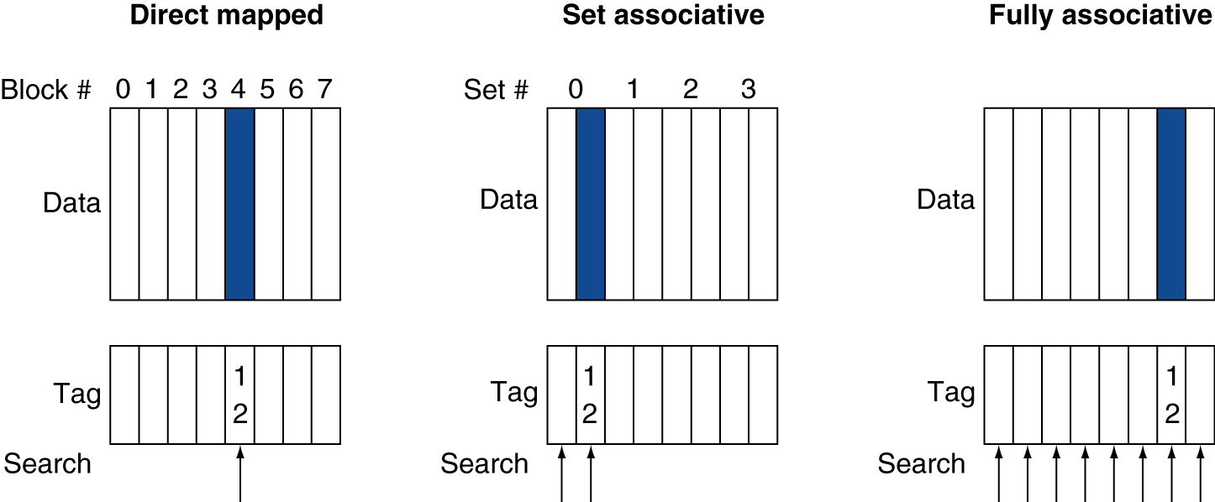
Associative Cache
Direct-mapped cache: a block can be placed in one location
Fully associative cache: a block can be placed anywhere in the cache
Set associative cache: more than one location, but not anywhere (e.g., n-way set associative cache)

Slide 15
Associative Cache
Direct-mapped cache and fully associative cache are special cases of set associative cache
direct-mapped: one-way set associative
fully associative: n-way set associative
Advantage of associative cache
Decreased miss rate
Disadvantage
Longer hit time
All tags within the set must be compared and selected
Higher H/W cost

Slide 16
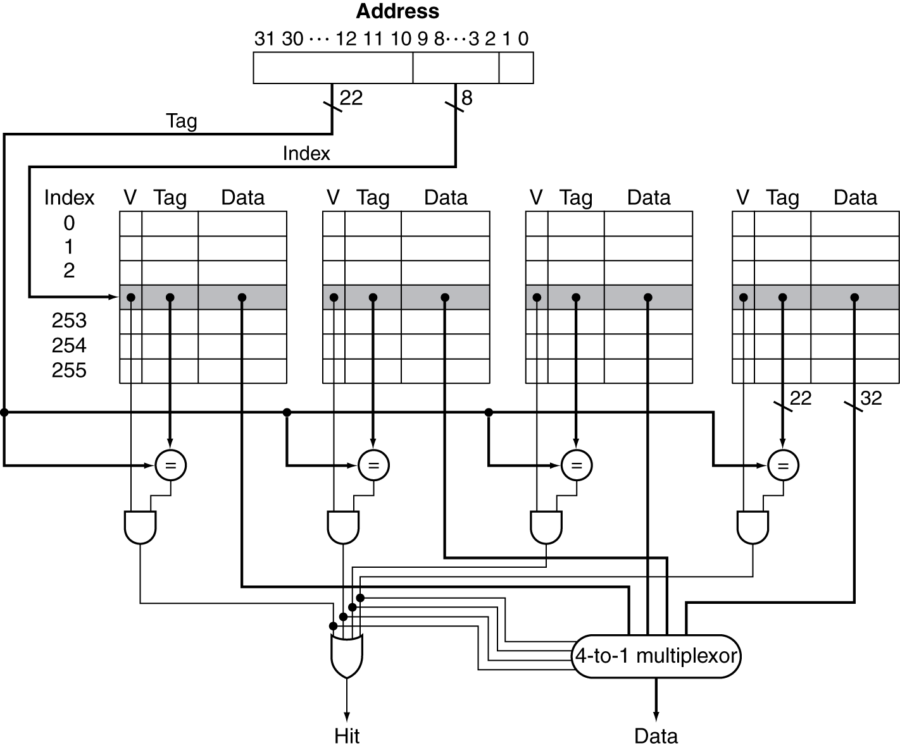
4-way Set Associative Cache Schematic
higher cost
longer hit time

Slide 17
Multi-level Cache
Modern processors have more than 1 level of cache
L1, L2, shared L3 cache on chip
L1: small, fast
L2: larger, slower
higher associativity, larger block size
Access time is less critical than L1
L1 cache miss → served by L2 cache
L2 cache miss → served by L3 cache
L3 Cache
memory address
L2 Cache
A
Processor
L1 Cache
Main Memory
A
A

Slide 18
Multilevel Cache Performance
Performance with L1 Cache only
i) Avg CPI = 1 cycle x 1.0 + 400 cycles x 0.02 = 9
ii) Avg CPI = 1 cycle x 0.98 + (400+1) cycles x 0.02 = 0.98 + 8.02 = 9
Performance with L2 cache
i) Avg CPI = 1 cycle x 1.0 + 20 cycles x 0.02 + 400 cycles x 0.005 = 3.4
ii) Avg CPI = 1 cycle x 0.98 + (20+1) cycles x 0.015 + (400+20+1) cycles x 0.005 = 3.4
Performance comparison
$\frac{9}{3.4}=2.6$
Base CPI | 1.0
Clock rate | 4 Ghz
L1 Miss rate | 2%
Main memory access latency | 100 ns
MM
L1 Cache
2%
1 cycle
100 ns
MM
L1 Cache
2%
L2 Cache
0.5%
1 cycle
5 ns
100 ns

