Slide 1

Submission Data: 23.05.25
Course ID: 14448_001
Course Name: Deep Learning
Deep Learning Active Learning 2
Project Presentation
Team: 이제는 더 이상 물러설 곳이 없다
201835465 Seo Ji Won
201835474 Ahn Hae Bin
202034347 Jeong Si Yeon
201835459 Park Jun Young

Slide 2

Deep Learning Active Learning 2
Contents
Team Introduction
Project Overview: topic, repository dataset
Model – YOLOv5
Result
After transfer learning - Evalution / Analysis
Opinion
Code Repository

Slide 3
1. Team Introduction
Member
1. 201835465 Seo Ji Won
2. 201835474 Ahn Hae Bin
3. 202034347 Jeong Si Yeon
4. 201835459 Park Jun Young
Team Name
이제는 더 이상 물러설 곳이 없다
Code Repository

Slide 4
2. Project Overview
Topic
Human Pose Estimation
Our Goal is
Repository
https://github.com/JeongSiYeon/DL23_ActiveLearning2
Code Repository

Slide 5
2. Project Overview
Dataset
OpenImages Dataset for training
open-source image dataset
consists of millions of images, each labeled with annotations
covers a wide range of object categories, such as animals, vehicles, and more.
It is frequently updated and expanded to include more images and annotations
We used 500 of dog and cat images
Custom Dataset for testing
10 images of Haebin's cat, Haechi
7 images of Ji Won’s dog, ?????
Code Repository

Slide 6

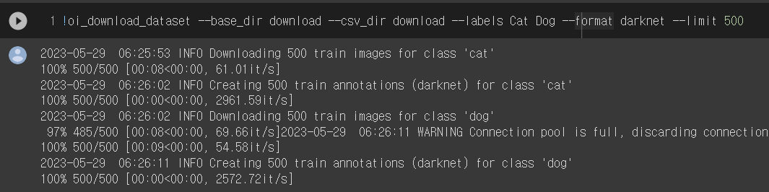
2. Project Overview
How to use OpenImages?
install the "openimages" package
Using the OpenImages package,
download 500 images each with the labels Cat and Dog in the Darknet format.

Slide 7
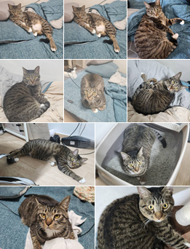
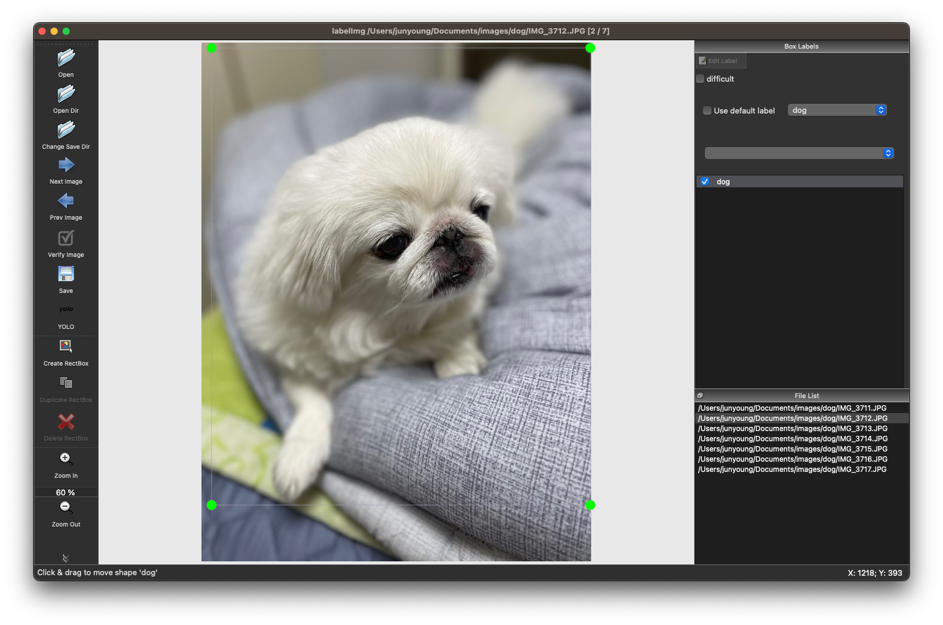
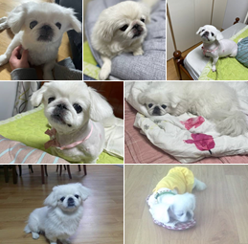
2. Project Overview
How to collect custom imgs
1. Collect 7 images of dogs and 10 images of cats
2. Using the labelImg tool, draw a bounding box

Slide 8
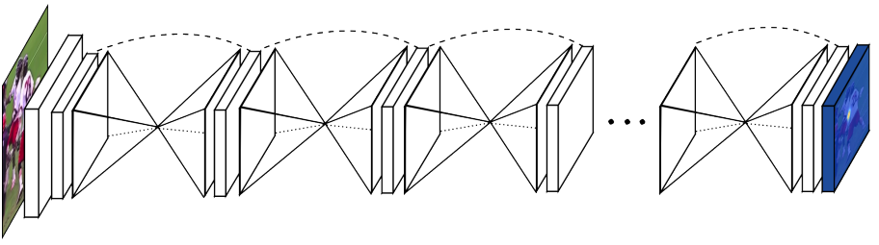
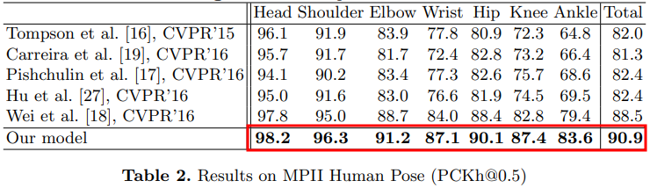
3. Model
Model
Topic
Stacked Hourglass Networks
The network based on the successive steps of pooling and upsampling that are done to produce a final set of predictions, hence called “stacked hourglass”
The design of the hourglass is motivated by the need to capture information at every scale. Features like faces require local evidence, while coherenct understanding of the full body is crucial for determining final poses
Application

Slide 9
4. Result
Topic
Human Pose Estimation
Application
Game played by recognizing the player's pose
This model can be used for games that can be played by recognizing the player's pose.
No additional equipment is required
It can make the game more fun and immersive.
Code Repository

Slide 10
Deep Learning Active Learning 2
Thank You
References
1. https://github.com/heartexlabs/labelImg
2. https://velog.io/@kimsoohyun/YOLO-%EC%9D%B4%EB%AF%B8%EC%A7%80-%EB%9D%BC%EB%B2%A8%EB%A7%81%EC%9D%84-%EC%9C%84%ED%95%9C-labelImg-%EC%82%AC%EC%9A%A9%EB%B2%95

