Slide 1

Public doamin
Designed by Luis Prado

Slide 2

Public doamin
Designed by Carlos Andujar

Slide 3

CCL License
Snail by aLf from The Noun Project

Slide 4

Creative Commons – Attribution (CC BY 3.0)
Cheeta designed by kesaryvamshi
from the Noun Project

Slide 5

Creative Commons – Attribution (CC BY 3.0)
City by Joel McKinney
from The Noun Project

Slide 6
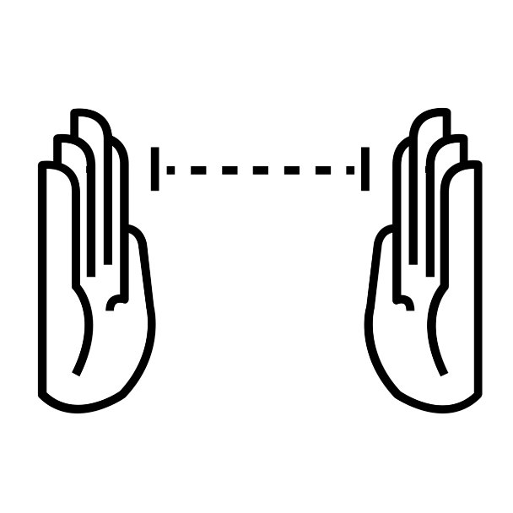
Measure by Ryan Beck from
The Noun Project

Slide 7
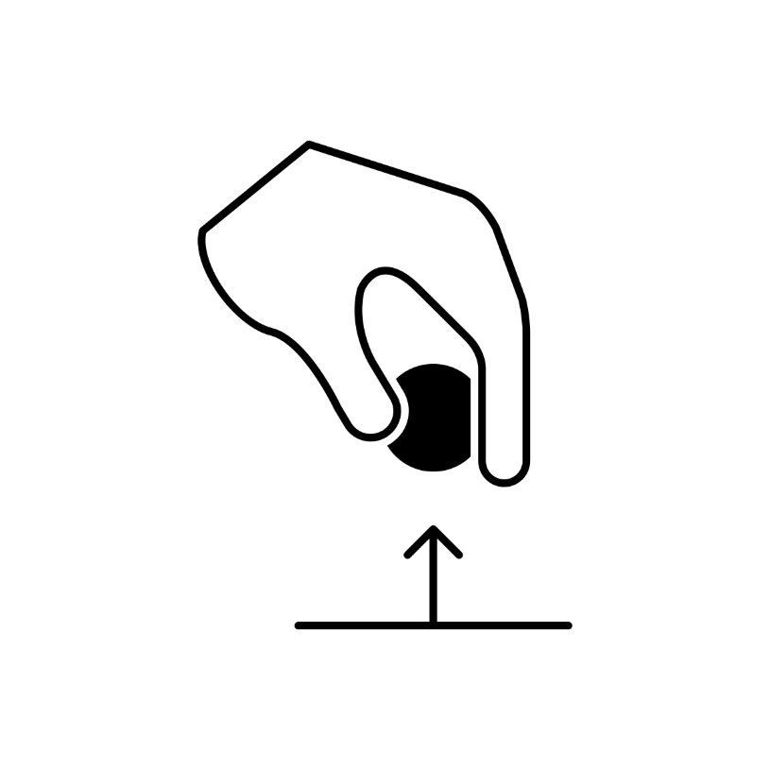
to pick by athanagore x
from The Noun Project

Slide 8
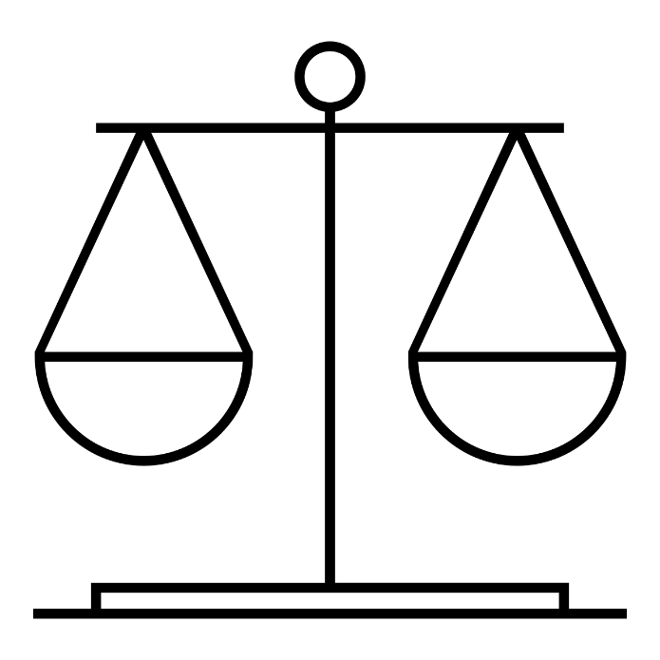
Balance by Juan Pablo Bravo
from The Noun Project

Slide 9

Hdmi Cable designed by Dan Hetteix
from the Noun Project

Slide 10

Group by irene hoffman
from The Noun Project

Slide 11
Group by irene hoffman
from The Noun Project

Slide 12
Group by irene hoffman
from The Noun Project

Slide 13
Group by irene hoffman
from The Noun Project

Slide 14
Group by irene hoffman
from The Noun Project

Slide 15
Group by irene hoffman
from The Noun Project

Slide 16
Group by irene hoffman
from The Noun Project

Slide 17
Group by irene hoffman
from The Noun Project

Slide 18
Group by irene hoffman
from The Noun Project

Slide 19
Group by irene hoffman
from The Noun Project

