Slide 1
JAVA Array List 구현방법

Slide 2

Create
생성

Slide 3
package ot.ds.list.arraylist.implementation;
class ArrayList{
}
public class Main {
public static void main(String[] args) {
ArrayList numbers = new ArrayList();
}
}

Slide 4
Insert
추가

Slide 5
numbers.add(10);
numbers.add(20);
numbers.add(30);
numbers.add(40);

Slide 6
10
20
30
40
0
1
2
3

Slide 7
public boolean add(Object element){
elementData[size++] = element;
return true;
}

Slide 8
numbers.add(1, 50);

Slide 9
3
2
1
10
20
30
40
0
1
2
3
반복끝
index
반복시작
Size -1
반복
for( int i = ; i >= ; ){
elementData[i+1] = elementData[i];
}
size-1
index
i--

Slide 10
10
50
20
30
40
0
1
2
3
4
elementData[index] = element;

Slide 11
size++;

Slide 12

Remove
삭제

Slide 13
numbers.remove(2);

Slide 14
10
50
20
30
40
0
1
2
3
4
elementData[index] = element;

Slide 15
1
2
3
10
20
30
40
0
2
3
4
반복시작
Index+1
반복끝
Size -1
반복
for( int i = ; i <= ; ){
elementData[i-1] = elementData[i];
}
Index+1
size-1
i++

Slide 16
size++;

Slide 17
10
20
30
40
40
0
2
3
4
4
elementData[index] = null;

Slide 18
Get
가져오기

Slide 19
numbers.get(2)

Slide 20
10
50
30
40
0
1
2
3
public Object get(int index) {
return elementData[index];
}

Slide 21
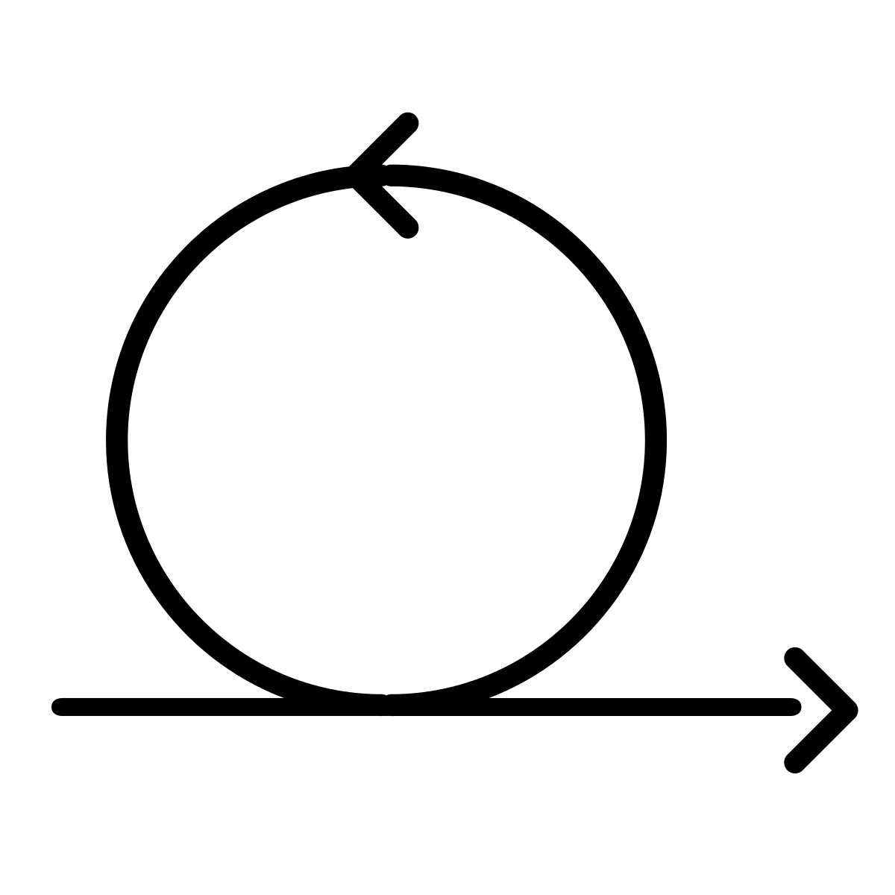
Iteration
반 복

