Slide 1
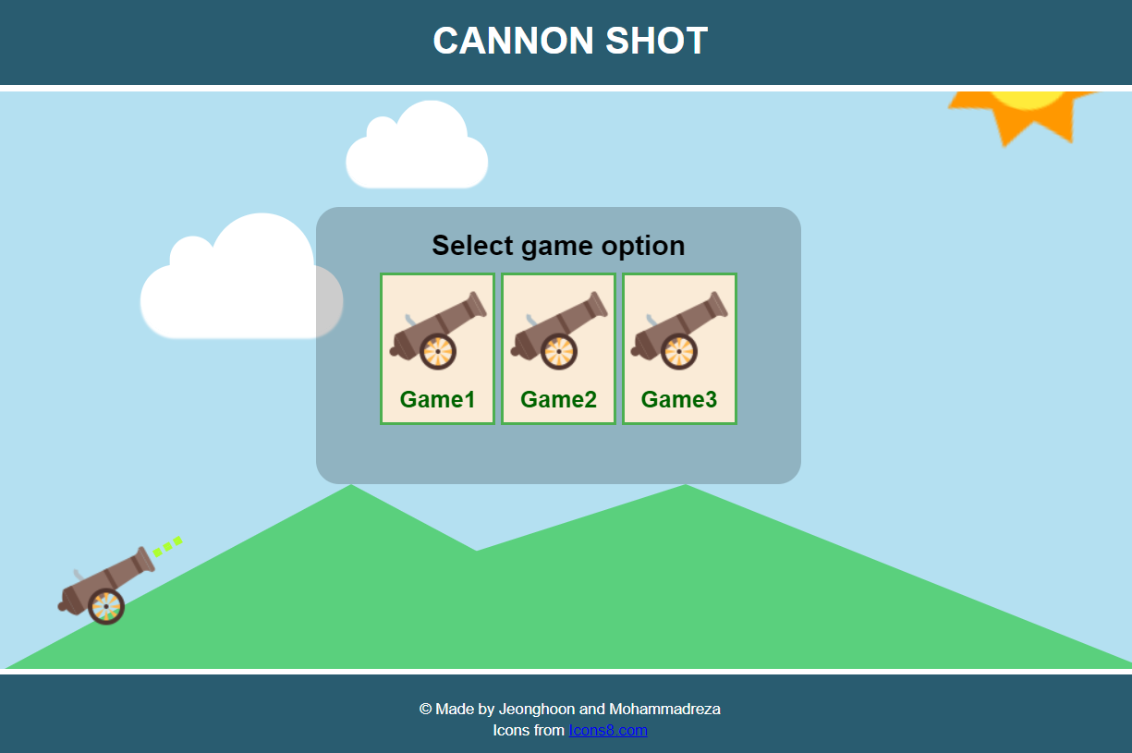
Cannon shot
Jeonghoon Lee
Mohammadreza Saleh

Slide 2
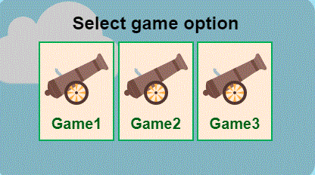
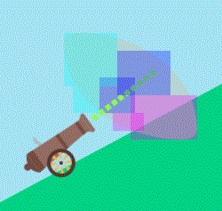
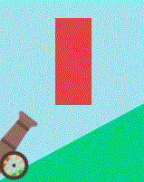
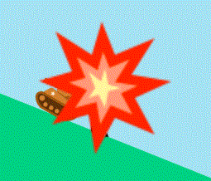
Game Scenario
Start the game by selecting one of the game option
- 3 input checkbox
Select the angle of fire for target
- 3 input radiobox
Set the launching power
- 4 input radiobox
You will win if the missile hit the target.

Slide 3
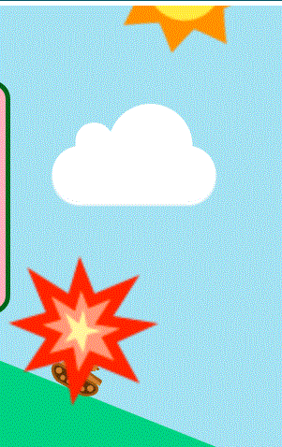

Transform, Transition and Animation
Cloud moving animation
- move horizontally
- scale & translate transform
Sun moving animation
- rotate transform
Missile explosion animation
- move explosion position by user
input
- scale transform
Cannon launching angle moving
- rotate transform
- transform origin is the bottom center
(transform-origin: 50% 75%; )

Slide 4
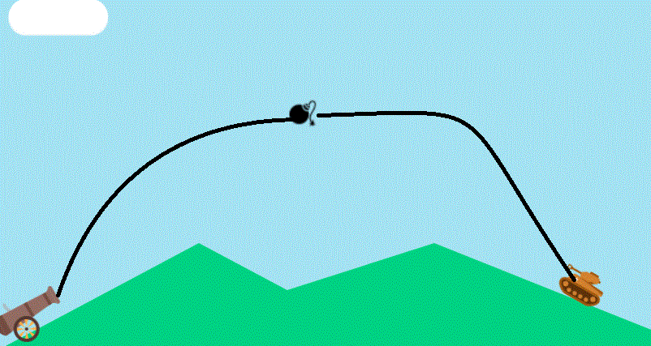
Missile Moving
The missile is launched through the curve line to hit the target
- 12 moving path

Slide 5
Moving Algorithm
game_start:checked ~ #angle1_check:checked ~ input#power1_check:checked ~ #missile {
animation: xAxis_11 2.5s 1 ease-in forwards;
}
.game_start:checked ~ #angle1_check:checked ~ input#power1_check:checked ~ #missile::after {
animation: yAxis_11 2.5s 1 ease-in-out forwards;
}
@keyframes xAxis_11 { 70% { animation-timing-function: ease-out; transform: translateX(500px); } … }
@keyframes yAxis_11 { 70% { animation-timing-function: ease-in; transform: translateY(-250px) scale(2); }… }
Y
(top)
Use 2 animation same time
- X, Y move with different speed
Use 1 animation
- X, Y move with same speed
X (left)

