Slide 1
\
7조 PPT
Enjoy your stylish business and campus life with BIZCAM
7조 2021-03-24

Slide 2



삽질 PRESENTATION Enjoy your stylish business and campus life with DDIT

Slide 3
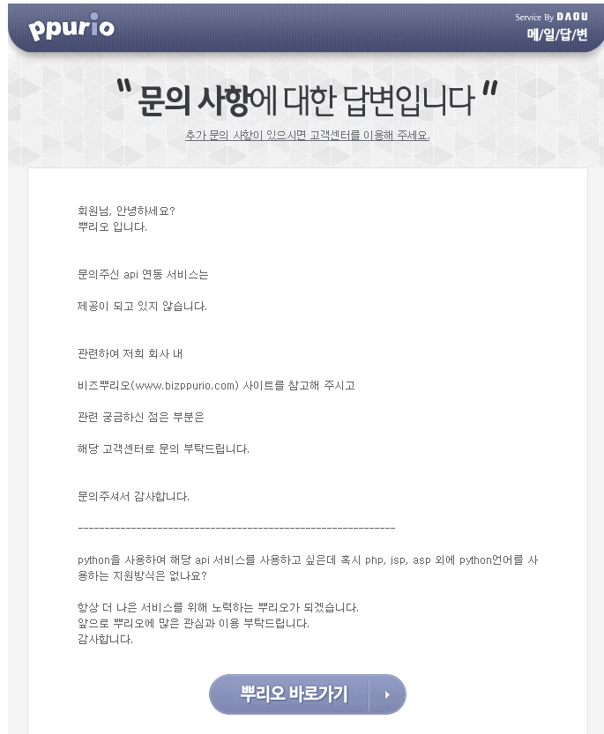
삽질 PRESENTATION Enjoy your stylish business and campus life with DDIT

Slide 4
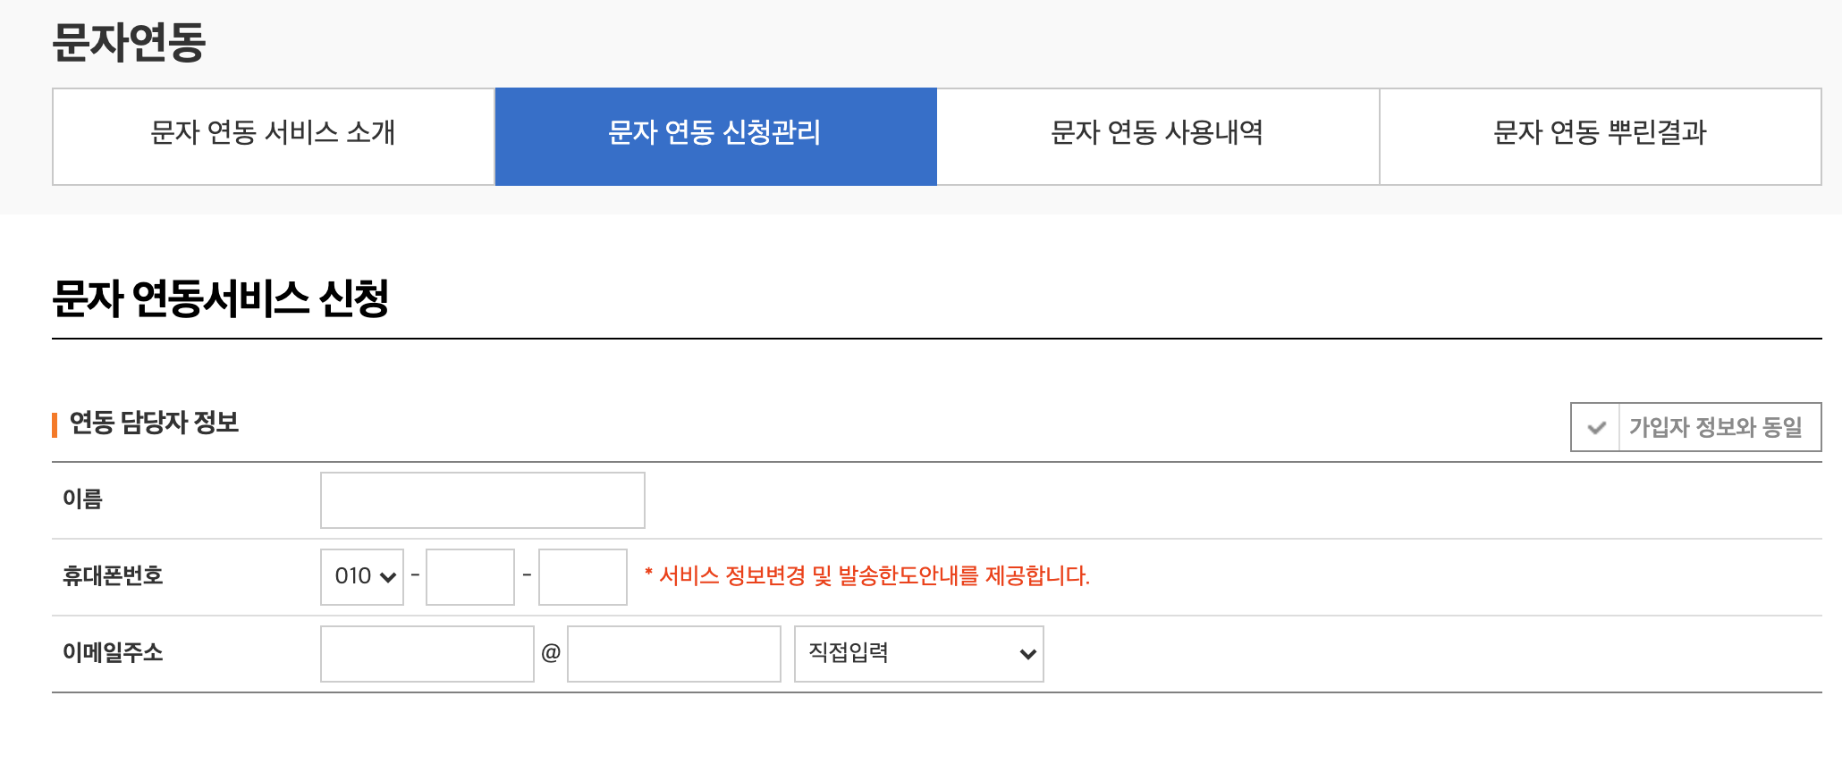
삽질 PRESENTATION Enjoy your stylish business and campus life with DDIT

Slide 5
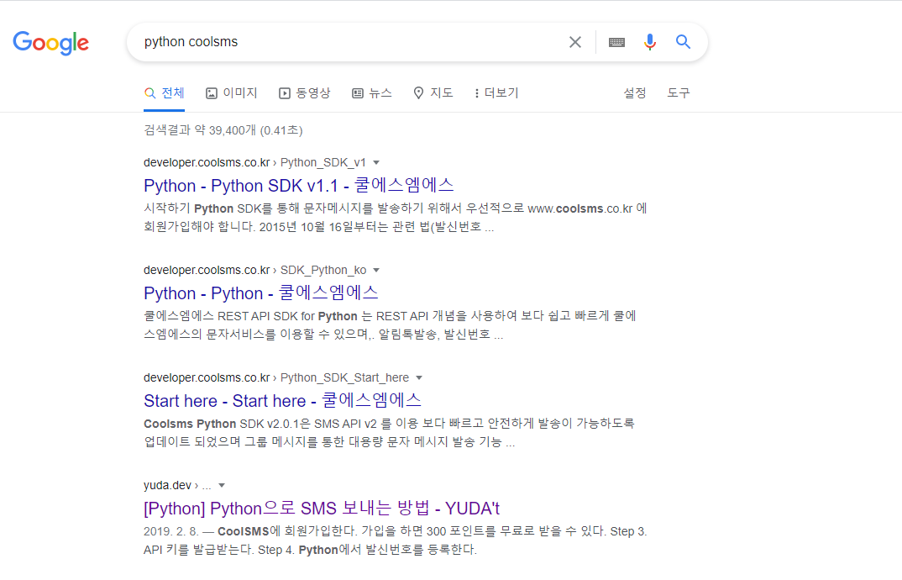
삽질 PRESENTATION Enjoy your stylish business and campus life with DDIT

Slide 6
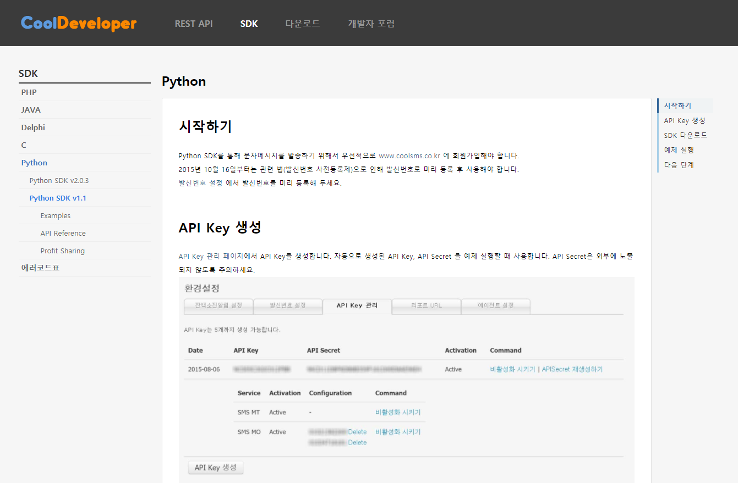
삽질 PRESENTATION Enjoy your stylish business and campus life with DDIT

Slide 7
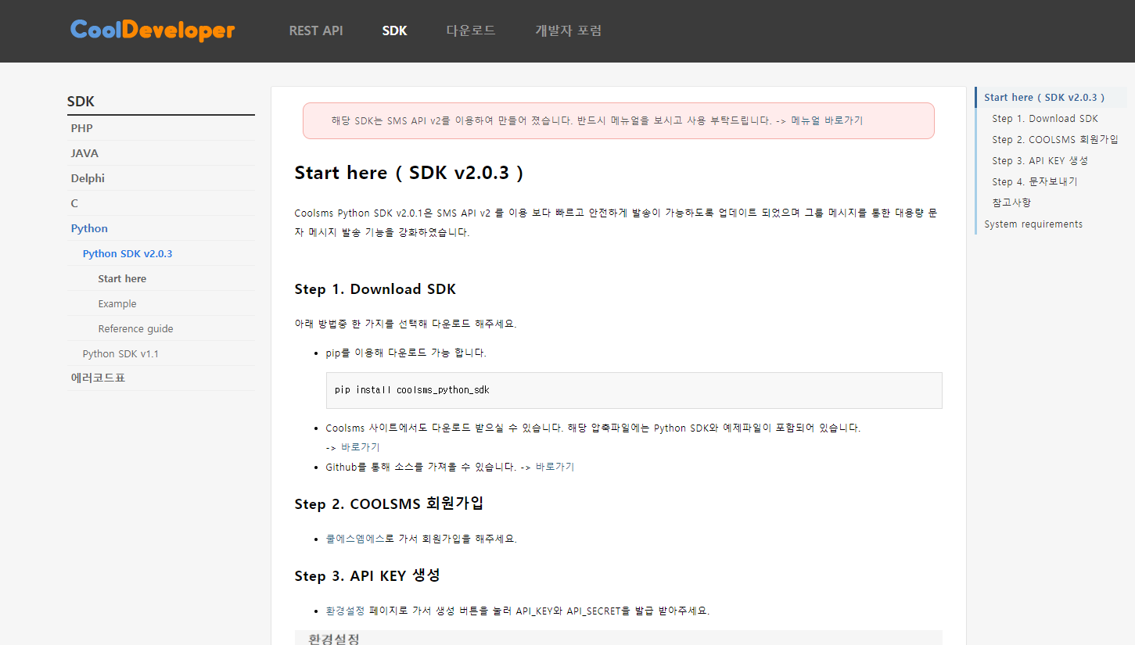
삽질 PRESENTATION Enjoy your stylish business and campus life with DDIT

Slide 8
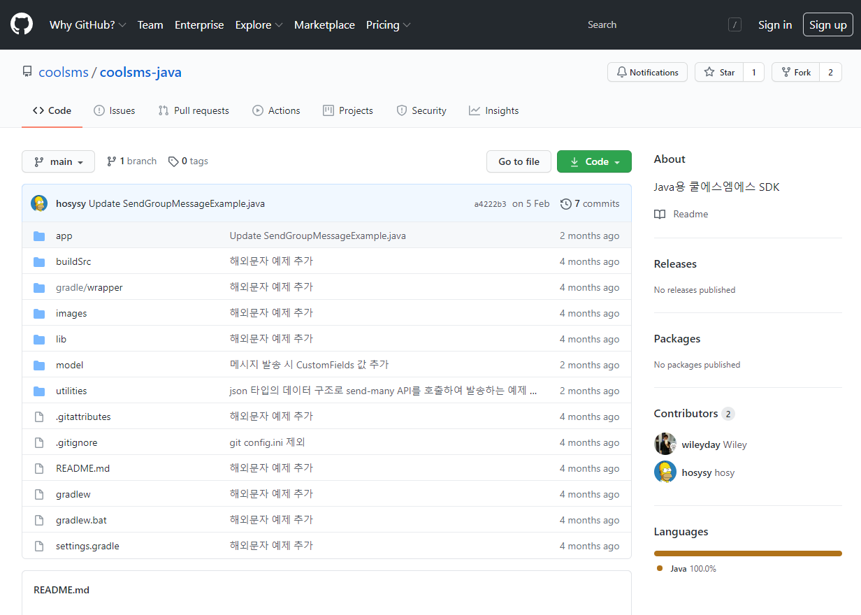
삽질 PRESENTATION Enjoy your stylish business and campus life with DDIT

Slide 9
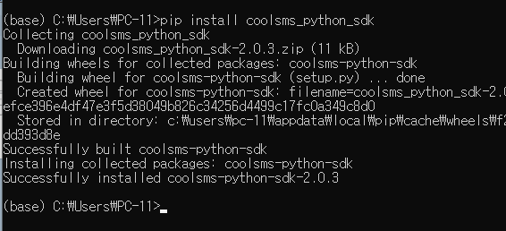
PYTHON PRESENTATION Enjoy your stylish business and campus life with DDIT
cmd창에서 $pip install coolsms_python_sdk 설치하기

Slide 10
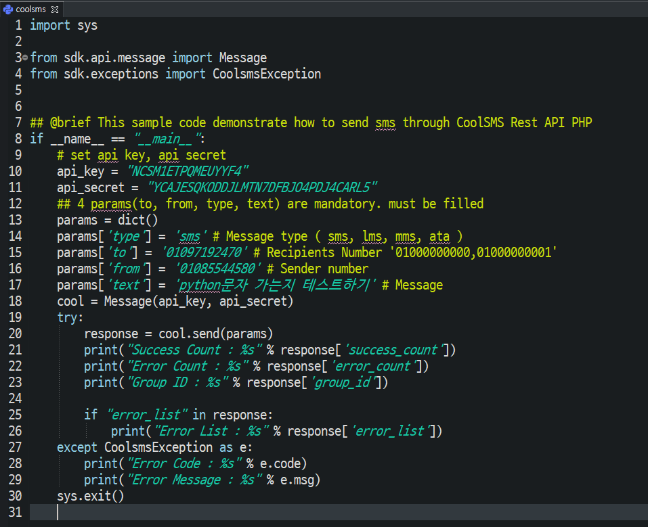
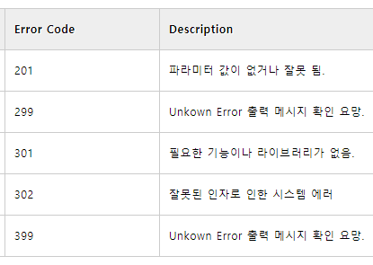
PYTHON PRESENTATION Enjoy your stylish business and campus life with DDIT
PYTHON 예제
- 발급받은 API 키, API_PASS 입력
- 보낼번호, 받을번호, 내용 입력
- 오류에 따라 Console에 안내
오류코드

Slide 11
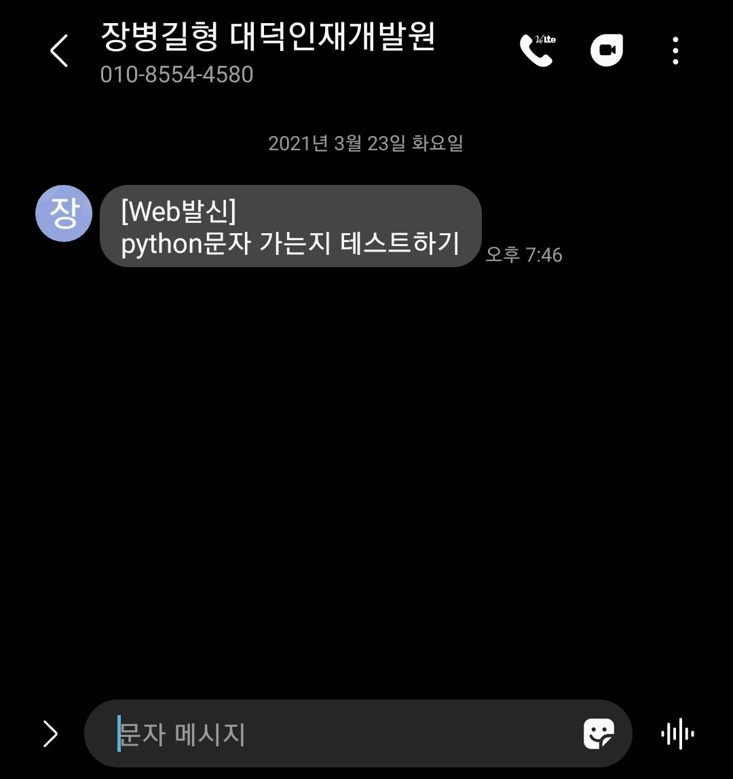
RESULT PRESENTATION Enjoy your stylish business and campus life with DDIT
Title | Contents
CoolSMS | 문자보내기 API
Developer_URL | https://developer.coolsms.co.kr/developer
Home_URL | https://console.coolsms.co.kr/dashboard
활용사례 | 비밀번호 찾기 인증번호 보내기, 알림톡, 카카오알림톡, 기차예매내역알림, 품절의류 재입고알림
지원 | PHP, JAVA, Delphi, C, Python
발송가능형태 | SMS, LMS, MMS, ATA, CTA, Image첨부가능, 해외문자 발송가능
서비스 | 유료 ( 기본 300 제공 )

Slide 12
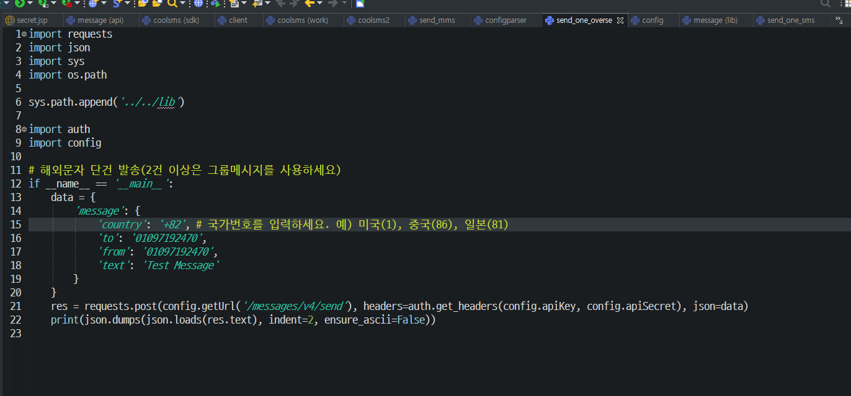
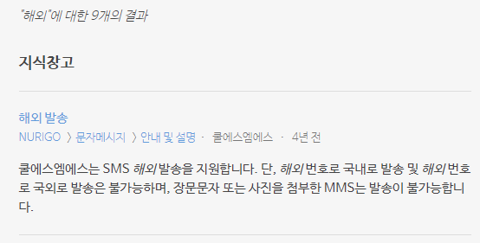
EX PRESENTATION Enjoy your stylish business and campus life with DDIT

Slide 13
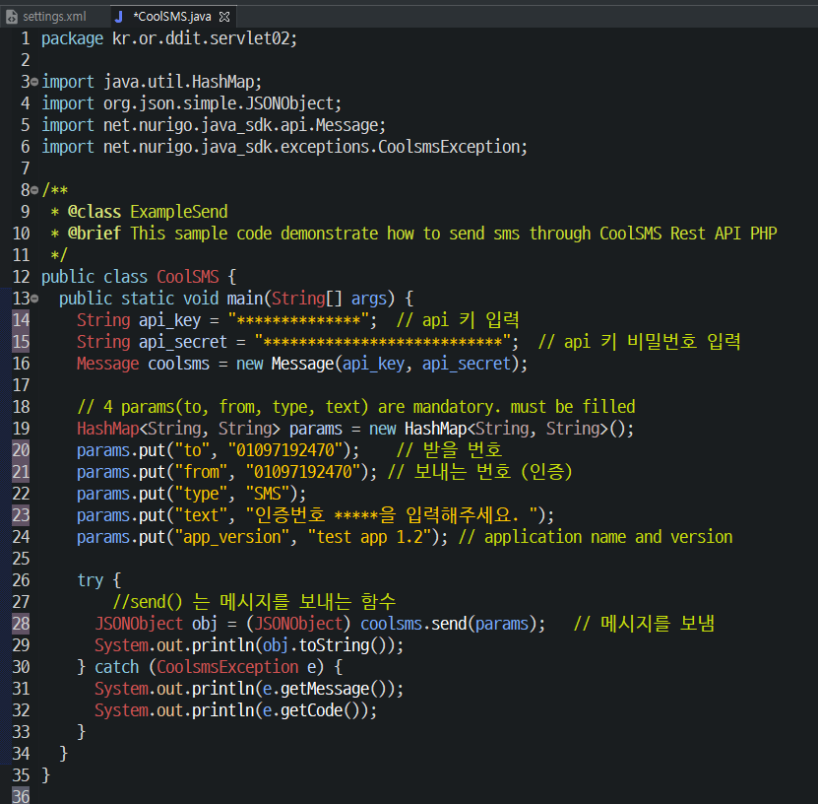
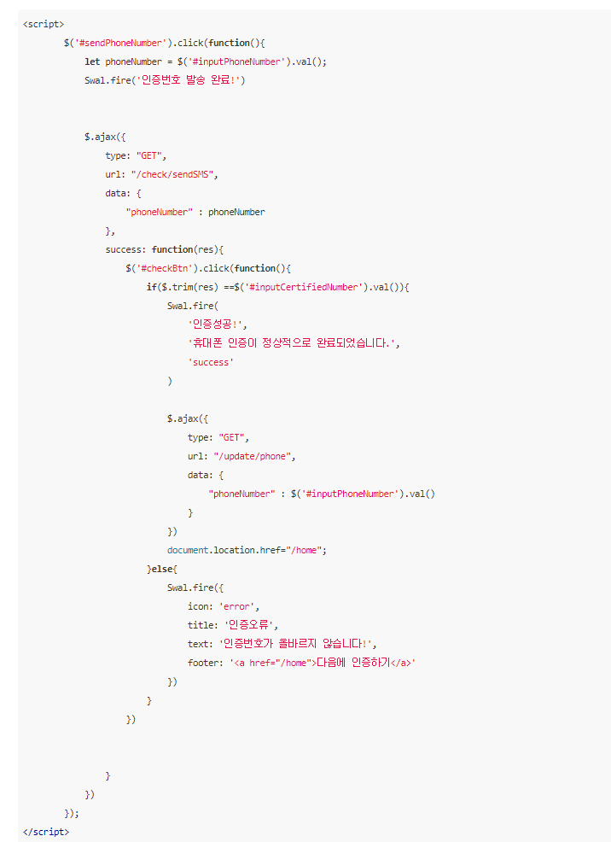
JAVA-CODE PRESENTATION Enjoy your stylish business and campus life with DDIT

Slide 14
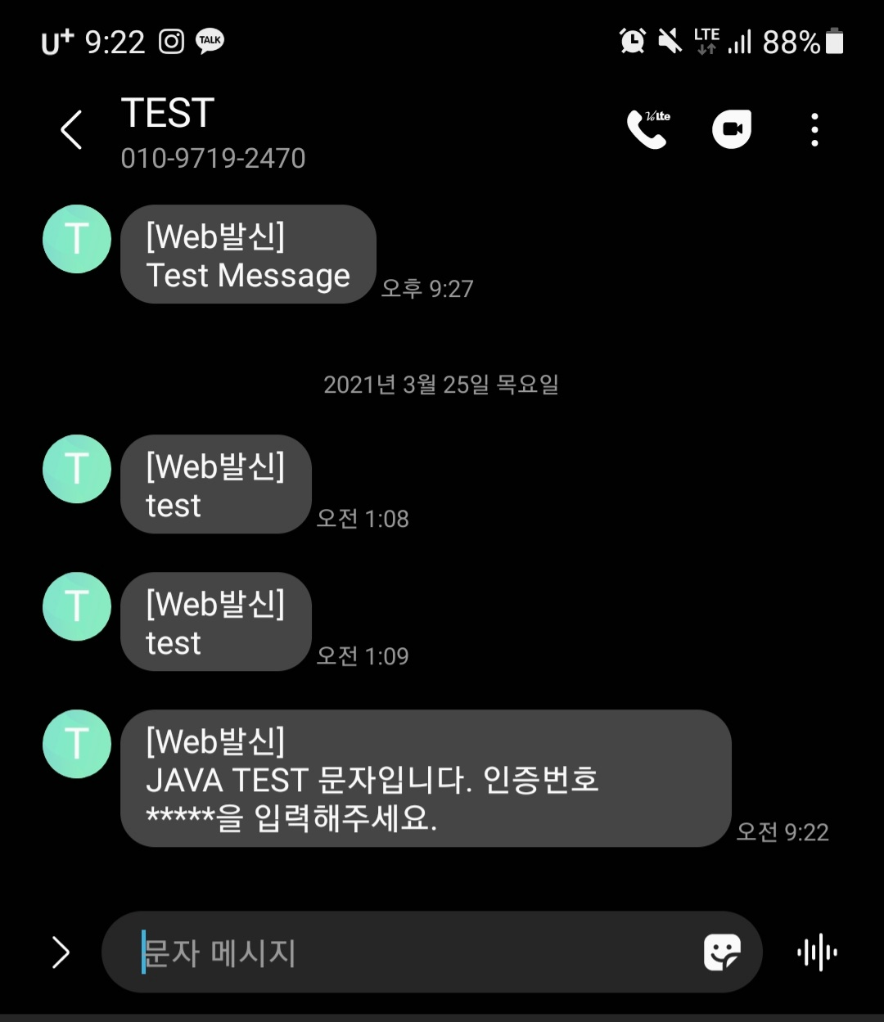

EX PRESENTATION Enjoy your stylish business and campus life with DDIT
CoolSMS 사용법
1. CoolSMS 회원가입
2. 개발자센터 사용할 언어로 SDK 다운로드
3. KEY 발급 ( KEY, PASSWORD )
4. 라이브러리 추가
5. 필요한 방향으로 코딩작업

Slide 15
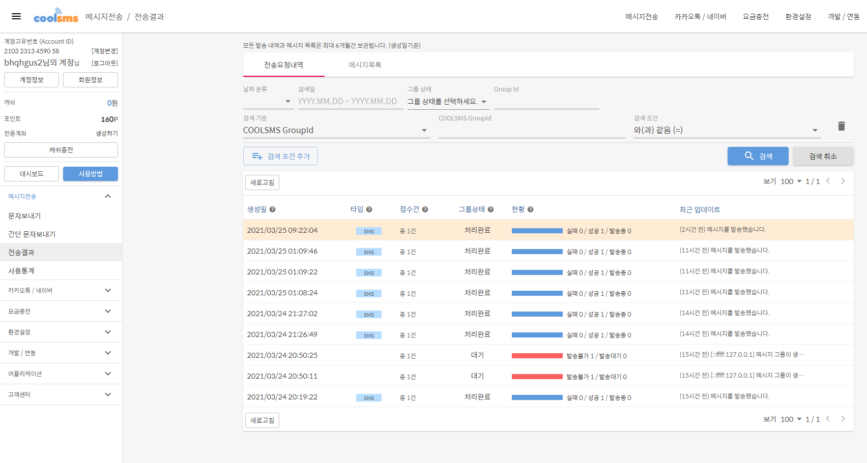
삽질 PRESENTATION Enjoy your stylish business and campus life with DDIT

Slide 16
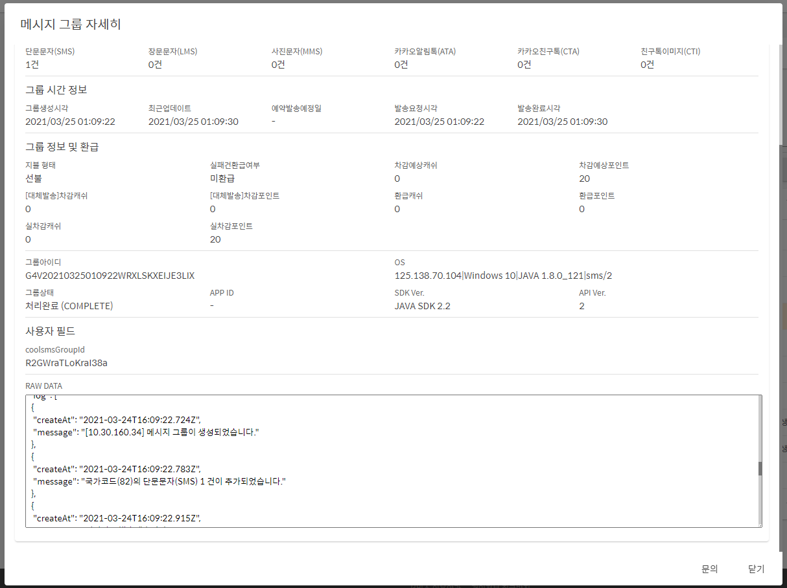
삽질 PRESENTATION Enjoy your stylish business and campus life with DDIT

Slide 17
삽질 PRESENTATION Enjoy your stylish business and campus life with DDIT
\
감사합니다
Enjoy your stylish business and campus life with BIZCAM
7조 2021-03-24
Git
https://github.com/KrGil/DDIT_python/tree/master/SMS_api/coolAPI
Tistory
https://jjam89.tistory.com/entry/CoolSMS-사용하기

Slide 18
삽질 PRESENTATION Enjoy your stylish business and campus life with DDIT

