Slide 1
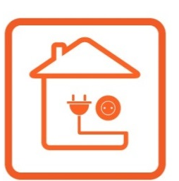
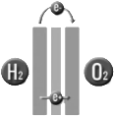



H2-based
power supply
Photovoltaic
panel (12kW)
Power
load (2kW)
Dump load
(curtailment)
Battery
(15kWh)
Limited to 1.1kW

