Slide 1
Keep Moments

Slide 2

Introduction
KEEP MOMENTS
An Android application
Records a video
Stores the video to a cloud storage
Stream the video from the cloud

Slide 3
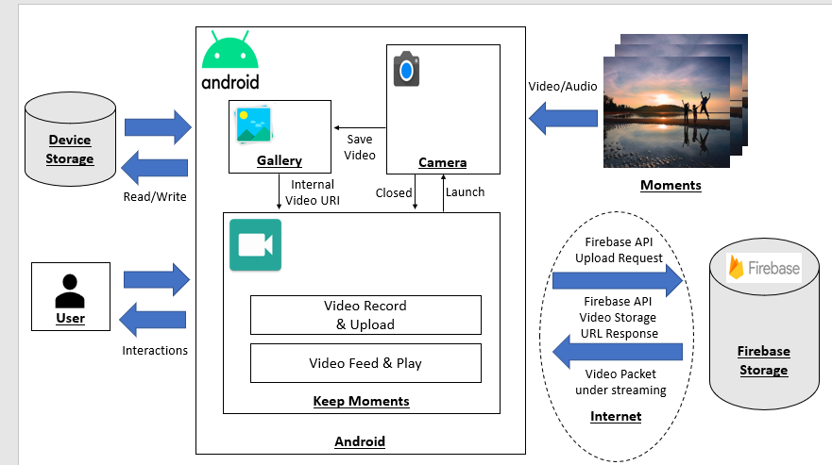
Architecture

Slide 4
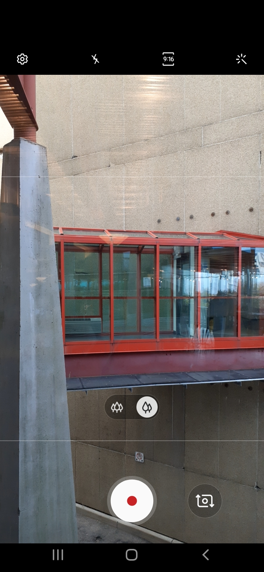

Recording
Android library: MediaRecorder
Use of the default camera app: it supports many video codec, depending on the phone
Save files in .mp4 in Gallery, before user upload it

Slide 5

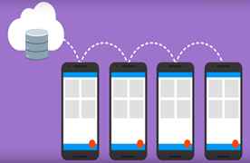
Firebase Storage & Connect
Stand-alone cloud solution for uploading user generated content like images and videos from an iOS and Android device.
Upload and download files directly from clients -> No server required!
Easy connection establishment:
1. Create a Firebase project
2. Register your app with Firebase
3. Add a Firebase configuration file: google-services.json
4. Add Firebase SDK to your app
Source: https://firebase.google.com/docs/storage/android/start

Slide 6
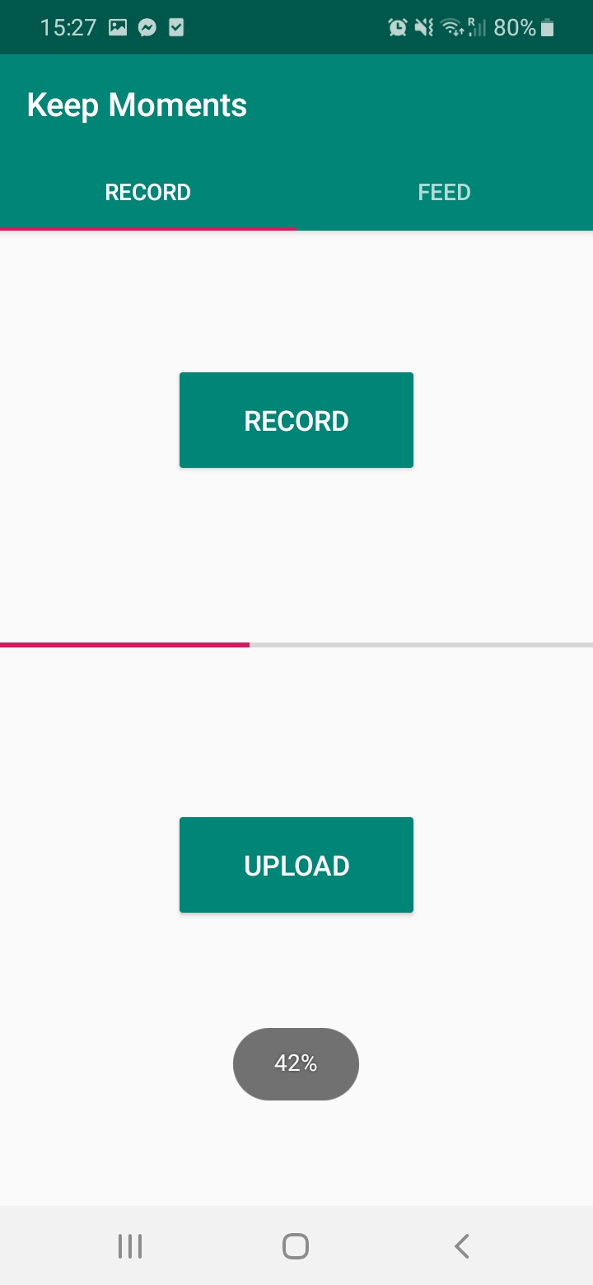

Uploading
Firebase SDK -> FirebaseStorage
Upload local files on the device, such as photos and videos from the camera, with the “putFile()” method of FirebaseStorage.

Slide 7
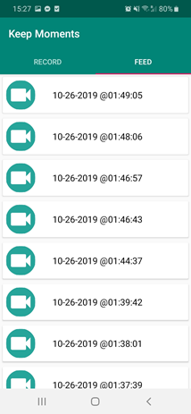
Downloading URL
After uploading a file, There is an option to get a URL to download the file by calling the “getDownloadUrl()” method of FirebaseStorage.
“listAll()” method of FirebaseStorage fetches the list of files having each “file name” and “url” from Firebase Storage. -> Used to display video items on FEED tab.

Slide 8
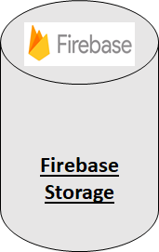

Streaming
VideoView class is used to play online videos inside android app via Http or Https URL.
Thus, a video located on Firebase Storage can be played if the application can provide each video URL to VideoView.
KeepMoments has all of the Video URLs on Firebase Storage before and save the newly uploaded Video URL as well.
Keep Moments
VideoView
TCP/IP Packet with video data under Streaming

Slide 9
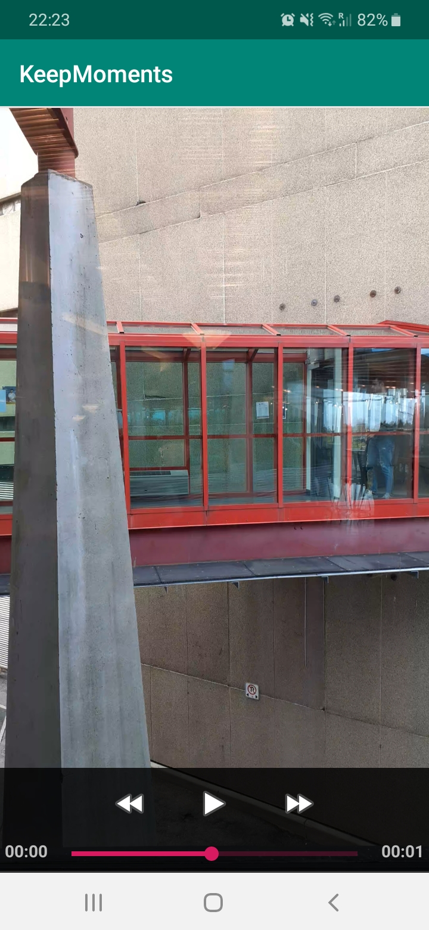

VideoPlayer
Video in streaming directly from Firebase
Use Android libraries
VideoView
MediaController
Anchor a MediaController to the VideoView

