Slide 1


Accelerating Critical OS Services in Virtualized Systems with Flexible Micro-sliced Cores
Jeongseob Ahn*, Chang Hyun Park‡, Taekyung Heo‡, Jaehyuk Huh‡
*
‡

Slide 2

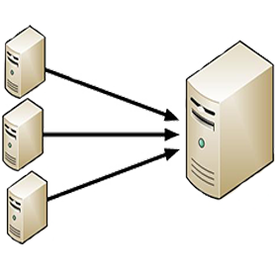



Challenge of Server Consolidation
Fraction of time
0
0.5
1
Utilization
Consolidation improves system utilization
However, resources are contended

Slide 3


Challenge of Server Consolidation
Fraction of time
0
0.5
1
Utilization
Consolidation improves system utilization
However, resources are contended

Slide 4
So, What Can Happen?
Virtual time discontinuity
vCPU 0
Running
Waiting
Virtual Time
VMEXIT / VMENTER
vCPU 1
pCPU 0
Physical Time
Time shared

Slide 5
So, What Can Happen?
Virtual time discontinuity
vCPU 0
Running
Waiting
Virtual Time
VMEXIT / VMENTER
➊ Spinlock waiting time(gmake)
➋ TLB synchronization latency (μsec)
Kernel Component | Avg. waiting time (μsec)
 | solo | co-run*
Page reclaim | 1.03 | 420.13
Page allocator | 3.42 | 1,053.26
Dentry | 2.93 | 1,298.87
Runqueue | 1.22 | 256.07
vCPU 1
 |  | Avg. | Min. | Max.
dedup | solo | 28 | 5 | 1927
 | co-run* | 6,354 | 7 | 74915
vips | solo | 55 | 5 | 2052
 | co-run* | 14,928 | 17 | 121548
pCPU 0
Physical Time
Time shared
➌ I/O latency & throughput (iPerf)
* Concurrently running with Swaptions of PARSEC
 | Jitters (ms) | Throughput (Mbits/sec)
solo | 0.0043 | 936.3
mixed co-run* | 9.2507 | 435.6
Processing time is amplified

Slide 6
How about Shortening Time Slice?
Time slice
Waiting time
vCPU 0
vCPU 1
vCPU 2
Shortening time slice is very simple and powerful, but the overhead of frequent context switches is significant
pCPU 0
T
Time shared
Reduced waiting time
$$Waiting time=(\# active vCPUs −1)∗time slice$$
vCPU 0
vCPU 1
vCPU 2
pCPU 0
T
Time shared

Slide 7
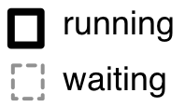
Approach: Dividing CPUs into Two Pools
➊ Normal pool
➋ Micro-sliced pool
- quickly but briefly schedule vCPUs
Shortened time slice
Time slice
Waiting time
vCPU 0
vCPU 0
vCPU 1
vCPU 1
vCPU 2
vCPU 2
pCPU 0
pCPU 3
Serving the main work of applications
Serving critical OS services to minimize the waiting time

Slide 8
Challenges in Serving Critical OS Services on Micro-sliced Cores
1. Precise detection of urgent tasks
2. Guest OS transparency
3. Dynamic adjustment of micro-sliced cores

Slide 9

Detecting Critical OS Services
Instruction pointer
0x8106ed62
➊
Examining the instruction pointer (a.k.a PC)
whenever a vCPU yields its pCPU
workloads | # of yields
 | solo | co-run*
gmake | 79,440 | 295,262,662
exim | 157,023 | 24,102,495
dedup | 290,406 | 164,578,839
vips | 644,643 | 57,650,538
* Concurrently running with Swaptions of PARSEC

Slide 10

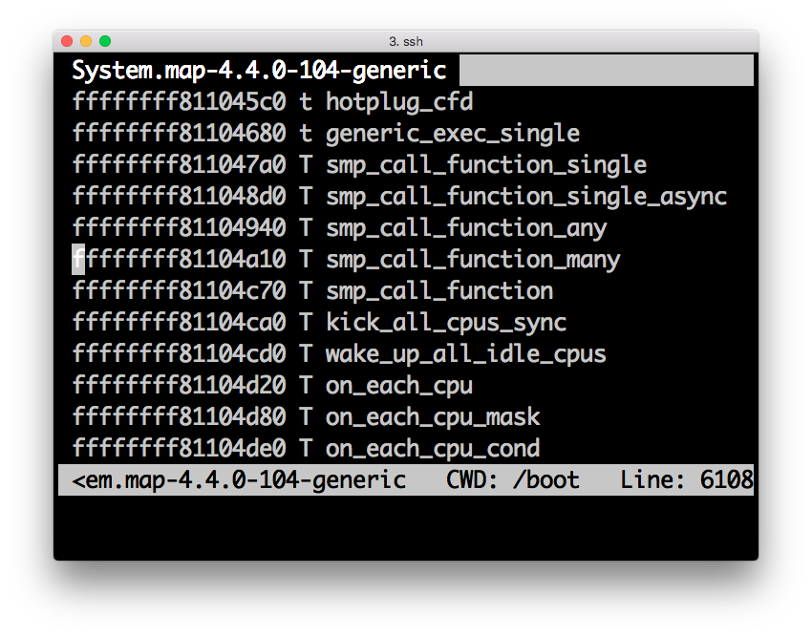
Profiling Virtual CPU Scheduling Logs
Investigating frequently preempted regions
vCPU scheduling trace
(w/ Inst. Pointer)
Critical Guest OS Components
Module | Operation
sched | scheduler_ipi() resched_curr() …
mm | flush_tlb_all() get_page_from_freelist() …
irq | irq_enter() irq_exit() …
spinlock | __raw_spin_unlock() __raw_spin_unlock_irq() …
Instruction pointer and kernel symbols enable to precisely detect vCPUs preempted while executing critical OS services without guest OS modification
In our paper, you can find the table in details
Kernel symbol tables

Slide 11


Accelerating Critical Sections
➊
➋
➌
P0
P1
P2
P3
➊ Yield occurring
➋ Investigating the preempted vCPUs
➌ Scheduling the selected vCPU on the micro-sliced pool

Slide 12
Accelerating Critical TLB Synchronizations
➊
➋
➌
P0
P1
P2
P3
➍
➊ Yield occurring
➋ Investigating the preempted vCPUs
➌ Scheduling the selected vCPU on the micro-sliced pool
➍ Dynamically adjusting micro-sliced cores based on profiling

Slide 13
Detecting Critical I/O Events
vIPI
➌
vIRQ
➋
➊pIRQ
I/O handling consists of a chain of operations involving potentially multiple vCPUs

Slide 14
Experimental Environments
Testbed
12 HW threads (Intel Xeon)
2 VMs with 12 vCPUs for each
Xen hypervisor 4.7
Benchmarking workloads
dedup and vips from PARSEC
exim and gmake from MOSBENCH
Pool configuration
Normal: 30ms (Xen default)
Micro-sliced: 0.1ms
App
App
OS
OS
12 virtual
CPUs
Xen hypervisor
12 physical threads
2-to-1 consolidation ratio

Slide 15
Performance of Micro-sliced Cores
[Our schemes]
3
1
3
3
1
3

Slide 16
Performance of Micro-sliced Cores
[Our schemes]
3
1
3
8% gap
3
1
3

Slide 17
I/O Performance
 | Workloads
VM-1 | iPerf lookbusy
VM-2 | lookbusy

Slide 18
Conclusions
We introduced a new approach to mitigate the virtual time discontinuity problem
Three distinct contributions
Precise detection of urgent tasks
Guest OS transparency
Dynamic adjustment of the micro-sliced cores
Overhead is very low for applications which do not frequently use OS services

Slide 19
Thank You! jsahn@ajou.ac.kr
Accelerating Critical OS Services in Virtualized Systems with Flexible Micro-sliced Cores
Jeongseob Ahn*, Chang Hyun Park‡, Taekyung Heo‡, Jaehyuk Huh‡
*
‡

