Slide 1
Revisiting Hardware-Assisted Page Walks for Virtualized Systems
Jeongseob Ahn, Seongwook Jin, and Jaehyuk Huh
Computer Science Department
KAIST

Slide 2
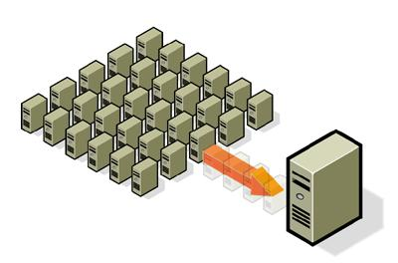
System Virtualization
Widely used for cloud computing as well as server consolidation
Hypervisor serves resource managements
E.g.,) CPU, Memory, I/O, and etc
App
App
VM1
VM2
OS
OS
Virtual
Virtual
Hypervisor
Physical
Physical
System

Slide 3
Address Translation for VMs
Virtualization requires two-level address translations
To provide isolated address space for each VM
Guest page tables are used to translate gVA to gPA
Guest Virtual
Address
Guest
Page Table
(per process)
Guest Physical
Address
Nested
Page Table
(per VM)
System Physical
Address
Guest virtual address
gPPN
Offset
gVPN
Offset
Guest physical address
Page table

Slide 4
Does it make sense ?
Memory required to hold page tables can be large
48-bit address space with 4KB page = 2⁴⁸/2¹² = 2³⁶ Pages
Flat page table: 512GB (2³⁶ x 2³= 2³⁹)
Page tables are required for each process
Multi-level page table
47
11
0
VPN
offset
2³⁶
2¹²
VA:
L4
L3
L2
L1
offset
Base address
(CR3)

Slide 5
Address Translation for VMs
Virtualization requires two-level address translations
To provide isolated address space for each VM
Current hardware page walker assumes the same organization for guest and nested page tables
AMD Nested paging
Intel Extended Page Table
Guest Virtual
Address
Guest
Page Table
(per process)
Guest Physical
Address
Nested
Page Table
(per VM)
System Physical
Address

Slide 6
Hardware-Assisted Page Walks
Two-dimensional page walks for virtualized systems
gVA
gCR3
gL4
gL3
gL2
gL1
Guest page table
(gLn)
x86_64
5
10
15
20
gPA (gL4)
nL4
nL4
nL4
nL4
nL4
Nested page table
(nLn)
1
6
11
16
21
nCR3
nL3
nL3
nL3
nL3
nL3
2
7
12
17
22
nL2
nL2
nL2
nL2
nL2
3
8
13
18
23
gVA: guest virtual address
nL1
nL1
nL1
nL1
nL1
gPA: guest physical address
4
9
14
19
24
sPA
sPA: system physical address
sPA

Slide 7
Hardware-Assisted Page Walks
Two-dimensional page walks for virtualized systems
Guest (m-levels) and nested (n-levels) page tables
# of page walks: mn + m + n
x86_64: 4*4 + 4 + 4 = 24
gVA
gCR3
gL4
gL3
gL2
gL1
Guest page table
(gLn)
x86_64
5
10
15
20
gPA (L4)
nL4
nL4
nL4
nL4
nL4
1
6
11
16
21
Nested page table
(nLn)
nCR3
nL3
nL3
nL3
nL3
nL3
2
7
12
17
22
Can we simplify the nested page tables ?
nL2
nL2
nL2
nL2
nL2
gVA: guest virtual address
3
8
13
18
23
gPA: guest physical address
sPA: system physical address
nL1
nL1
nL1
nL1
nL1
4
9
14
19
24
sPA
sPA

Slide 8
Revisiting Nested Page Table
Exploit the characteristics of VM memory management
# of virtual machines < # of processes
There are 106 processes in a Linux system after booting
Differences address space between VMs and processes
Virtual machines use much of the guest physical memory
Processes use a tiny fraction of virtual memory space
<
47
31
11
0
47
11
0
gPPN
offset
gVPN
offset
Guest physical address space
e.g.) 32bit (4GB VM)
Guest virtual address space
48bit

Slide 9
Revisiting Nested Page Table
Exploit the characteristics of VM memory management
# of virtual machines < # of processes
There are 106 processes in a Linux system after booting
Differences address space between VMs and processes
Virtual machines use much of the guest physical memory
Processes use a tiny fraction of virtual memory space
Multi-level nested page tables are not necessary!!
<
47
31
11
0
47
11
0
gPPN
offset
gVPN
offset
Guest physical address space
e.g.) 32bit (4GB VM)
Guest virtual address space
48bit

Slide 10
Flat Nested Page Table
Guest physical address
Physical memory
gPPN
Offset
Base address
(nCR3)
Flat nested page table
Reduces the number of memory references for nested page walks

Slide 11
Flat Nested Page Table
Memory consumption
 | Process | Virtual Machine (4GB)
# of pages | 2⁴⁸ / 4KB = 68,719,476,736 | 2³² / 4KB = 1,048,576
Flat Page table size | # of pages x 8B = 512GB | #of pages x 8B = 8MB

Slide 12
Page Walks with Flat Nested Page Table
gCR3
gVA
gCR3
gVA
gL4
gL4
gL4
gL4
gL4
gL4
gL4
gL4
Guest page table
5
Guest page table
2
10
4
15
6
20
8
gPA
gPA
nL4
nL4
nL4
nL4
nL4
nL4
nL4
nL4
nL4
nL4
Nested page table
1
Nested page table
1
6
3
11
5
21
16
9
7
nCR3
nCR3
nL3
nL3
nL4
nL4
sPA
nL4
2
7
12
17
22
nL2
nL2
nL4
nL4
nL4
Reducing 15 memory references from current 24 references
3
8
13
18
23
nL1
nL1
nL4
nL4
nL4
4
9
14
19
24
sPA
sPA

Slide 13
Does it make sense ?
Flat nested table cannot reduce # of page walks for guest page tables
It still requires 9 memory references
We would like to fetch a page table entry by a single memory reference
Guest Virtual
Address
System Physical
Address
?
Traditional inverted page table can do it !!

Slide 14
Traditional Inverted Page Table
Provides direct translation from guest to physical pages
Virtual address
Physical frames
VPN
Offset
Inverted Page Table
(per system)
P-ID
VPN
Hash Key
Hash()

Slide 15
Inverted Shadow Page Table
Guest Virtual
Address
Guest
Page Table
(per process)
Guest Physical
Address
Nested
Page Table
(per VM)
System Physical
Address
Inverted shadow page table
Guest virtual address
Physical frames
VPN
Offset
Inverted Page Table
(per system)
VM-ID
P-ID
VPN
Hash Key
Hash()

Slide 16
Inverted Shadow Page Table
Guest Virtual
Address
Guest
Page Table
(per process)
Guest Physical
Address
Nested
Page Table
(per VM)
System Physical
Address
Inverted shadow page table
Whenever guest page table entries change,
the inverted shadow page table must be updated
Guest virtual address
Physical frames
VPN
Offset
Inverted Page Table
(per system)
VM-ID
P-ID
VPN
Hash Key
Hash()

Slide 17
Inverted Shadow Page Table
Guest OS
Guest virtual address
L4
L3
L2
L1
offset
1: ...
2: ...
3: update_page_table_entries()
4: ...
Guest CR3
Intercepts on page table
edits, CR3 changes
Hypervisor
Guest virtual address
Physical frames
VPN
Offset
Inverted Page Table
(per system)
1: static int sh_page_fault(...)
2: {
3: ...
4: sh_update_page_tables()
5: ...
6: return 0;
7: }
VM-ID
P-ID
VPN
Hash Key
Hash()

Slide 18
Inverted Shadow Page Table
Guest page tables
by guest OS
Guest Virtual address
L4
L3
L2
L1
offset
1: ...
2: ...
3: update_page_table_entries()
4: ...
Guest CR3
To sync between guest and inverted shadow page table, a lot of hypervisor interventions are required
Intercepts on page table
edits, CR3 changes
Shadow page tables
by hypervisor
Guest Virtual address
Physical frames
VPN
Offset
Inverted Page Table
(per system)
1: static int sh_page_fault(...)
2: {
3: ...
4: sh_update_page_tables()
5: ...
6: return 0;
7: }
VM-ID
P-ID
VPN
Hash Key
Hash()

Slide 19
Overheads of Synchronization
Significant performance overhead [SIGOPS ‘10]
Exiting from a guest VM to the hypervisor
Polluting caches, TLBs, branch predictor, prefetcher, and etc.
Hypervisor intervention
Whenever guest page table entries change, the inverted shadow page table must be updated
Similar with traditional shadow paging
[VMware Tech. report ‘09] [Wang et al. VEE ‘11]
Performance behavior (Refer to our paper)

Slide 20
Speculatively Handling TLB misses
We propose a speculative mechanism to eliminate the synchronization overheads
SpecTLB first proposed to use speculation to predict address translation [Barr et al., ISCA 2011]
No need for hypervisor interventions, even if a guest page changes
Inverted shadow page table may have the obsolete address mapping information
Misspeculation rates are relatively low
With re-order buffer or checkpointing

Slide 21
Speculative Page Table Walk
gVA
gCR3
2
4
6
8
1
3
5
7
9
TLB miss
nCR3
sPA
Retired ?
Page walks with flat nested page table
gVA
1
PID
sPA*
Speculative execution
VMID
Speculative page walk
with inverted shadow page table
sPA*: Speculatively obtained system physical address

Slide 22
Experimental Methodology
Simics with custom memory hierarchy model
Processor
Single in-order processor for x86
Cache
Split L1 I/D and unified L2
TLB
Split L1 I/D and L2 I/D
Page Walk Cache
intermediate translations
Nested TLB
guest physical to system physical translation
Xen hypervisor on Simics
Domain-0 and Domain-U(guest VM) are running
Workloads (more in the paper)
SPECint 2006: Gcc, mcf, sjeng
Commercial: SPECjbb, RUBiS, OLTP likes

Slide 23
Evaluated Schemes
State-of-the-art hardware 2D page walker (base)
With 2D PWC and NTLB
[Bhargava et al. ASPLOS ’08]
Flat nested walker (flat)
With 1D PWC and NTLB
Speculative inverted shadow paging (SpecISP)
With flat nested page tables as backing page tables
Perfect TLB

Slide 24
Performance Improvements
Better
[SPECint]
[Commercial]

Slide 25
Performance Improvements
[SPECint]
[Commercial]

Slide 26
Performance Improvements
[SPECint]
[Commercial]

Slide 27
Performance Improvements
Up to 25%(Volano), Average 14%

Slide 28
Conclusions
Our paper is revisiting the page walks for virtualized systems
Differences of memory managements for virtual machines and for processes in native systems
We propose a bottom-up reorganization of address translation supports for virtualized systems
Flattening nested page tables
Reduce memory references for 2D page walks with little extra hardware
Speculative inverted shadow paging
Reduce the cost of a nested page walk

Slide 29
Thank you ! Revisiting Hardware-Assisted Page Walks for Virtualized Systems
Jeongseob Ahn, Seongwook Jin, and Jaehyuk Huh
Computer Science Department
KAIST

Slide 30
Backup Slides

Slide 31
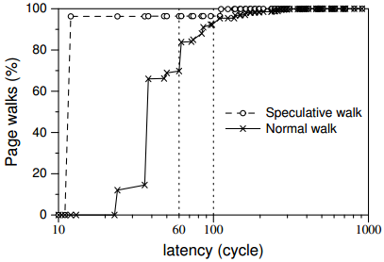
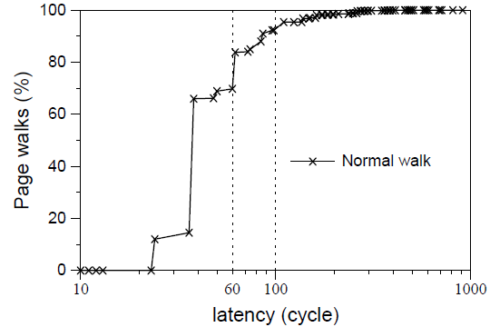
Details on SpecISP
Cumulative distributions of TLB miss latencies
Misspeculation rates
CDF
90 cycles
Volano
workloads | Mis-spec. rate | workloads | Mis-spec. rate
gcc | 2.072% | SPECjbb | 0.057%
mcf | 0.008% | Volano | ≈ 0.000%
sjeng | 0.150% | KernelCompile | 5.312%
Penalty: misspeculation << hypervisor intervention

Slide 32
Details on SpecISP
Cumulative distributions of TLB miss latencies
Misspeculation rates
CDF
90 cycles
Volano
workloads | Mis-spec. rate | workloads | Mis-spec. rate
gcc | 2.072% | SPECjbb | 0.057%
mcf | 0.008% | Volano | ≈ 0.000%
sjeng | 0.150% | KernelCompile | 5.312%
Penalty: misspeculation << hypervisor intervention

