Slide 1




GrandSLAm: Guaranteeing SLAs for Jobs in Microservices Execution Frameworks
Ram Srivatsa Kannan, Lavanya Subramanian, Ashwin Raju,
Jeongseob Ahn, Jason Mars, Lingjia Tang

Slide 2




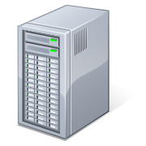
Transformation of Cloud Services
Monolithic
Microservices
App
App
OS
OS
Virtualization
Hardware

Slide 3


Building Applications with Microservices
Duplicated microservices
App: Image query (4 microservices)
Recognizes the input image
Generates natural language descriptions of the images
Builds a sentence for the description
Outputs the sentence as voice
Low Resource Utilization
App: Intelligent personal assistant (3 microservices)
- Provides answers to queries that are given as input through voice

Slide 4
Sharing Microservices
Amalgamate redundant microservices
Sharing microservices can improve resource utilization

Slide 5
How does instance sharing actually happen?
Impact on resource utilization?

Slide 6



Approach in AI & ML Microservices
Batching multiple requests¹
Requests belonging to the different applications can be composed into a single batch
App A
App B
App C
3
1
Sharing degree (batch size):
2
1. Djinn and Tonic: DNN as a Service and Its Implications for Future Warehouse Scale Computers, ISCA 15

Slide 7
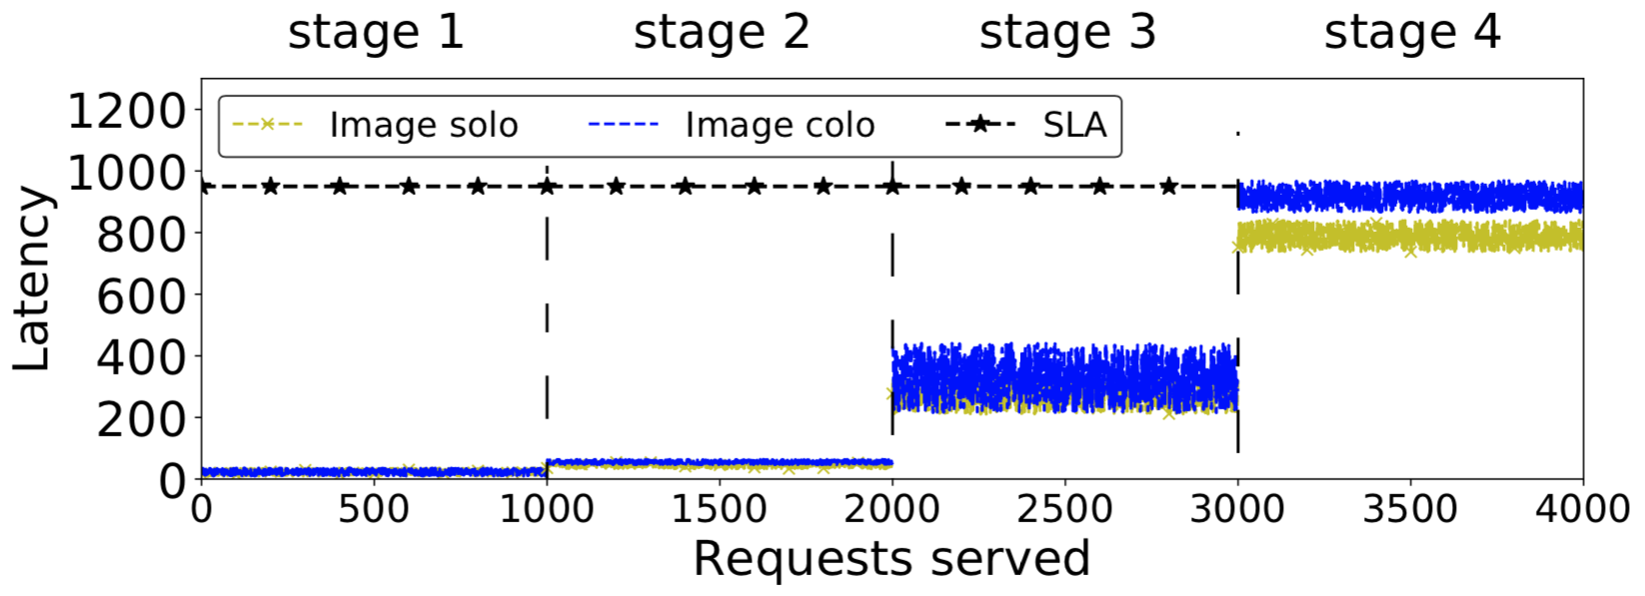



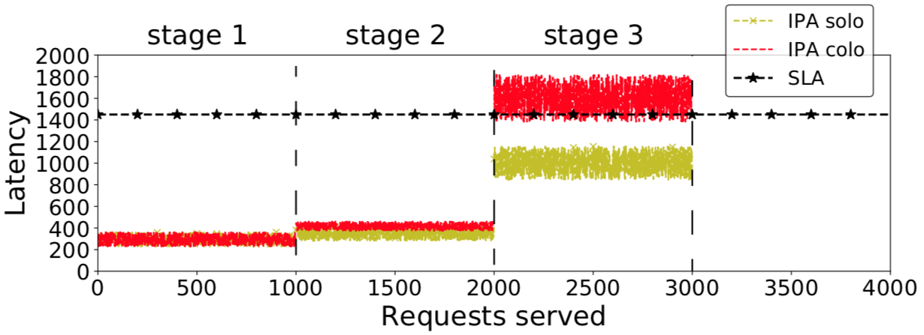



Impact of Sharing Microservices
Allow sharing
Image query
(4 microservices)
Disallow sharing
Sharing microservices can improve resource utilization, but the SLA can be violated sometimes
Intelligent personal assistant
(3 microservices)
Allow sharing
Disallow sharing

Slide 8

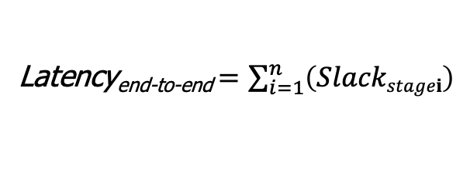
Latency Aware Sharing – Holy Grail of Multi-tenancy in Microservices
What is a necessary condition?
Slack_{stage1}
Slack_{stage2}
Slack_{stage3}
Slack_{stage4}
Latency_{end-to-end} $=\sum_{i=1}^{n}{\left(Slackstagei\right)}$
The maximum amount of time, a request can spend at the stage

Slide 9
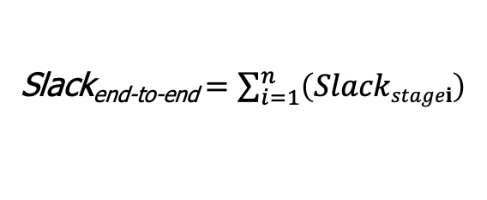
Enabling Sharing Microservices
What is a necessary condition?
Slack_{stage1}
Slack_{stage2}
Slack_{stage3}
Slack_{stage4}
Goal 1: Accurately estimate completion time for any given request.
Slack_{end-to-end} $=\sum_{i=1}^{n}{\left(Slackstagei\right)}$
Goal 2: Identify slack at each microservice stage.
The maximum amount of time, a request can spend at the stage

Slide 10
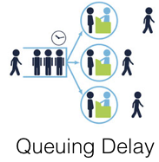
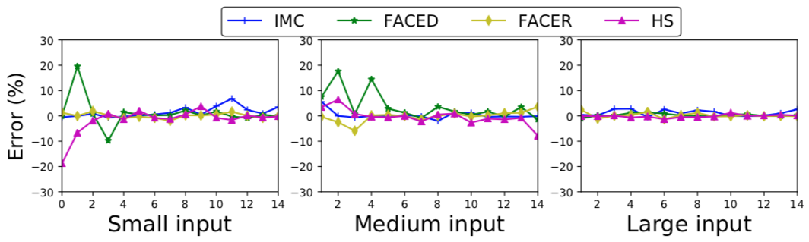

Towards Predicting The Execution Time
Performance study: image recognition
We can build a simple performance model for
AI & ML microservices based on these observations
Input: 128x128 dimension
➊
➋
➌
Estimated Time of Completion = T_{compute} + T_{queuing}
we use a linear regression model

Slide 11
Calculating Microservice Stage Slack
Stage slacks are proportionally allocated from the end-to-end latency
Computation time across stages vary by a lot.
2. Percentage of slack does not vary much across batch sizes.
App: Pose Estimation for Sign Language (4 microservices)

Slide 12
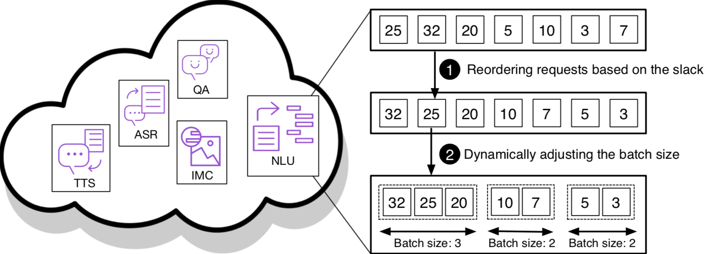
Stage Slack based Request Handling
Prioritizing the execution with lower slack
Dynamically batching requests based on slack
Tail
Head

Slide 13
Slack Forwarding
Unused slack can be utilized later
It can increase the overall request slack in the later stages of execution
Lead to enabling higher sharing degrees

Slide 14
Evaluation
Experimental platforms
CPU: Intel Xeon E5-2630, E3-1420
GPU: Nvidia GTX Titan X, GTX 1080
Each microservice run on a docker container
Applications used (implemented on TensorFlow)
Three workload scenarios

Slide 15
SLA: Latency Violation
GrandSLAm improves percentage of requests that violate SLA
Baseline: Executes requests in a FIFO fashion without sharing the microservices

Slide 16
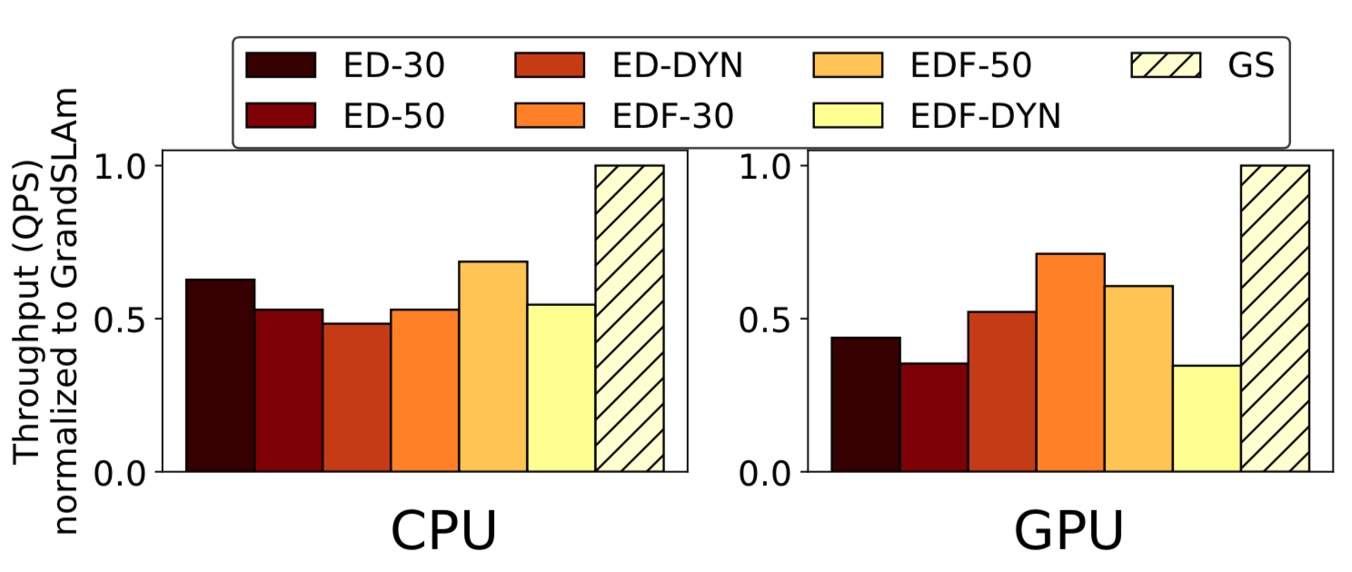
Utilization: Throughput
ED: Equally Division
EDF: Earliest Deadline First
Batch size: 30, 50, DYN

Slide 17
Conclusions
We explored a new approach to improve resource utilization while not violating SLAs
Three distinct contributions
Analysis of microservice execution scenarios
Accurate estimation of completion time at each microservice
Guarantee end-to-end SLAs by exploiting stage level SLAs
Future work
Enhancing the model to handle complex execution models
e.g., Parallel execution of multiple microservices, conditional execution of microservices

Slide 18
Thank You!
GrandSLAm: Guaranteeing SLAs for Jobs in Microservices Execution Frameworks
Ram Srivatsa Kannan, Lavanya Subramanian, Ashwin Raju,
Jeongseob Ahn, Jason Mars, Lingjia Tang

