Slide 1
V synth 2
EP-353_Audio Programming in C
0887184 Jeongwoo Park

Slide 2
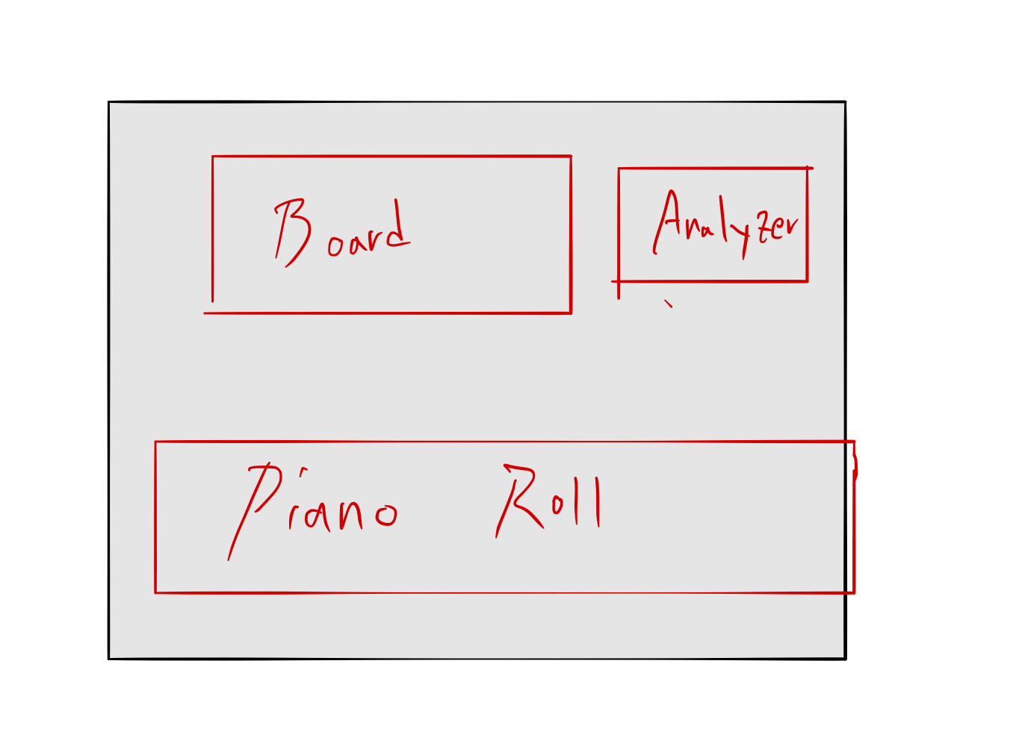
About your Project
My software will be a virtual instrument, literally analog synthesizer. It will have some oscillators, compressors, ADSR, and etc that user can control with their own tastes. Moreover, a graphic parameter will show what sound user makes.

Slide 3

Why this Project?

Slide 4
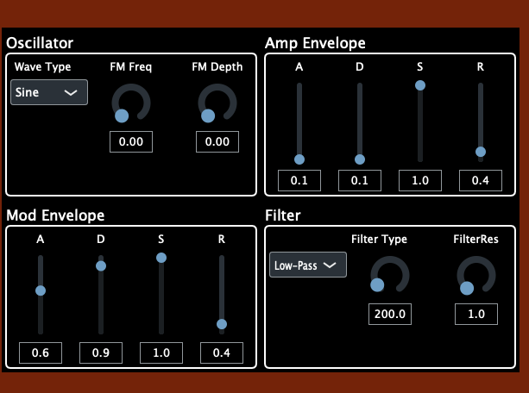
How does your project work?
& What works?
I have completed the first part, which is the most foundational,
and also finished building the oscillator, envelope generator, and filter.
Also, I’m studying the visualized Analyzer.

Slide 5

Future Plan

Slide 6
V synth 2
THANK YOU

