Slide 1
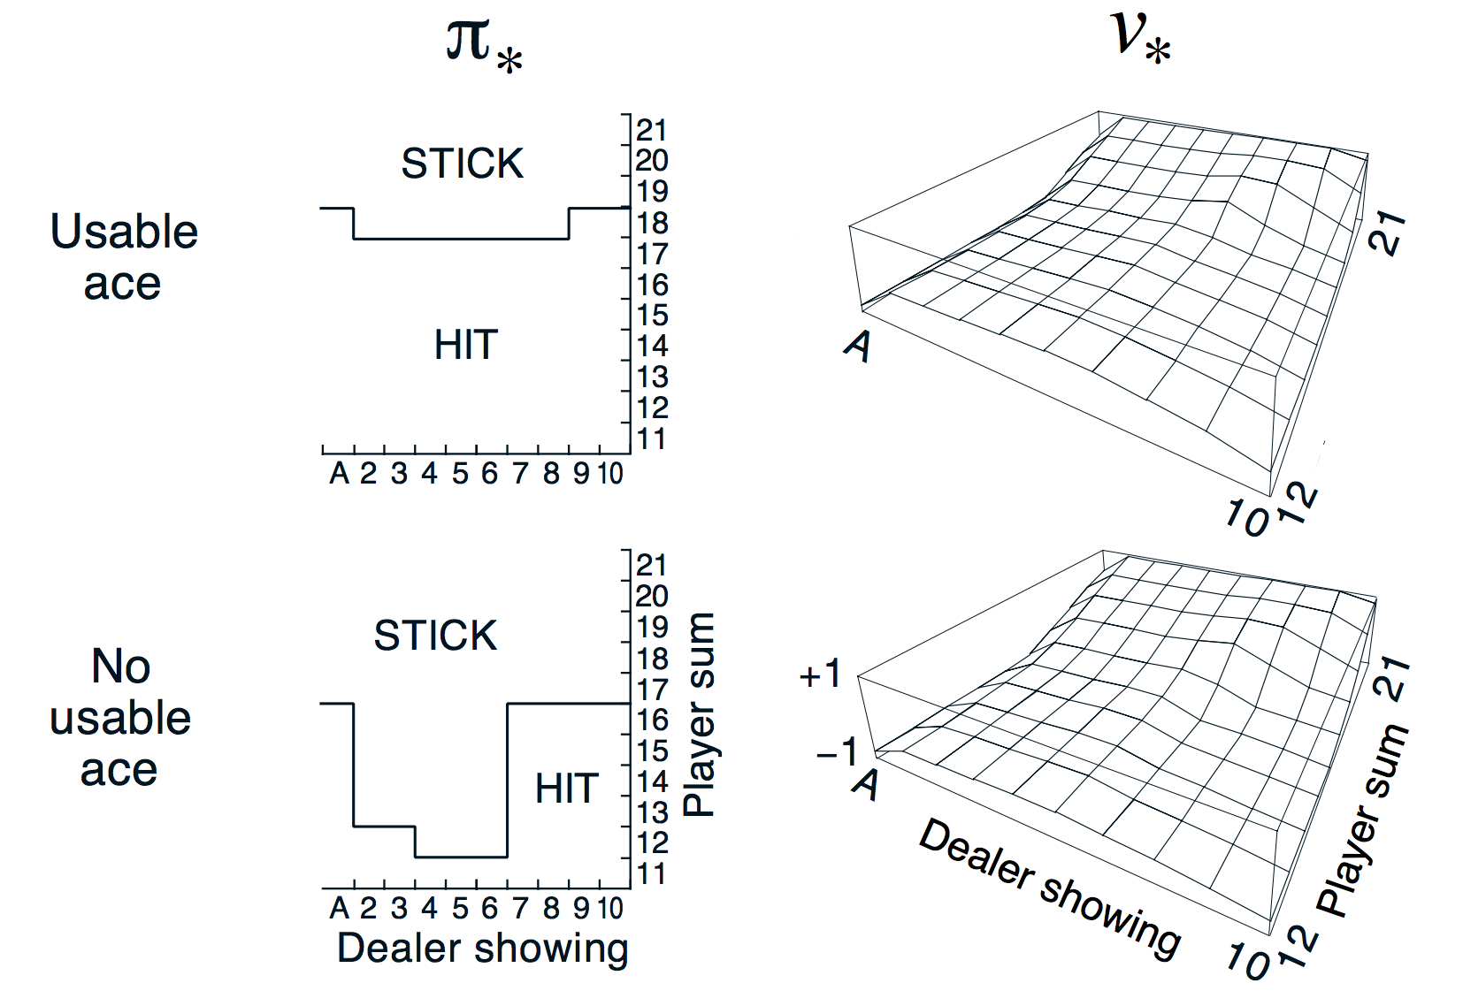
MC
(Black jack )
* GLIE Monte-Carlo Control 을 이용해 학습한 Black-jack

Slide 2
TD Control
* TD Control
Temporal-difference (TD) learning의 장점(MC와의 비교)
lower variance
Online(매 step 마다)
Incomplete sequences
그렇다면 MC 대신 TD로 Control loop를 하면 어떨까?
Apply TD to Q(S, A)
e-greedy policy improvement 사용
Update every time-step

Slide 3
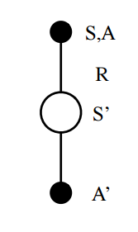
Sarsa
* Sarsa
Updating Action-Value Function with Sarsa
TD-Error
Q(S, A) ← Q(S, A) + $α$(R + $γ$Q(S’, A’) – Q(S, A))
TD-Target

Slide 4
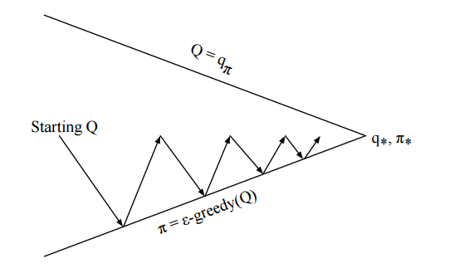
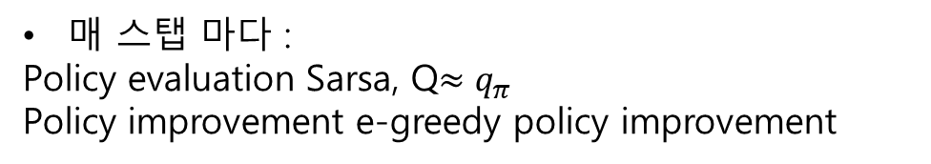
Sarsa
* Sarsa
On-Policy Control with Sarsa
1 STEP
매 스탭 마다 :
Policy evaluation Sarsa, Q$≈q_{π}$
Policy improvement e-greedy policy improvement

