Slide 1
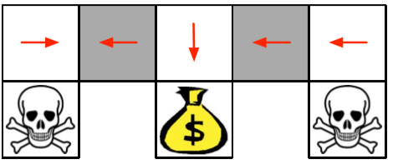
Bias
Actor-Critic
Algorithms
Variance
Bias
Variance
Bias
MC Policy Gradient
?
TD(0) Actor-Critic
* Approximating the policy gradient introduces bias
* A biased policy gradient may not find the right solution
Ex) grid-world
* Luckily, if we choose value function approximation carefully
then we can avoid introducing any bias
i.e. We can still follow the exact policy gradient

Slide 2

Compatible
Function
Approximation
Theorem(Compatible Function Approximation Theorem)
If the following two conditions are satisfied:
1. Value function approximator is compatible to the policy
2. Value function parameters w minimize the mean-squared error
Then the policy gradient is exact,
$$∇_{w}Q_{w}\left(s, a\right)= ∇_{θ}logπ_{θ}(s, a)$$
$$ε= 𝔼_{πθ}[{\left(Q^{θ}\left(s, a\right)− Q_{w}\left(s, a\right)\right)}^{2}]$$
$$∇_{θ}J(θ)= 𝔼_{πθ}[∇_{θ}logπ_{θ}\left(s, a\right)Q_{w}\left(s, a\right)]$$

Slide 3



Proof of
Compatible
Function
Approximation
If w is chosen to minimize mean-squared error, gradient of $ε$ w.r.t w must be zero,
So $Q_{w}\left(s, a\right)$ can be substituted directly into the policy gradient
$$∇_{w}ε=0$$
$𝔼_{πθ}[{(Q}^{πθ}\left(s, a\right)− Q_{w}\left(s, a\right)$)$∇_{w}Q_{w}\left(s, a\right)$] = 0
$𝔼_{πθ}[{(Q}^{πθ}\left(s, a\right)− Q_{w}\left(s, a\right)$)$∇_{θ}logπ_{θ}(s, a)$] = 0
$𝔼_{πθ}[Q^{πθ}\left(s, a\right)∇_{θ}logπ_{θ}(s, a)$] =$𝔼_{πθ}[Q_{w}\left(s, a\right)∇_{θ}logπ_{θ}(s, a)$]
$$∇_{θ}J(θ)= 𝔼_{πθ}[∇_{θ}logπ_{θ}\left(s, a\right)Q_{w}\left(s, a\right)]$$

Slide 4
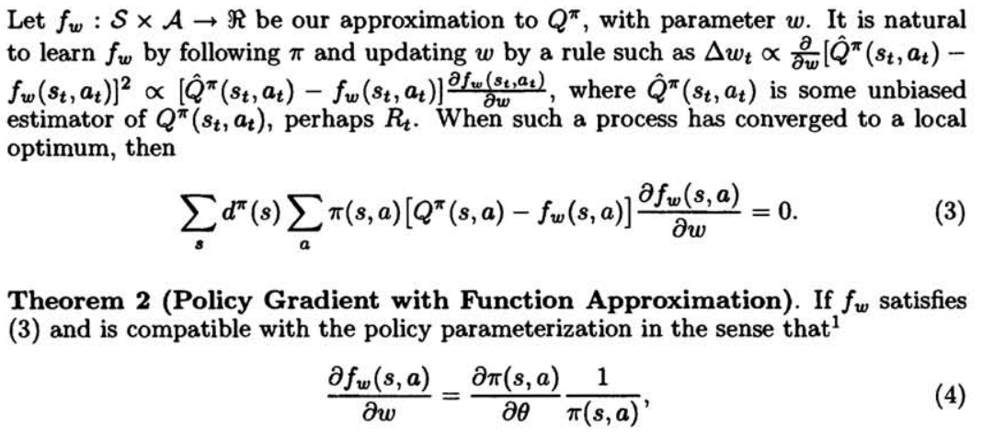
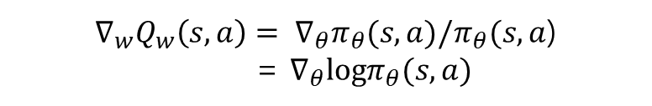
Compatible
Function
Approximation
출처 : Policy Gradient Methods for Reinforcement Learning with Function Approximation
$∇_{w}Q_{w}\left(s, a\right)= ∇_{θ}π_{θ}(s, a)/π_{θ}(s, a$)
= $∇_{θ}logπ_{θ}(s, a)$

Slide 5
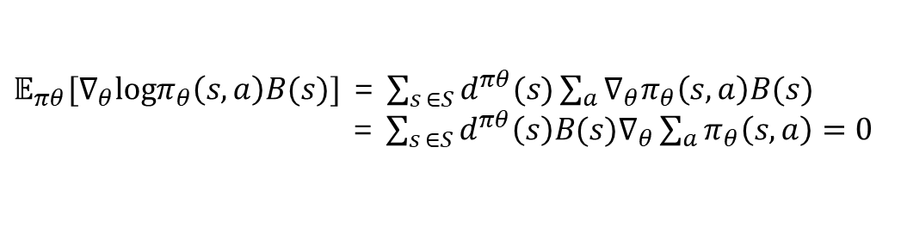

Reducing
Variance
Using a Baseline
* We subtract a baseline function B(s) from the policy gradient
→ Variance를 어떻게 더 줄일 수 있을까?
* This can reduce variance, without changing expectation
→ Variance를 어떻게 더 줄일 수 있을까?
$𝔼_{πθ}[∇_{θ}logπ_{θ}\left(s, a\right)B(s)]$ = $\sum_{s ∈S}{d^{πθ}(s)}\sum_{a}{∇_{θ}π_{θ}\left(s, a\right)B(s)}$
= $\sum_{s ∈S}{d^{πθ}\left(s\right)B(s)∇_{θ}}\sum_{a}{π_{θ}\left(s, a\right)}=0$
* A good baseline is the state value function $B(s$) = $V^{πθ}(s)$
* So we can rewrite the policy gradient using the advantage function $A^{πθ}(s, a)$
$A^{πθ}(s, a)$ = $Q^{πθ}(s, a)$ - $V^{πθ}(s)$
$$∇_{θ}J(θ)= 𝔼_{πθ}[∇_{θ}logπ_{θ}\left(s, a\right)A^{πθ}(s, a)]$$
* Policies Parameters들은 상대적인 차이에 의해 Policy를 결정한다.
* $Q^{πθ}(s, a1)$ = 100,000, $Q^{πθ}\left(s, a2\right)=99,998$ 보다 $Q^{πθ}(s, a1)$ = +1, $Q^{πθ}\left(s, a2\right)=−1 이$ 더 낫다.

