Slide 1
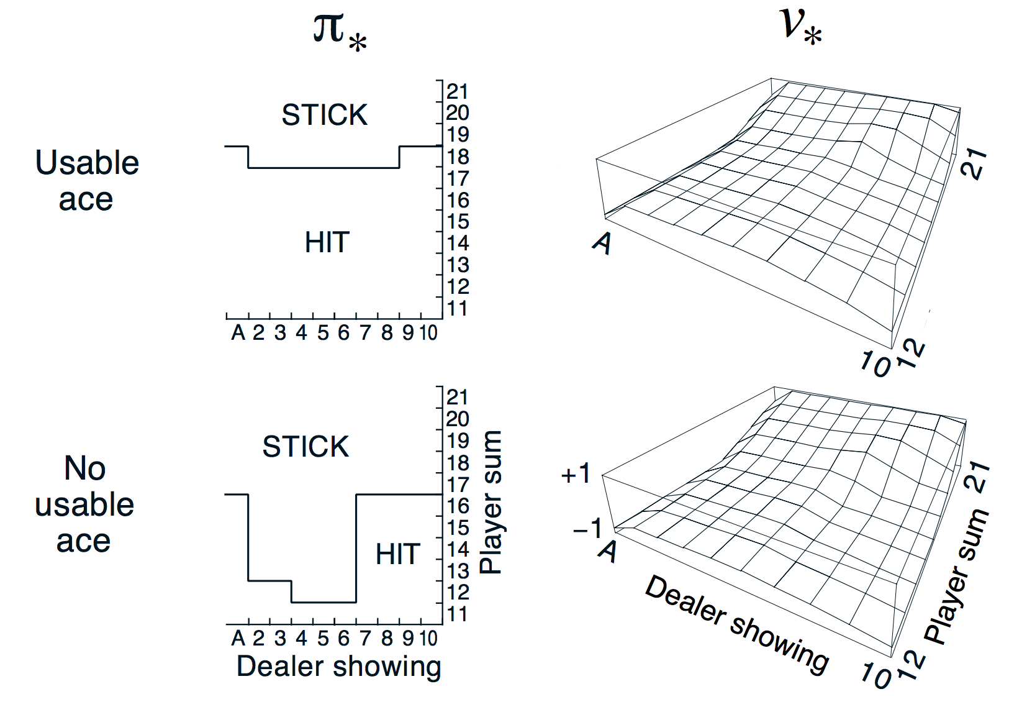
GLIE &
SARSA
(Black jack )
GLIE Monte-Carlo & SARSA Control 을 이용해 학습한 Black-jack

Slide 2
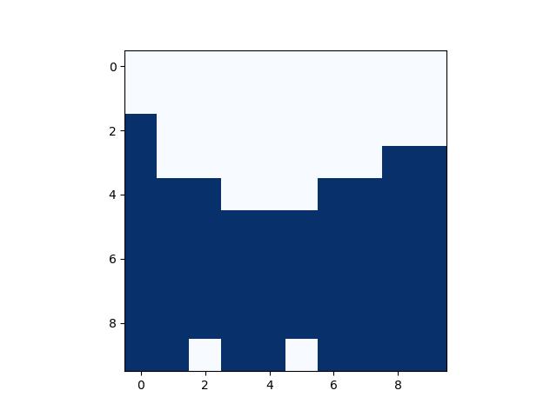
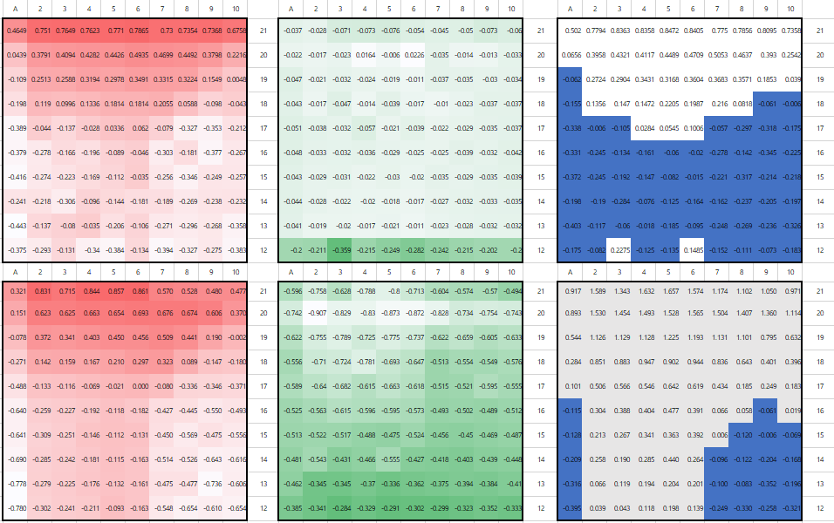
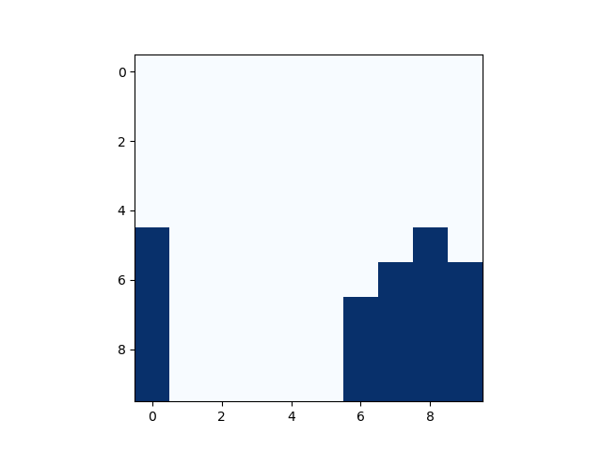
GLIE
* CODE결과
GLIE Monte-Carlo {episode 500000}
Stick
21
20
19
18
17
16
15
14
13
12
Hit
21
20
19
18
17
16
15
14
13
12
Stick
Hit

Slide 3
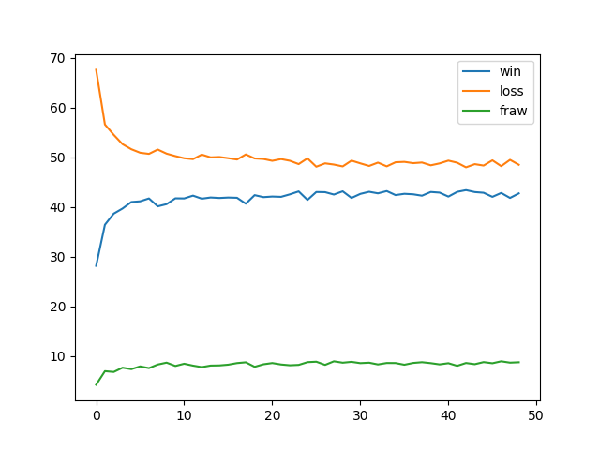
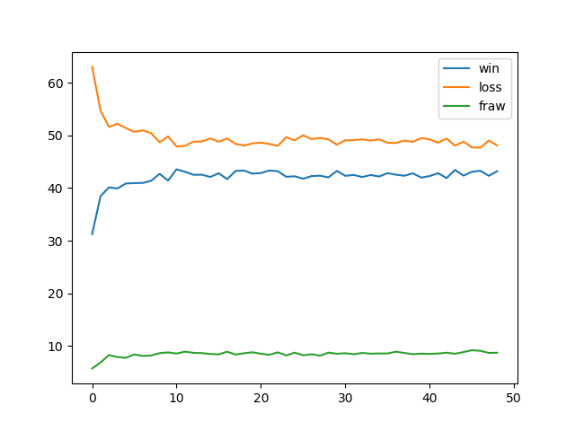
GLIE
* CODE결과
GLIE Monte-Carlo {episode 500000}
Stick
21
20
19
18
17
16
15
14
13
12
Hit
21
20
19
18
17
16
15
14
13
12
Stick
Hit

Slide 4
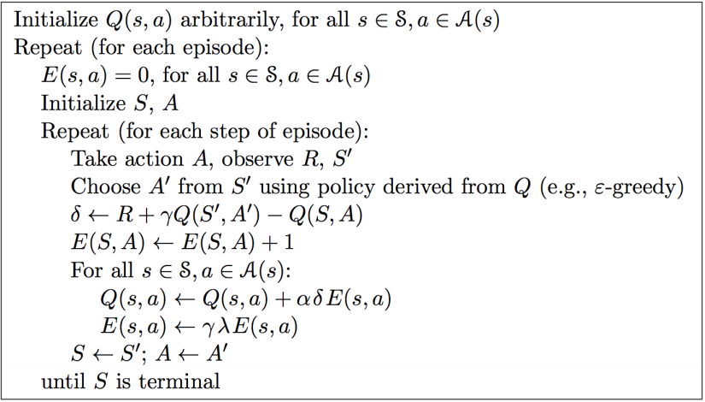
SARSA
* 참고
SARSA($λ$) Algorithm

Slide 5
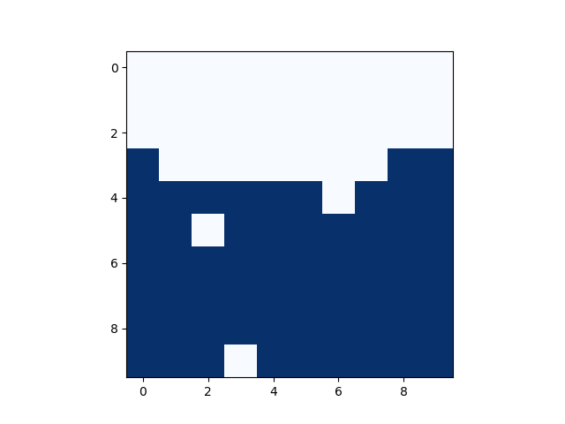
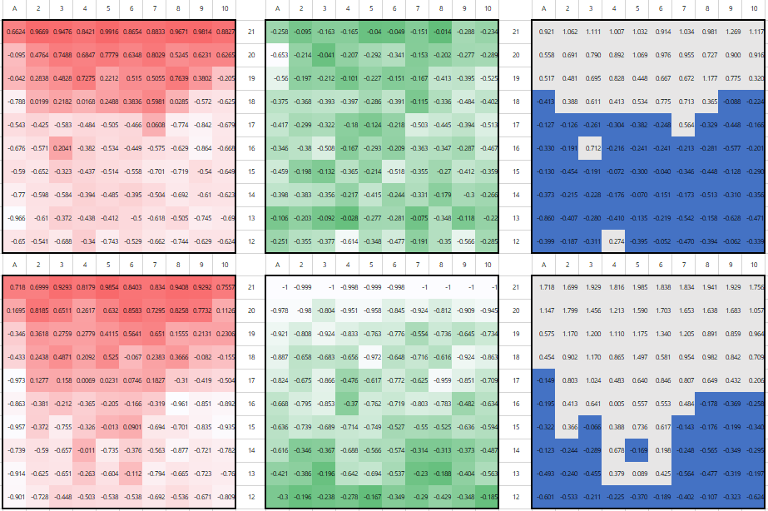
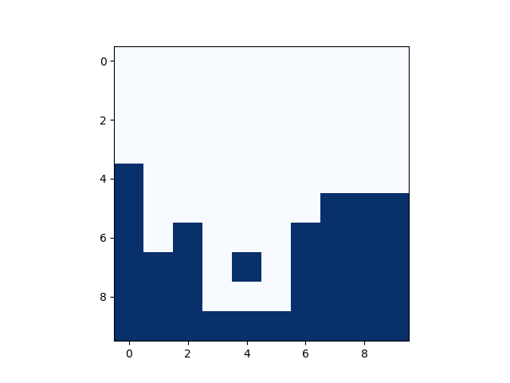
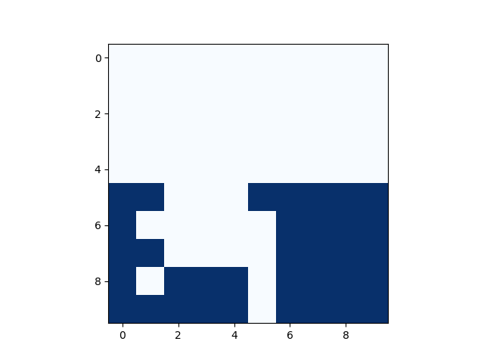
GLIE
* CODE결과
Backward View Sarsa($λ$) {episode 500000}
Stick
21
20
19
18
17
16
15
14
13
12
Hit
21
20
19
18
17
16
15
14
13
12
Stick
Hit

Slide 6
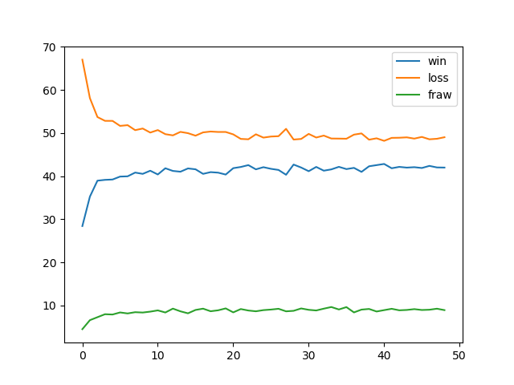
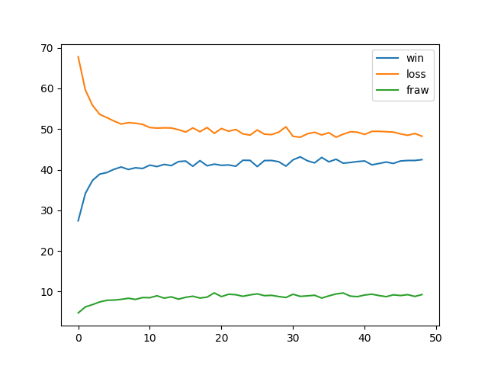
GLIE
* CODE결과
Backward View Sarsa($λ$) {episode 500000}
Stick
21
20
19
18
17
16
15
14
13
12
Hit
21
20
19
18
17
16
15
14
13
12
Stick
Hit

