Slide 1
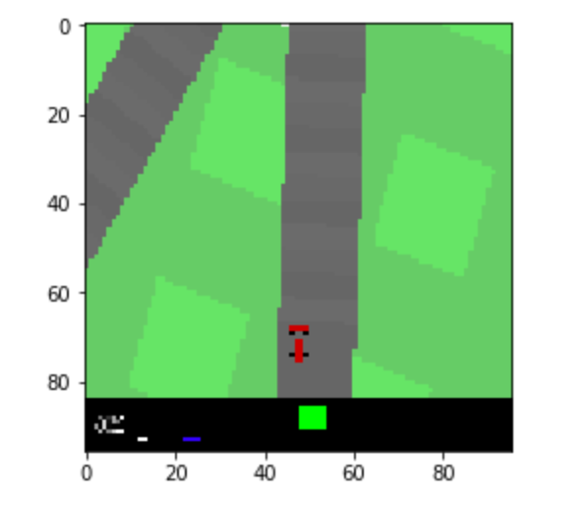
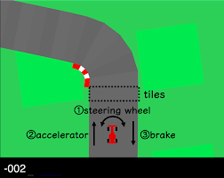
Open ai gym
CarRacing
OBJECTIVE: How many tracks did you drive in 1000 steps?
State: [96, 96, 3] # 96X96Pixel, RGB
Action : [3] #[wheel direction, accelerator, brake]
-1.0~1.0 0~1 0~0.8
Reward : -0.1(every frame(step)) + 1000/N(every track tile visited
*N : total number of tiles in track
* For example, if you have finished in 732 frames, your reward is 1000 - 0.1*732 = 926.8 points.
Action Space Discretization
wheel direction
accelerator
brake
Right
0%
0%
Left
50%
100%
Straight
100%
→18-action space
Attempt to implement DDQN algorithm using CNN

Slide 2
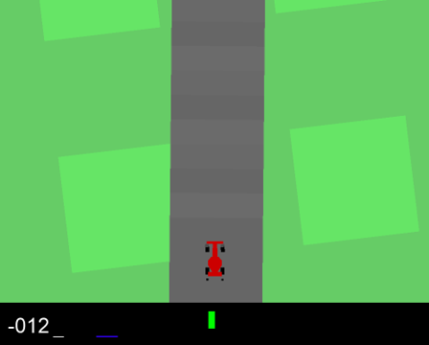


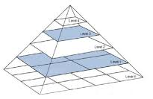
Open ai gym
CarRacing
1. Downsampled with OpenCV
24x24x3
96x96x3

Slide 3
Open ai gym
CarRacing
CODE
24
22
3
11
2
3
…
96
48
48
18
11
2
24
22
24
6
CONV1(ReLU)
6
Max_
Pooling
(2)
Fully-connected
layer1
FC
layer2
FC
layer3
FC
layer4
CONV2
(ReLU)
Max_
Pooling
(2)
CONV3
(ReLU)
Max_
Pooling
(2)
3
class Qnet(nn.Module): def __init__(self): super(Qnet, self).__init__() conv1 = nn.Conv2d(3, 6, kernel_size=3, stride=1) #3x24x24 pool1 = nn.MaxPool2d(2) #6x22x22 conv2 = nn.Conv2d(6, 12, kernel_size=2, stride=1) # 12 x 11 x 11 pool2 = nn.MaxPool2d(2) # n x 6 x 5 x 5 conv3 = nn.Conv2d(12, 24, kernel_size=2, stride=1) # 15 x 5 x 5 pool3 = nn.MaxPool2d(2) # n x 24 x 2 x 2 self.conv_module1 = nn.Sequential(conv1, nn.ReLU(), pool1, conv2, nn.ReLU(), pool2, conv3, nn.ReLU(), pool3).cuda(device) self.fc1 = nn.Linear(node, node).cuda(device) self.fc2 = nn.Linear(node, 48).cuda(device) self.fc3 = nn.Linear(48, output_size).cuda(device) self.relu = nn.LeakyReLU().cuda(device) def forward(self, x): x = x.cuda(device) s_out = self.conv_module1(x) s_out = s_out.view(-1, node) s_out = self.relu(self.fc1(s_out)) s_out = self.relu(self.fc2(s_out)) s_out = self.fc3(s_out) return s_out

Slide 4
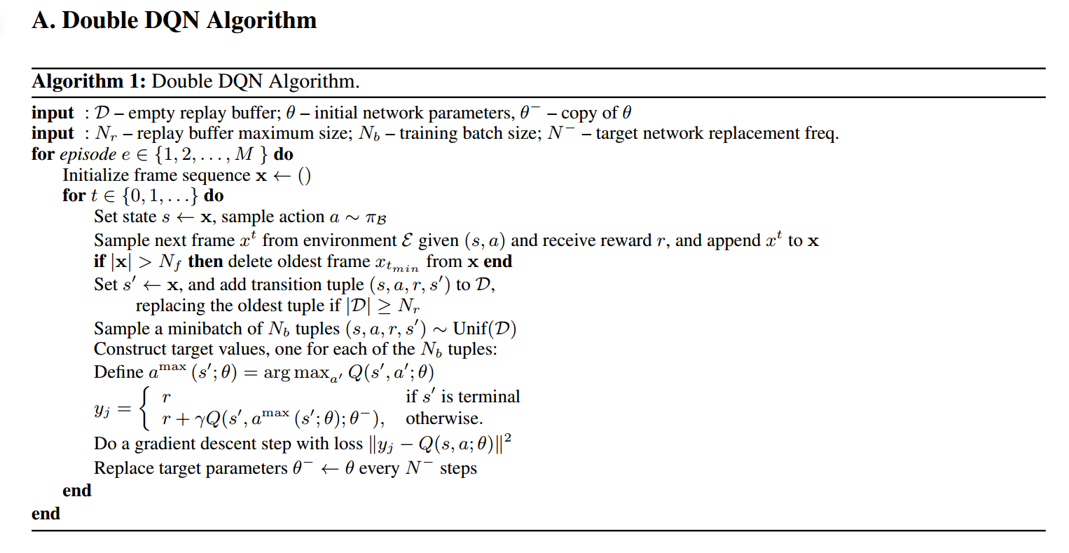



Open ai gym
CarRacing
CODE
def Train(Q, Q_target, memory, optimizer): for i in range(30): state, action, reward, next_state, done = memory.sample(batch_size) state = state.to(device) action = action.to(device) reward = reward.to(device) next_state = next_state.to(device) done = done.to(device) Q_out = Q(state) Q_value = Q_out.gather(1, action) Q_dot_out = Q(next_state) Q_dot_value = Q_dot_out.max(1)[1].unsqueeze(1) Q_prime = Q_target(next_state) Q_prime = Q_prime.gather(1, Q_dot_value) #DDQN target = reward + gamma * Q_prime * done loss = F.smooth_l1_loss(Q_value, target) optimizer.zero_grad() loss.backward() optimizer.step()
$$Q(s,a;θ)$$
$$\underset{a′}{argmax}{Q(s^{′},a^{′};θ)}$$
$$Q(s^{′},\underset{a′}{argmax}{Q(s^{′},a^{′};θ)};θ^{−})$$

