Slide 1

Stateful Objects
Cano morales Jeorval jose

Slide 2
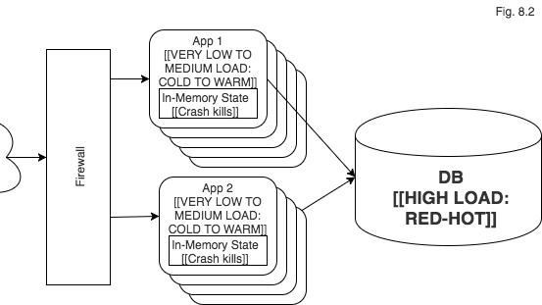
Definition
A stateful object is an instance of a class that may morph itself into various states. For example an object can be created, but not initialized, later initialized and ready for being used and at the end it can be disposed (but still remain accessible in memory).
In contrast to this a stateless object represents just one state for its whole life-cycle. Modeling this as an immutable object, whose fields are only initialized once during construction and then remain unchanged, seems to be the most straightforward design technique.

Slide 3
Getter
It means establishing, because it helps us to assign an initial value to an attribute, but explicitly, in addition the Setter never returns anything (It is always void), and only allows us to give public access to certain attributes that we want the user to modify.

Slide 4
Setter
It means to obtain, because it helps us to obtain (retrieve or access) the value already assigned to an attribute and use it for a certain method.

