Slide 1
Mosquito
exTorr RGA interface

Slide 2
Instrument
exTorr RGA Model XT100 http://www.extorr.com/products
Mass range: 1 to 100 amu
Interaction only with Windows
Control software: Vacuum Plus

Slide 3
How mosquito works
Behavior of the RGA controlled by instances of VacuumPlus.exe and a set of configuration files loaded by each instance
Filament off/Saving off (off)
Filament on/Saving off (warmup)
Filament on/Saving on (acquisition mode)
Interface with dripline-labview

Slide 4
Requirements

Slide 5
Global scheme (main.vi)
One-time method
Dripline interface
While loop
Internal
Listen to broadcast
broadcast.ping
rga_interface.ping
Display log
Do data taking procedure
Listener
- rga_interface.start
Stop taking procedure
Init
.project8_authentications
Config file
Listener
- rga_interface.stop
Scheduler
Listener
- rga_interface.is_running

Slide 6

Init
Read information from various files and fill some global variables
Config file for mosquito $→$ Config_infos
.project8_authentications.json (%HOME) $→$ AMQP_credentials (dripline-labview)
Dripline_info (dripline-labview) $→$ Sender_info (dripline-labview)

Slide 7
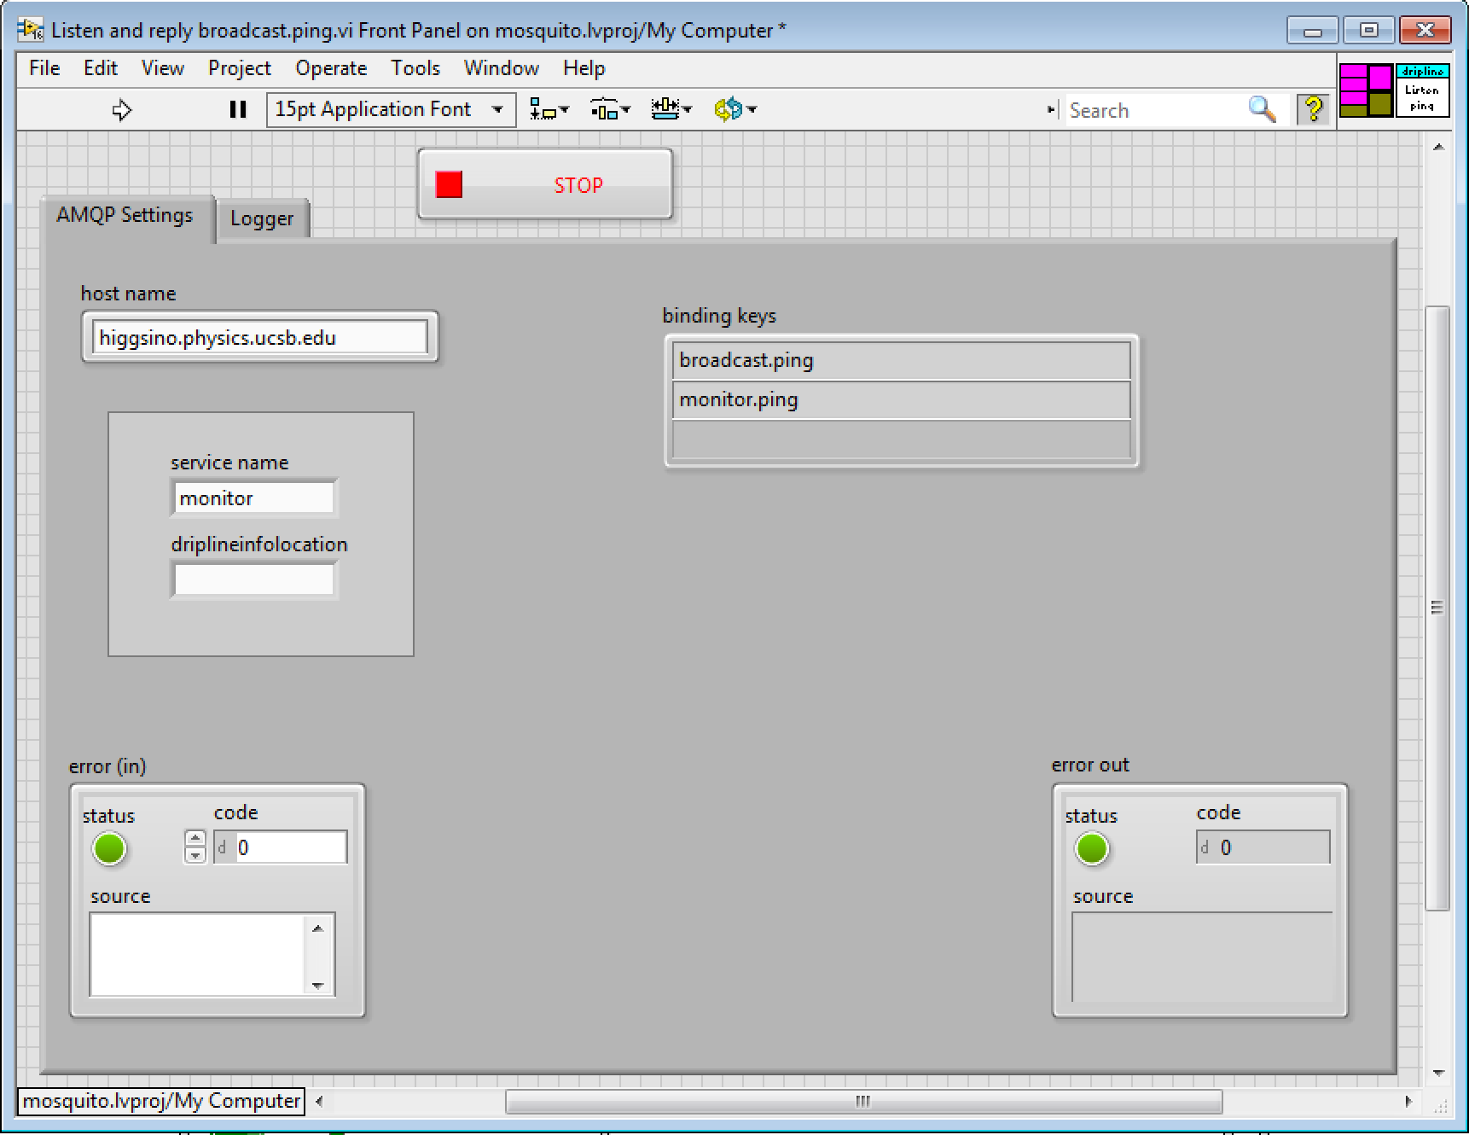
Broadcast
Stand-alone application
dripline-labview/vi/API/Listen and reply broadcast.ping.vi
Listen to broadcast.ping and service_name.ping
Possess its own logger
Open and run into a sub-panel of main.vi

Slide 8
Listeners
Listen to rga_interface_xxx
Upon receiving a request, check the status of the instrument (is_running)
Reply immediately to any request

