Slide 1
Data and model versioning
Data Science in Production:
MLOps and Software Engineering

Slide 2
How did the exercises go?
Did you manage to get DVC to work?
What are the similarities and differences with git (in your words)?
Fewer exercises? More challenging? Adequate?

Slide 3

Outline
Why data versioning?
Data storage
Data stages (medallion)
Data version operations
Metadata for versions
Data stages in ML

Slide 4
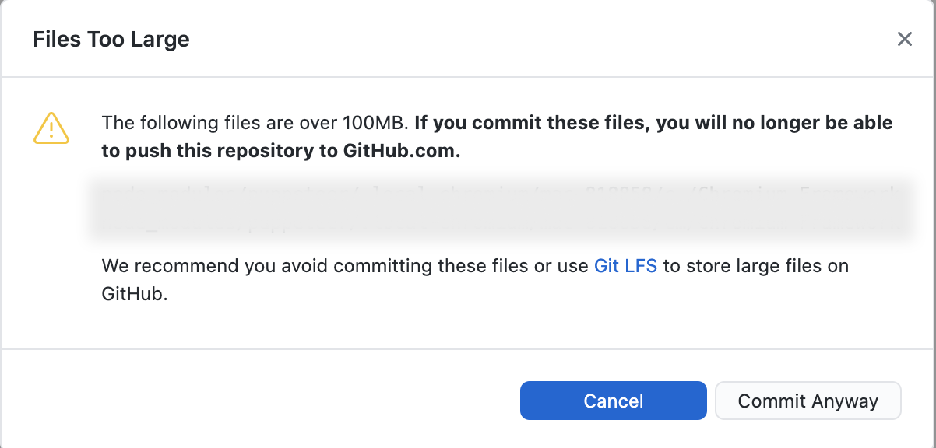

Slide 5
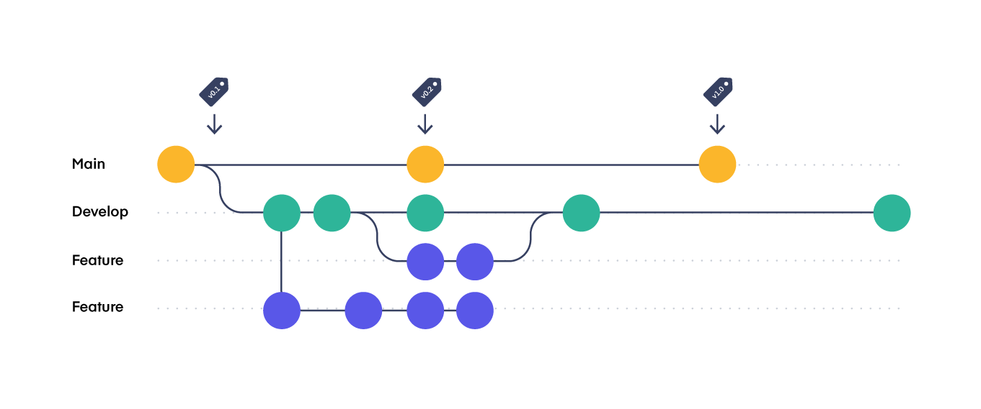
Unique reference to data
Like with git and code
  Versioned changes
  Revert/roll-back
Check previous performance
From https://www.pablogonzalez.io/salesforce-git-branching-strategies/

Slide 6
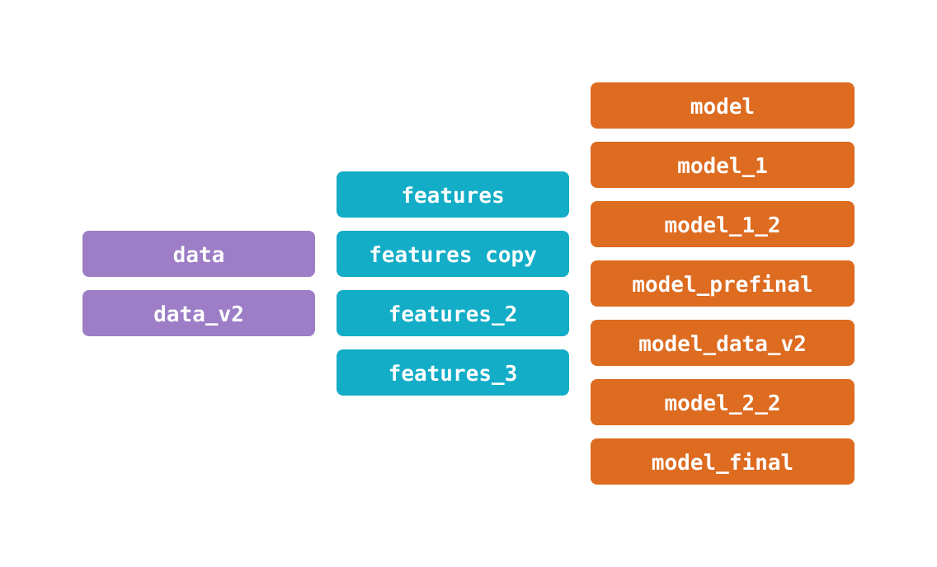
Complexity of DS projects
Looks familiar?
Can easily happen without planning
Not production viable
From https://dvc.org/doc/use-cases/versioning-data-and-models

Slide 7
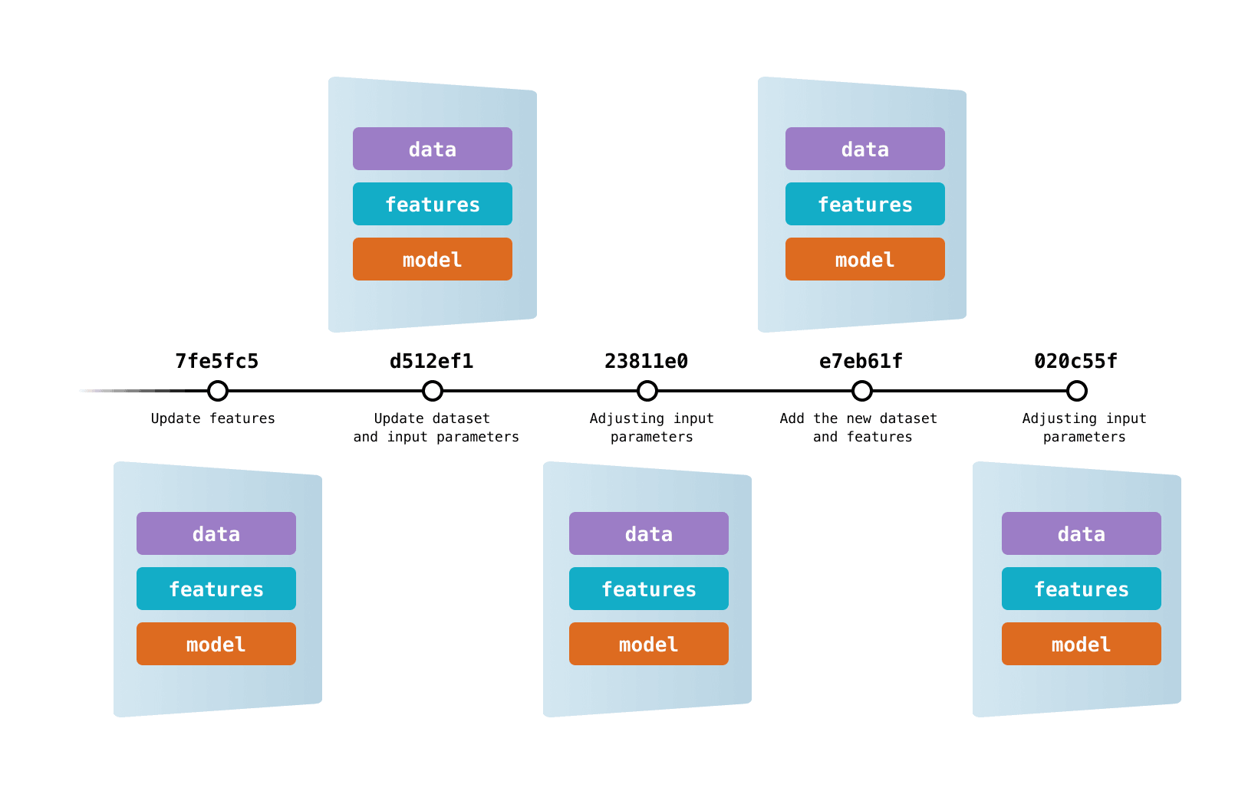
Package solutions
One commit, one “package”
  Data
  Features
  Models
Applies to all kinds of data
  Images
  Tabular
  Etc
From https://dvc.org/doc/use-cases/versioning-data-and-models

Slide 8
Multiple levels of data versioning
Level 0 | Level 1 | Level 2 | Level 3
Data is unversioned | Data is versioned as a snapshot | Data and code are versioned | Data and code are versioned through specialised tools
From http://www.mlebook.com/wiki/doku.php Chapter 3.11

Slide 9
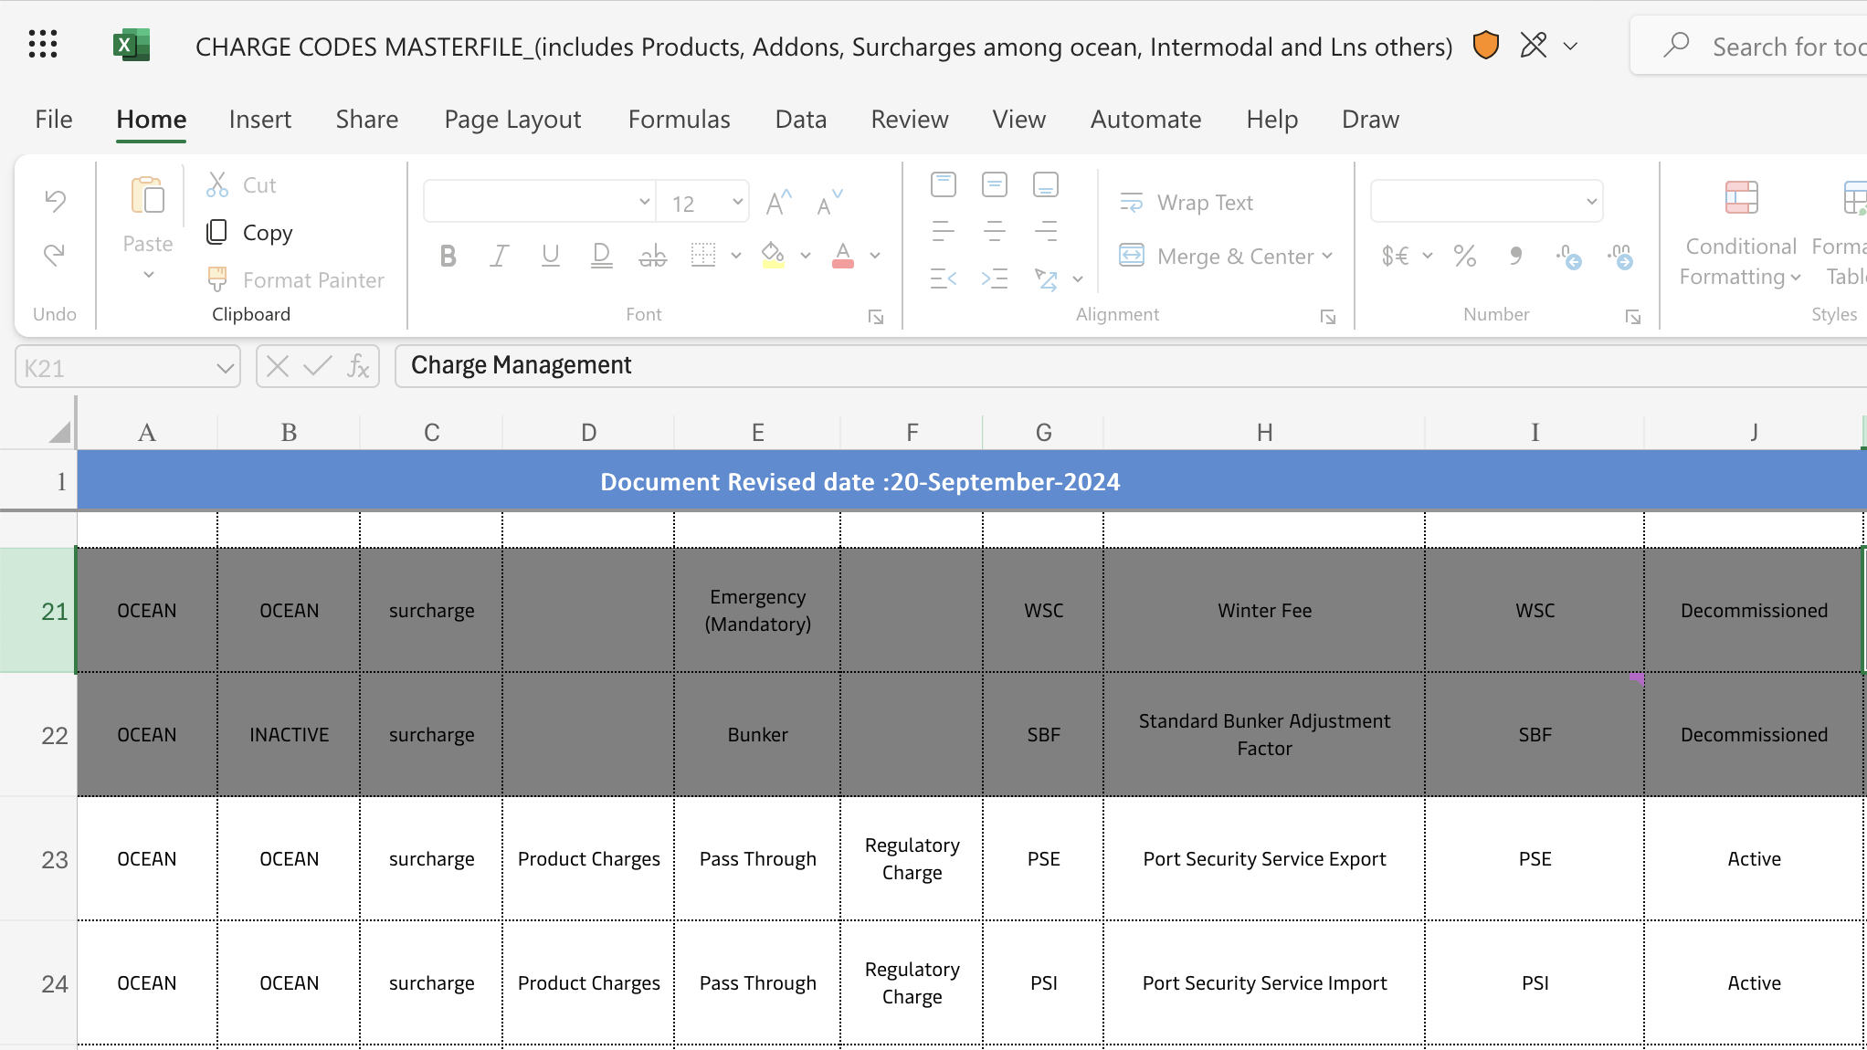
Level 0: Unversioned data

Slide 10
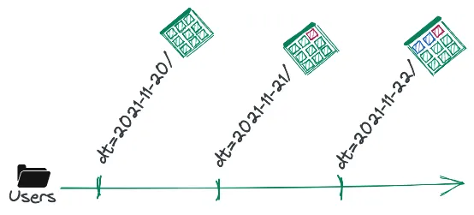
Level 1: Snapshots
Duplicate all relevant data
  Storage intensive → cloud
  Manual tracking of versions
Viable if:
  Infrequent updates
  Few models
From https://lakefs.io/blog/data-versioning/

Slide 11
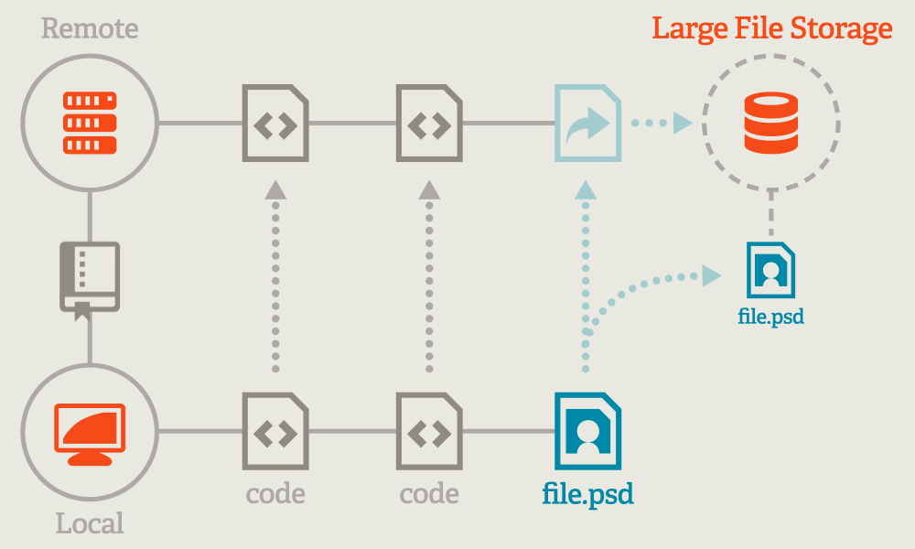
Level 2: Data and code as one asset
Version control with Git
  Metadata saved for large files
Large files stored in cloud
  Efficient formats
Tools:
  DVC
  Git Large Files Storage
From https://git-lfs.com/

Slide 12
Level 3: Specialized versioning
Tool-specific solutions
Comes with a lot extra functionality
  Pipelines
  Experiment tracking
  Etc etc
From https://dvc.org/doc/use-cases/experiment-tracking

Slide 13
Which level(s) do you usually follow?
Level 0 | Level 1 | Level 2 | Level 3
Data is unversioned | Data is versioned as a snapshot | Data and code are versioned | Data and code are versioned through specialised tools

Slide 14
Data version operations

Slide 15
Standard flow
Demo time!
dvc add data/
git add data.dvc
git commit -m "Added cleansed data from new method"
git push
dvc push
From https://dvc.org/doc/use-cases/versioning-data-and-models

Slide 16
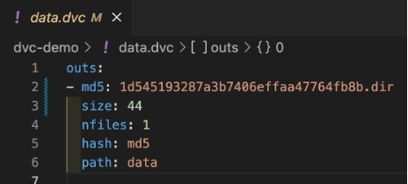
Info in (dvc) files
Outs:
  Path
  Hash
  Size
  nfiles
  md5

Slide 17
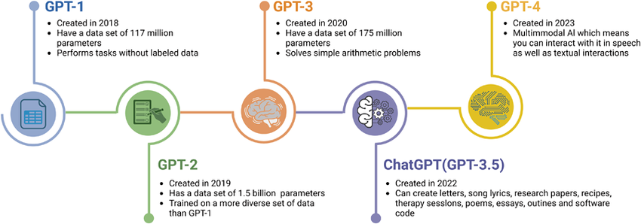
Release tags
Do it through git
  git tag -a "v2.0" -m "imagenet v2.0"
Examples:
  GPT
  Do you have any?
From https://www.researchgate.net/figure/Illustration-of-GPT-development-history-and-the-rise-of-ChatGPT-The-development-timeline_fig1_374092520

Slide 18
Data storage

Slide 19
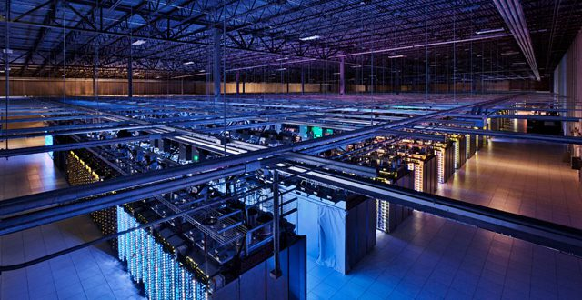
Storage costs money
From https://www.backblaze.com/blog/whats-the-diff-hot-and-cold-data-storage/

Slide 20
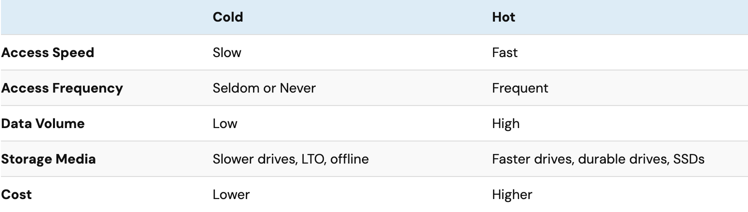
Strategies
Cloud and/or on premise
Cold vs hot
Mounted drive vs network API
From https://www.backblaze.com/blog/whats-the-diff-hot-and-cold-data-storage/

Slide 21
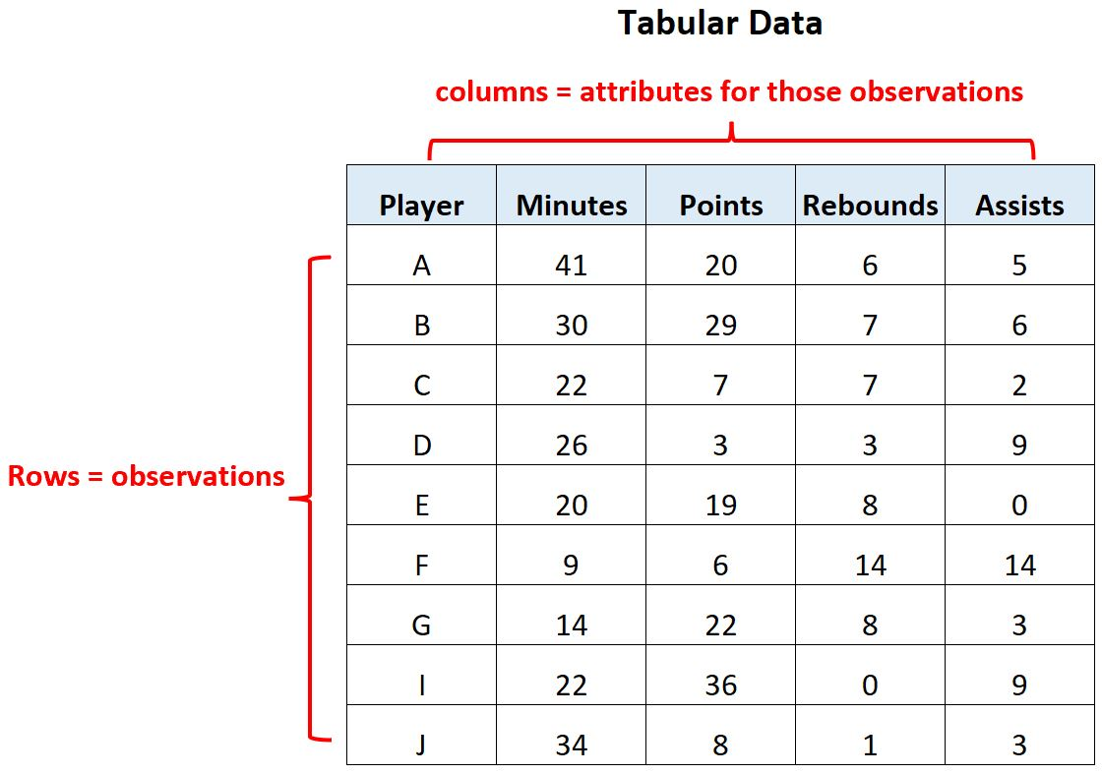
Tabular/relational data
One row per ID, organised in tables
Commonly associated files
  CSV
  Parquet
  ORC
Typical RDBs
  MySQL
  Google BigQuery
From https://www.statology.org/tabular-data/

Slide 22
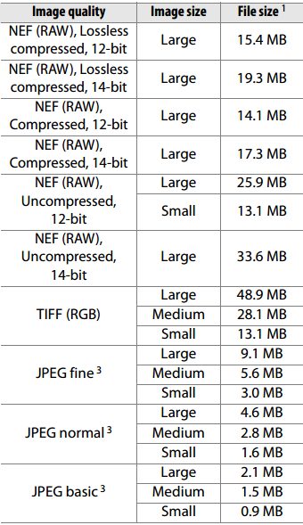
Images
RAW files can be big
Compressed files
Little difference to models
From https://mcpactions.com/nikon-raw-s-file-size-option/

Slide 23
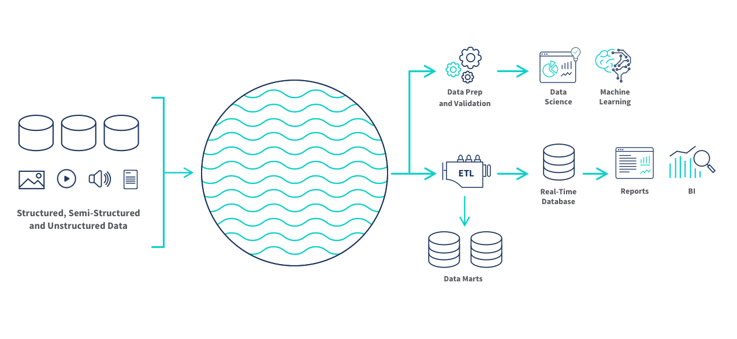
Data lakes
All types:
  Unstructured
  Semi-structured
  Structured
Blobs or files
  Binary Large OBject
From https://www.qlik.com/us/data-lake

Slide 24
Did anyone use a cloud solution for the exercises?

Slide 25
Data stages

Slide 26
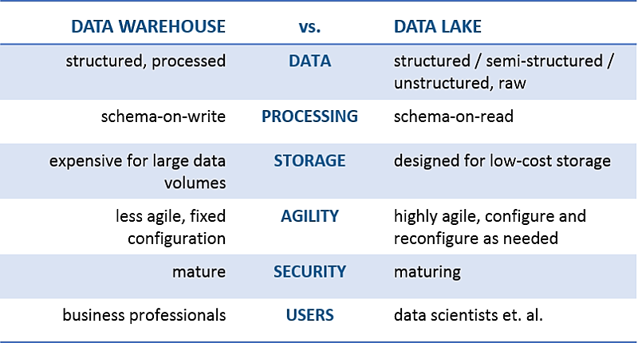
Data lakes/warehouses
Lakes: raw, unfiltered
Warehouses: processed, vetted
ELT vs ETL
  Extract, Load/Transform
  In reality: E(T)LTLTL…
From https://dvc.org/doc/use-cases/versioning-data-and-models
Notes:
Just want to highlight that there are different strategies for collecting data, and the main one we are discussing here is essentially data lakes.
Terms and tech change all the time so don’t get too hung up on the name.

Slide 27
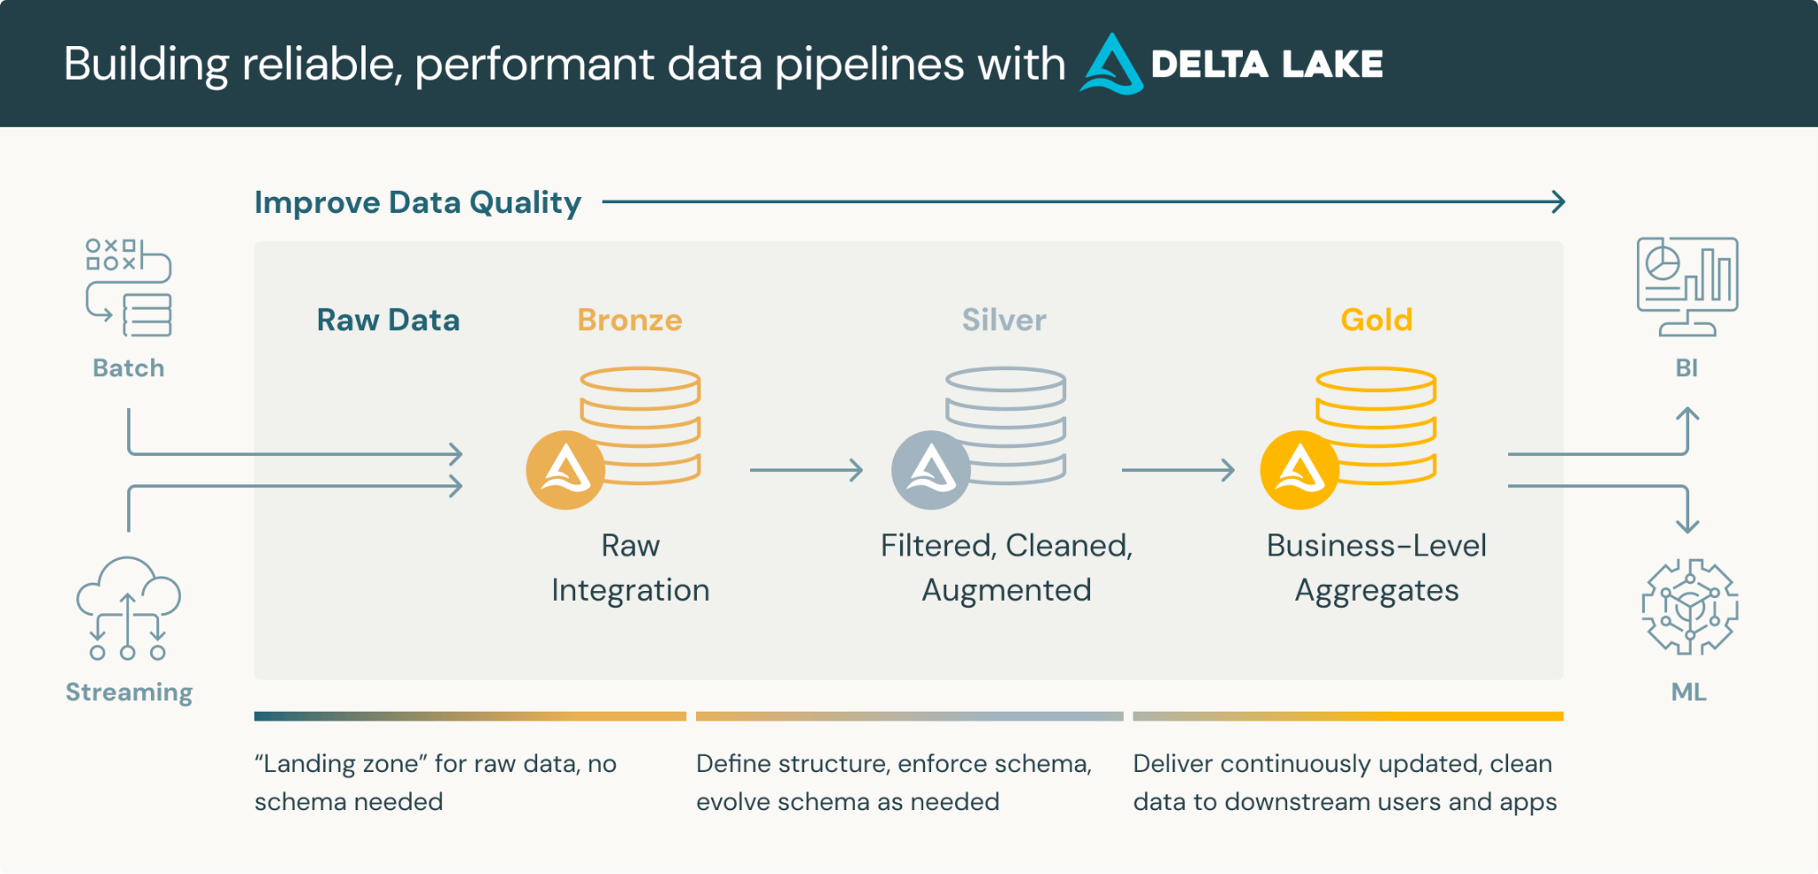
Medallion architecture
From https://www.databricks.com/glossary/medallion-architecture
Notes:
The different layers are sometimes referred to as Landing / Staging / Curated, Raw / Transformed / Final or Zones0 / Zone1 / Zone2.
ELT vs ETL

Slide 28
Version control where?
From https://www.databricks.com/glossary/medallion-architecture

Slide 29
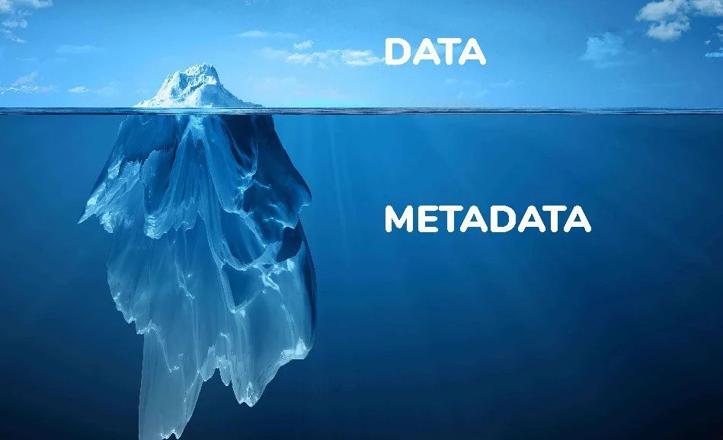
Metadata
Creation/modification
  Author and lineage
  Time created
  Description
  Version history
Schemas
  Data types and values
  Columns
From https://zeenea.com/the-role-of-metadata-in-a-data-driven-strategy/

Slide 30
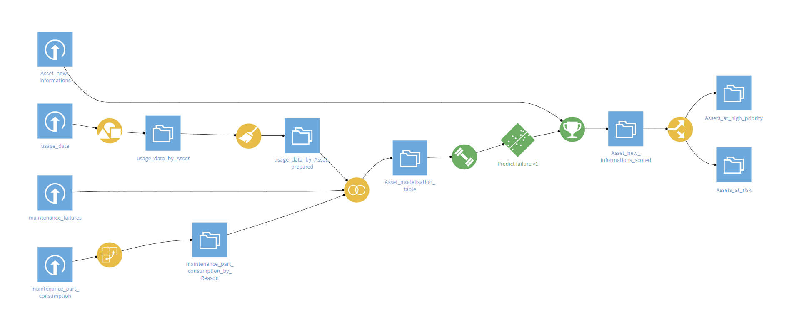
Data lineage
Where does the data come from?
  Root cause(s) for bad data
From https://godatadrive.com/blog/favorite-features-of-dataiku

Slide 31
Data stages in ML
Notes:
It’s not much different than above, really

Slide 32
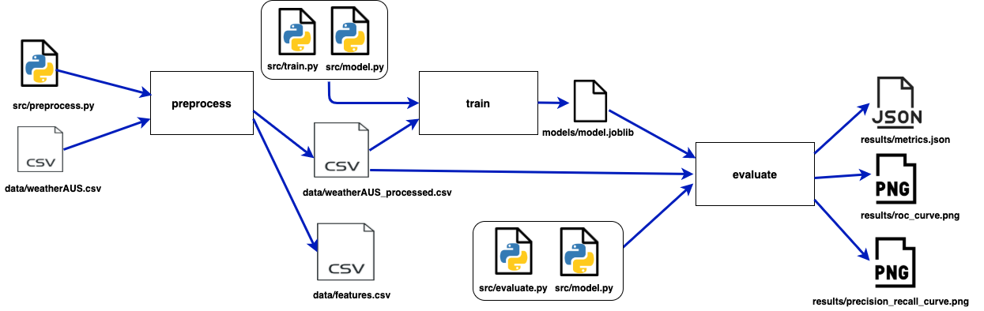
Data pipelines
Key for reproducible data
From https://mlops-guide.github.io/Versionamento/pipelines_dvc/

Slide 33
Typical ML datasets
Raw: collected data
  Event stream data, sensor time series
Cleansed: preprocessed
  Deduplicated events, imputation
Model-ready: features
  Train/validation split
Monitoring

Slide 34
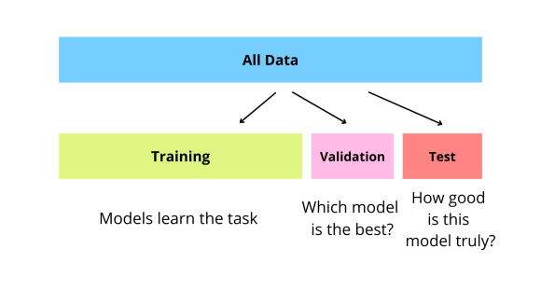
Train/test split
You are probably familiar
Which bronze/silver/gold layer?
Control RNG w. seed
From https://www.kaggle.com/discussions/general/516681
Notes:
It should happen between bronze and silver the spit

Slide 35
Summary

Slide 36
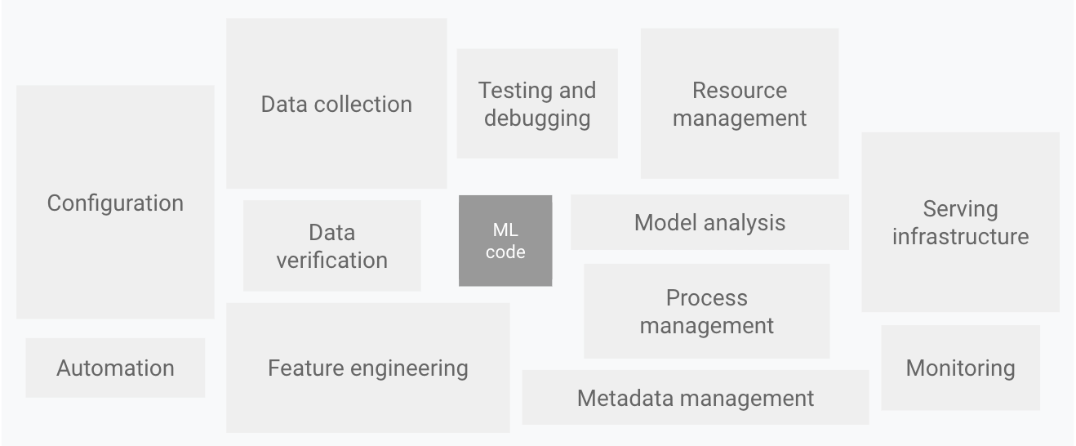
ML projects components
Data examples
  Collection
  Cleaning
  Validation
More on this next week(s)
From https://cloud.google.com/architecture/mlops-continuous-delivery-and-automation-pipelines-in-machine-learning

Slide 37

Next 2 times: Golang
Introduction and fundamentals

Slide 38
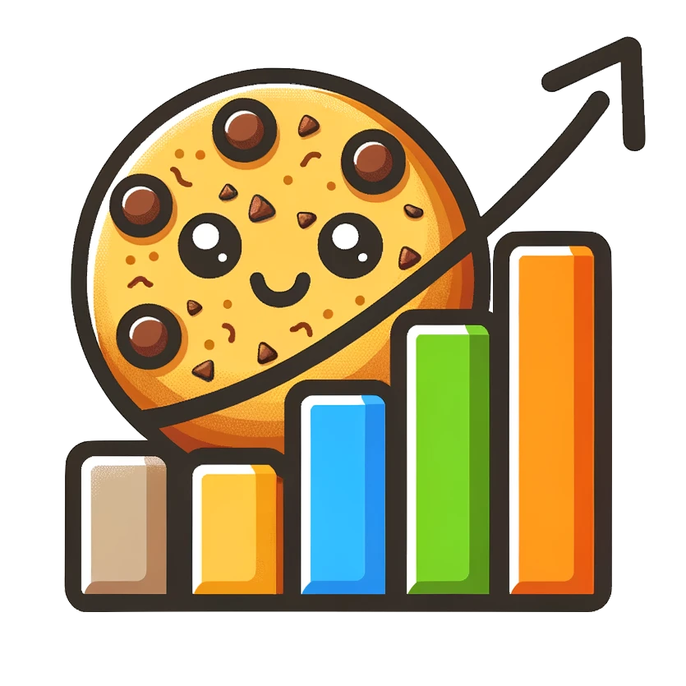
In 3 weeks: ML project structure
Template DS project
Make sure to install
Cookiecutter DS
2 hour code-together
2 hour lecture
From https://cookiecutter-data-science.drivendata.org/

Slide 39

In 4 weeks: ML models
Extend thinking to any artifact
  Data
  Models
  Experiments
Monitoring, selection, experimentation, etc

