Slide 1
Data Science in Production:
MLOps and Software Engineering
Productionising models

Slide 2
How did the exercise go?
Did you manage to go through all the exercises?
Did you try logging different things?
Was the difficulty adequate? More exercises? Other thoughts?

Slide 3
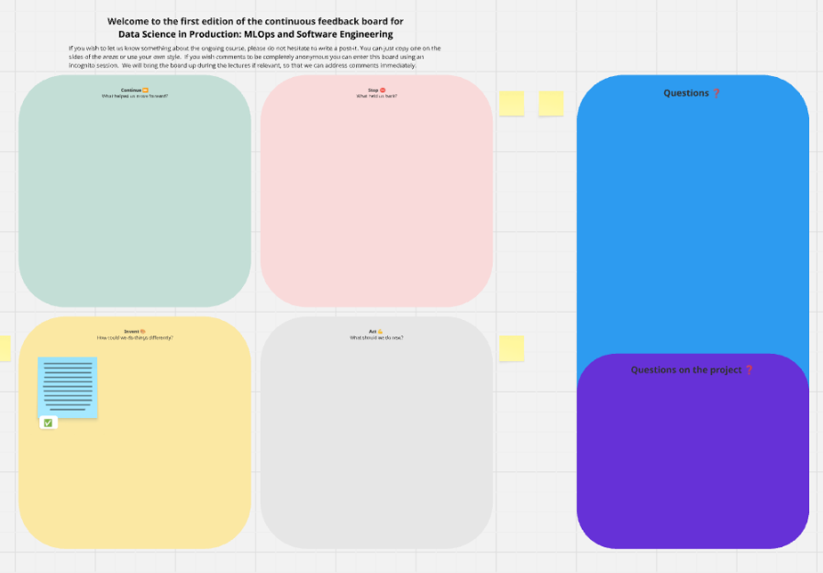
https://miro.com/app/board/uXjVJQwy4bs=/

Slide 4
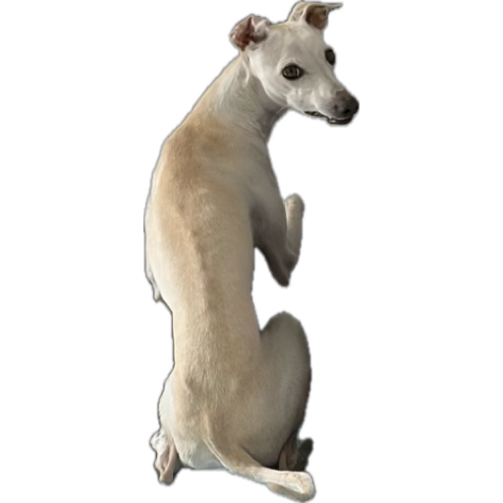
Outline
DORA metrics (for DevOps)
DORA metrics (for MLOps)
  Deployment frequency
  Lead time for change
  Mean time to restore
  Change failure rate
Notes:
The DORA Metrics for MLOps will be our red thread for explaining why model experimentation, selection and monitoring is important.

Slide 5
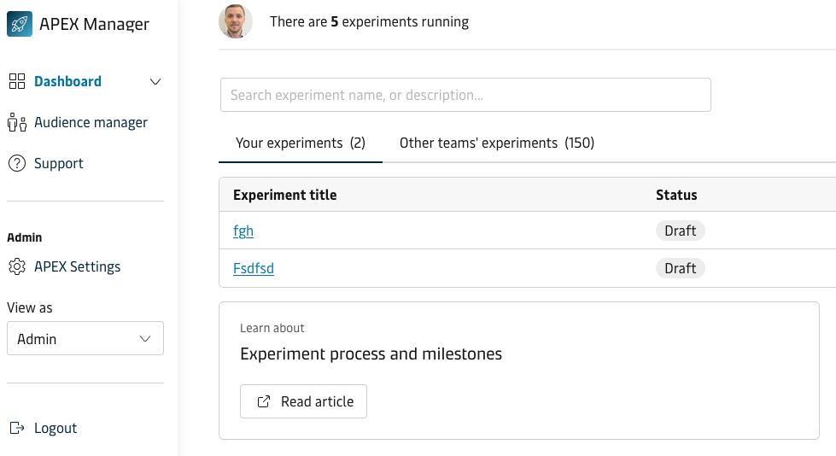
The APEX team
Internal A/B testing tool
Deliver new requests
  Features
  Metrics
Bugs in setup
  Resume when?

Slide 6
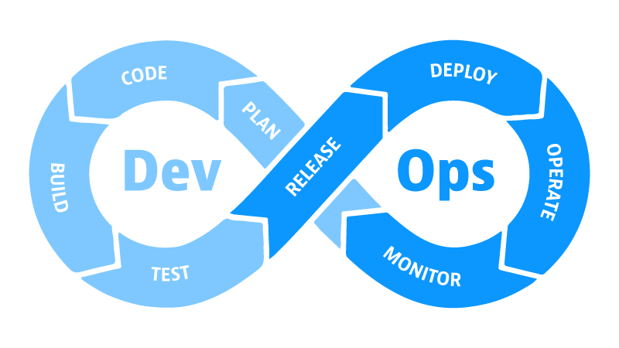
DORA metrics
Google Team
DevOps Research and Assessment
“State of DevOps” Reports (~2013)
Note: DORA is not an abbreviation of the metrics

Slide 7
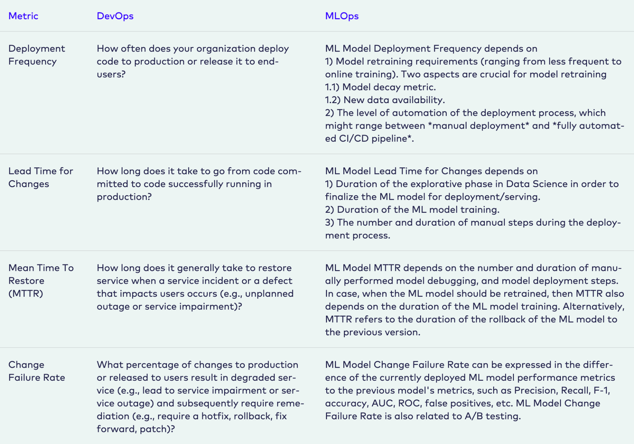
Overview
Measuring success/performance
2 “dev” metrics
2 “ops” metrics
Do you have any ideas?
From https://ml-ops.org/content/mlops-principles

Slide 8
Deployment frequency
Deploy code to end-users
Smaller bits > large chunks
Typically ~1/week up to daily
From https://ml-ops.org/content/mlops-principles

Slide 9
Lead time for changes
Time from commit to production
Highlight inefficient processes
  Slow code review?
  (Too) complex code?
1 week/month to <1 day
From https://ml-ops.org/content/mlops-principles

Slide 10
Mean time to restore
Fix bugs → new code → update
You don’t want bugs in production…
From months to <1 hour
From https://ml-ops.org/content/mlops-principles

Slide 11
Change failure rate
“Faulty” production code
Nothing is perfect
  But high rate → low trust
From ~0% to +60%
From https://ml-ops.org/content/mlops-principles

Slide 12
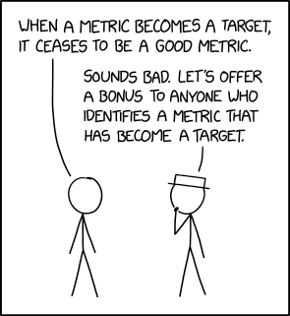
Shortcomings
Goodhart’s law: ————→
! comparing teams
Context specific
Simplification (24 other metrics)
[later] I'm pleased to report we're now identifying and replacing hundreds of outdated metrics per hour.
From https://xkcd.com/2899/

Slide 13
DORA… for MLOps?

Slide 14
MLOps
?
From https://ml-ops.org/content/mlops-principles
Notes:
Talk in pairs about:
How would you measure this?
What affects this for ML?

Slide 15
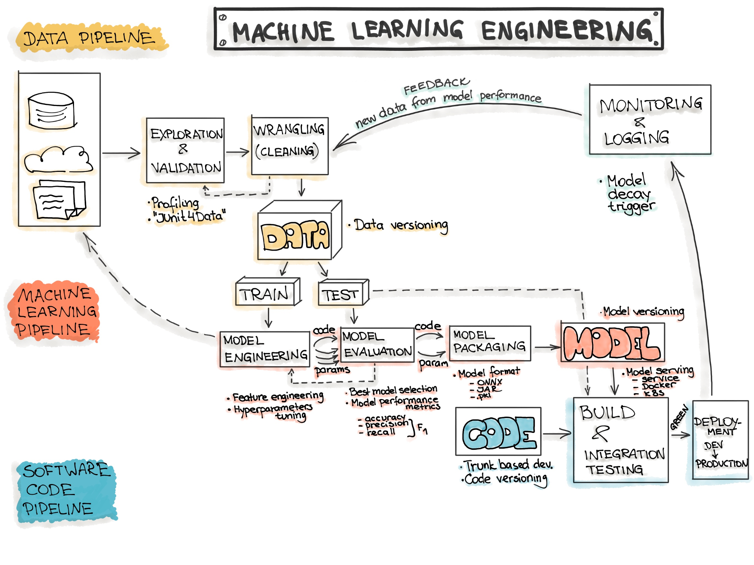
More complex pipelines
From https://ml-ops.org/content/end-to-end-ml-workflow

Slide 16
Deployment frequency

Slide 17
What deployment?
From https://ml-ops.org/content/end-to-end-ml-workflow

Slide 18
What affects frequency?
Week 7
From https://ml-ops.org/content/end-to-end-ml-workflow
Notes:
Covered degree of automation in last lecture

Slide 19
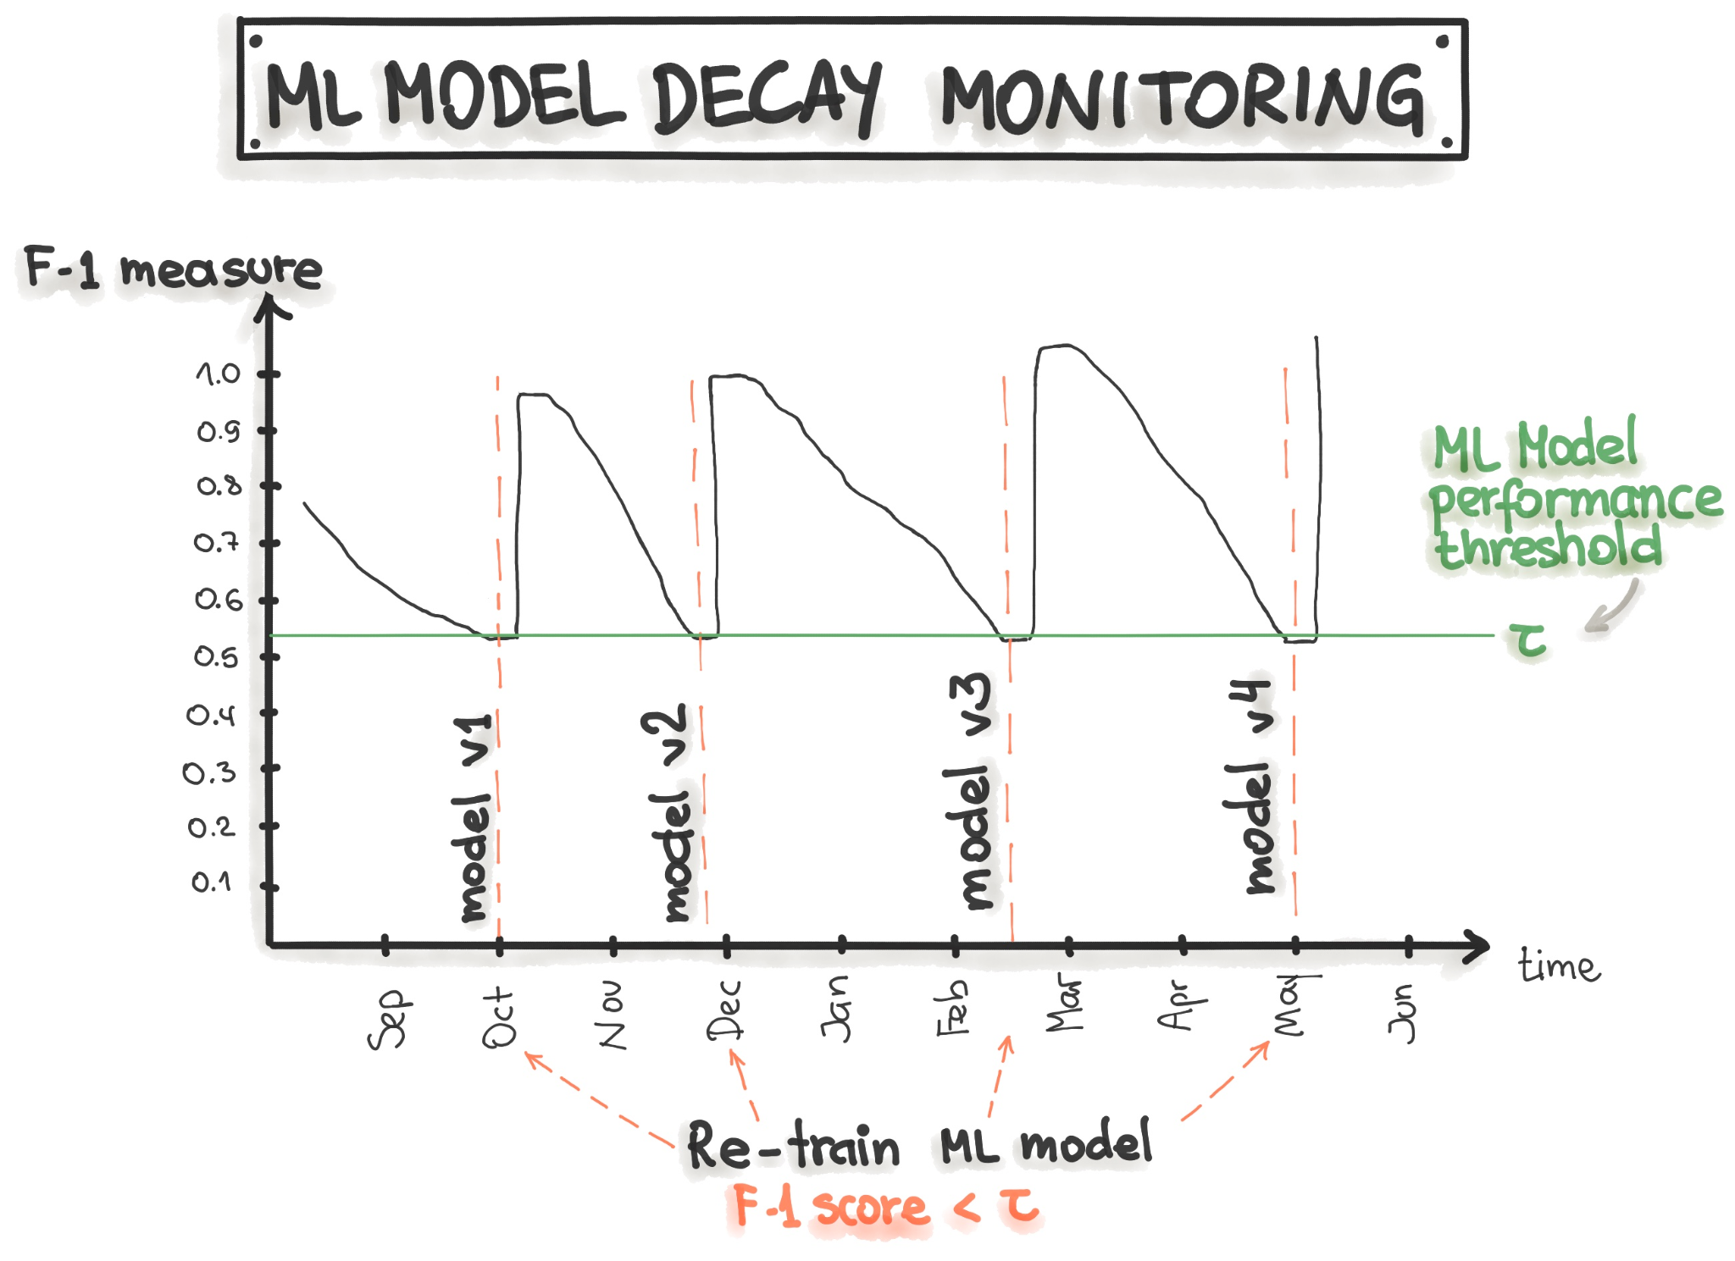
Model decay
Many causes…
  Changes in dependencies
  New training data → worse model
  Different feature extraction
  Code updates
  …
From https://ml-ops.org/content/mlops-principles

Slide 20
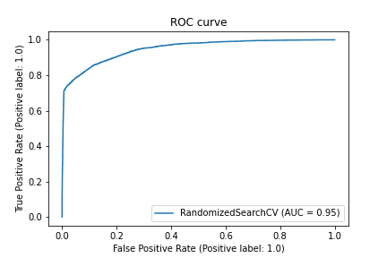
Quantifying changes
Model metrics
  Training loss
  Acc./F1-score/ROCAUC
  Prediction bias
Threshold ↔ business

Slide 21
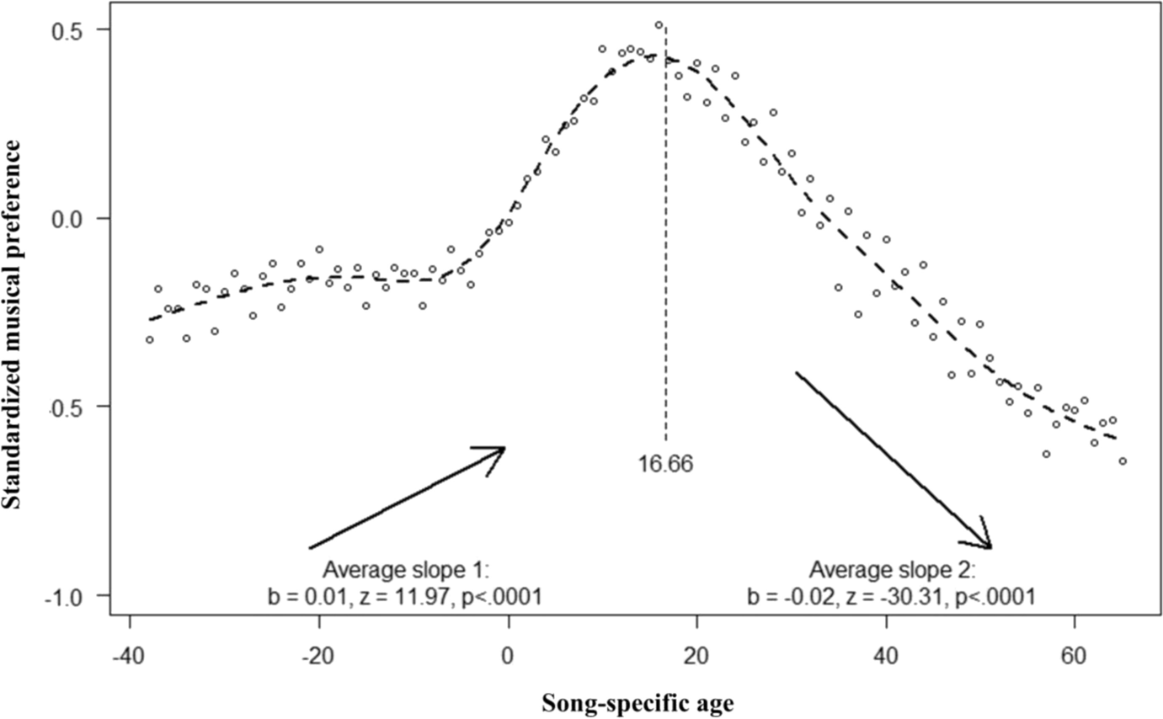
Concept/model drift
Feature ↔ output change
E.g., age ↔ music preference
Gradual, sudden, recurring
Example:
30% Week over Week change
Fig. 3, from https://link.springer.com/article/10.1007/s11002-022-09626-7

Slide 22
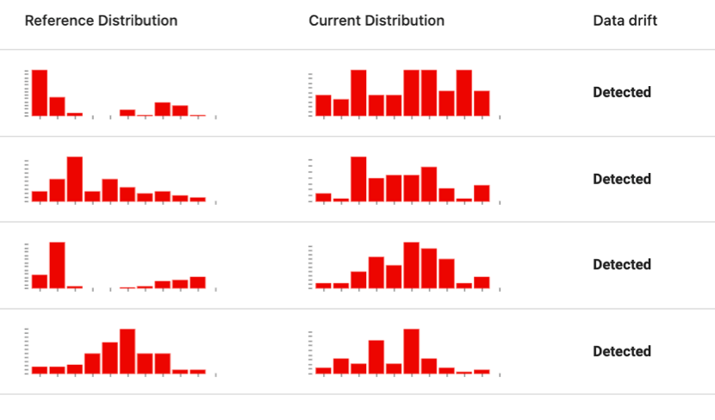
Data issues
Data quality issues
Data/feature drift
Outliers
From https://www.evidentlyai.com/ml-in-production/data-drift

Slide 23

Data quality
Long list…
  Data source changes
  Source data schema changes
  Data loss
  …
Common checks
  Schema comparison
  NaNs, min/max, etc

Slide 24
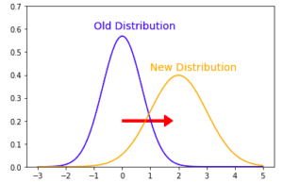
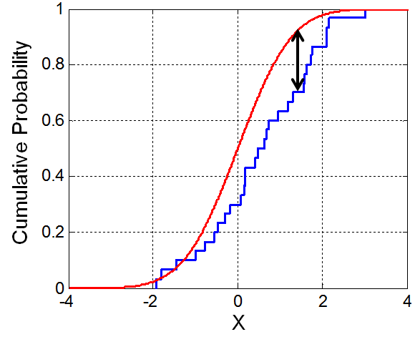
Data/feature drift
Distribution change over time
Source data vs feature dist.?
Statistical tests
  Kolmogorov-Smirnov test
  I.e., max distance in cumulative dist.
  Chi-squared for cat.
From https://datajello.com/production-ml-data-drift-and-concept-drift/
From https://en.wikipedia.org/wiki/Kolmogorov%E2%80%93Smirnov_test#/media/File:KS_Example.png

Slide 25
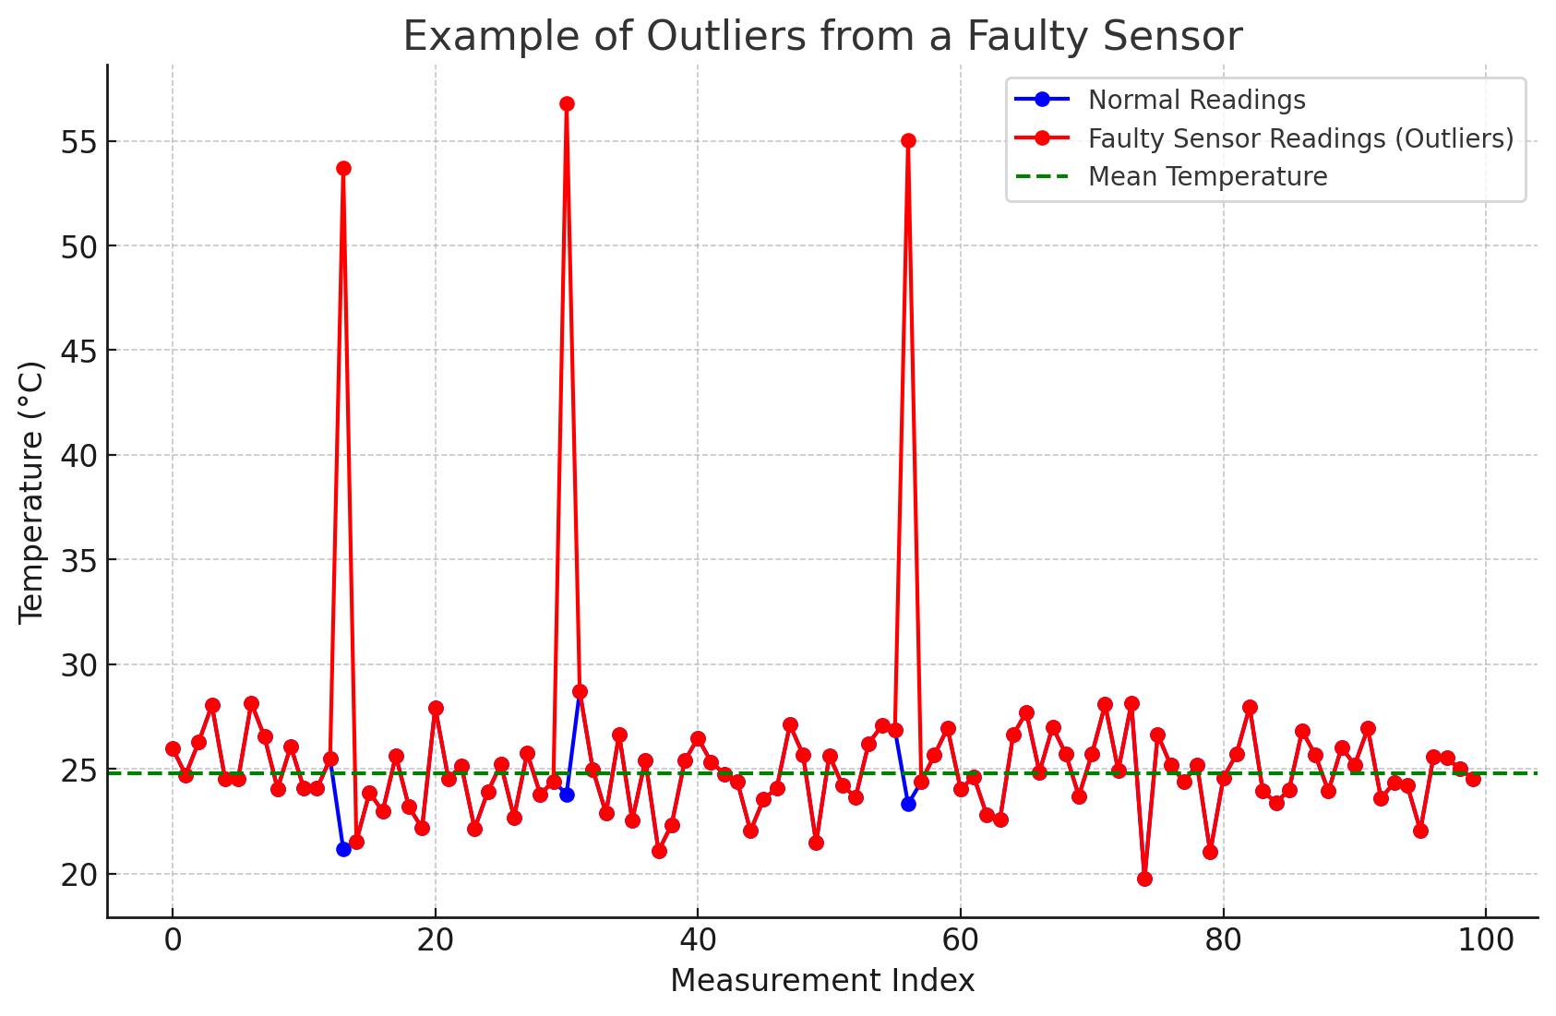
Outliers
Bots/adversarial attacks?
NaN/Infinities?
Faulty data entries?
→ When and how to react?
From… ChatGPT? I just asked it to make me a graph example of how data could look from a faulty sensor which leads to outlier data, and it created this graph from a Python script, and it looks good to me!

Slide 26
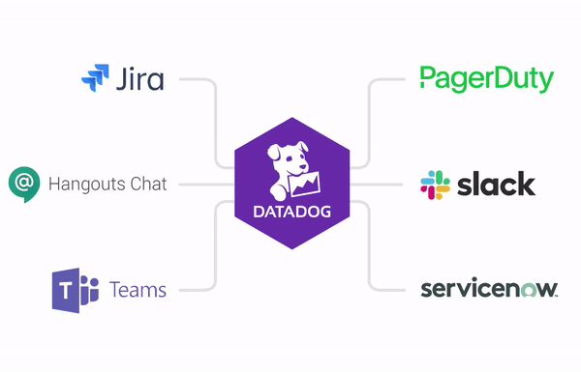
Log, monitor and alerts for everything
Staleness of model
Prediction quality
Dev ↔ prod prediction mismatch
Schema mismatches
Numerical stability
Computational performance
Pipeline changes

Slide 27
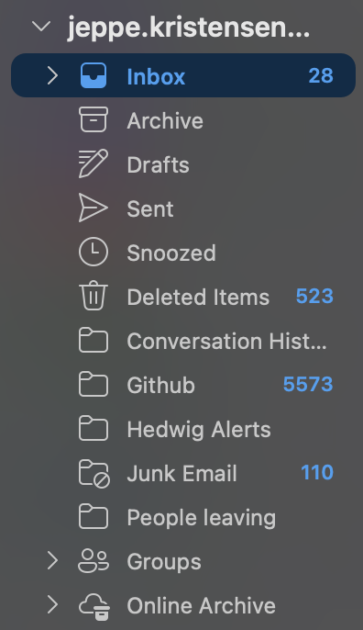
Notes:
Within reason, anyway

Slide 28
Circling back to deployment frequency
Nice to know average freq.
But depends on lots of things
→ Good relative goal

Slide 29
Lead time for changes

Slide 30
What changes?

Slide 31
What affects the speed?
Exploration phase
Training time
Manual steps

Slide 32
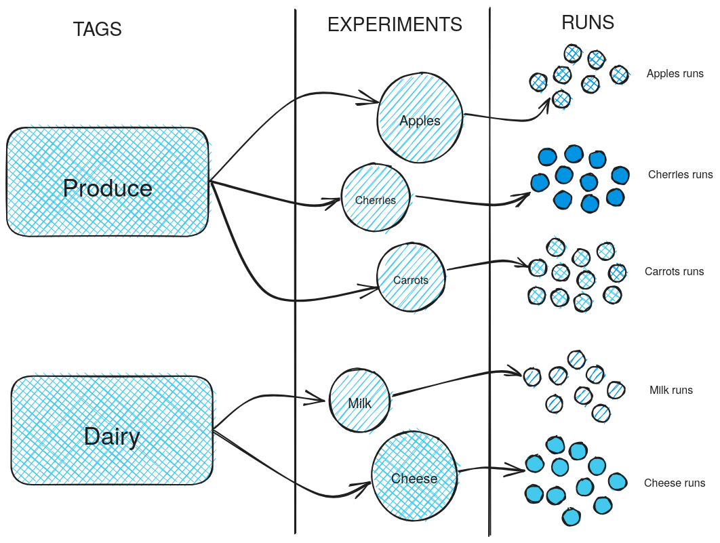
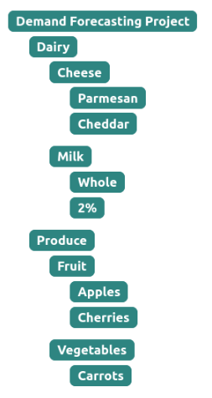
Hierarchy of experiments
From https://mlflow.org/docs/latest/ml/getting-started/logging-first-model/step3-create-experiment/

Slide 33
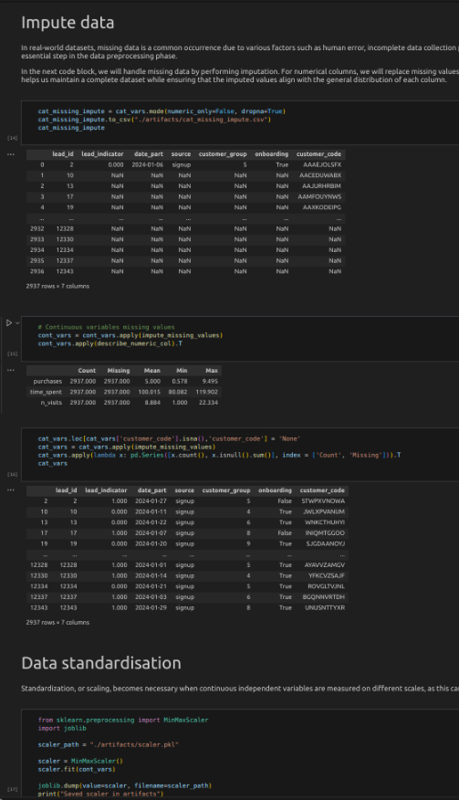
Exploration
New features/columns?
Different output?
Other kind of model?
→ ML experiments

Slide 34
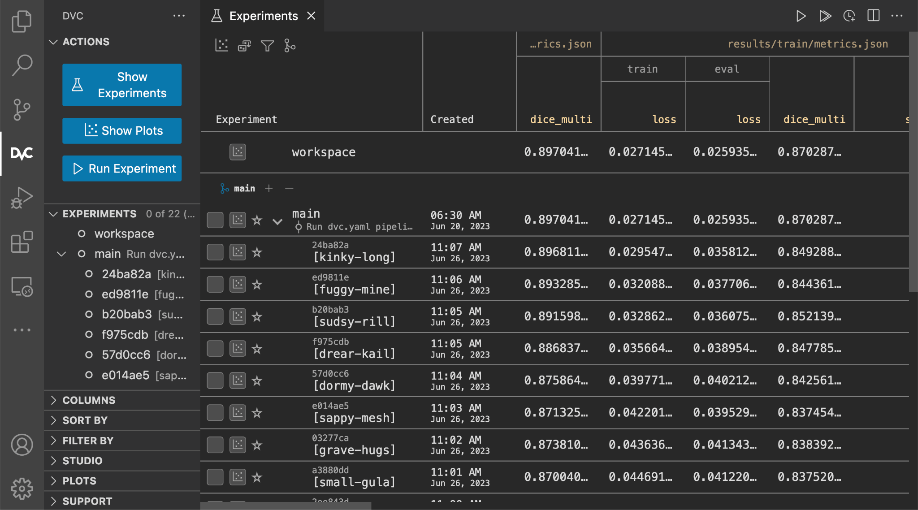
Running an “ML experiment” – in DVC + VSCode
From https://dvc.org/doc/user-guide/experiment-management/comparing-experiments?tab=VSCode-Extension

Slide 35
MLflow? Demo time

Slide 36
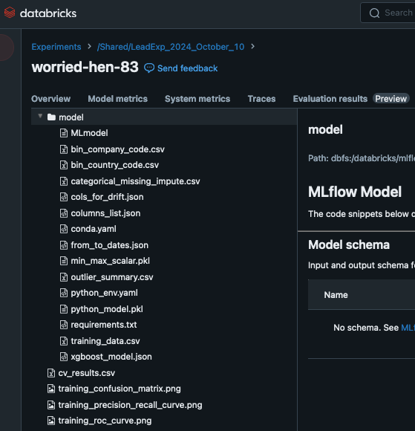
Databricks ML experiments
Artifacts
  Model file
  Training results
  Configurations
Managed MLflow implementation

Slide 37
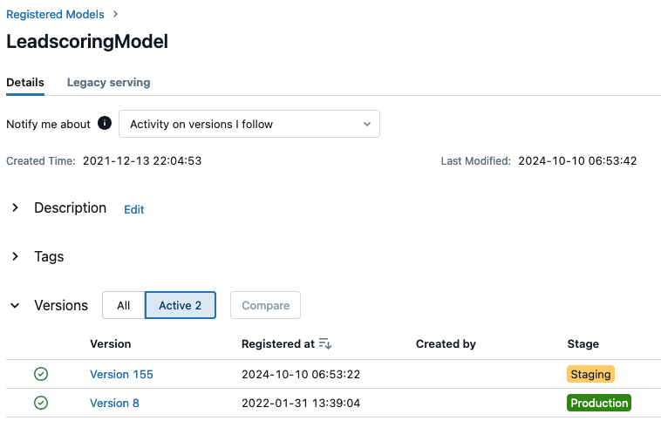
Putting it in production
Multiple models
  Staging → production
Go with best metric one
Recent != better
  Although in this case…
  Old model not tested on new data

Slide 38
Mean time to restore

Slide 39
Mean time to restore

Slide 40
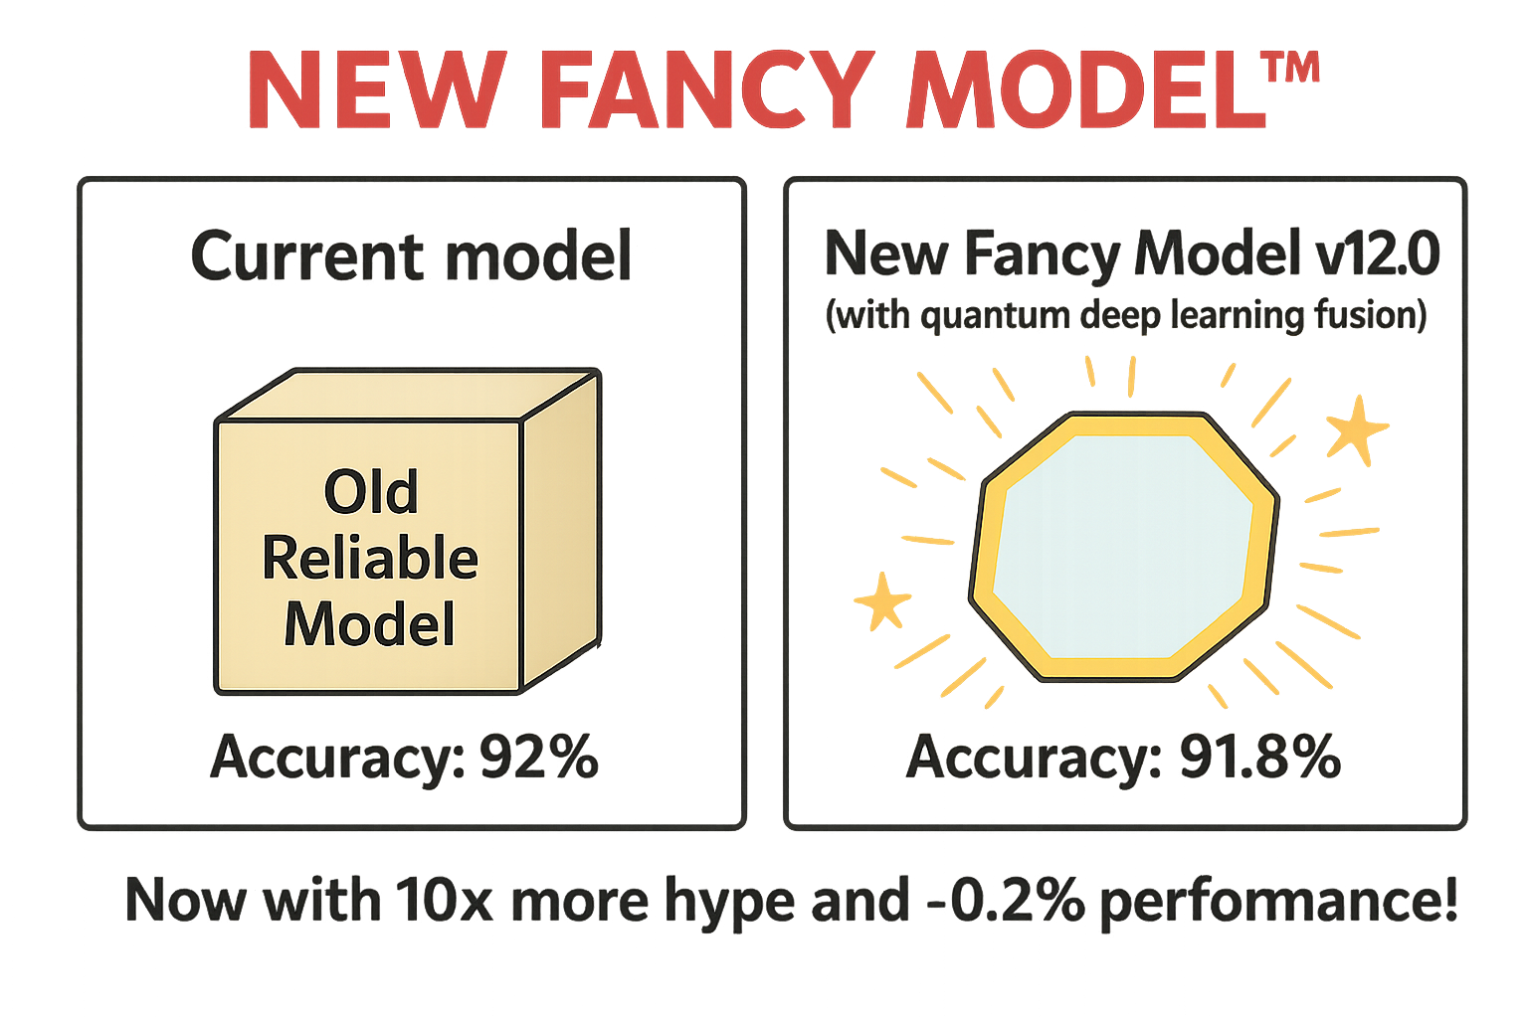
New model releases
↓Loss↓ but also ↓KPI↓
  Why? Users build heuristics
Buggy implementation
  Automation not a guarantee
Retrain, rectify, or rollback?
Thanks ChatGPT
Notes:
“This churn model always overestimates the chance of freight forwarders stopping to be our customers”

Slide 41
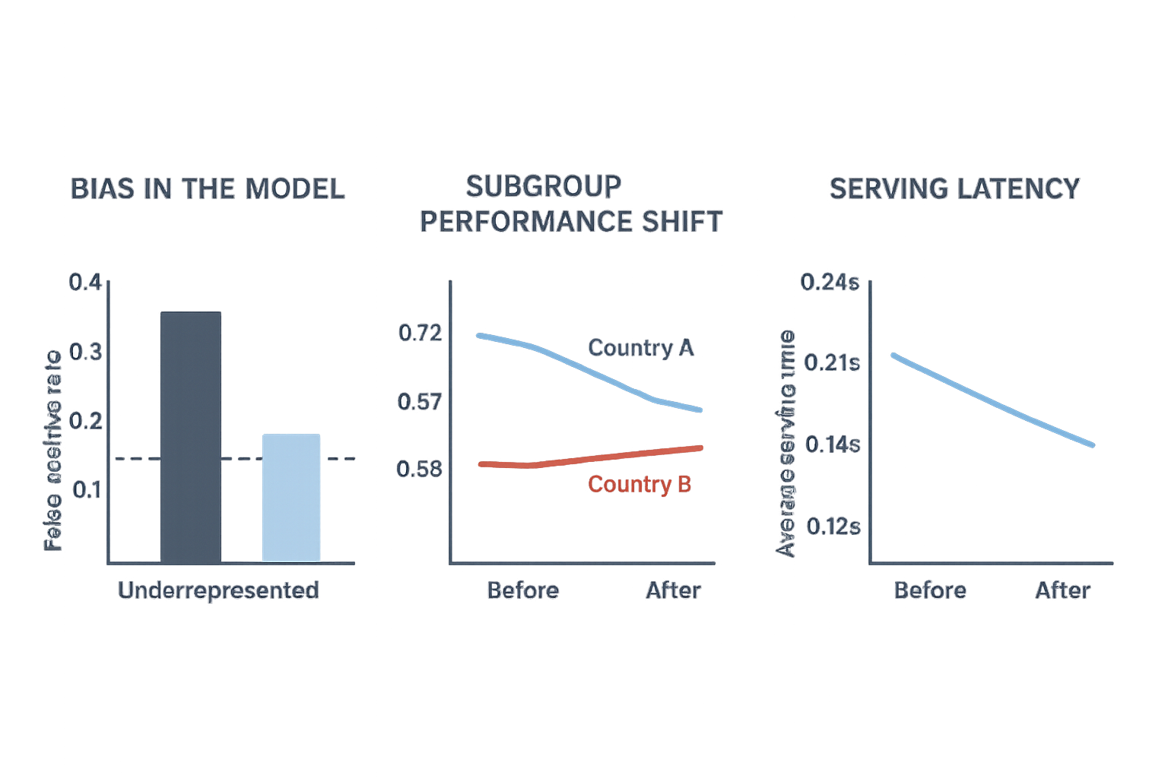
Troubleshooting
Bias in the model?
Subgroup performance shift?
Serving latency?
→ Domain knowledge + logging

Slide 42
Rollback of model
Promote old model to prod
  Saving all model artifacts
Not solving underlying problem

Slide 43
Change failure rate

Slide 44
Mean time to restore

Slide 45
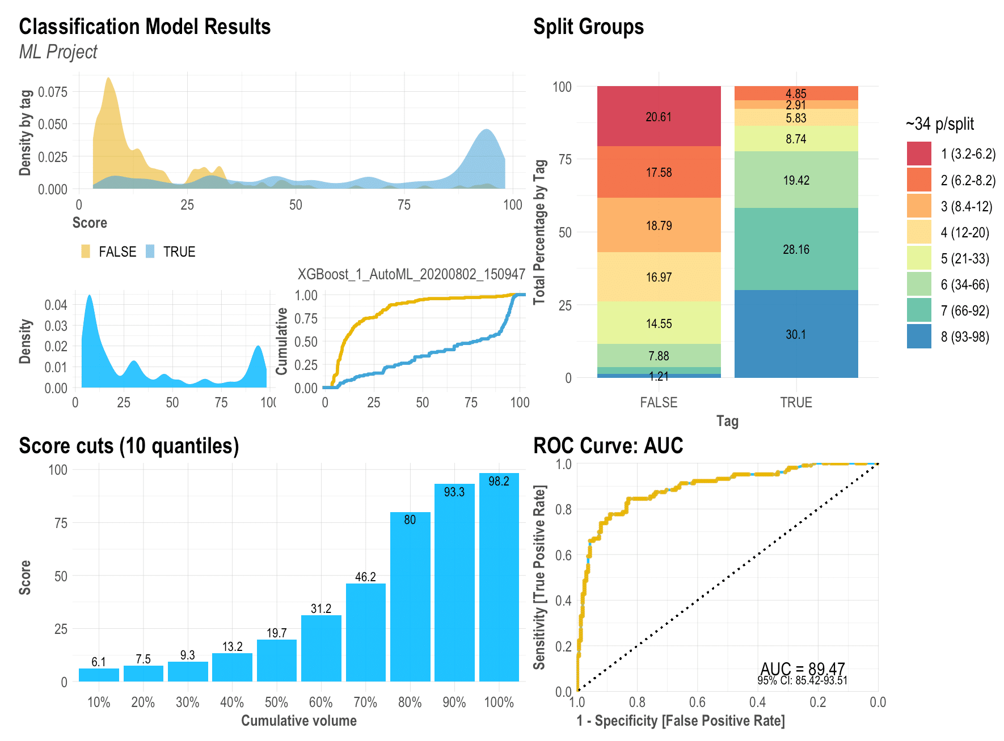
Failures happen
Any change carries a risk
Failure = subpar performance
  F1-score, precision, etc
  User experience
Every release? Every 3rd? …
Notes:
As discussed before

Slide 46
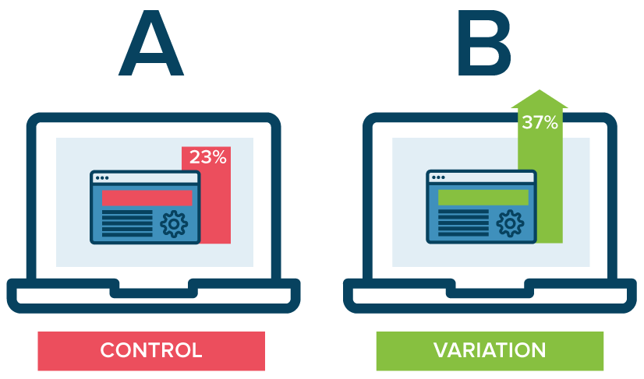
Managing risk
Only rollout partly
Different strategies
  Pilot studies
  A/B tests
  Shadow testing
From https://mlinproduction.com/ab-test-ml-models-deployment-series-08/
Notes:
As discussed before

Slide 47
Summary

Slide 48
MLOps
?
From https://ml-ops.org/content/mlops-principles

Slide 49

Shifting gears back to tooling
Week 9: Docker
  Containerize things!
  Avoid “works on my computer”
Week 10+11: Dagger
  Orchestration w. Go
  Workflow automation

