Slide 1

AI, Ethics, and Business Decision-Making
By: Joshua Zimmerman-Gibson
3/30/2026
Notes:
Role of Artificial Intelligence in Modern Business Decisions, Applications of AI and Machine Learning Across Industries, Healthcare Industry Case Example with a Data Science Focus, Bias and Fairness Challenges in Machine Learning Algorithms, Strategies Businesses Can Use to Mitigate AI Bias, Improving Transparency in AI Decision-Making, Ethical Standards and Privacy Protection in Healthcare AI, Key Takeaways and Responsible AI Adoption

Slide 2

Role of Artificial Intelligence in Modern Business Decisions
AI Enhances Data Analysis
AI and machine learning enable fast, large-scale data analysis to generate valuable business insights and improve decision accuracy.
Automation of Decisions
AI automates repetitive business decisions like transaction approvals and lead prioritization, boosting efficiency.
Ethical Considerations
Ethical concerns in AI involve fairness, transparency, and accountability, especially in sensitive fields like hiring and lending.
Balancing AI Benefits and Risks
Businesses must balance AI's practical advantages with responsible use to maintain stakeholder trust and fairness.
Notes:
Artificial intelligence (AI) and machine learning (ML) have become central to modern business decision-making by enabling organizations to analyze vast volumes of data and generate insights at a speed and scale that would be impossible for humans alone. Businesses increasingly rely on data-driven decision support systems to improve accuracy, efficiency, and competitiveness. For example, AI-powered analytics platforms help executives show market trends, forecast demand, and improve operations using historical and real-time data. In industries such as retail and planning, machine learning models analyze buying behavior and supply chain data to reduce costs and improve customer satisfaction. Another key benefit of AI in business is its ability to automate repetitive decision processes, such as approving transactions, prioritizing leads, or flagging anomalies. However, while AI enhances efficiency, it also raises important ethical considerations. Decisions made by algorithms can significantly change customers, employees, and society, especially when used in hiring, lending, healthcare, or law enforcement contexts. Poorly designed or unmonitored AI systems may reinforce existing inequalities, reduce accountability, or make decisions that are difficult to explain. As a result, businesses must balance the practical advantages of AI-driven decision-making with ethical responsibilities such as fairness, transparency, and accountability. Understanding this balance is critical for organizations looking to adopt AI responsibly while supporting trust with stakeholders.

Slide 3
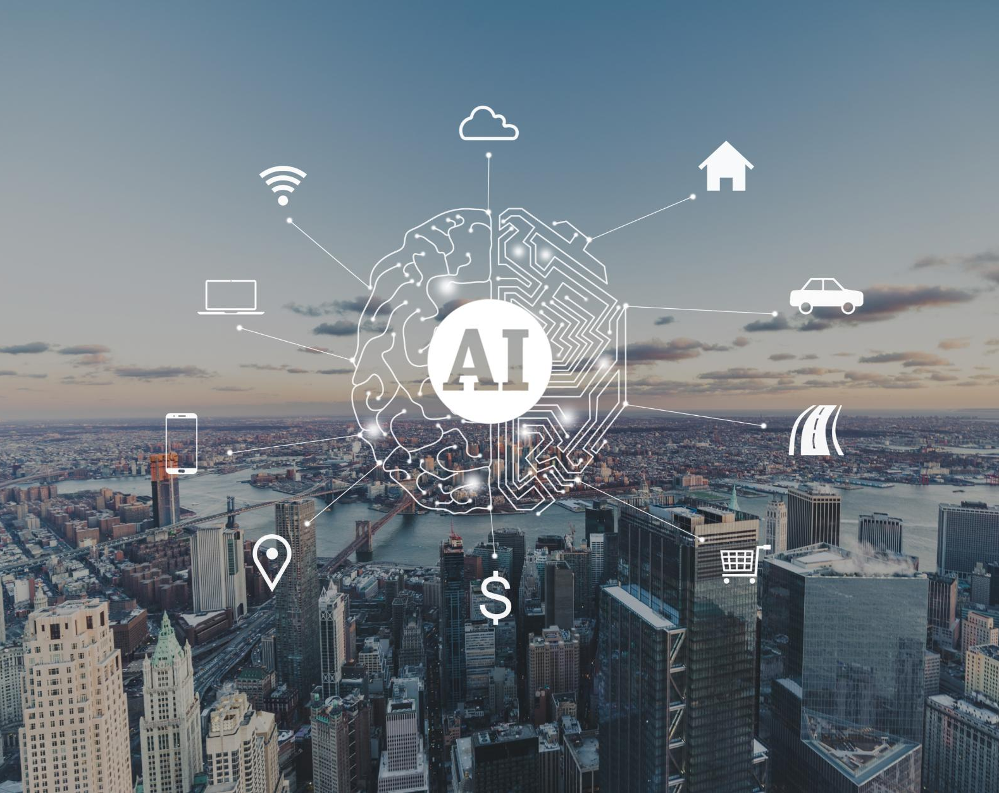
Applications of AI and Machine Learning Across Industries
Healthcare Applications
AI analyzes medical images and patient data to enable early diagnosis and personalized treatments in healthcare.
Finance Industry Uses
AI detects fraud, assesses credit risk, and supports algorithmic trading by analyzing transactional data.
Retail and Customer Experience
Retailers use AI for recommendation engines, demand forecasting, and dynamic pricing to enhance customer experiences.
Manufacturing and Logistics
AI optimizes predictive maintenance, route planning, and fleet management to improve manufacturing and logistics efficiency.
Notes:
Artificial intelligence and machine learning are applied across a wide range of industries, each leveraging data science techniques to solve domain-specific problems. In healthcare, machine learning models analyze medical images, electronic health records, and patient histories to support early diagnosis, predict disease risk, and personalize treatment plans. In the finance industry, AI systems are widely used for fraud detection, algorithmic trading, and credit risk assessment by identifying patterns in transactional and behavioral data. Retail companies rely on recommendation engines, demand forecasting models, and dynamic pricing algorithms to improve customer experiences and maximize revenue. Manufacturing organizations use predictive maintenance models to anticipate equipment failures, reduce downtime, and improve product quality by analyzing sensor and operational data. Transportation and logistics companies apply AI to optimize routes, manage fleets, and forecast delivery times. Across all these industries, data science plays a foundational role by enabling data collection, cleaning, feature engineering, and model evaluation. These applications demonstrate how AI transforms raw data into actionable insights. However, the widespread adoption of AI also means that errors or biases in models can scale rapidly across entire industries, reinforcing the need for ethical oversight and responsible design practices in every sector where AI is deployed.

Slide 4
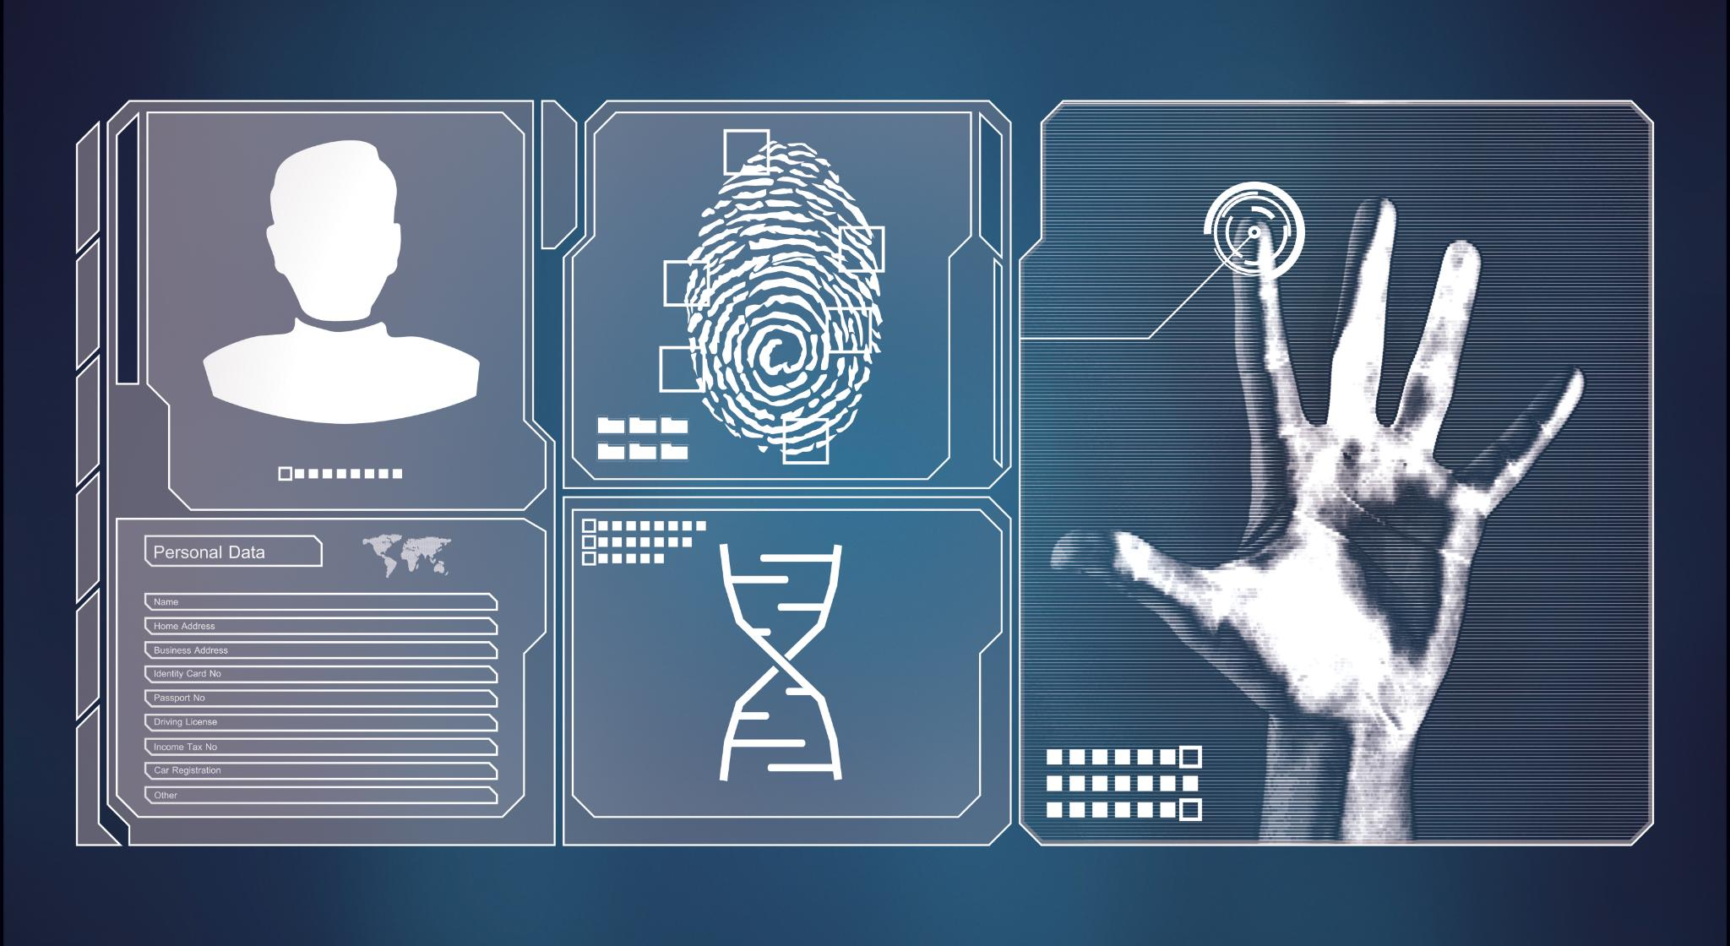
Healthcare Industry Case Example with a Data Science Focus
AI in Medical Imaging
Machine learning models analyze X-rays, MRIs, and CT scans to detect diseases like cancer and neurological disorders.
Predictive Analytics in Healthcare
Predictive tools assess patient data to estimate risks of readmission, disease progression, and treatment effectiveness.
NLP for Clinical Insights
Natural language processing extracts insights from unstructured clinical notes to support healthcare decisions.
Ethical AI Challenges
Ethical risks include data bias and fairness concerns, requiring transparency and governance in AI healthcare tools.
Notes:
The healthcare industry provides a strong example of how artificial intelligence and data science intersect to influence critical decision-making. Machine learning models are commonly used to analyze medical imaging data such as X-rays, MRIs, and CT scans to detect conditions like cancer, fractures, or neurological disorders. Predictive analytics tools assess patient data to estimate readmission risks, disease progression, or treatment effectiveness. Natural language processing (NLP) techniques are also applied to unstructured clinical notes, enabling healthcare providers to extract insights from physician documentation. These AI systems rely heavily on high-quality, representative datasets and robust data science workflows. However, healthcare AI also highlights ethical risks, particularly when training data underrepresents certain populations, leading to less accurate predictions for minority groups. Additionally, decisions influenced by AI can have life-altering consequences, making accuracy, fairness, and transparency especially important. To address these concerns, healthcare organizations must combine technical rigor with ethical governance, ensuring that AI tools augment clinical judgment rather than replace it. This industry illustrates both the powerful benefits of AI-driven insights and the serious ethical responsibilities that accompany their use.

Slide 5

Bias and Fairness Challenges in Machine Learning Algorithms
Origins of Bias
Bias often stems from training data that reflects historical inequalities and social stereotypes.
Algorithmic Bias Sources
Bias can be introduced through feature selection, model design, or optimization focused solely on accuracy.
Impact of Bias
Biased models may lead to unfair decisions, legal risks, and damaged trust in sectors like hiring and healthcare.
Managing Fairness
Ethical risks must be managed throughout AI lifecycles, from data collection to deployment and monitoring.
Notes:
Bias and fairness represent some of the most significant challenges in machine learning systems used for business decision-making. Bias often originates from training data that reflects historical inequalities, social stereotypes, or uneven representation of different demographic groups. For example, if a hiring algorithm is trained on historical employee data from a company that lacked diversity, the model may unintentionally favor candidates similar to past hires. In healthcare and finance, biased models can result in unequal access to care or credit. Another challenge is algorithmic bias introduced through feature selection, model design, or optimization objectives that prioritize accuracy over fairness. Additionally, biases may go undetected because machine learning models can be complex and opaque, making it difficult to understand how decisions are made. These fairness issues can damage organizational reputation, expose businesses to legal risks, and erode public trust. Addressing bias requires recognizing that machine learning systems are not neutral and that ethical risks must be actively managed throughout the AI lifecycle, from data collection to deployment and monitoring.

Slide 6

Strategies Businesses Can Use to Mitigate AI Bias
Diverse and Representative Data
Use high-quality, diverse datasets that represent affected populations to reduce AI bias effectively.
Regular Bias Audits
Conduct frequent audits and bias testing to assess AI model fairness across demographic groups.
Fairness-Aware Techniques
Implement fairness-aware ML methods like data reweighting and decision threshold adjustments to reduce discrimination.
Human Oversight and Governance
Ensure human review of automated decisions and establish governance frameworks to uphold ethical AI use.
Notes:
Businesses can take several concrete steps to mitigate bias and promote fairness in AI models. One of the most important strategies is using diverse, representative, and high-quality datasets that accurately reflect the populations affected by AI-driven decisions. Regular audits and bias testing should be conducted to evaluate model performance across different demographic groups. Organizations can also implement fairness-aware machine learning techniques, such as reweighting data or adjusting decision thresholds, to reduce discriminatory outcomes. Human oversight is another critical safeguard, ensuring that automated decisions are reviewed, especially in high-stakes contexts like healthcare, lending, or hiring. Cross-functional teams involving data scientists, ethicists, legal experts, and domain specialists can help identify ethical risks early in development. Additionally, businesses should establish clear governance frameworks and ethical guidelines for AI use. By embedding fairness into both technical and organizational processes, companies can reduce bias, improve decision quality, and build trust with users and stakeholders.

Slide 7

Improving Transparency in AI Decision-Making
Explainable AI Techniques
Explainable AI helps users understand model decisions using feature importance and local explanations.
Clear Documentation
Documenting data sources, assumptions, and limitations promotes transparency for all stakeholders.
Open Communication
Businesses should openly share how AI systems are used, including their benefits and risks.
Ethical and Regulatory Compliance
Transparency supports audits, accountability, and ethical AI use in regulated industries.
Notes:
Transparency is essential for building trust in AI-driven business decisions, particularly when algorithms influence outcomes that affect individuals and communities. One way to enhance transparency is through explainable AI (XAI) techniques, which help users understand why a model produced a specific prediction or recommendation. For example, feature importance scores or local explanations can show which factors influenced a decision. Clear documentation of data sources, model assumptions, and limitations also supports transparency for internal and external stakeholders. Businesses should communicate openly about when and how AI systems are used, including their benefits and risks. In regulated industries such as healthcare and finance, transparency supports compliance and accountability by enabling audits and oversight. Transparent AI systems empower users to question, contest, or appeal decisions, reducing the perception of “black box” automation. Ultimately, transparency strengthens ethical AI adoption by aligning technological capabilities with human understanding and responsibility.

Slide 8

Ethical Standards and Privacy Protection in Healthcare AI
Compliance with Regulations
Healthcare AI systems must adhere to regulations like HIPAA to safeguard patient data privacy and security.
Data Protection Techniques
Implementing anonymization, encryption, and secure storage reduces risks of data breaches and misuse.
Access Control and Accountability
Limiting AI system access to authorized personnel ensures accountability and protects sensitive healthcare data.
Informed Consent and Ethical Use
Ensuring patients understand AI data usage through informed consent upholds ethical standards in healthcare.
Notes:
Upholding ethical standards and protecting user privacy are especially critical in industries like healthcare, where AI systems handle sensitive personal data. Healthcare organizations must comply with regulations such as the Health Insurance Portability and Accountability Act (HIPAA), which governs the use and protection of patient information. Data anonymization, encryption, and secure storage practices help reduce the risk of breaches and misuse. Access to AI systems and datasets should be limited to authorized personnel, with clear accountability mechanisms in place. Ethical standards also require informed consent, ensuring patients understand how their data is used in AI-driven tools. Additionally, organizations should regularly assess privacy risks as models evolve or are applied in new contexts. By prioritizing privacy and ethical safeguards, healthcare providers can leverage AI innovations while maintaining patient trust and protecting individual rights.

Slide 9

Key Takeaways and Responsible AI Adoption
AI Enhances Business Decisions
AI provides data-driven insights and predictive capabilities to improve business decision-making and operational efficiency.
Ethical Responsibilities
Responsible AI adoption requires addressing bias, fairness, transparency, and privacy to uphold ethical standards.
Organizational and Cultural Change
Adopting AI responsibly involves organizational culture shifts, ethical guidelines, human oversight, and continuous monitoring.
Long-term Trust and Value
Ethically governed AI builds trust, supports better decisions, and creates lasting value for businesses and society.
Notes:
Artificial intelligence offers powerful opportunities to improve business decision-making through data-driven insights, automation, and predictive capabilities. Across industries, AI and machine learning enable organizations to operate more efficiently and respond more effectively to complex challenges. However, these benefits come with ethical responsibilities related to bias, fairness, transparency, and privacy. Businesses must recognize that responsible AI adoption is not solely a technical challenge but also an organizational and cultural one. Implementing ethical guidelines, ensuring human oversight, and engaging in continuous monitoring are essential practices. When designed and governed responsibly, AI systems can enhance trust, support better decisions, and create long-term value for both businesses and society. The future of AI in business depends on aligning innovation with ethical principles, ensuring technology serves people fairly and responsibly.

