Slide 1

Excel and Power BI Integration for Business Analytics
Combining tools to enhance data-driven business insights

Slide 2

Purpose and value of combining Excel and Power BI
Excel's Role in Analytics
Excel offers flexibility for ad hoc analysis, data entry, and financial modeling familiar to many analysts.
Power BI's Advanced Capabilities
Power BI provides advanced visualization, centralized datasets, and interactive dashboards for scalable reporting.
Seamless Integration Benefits
Combining Excel and Power BI enables smoother analytics lifecycle, reduces redundancy, and enhances enterprise reporting.
Notes:
The integration of Excel and Power BI plays a critical role in modern business analytics by combining the familiarity and flexibility of Excel with the advanced visualization, modeling, and sharing capabilities of Power BI. Excel has long been the primary tool for analysts to perform ad hoc analysis, data entry, and financial modeling, while Power BI is designed to scale analytics through centralized datasets, interactive dashboards, and governed reporting. Together, they allow organizations to transition from isolated, spreadsheet-driven insights to enterprise-level analytics without abandoning existing workflows. This integration supports a smoother analytics lifecycle, where data can be prepared, validated, and explored in Excel, then published and visualized in Power BI for broader consumption. It also reduces redundancy, as the same datasets can be reused across reports and teams. By leveraging both tools in tandem, organizations can improve analytical depth, maintain user productivity, and accelerate decision-making while ensuring data integrity and consistency across the business.

Slide 3
Maintaining Data Accuracy and Consistency
Notes:
Key considerations when moving data between Excel and Power BI

Slide 4

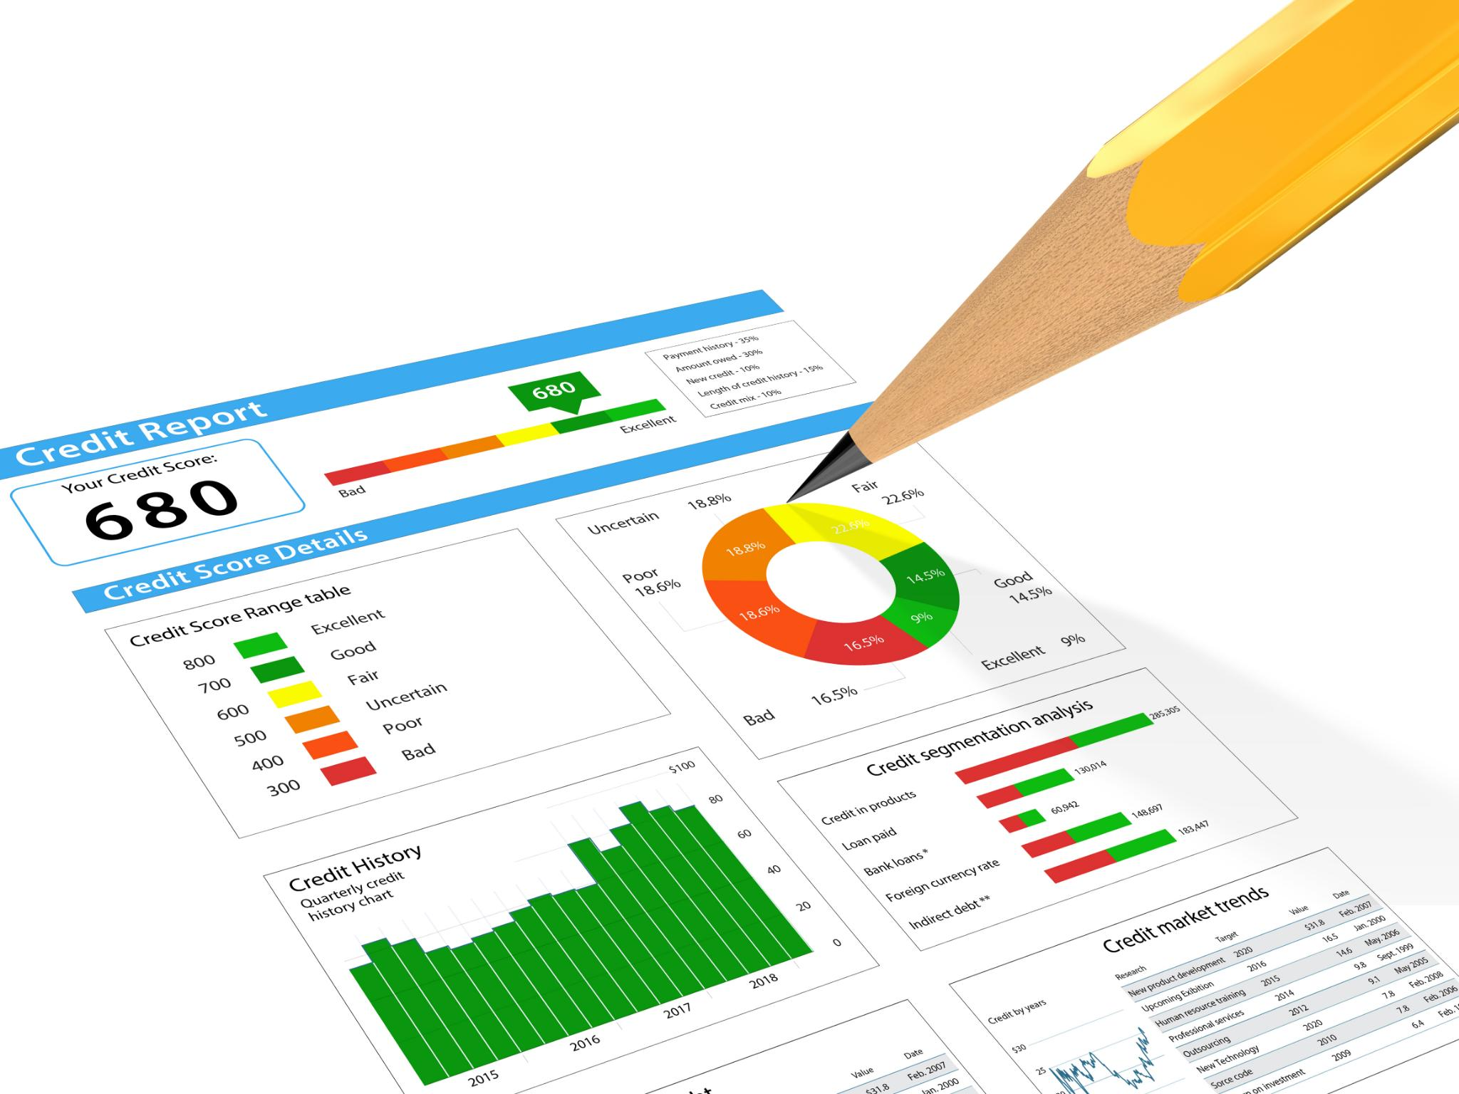
Key considerations when moving data between Excel and Power BI
Single Source of Truth
Ensure Power BI connects to authoritative data sources instead of disconnected Excel files to maintain consistency.
Transparent Data Transformation
Use Power Query for documented, repeatable data transformations to reduce manual errors.
Consistent Data Standards
Enforce consistent data types, naming conventions, and date formats to avoid refresh and model issues.
Aligned Refresh Schedules
Coordinate refresh times between Excel inputs and Power BI datasets to ensure up-to-date analysis.
Notes:
Maintaining data accuracy and consistency when transferring data between Excel and Power BI requires careful attention to governance, transformation logic, and data structure. One of the most important considerations is establishing a single source of truth, ensuring that Power BI datasets are connected to authoritative data sources rather than multiple, disconnected Excel files. Data transformations should be handled using Power Query, where steps are documented, repeatable, and transparent, reducing the risk of manual errors. Consistent data types, naming conventions, and date formats must be enforced to avoid mismatches during refreshes or model relationships. Additionally, organizations should define clear data ownership so that responsibilities for data validation, updates, and approvals are well understood. Refresh schedules must be aligned between Excel inputs and Power BI datasets to prevent outdated or partial data from being analyzed. By addressing these considerations, businesses can ensure that insights derived from Power BI accurately reflect the underlying Excel data and remain trustworthy over time.

Slide 5
Policies and Procedures to Mitigate Data Discrepancies
Notes:
Governance practices to reduce inconsistencies

Slide 6


Governance practices to reduce inconsistencies
Standardized Data Definitions
Establish shared dictionaries for data definitions, metrics, and naming conventions to ensure report consistency.
Version Control Practices
Use controlled repositories like SharePoint or OneDrive to avoid outdated or conflicting Excel files.
Automated Refresh Policies
Implement scheduled and automated refresh in Power BI to reduce manual updates and human error.
Access Controls and Documentation
Apply role-based permissions and document transformation steps to ensure auditability and secure data management.
Notes:
Strong policies and procedures are essential to mitigating the risk of data discrepancies between Excel and Power BI. Organizations should standardize data definitions, metrics, and naming conventions through a shared data dictionary to ensure consistency across reports. Version control practices, such as storing Excel files in controlled repositories like SharePoint or OneDrive, help prevent analysts from using outdated or conflicting files. Scheduled and automated refresh policies in Power BI reduce reliance on manual updates, minimizing human error. Documentation of data transformation steps, business rules, and assumptions should be mandatory so that changes can be audited and understood by others. Access controls and role-based permissions also play a key role, ensuring that only authorized users can modify critical datasets or models. Together, these governance practices create a structured analytics environment where Excel and Power BI can coexist without introducing confusion or conflicting results.

Slide 7
Business Scenarios Where Excel and Power BI Excel Together
Notes:
Use cases that benefit most from combined usage

Slide 8


Use cases that benefit most from combined usage
Financial Planning and Analysis
Excel is used for budgeting, forecasting, and modeling, while Power BI creates executive dashboards.
Supply Chain and Operations
Excel enables detailed planning and exception analysis; Power BI provides real-time inventory and performance insights.
Healthcare Data Management
Excel handles data validation and calculations; Power BI delivers interactive patient outcome dashboards.
Retail and Sales Analysis
Excel analyzes historical data and scenarios; Power BI monitors trends and key performance indicators.
Notes:
The combined use of Excel and Power BI offers the greatest advantages in scenarios that require both detailed analysis and scalable reporting. Financial planning and analysis teams often use Excel for budgeting, forecasting, and what-if modeling, then publish results to Power BI for executive dashboards. In supply chain and operations, Excel supports granular planning and exception analysis, while Power BI provides real-time visibility into inventory levels, delivery performance, and bottlenecks. Healthcare organizations benefit from this integration by using Excel for data validation and specialized calculations, while Power BI delivers interactive dashboards for patient outcomes, capacity management, and compliance reporting. Retail and sales teams frequently analyze historical data and promotional scenarios in Excel, then use Power BI to monitor trends, regional performance, and KPIs across the organization. These contexts highlight how the tools complement each other rather than compete.

Slide 9
Industry Examples
Notes:
Finance, healthcare, retail, and manufacturing analytics

Slide 10

Finance, healthcare, retail, and manufacturing analytics
Finance Analytics
Excel is used for financial models and scenario analysis; Power BI provides KPI dashboards and variance analysis for leadership.
Healthcare Analytics
Excel manages structured data entry and validation; Power BI visualizes patient metrics and operational efficiency.
Retail Analytics
Excel supports sales analysis and demand planning; Power BI tracks product performance and customer behavior.
Manufacturing Analytics
Excel logs quality control and production plans; Power BI monitors efficiency, downtime, and yield across plants.
Notes:
In finance, Excel remains essential for detailed financial models, reconciliations, and scenario analysis, while Power BI enhances visibility through KPI dashboards and variance analysis for leadership. Healthcare organizations rely on Excel for structured data entry and validation, then use Power BI to visualize patient care metrics, operational efficiency, and regulatory compliance. Retail businesses combine Excel-based sales analysis and demand planning with Power BI dashboards that track product performance, customer behavior, and regional trends. In manufacturing, Excel supports quality control logs and production planning, while Power BI aggregates data across plants to monitor efficiency, downtime, and yield. Across these industries, the integration of Excel and Power BI supports both tactical analysis and strategic decision-making, enabling organizations to respond more quickly to changing conditions.

Slide 11
Training and Transitioning Excel Users to Power BI
Notes:
Strategies for effective user adoption

Slide 12

Strategies for effective user adoption
Role-Based Training
Provide training tailored to user roles linking Power BI features to familiar Excel tasks for smoother transition.
Hands-On Workshops
Use familiar datasets in workshops to reduce resistance and boost user confidence with Power BI skills.
Mentorship and Communities
Establish mentorship programs and communities of practice to encourage ongoing learning and knowledge sharing.
Highlighting Quick Wins
Showcase tangible benefits like automated refreshes and interactive dashboards to encourage adoption.
Notes:
Successfully transitioning Excel users to Power BI requires a structured training and change management approach. Organizations should offer role-based training that connects Power BI features directly to tasks users already perform in Excel. Hands-on workshops using familiar datasets help reduce resistance and build confidence. Training should emphasize Power Query, data modeling fundamentals, and the similarities between Excel formulas and DAX concepts. Mentorship programs and internal communities of practice can support ongoing learning and knowledge sharing. Highlighting quick wins, such as automated refreshes or interactive dashboards, helps demonstrate tangible benefits. By positioning Power BI as an extension of Excel rather than a replacement, organizations can accelerate adoption and build analytics maturity more effectively.

Slide 13
Streamlining Analysis and Improving Collaboration
Notes:
Collaboration benefits of Excel and Power BI integration

Slide 14


Collaboration benefits of Excel and Power BI integration
Centralized Data Consistency
Power BI datasets centralize data, reducing duplication and ensuring consistent information for all teams.
Shared Workspaces and Transparency
Shared dashboards and workspaces promote transparency and enable stakeholders to access insights easily.
Direct Excel-Power BI Connection
Excel users connect directly to Power BI datasets for detailed analysis without compromising governance.
Automated Refresh and Efficiency
Automated data refreshes eliminate repetitive tasks, allowing analysts to focus on strategic insights.
Notes:
The integration between Excel and Power BI significantly streamlines the data analysis process and enhances collaboration across teams. Centralized Power BI datasets reduce duplication and ensure that all teams work from consistent data. Shared workspaces and dashboards promote transparency and alignment, enabling stakeholders to access insights without requesting manual reports. Excel users can connect directly to Power BI datasets, allowing them to perform detailed analysis without compromising governance. Automated refreshes eliminate repetitive reporting tasks, freeing analysts to focus on higher-value insights. This collaborative ecosystem improves communication between finance, operations, sales, and leadership, ultimately leading to faster and more informed decision-making.

Slide 15
Conclusion
Notes:
Key takeaways and business impact

Slide 16
Key takeaways and business impact
Complementary Analytics Tools
Excel and Power BI combine to create a powerful analytics ecosystem for enhanced data insights.
Governance and Training
Strong governance, clear policies, and training improve data accuracy and user collaboration.
Business Impact
Integrated tools boost analytical efficiency and support sustainable growth and decision-making.
Notes:
Excel and Power BI together form a powerful and complementary analytics ecosystem. When supported by strong governance, clear policies, and effective training, the integration enhances data accuracy, scalability, and collaboration. Organizations that successfully combine these tools can preserve the flexibility analysts value while delivering consistent, enterprise-grade insights. Ultimately, this integrated approach improves analytical efficiency, strengthens decision-making, and supports sustainable business growth across industries.

