Slide 1
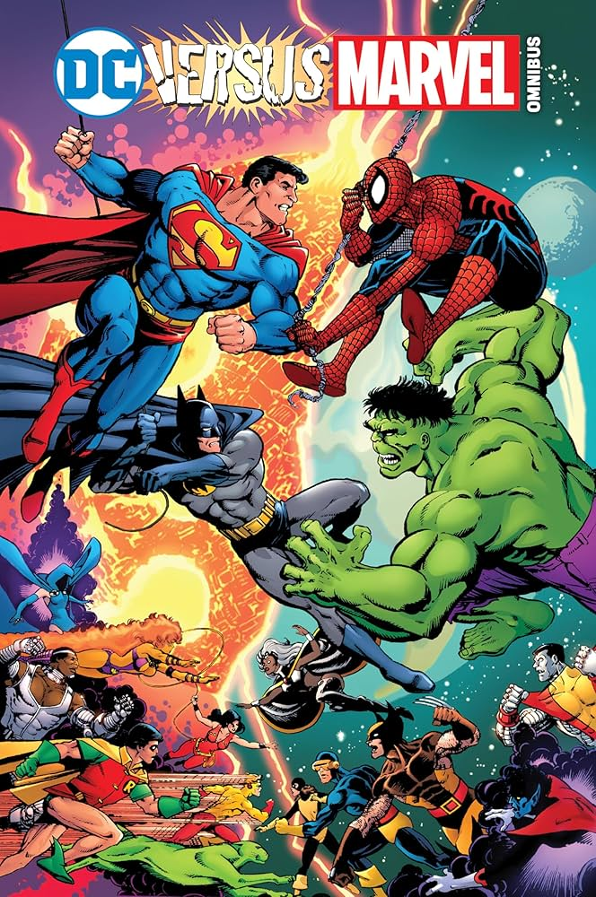
GROUP 7
Statistical Modelling of the Ultimate Superhero Tournament
A data-driven clash of universes using Principal Component Analysis, K-Means Clustering, Logistic Regression, and Markov Chain transitions.
Submitted to: Prof. Jimut Bahan Chakraborty
Group Members:
• Abdul Arham Shamim
• Anjali
• Chahat Kamalni
• Jeptha Lalawmpuia
• Nandini Talwar
Notes:
Speaker Notes:
Welcome to Group 7's presentation on the Statistical Modeling of the Ultimate Superhero Tournament.
We have built a four-step statistical machine in R to resolve long-standing comic book debates with objective, mathematical rigor. Our topic explores whether the strongest character is always the most likely champion when subjected to a structured, stochastic 16-player knockout bracket.

Slide 2
Problem Statement: Can Statistics Predict the Ultimate Superhero?
02
The Subjective Barrier
Superhero battles are traditionally decided by subjective fan opinions and favorite-character bias. However, superhero profiles have multiple measurable attributes like Strength, Speed, and Intelligence, enabling statistical analysis.
The Project Objective
To develop a data-driven superhero tournament model that uses statistical techniques to predict the outcomes of hypothetical 1v1 matchups. Pairwise battles are modeled using the overall score difference as a proxy winner target.
Methodology & Simulation
Using Logistic Regression to estimate win probabilities and identify which attributes matter most. The model then propagates progression odds through a stochastic tournament and simulates what-if entry barriers for new heroes.
CORE STRATEGIC QUESTION
Can statistical modelling turn superhero battles from subjective debates into a data-driven tournament, and what characteristics ultimately give a superhero the greatest probability of winning?
Notes:
Speaker Notes:
Here is our formal problem statement. Superhero debates are highly popular but usually subjective.
By collecting data on standardized ability scores, we can treat 1v1 matchups as probabilistic outcomes.
We fit a logistic model to win probabilities and use Markov state-transitions to propagate outcomes round-by-round. Our key question is whether statistical modeling can bring objectivity and identify the true determinants of victory.

Slide 3
Beyond Fan Debates: Bringing Rigor to the Multiverse
03
THE SUBJECTIVE BARRIER
Recency Bias & Favoritism
• Arguments are heavily prone to recency bias (e.g., who starred in the latest blockbuster film).
• Subjective fan favoritism dominates, focusing on emotional attachment rather than analytical consistency.
• Character rankings ignore secondary uncertainty introduced by a tournament structure, where a hero's success depends on the exact seeding and match pathways.
THE ANALYTICAL SOLUTION
Rigor & Probability Models
• Standardized ratings in 6 categories: Intelligence, Strength, Speed, Durability, Power, and Combat.
• Applying statistical dimensionality reduction to handle attribute correlations cleanly.
• Propagating probabilities sequentially across a 16-player bracket to calculate realistic tournament outcomes, proving that 'strongest' and 'most likely champion' are distinct.
Notes:
Speaker Notes:
This motivation slide contrasts the subjective barrier of traditional comic book debates with the rigorous analytical pipeline we built. We seek to demonstrate that rankings alone fail to model matchups, and only a structured, probability-conserving sequential tournament model can capture bracket pathways.

Slide 4
Filtering and Restructuring the Superhero Multiverse
04
RAW DATABASE SCALE
1,471
Bio-dataset rows containing biographical details, publisher indices, and multiple raw power categories across creators.
CLEANED CASSETTES
958
Unique character profiles retained after filtering exclusively to Marvel and DC, removing duplicates, and purging incomplete records.
PREDICTORS RETAINED
6
Standardized abilities: Intelligence, Strength, Speed, Durability, Power, and Combat used to model character-level capabilities.
Notes:
Speaker Notes:
We started with a dataset containing 1,471 rows and 1,268 columns of biographical metrics.
We remove unnamed columns and filter exclusively to Marvel and DC characters.
This leaves 958 unique, completely populated profiles. We focus on the six primary capabilities as variables.

Slide 5
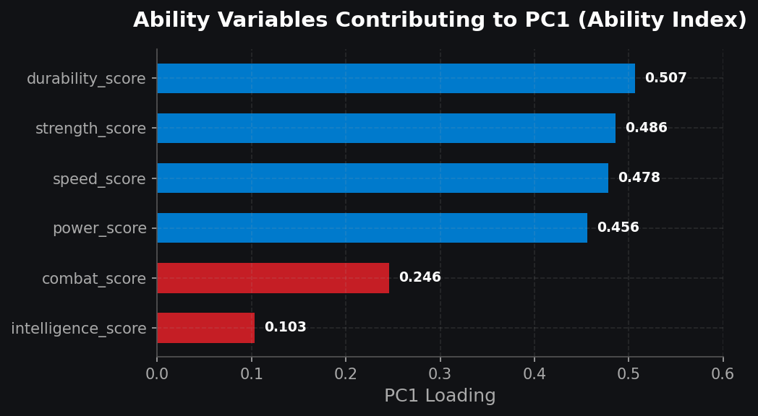
PCA Compresses 6 Core Stats to Build a Single Ability Index
05
DIMENSIONALITY REDUCTION
Principal Component 1 Captures 50.4% Variance
• PCA evaluates if six highly correlated stats can be reduced to a smaller set of orthogonal components.
• PC1 captures 50.4% of total standardized variance, serving as our composite Ability Index.
• Standardization of all six abilities is crucial prior to projection to avoid scaling imbalances.
• Loading strengths show that Durability (0.507), Strength (0.486), and Speed (0.478) dominate PC1. Combat (0.246) and Intelligence (0.103) contribute weakly.
Notes:
Speaker Notes:
Our six variables are highly correlated. To compress them without losing structure, we use PCA.
The first component captures over half the variance. When looking at loadings, Durability and Strength carry the most weight in defining PC1, while Intelligence and Combat skill are mathematically discounted in this dimension.

Slide 6
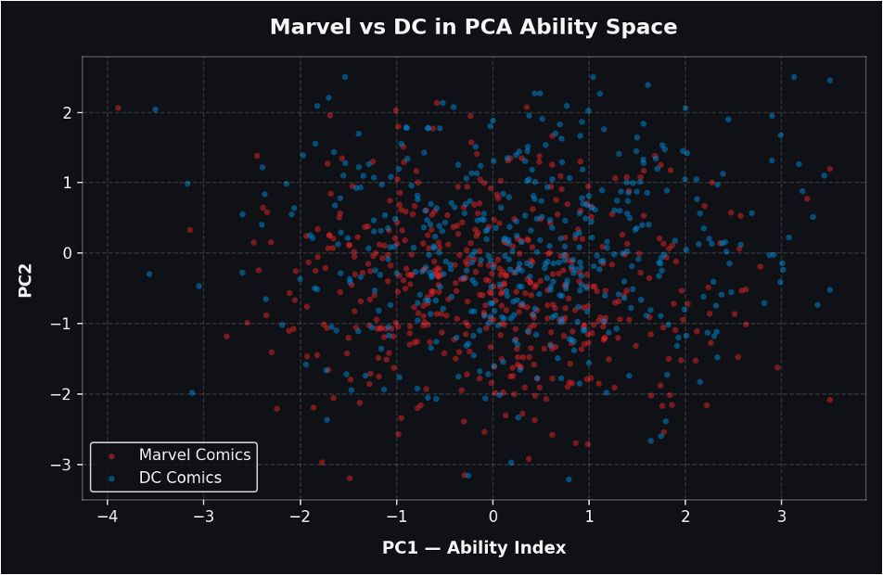
PCA Coordinate Space: Substantial Overlap Between Universes
06
COORDINATE SPACE VISUALIZATION
PC1 vs. PC2 Character Coordinate Space
• Plotting characters in the PC1-PC2 coordinate space allows us to visualize character patterns.
• PC1 represents raw physical/energy capacity (Ability Index), while PC2 explains 18.9% of variance, capturing intelligence/skill trade-offs.
• Substantial spatial overlap occurs between Marvel (red) and DC (blue), showing neither publisher holds an exclusive monopoly on extreme characters.
• Outliers show cosmic beings at the far right, and grounded characters at the lower-left.
Notes:
Speaker Notes:
This slide analyzes the coordinate space where we visualize our 958 characters.
Plotting PC1 vs PC2 shows a massive spatial overlap. There is no publisher clustering—DC and Marvel are highly similar at all tiers of power, with cosmic-level profiles occupying the far-right boundaries and skill-based humans on the left.

Slide 7
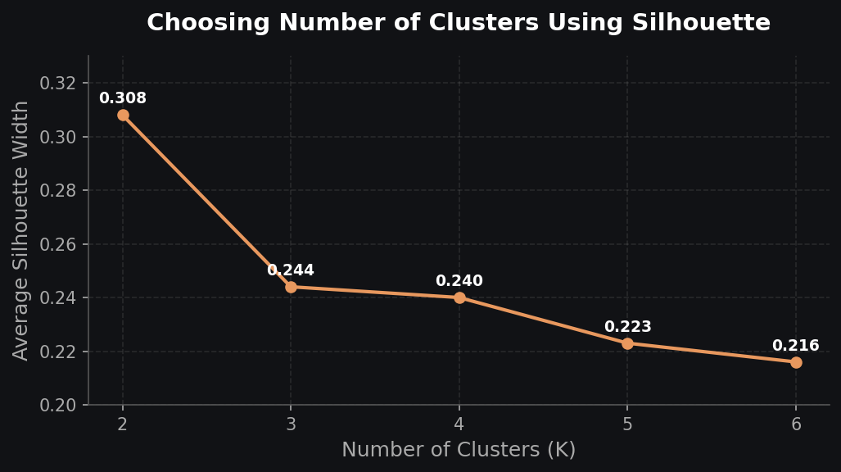
K-Means Partitions Characters Into 3 Combat Archetypes
07
EXPLORATORY PROFILING
Clustering Reveals 3 Character Archetypes
• K-Means is used alongside PCA to find natural, descriptive groupings of power profiles.
• Silhouette metric peaks at K=2 (~0.31), indicating two massive classes (grounded vs powerhouse). We select K=3 (~0.24) to isolate a richer mid-tier.
• Crucially, clustering is kept purely exploratory — it is not used to predict matchups.
• Cluster 1: Cosmic Powerhouses | Cluster 2: Street-Level / Skill-Based | Cluster 3: Mid-Tier / Specialists.
Notes:
Speaker Notes:
To discover natural groupings of profiles, we apply K-Means clustering.
While silhouette analysis mathematically peaks at K=2, splitting characters into simple 'weak' and 'strong' groups, retaining K=3 provides a much richer description by isolating a versatile middle tier.

Slide 8
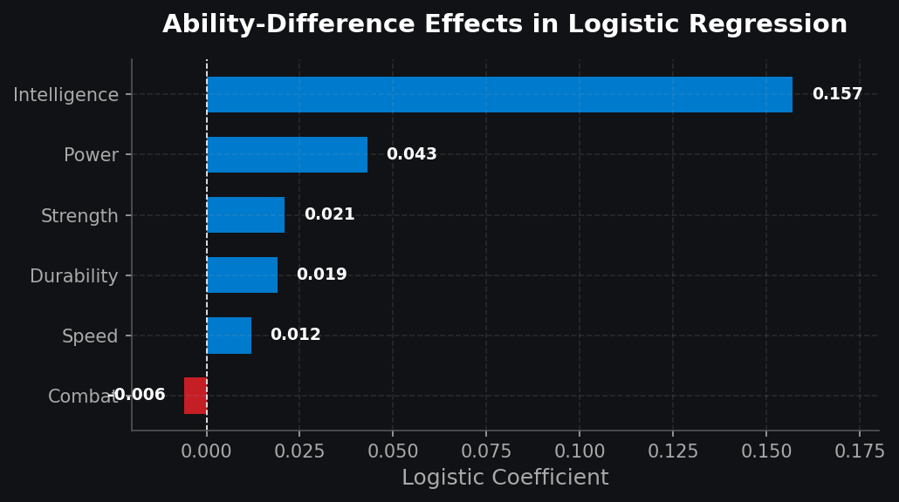
Logistic Model Reveals Intelligence Outweighs Combat Skill
08
PAIRWISE PROBABILITY MODEL
The Combat Paradox & Coefficients
• Pairwise training cases are constructed using difference in ability scores, using overall score delta as a proxy winner target.
• We fit a binomial generalized linear model (GLM) to convert linear predictors into bounded probabilities.
• Intelligence has an overwhelming positive effect (0.157 coefficient). Power (0.043) and Strength (0.021) follow.
• The Combat Paradox: Combat has a slight negative coefficient (-0.006), suggesting minor combat rating increases do not predict wins once physical power and brains are accounted for.
Notes:
Speaker Notes:
This slide details our pairwise logistic predictor. Because we don't have historical fight outcomes, we use difference vectors to train our GLM. The most fascinating finding is 'The Combat Paradox': Intelligence is the dominant predictor of matchup wins, while Combat skill displays a negative coefficient when physical power is controlled for.

Slide 9
Markov Transitions Propagate Odds Across Bracket Stages
09
Sequential State Transitions
The tournament is modeled as a sequence of discrete transition steps: Round of 16 → Quarterfinals → Semifinals → Finals → Champion. A stochastic state vector represents the probability of a hero occupying the active position, which we aggregate across possible opponent pairings.
The Probability Axiom (QA Rule)
The initial pipeline computed independent pairwise matchups, which violated probability axioms (summing to >1.00). We enforce P(B wins) = 1 - P(A wins) to guarantee a strict probability-conserving sum of exactly 1.00 (100%) across all players.
SEQUENTIAL TOURNAMENT DECAY FLOW
Round of 16 ──► Quarterfinals ──► Semifinals ──► Finals ──► Champion
• Round of 16: 16 entrants sorted into fixed seed positions (8 Marvel vs 8 DC) based on PC1 score.
• Quarterfinal: Survival probability is determined by initial 1v1 win likelihoods.
• Semifinal & Finals: Paths are aggregated over all possible potential opponents carrying their respective survival weights.
Notes:
Speaker Notes:
To model the bracket sequentially, we construct a Markov chain process.
Crucially, the initial pipeline calculated independent pairwise wins, which allowed sums to exceed 1.00.
We enforce P(B wins) = 1 - P(A wins). This ensures the total champion probability sums to exactly 100%.

Slide 10
Thor Claims the Statistical Crown with 13.8% Odds
10
STOCHASTIC CHAMPION
Why the Strongest Doesn't Always Win
• Cosmic King Thor is the ultimate modeled champion, securing a 13.8% championship probability.
• Rank vs. Odds Divergence: Thor is NOT the highest-ability character (Hercules, One-Above-All exceed him), yet has higher final odds.
• The Seeding Advantage: Thor's bracket seed grants him an easier initial branch, avoiding early-round roadblocks.
• Analytical Insight: This proves that raw ability ranking and final tournament odds are distinct.
Character | Creator | Championship Odds
Cosmic King Thor | Marvel Comics | 13.8%
Black Adam | DC Comics | 11.1%
One-Above-All | Marvel Comics | 10.5%
All-father Hercules | Marvel Comics | 10.3%
Notes:
Speaker Notes:
Here are our final modeling results. Cosmic King Thor is our statistical champion with 13.8% odds.
Crucially, Thor is not the highest-ability character in the database. He is outranked in raw PCA score by Hercules and the One-Above-All. However, Thor benefits from favorable seeding, allowing him to bypass high-risk early matchups.

Slide 11
Tracing Survival Decay across Knockout Tournament Stages
11
Top 8 Contenders | Quarterfinals | Semifinals | Finals | Tournament Champion
Cosmic King Thor (Marvel) | 91% | 50% | 27% | 13.8%
Black Adam (DC) | 70% | 38% | 21% | 11.1%
One-Above-All (Marvel) | 70% | 40% | 20% | 10.5%
All-father Hercules (Marvel) | 70% | 39% | 20% | 10.3%
Ragnarok (Marvel) | 70% | 37% | 19% | 9.7%
Dark Phoenix (Venomized) (Marvel) | 52% | 31% | 18% | 9.6%
Ultron (Final Form) (Marvel) | 67% | 31% | 17% | 8.5%
Great Evil Beast (DC) | 55% | 31% | 16% | 8.0%
Notes:
Speaker Notes:
This survival matrix tracks how probabilities decay across the tournament rounds.
Cosmic King Thor starts with a high 91% Quarterfinal survival probability, which decays to 13.8% to win.
Mid-tier characters like Dark Phoenix face a coin-flip early matchup, heavily limiting their final championship odds.

Slide 12
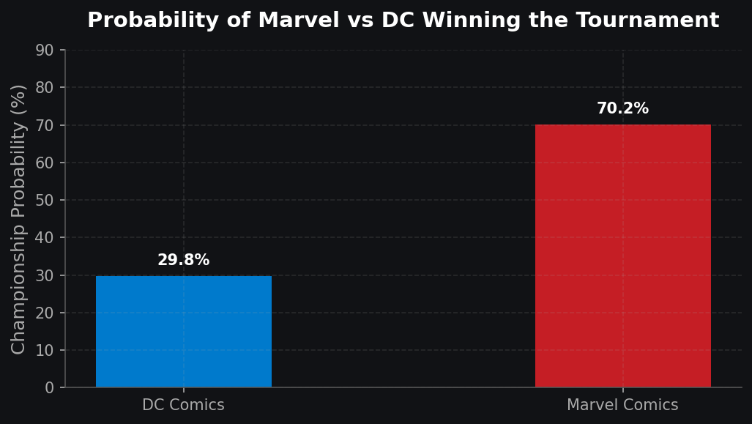
Marvel Outpaces DC with 70.2% Championship Probability
12
AGGREGATED BRACKET POWER
Publishers Clash in the Tournament
• By summing character-level championship probabilities within each publisher, we resolve the classic debate.
• Marvel Comics secures 70.2% of aggregate championship probability, while DC holds 29.8%.
• No Canonical Claim: This is an artifact of bracket composition and seeding, not a claim that Marvel characters are canonically stronger.
• Distributed Strength: Marvel's powerful characters are distributed across seeds in a way that aggregates massive survival paths.
Notes:
Speaker Notes:
To resolve the publisher battle, we aggregate individual probabilities within Marvel and DC.
Marvel holds 70.2% aggregate championship probability versus DC's 29.8%. This is an analytical result of seeding and roster distribution across the bracket, rather than canonical comic book proof.

Slide 13
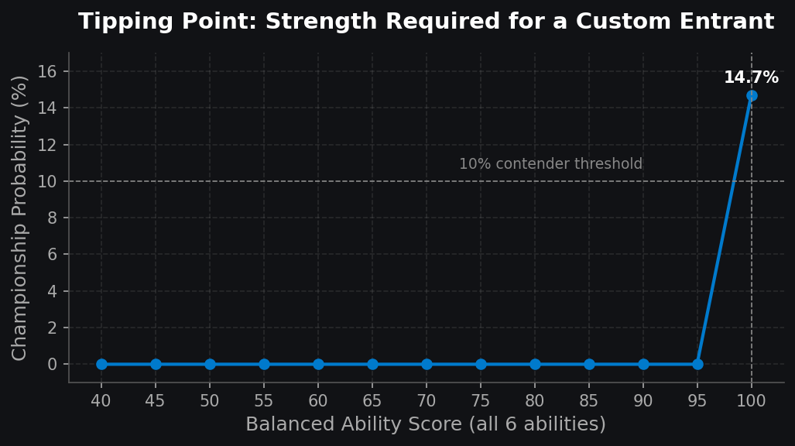
Balanced Entrants Must Hit Perfect 100/100 to Compete
13
SENSITIVITY ANALYSIS
The Tipping Point for New Characters
• We test model sensitivity by inserting a perfectly balanced new hero with identical ratings (40 to 100) across all six abilities.
• The new hero is projected into PCA space, sorted, and appended to the tournament (bumping the 16th player).
• The Tipping Point: Below 100/100, the entrant has exactly 0% championship probability because they fail to make the top-16 roster cut.
• At perfect 100/100 ratings, they instantly become the top threat with 14.7% champion odds.
Notes:
Speaker Notes:
To test model sensitivity, we inserted a balanced new hero with ratings ranging from 40 to 100.
We discovered a dramatic tipping point. Below 100/100, they have 0% chance because they don't quality for the tournament.
At exactly 100/100, they immediately jump to a 14.7% championship probability, which leads the tournament field.

Slide 14
Empirical Battle Data and Seeding Tests Define the Roadmap
14
EMPIRICAL BATTLE DATA
Moving Beyond Proxy Targets
Currently, no actual battle history exists in our database. Wins are trained using overall score differences as proxy targets. Collecting real victory logs from comic books will significantly improve predictor coefficients.
MONTE CARLO SEEDING
Isolating Seeding Luck
Seeding and brackets are currently fixed, leading to seeding bias (which benefited Thor). Run Monte Carlo simulations across randomized bracket shuffles to separate raw character power from pure placement luck.
PROBABILITY INTEGRITY
Retaining Rigorous Axioms
It is critical to preserve probability-consistency rules. Ensuring P(B wins) = 1 - P(A wins) maintains mathematical integrity, preventing sums from exceeding 100% in sequential transitions.
Notes:
Speaker Notes:
To conclude, we review model limitations and roadmap paths.
We recommend collecting actual observed battle data, running randomized seeding shuffles to remove bracket bias, and preserving the mathematical consistency check so our state transitions remain perfectly normalized.

Slide 15
THE END
Thank You!
Notes:
Speaker Notes:
Thank you for listening to Group 7's presentation on the Ultimate Superhero Tournament modeling.
We are happy to take any questions or comments you might have!

