Slide 1
PRESENTATION OVERVIEW
01 Motivation & Introduction
02 Background & Literature Review
03 Methodology
04 Evaluation & Results
05 Debiasing Pipeline
06 Conclusions & Future Work
Evaluating the Quality of
Re-LAION-2B
Insights into Large-Scale Image Dataset Assessment
Jerome Agius
Supervisor: Dr Dylan Seychell
MSc Artificial Intelligence (Mainly by Research)
University of Malta · May 2026

Slide 2
MOTIVATION & INTRODUCTION
Scale & Influence
RESEARCH QUESTION
Re-LAION-5B: ~5.85B image-text pairs. SDv1.5 trained on LAION-Aesthetics v2 5+ — a direct derivative. Deployed across DreamStudio, Hugging Face & beyond.
Do spurious low-level image features in Re-LAION-5B correlate with demographic attributes — and does Stable Diffusion v1.5 inherit, amplify, or alter those patterns?
Web-Scraped = Biased by Design
"The scale and automated nature of web scraping introduces systematic biases that reflect and potentially amplify societal inequities."
The Black-Box Problem
5 RESEARCH OBJECTIVES
Prior work measures demographic outcomes but does not expose which low-level image features cause them — treating models as black boxes.
O1 Dataset Acquisition & Annotation
O2 Spurious Feature Detection
O3 Demographic Correlation Analysis
O4 Inference-Time Debiasing
O5 Synthesis of Bias Mechanisms
Mechanisms, Not Just Outcomes
This thesis investigates spurious features: non-semantic image properties (colour, texture, frequency, structure) that correlate with demographic attributes.
Accessible Mitigation
Full retraining is beyond most practitioners. This work demonstrates inference-time debiasing on frozen models — no retraining required.

Slide 3
BACKGROUND & LITERATURE REVIEW · THE TWO PILLARS
ZENG ET AL. (NeurIPS 2024)
MEISTER ET AL. (ICCV 2023)
Understanding Bias in Large-Scale Visual Datasets
Gender Artifacts in Visual Datasets
Framework: Transform image → train classifier → accuracy = bias contribution of that feature type. Applied to YFCC, CC12M & DataComp-1B.
Framework: AUC-based gender artifact probing via ResNet-50 on COCO & OpenImages under systematic occlusion conditions. AUC 50% = chance.
Transformation | Category | Accuracy
Original images | Reference | 82.0%
SAM Contour | Structural | 73.2%
Depth Estimation | Structural | 73.1%
Canny Edge Detect. | Structural | 71.0%
High-pass Filter | Frequency | 79.2%
Low-pass Filter | Frequency | 70.4%
Semantic Seg. | Semantic | 69.8%
Captions (long) | Semantic | 66.1%
Object Detection | Semantic | 61.9%
VAE | Semantic | 77.4%
Patch Shuffle 16×16 | Spatial | 81.2%
Pixel Shuffle | Spatial | 52.2%
Mean RGB | Colour | 48.5%
DiT Synth. (uncond.) | Generative | 77.6%
Occlusion Condition | COCO AUC | OpenImages
Full image (no occlusion) | 93.4% | 81.2%
Full, background removed | 92.7% | —
Person → segm. mask | 79.6% | —
Person → segm. mask, no bg | 74.8% | —
Person → bounding box | 70.8% | 63.1%
Person → bbox, no bg | 58.0% | —
Keypoints only (17 pts) | 64.8% | —
Normalised pose only | 58.0% | —
Mean RGB (3 values) | 58.0% | 59.1%
Object presence (80 cats.) | 75.4% | 63.3%
30 random object classes | 66.8% | —

Slide 4
BACKGROUND & LITERATURE REVIEW · THE GAP
WHAT PRIOR WORK ESTABLISHED
THIS THESIS CONTRIBUTES
Bianchi et al. (FAccT '23) & Luccioni et al. (2023): T2I models amplify occupational stereotypes — generated distributions are more extreme than real-world labour statistics
Meister et al.: Gender artifacts are pervasive; fairness-through-blindness approaches leave demographic signal intact
Zeng et al.: Dataset-level spurious features are measurable via transformation-based classification
▸ First spurious feature analysis of Re-LAION-5B and SDv1.5 as a matched training-corpus/model pair
▸ Extended demographic probing from gender-only to include skin tone (MST 1–10 scale)
▸ 200 ISCO-08-aligned occupation categories — 200,000 images per dataset
WHAT WAS STILL MISSING
▸ 15-transformation classification pipeline isolating semantic, structural & low-level signals
Neither Bianchi nor Luccioni identify which low-level features carry bias — both treat the model as a black box
Meister et al. limited to COCO & OpenImages; gender only — no skin tone, no generative corpora
No spurious feature analysis of Re-LAION-5B; no pre-computed embeddings made retrieval non-trivial
SDv1.5 is uniquely auditable — SDXL & SD3 rely on proprietary training corpora
▸ Inference-time debiasing pipeline (ITI-GEN + ControlNet + Chamfer alignment) evaluated against the spurious feature profile
▸ Findings directly linked to training data properties — uniquely possible with SDv1.5's open lineage

Slide 5
METHODOLOGY · OVERVIEW
1. DATA
ACQUISITION
2. STRUCTURAL
FILTERING
3. DEMOGRAPHIC
ANNOTATION
4. TRANSFORMATION
PIPELINE
5. PROBING &
DEBIASING
Re-LAION-5B retrieval
& SDv1.5 generation
200K images each
YOLOv12l-Face
MediaPipe FaceMesh
Face–person validation
Gender: Realistic GC
Skin Tone: VGG-16 MST10
200,000 labels each
15 transformations
5 feature families
AUC-based gender &
skin tone probing
ITI-GEN + ControlNet
Scope: 200 ISCO-08-aligned occupations · 200,000 images per dataset · Re-LAION-5B (retrieved) vs Stable Diffusion v1.5 (generated) · COCO included as structural reference class for dataset classification
▸ Gender-neutral prompts throughout — no demographic priors injected at query or generation stage
▸ Guidance scale s = 1.0 — conservative lower bound; production bias would be stronger at s = 7
▸ Fixed labels across all transformations — representation changes, annotation does not

Slide 6
METHODOLOGY · DATA ACQUISITION & STRUCTURAL FILTERING
RE-LAION-5B RETRIEVAL
STABLE DIFFUSION v1.5 GENERATION
· Subset: 4 of 128 shards (random) → 65.5M URL-caption pairs
· Model: SDv1.5 + LCM-LoRA — only configuration satisfying traceability criterion within compute budget (1.5s vs 5.6s/image)
· Download & validate: HTTP 2xx + RGB decode + embedding success → 43.5M valid (decay rate 33.7%)
· Prompt: "full-body realistic photo of a {profession}, standing, centered, in a professional setting..." · gender-neutral throughout
· Embedding: CLIP ViT-L/14 (768-dim), L2-normalised, stored in Parquet; FAISS IndexFlatIP per shard
· Guidance scale: s = 1.0 — no CFG amplification; any bias detected is a conservative lower bound
· Profession query: "A photo of a/an {profession}" — 200 ISCO-08 occupations, gender-neutral
· Inference: 4-step LCM schedule · 512×512 · FP16 · NVIDIA RTX 3060 Ti
· Filtering stages: Negative prompt dominance filter → embedding deduplication → cosine threshold 0.15 → top 125K candidates/shard
· Structural validation: Same YOLOv12l-Face + FaceMesh pipeline; additionally: aesthetic score ≥ 3.0 (CLIP ViT-L/14)
· Structural validation: YOLOv12l-Face (1 face, conf ≥ 0.6) + person detection + face–person spatial consistency + MediaPipe FaceMesh
· Asynchronous pipeline: ValidationWorker pool decoupled GPU generation from CPU validation; per-profession resumability
· Output: Top 1,000 valid images per profession → 200,000 images total
· Output: 1,000 valid images per profession → 200,000 images total
Acceptance rate: Mean 33.51% · Median 33.67% · Min 9.55% · Max 59.21%
Acceptance rate: Mean 66.38% · Median 71.00% · substantially higher than retrieval (prompt engineering effect)

Slide 7
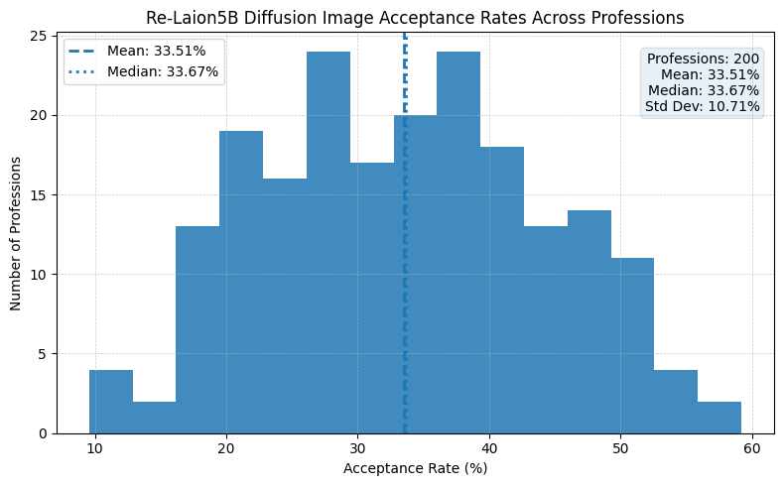
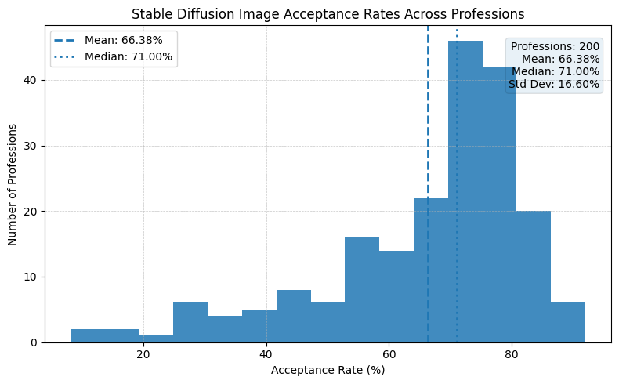
METHODOLOGY · DATA ACQUISITION & STRUCTURAL FILTERING FIGURES
Figure 1: Distribution of structural acceptance rates across 200 professions following CLIP retrieval and YOLO‐based structural filtering of Re‐LAION‐5B images. The distribution is approximately unimodal with a mean of 33.51% and median of 33.67%, with a visible left tail reflecting professions whose online visual representation is dominated by non‐person content
Figure 2: Distribution of structural acceptance rates across 200 professions for Stable Diffusion v1.5 generated images. The distribution is left‐skewed with a mean of 66.38% and median of 71.00%, substantially higher than the Re‐LAION‐5B retrieval acceptance rate of 33.51%.

Slide 8
METHODOLOGY · MODEL SELECTION
Component | Alternatives Tested | Selected | Decisive Criterion
Face Detection | MediaPipe, RetinaFace†, SCRFD | YOLOv12l-Face | Highest AP@0.5 (0.905) + widest high-precision recall range; filtering bias risk
Generative Model | SDv1.2, SDv1.5, SDv1.5+LCM-LoRA | SDv1.5 + LCM-LoRA | Only option satisfying LAION traceability criterion within compute budget (1.5s vs 5.6s/img)
Gender Annotation | HuggingFace GC, DeepFace, FairFace | Realistic GC (SigLIP) | Best CCv2 face-only accuracy + strongest M/F subgroup balance on FACET
Skin Tone Annotation | VGG-16 MST10/MST3 variants, baselines | VGG-16 MST10 Reg. (Black BG) | Best exact + within-one accuracy on CCv2, MSTE & FACET; full 10-point MST scale
Image Captioning | Multiple models (throughput vs quality) | BLIP Large | Best RefCLIP-S on COCO/Flickr30k; avoids template degeneration seen in faster models
Object Detection | Multiple YOLOv8 variants + weight sets | YOLOv8x / OpenImages V7 | Highest detection performance on OpenImages V7 val; best inference/accuracy tradeoff
Pose Estimation | Multiple pose models (standard + oracle) | YOLOv8l-Pose | Best COCO-17 keypoint AP in oracle mode; sufficient FPS for pipeline scale
Segmentation / Occlusion | Multiple models on COCO 2017 val | Mask2Former (Swin-L) | Best single-person mIoU on COCO 2017 val; precise person masks for occlusion protocol
† RetinaFace evaluated via batch_face library — AP@0.5 0.319; reflects deployment configuration, not published capability. Canny edge, frequency filters, pixel/patch shuffle, mean RGB, VAE & depth: no comparative selection required — classical/deterministic operations or adopted directly from Zeng et al. framework.

Slide 9
METHODOLOGY · DEMOGRAPHIC ANNOTATION
GENDER ANNOTATION
SKIN TONE ANNOTATION
· Pre-processing: MediaPipe FaceMesh → convex hull mask → background-removed face crop applied to ALL images before any annotation
· Scale: Monk Skin Tone (MST) 1–10 — extends Meister et al.'s gender-only framework to skin tone; prior work used binary or Fitzpatrick 6-class
· Model: Realistic Gender Classifier (SigLIP backbone) — selected via head-to-head benchmark on CCv2 face-only segmented crops and FACET
· Model: VGG-16 MST10 Regression, black-background variant — selected from multiple architectures and input configurations on CCv2, MSTE, FACET
· Performance: Highest overall CCv2 accuracy + best male/female subgroup balance — FairFace and DeepFace both showed stronger skew toward one subgroup
· Performance: Best exact + within-one accuracy across all three benchmarks; black background prevents model exploiting surrounding context
· Labels: Binary perceived gender (Male / Female) — proxy of perceived attributes, not ground truth identity
· Binning: Reported as MST 1–10 (fine) and Light (1–3) / Mid (4–7) / Dark (8–10) bins for aggregate analysis
· Known limitation: Classifier accuracy degrades at darker skin tones (MST 8–10) and at distribution extremes — documented in Table 3.4; no ground truth at scale available to correct this
· Known limitation: Race-to-skin-tone reference mapping abandoned — all racial groups collapsed to Mid bin in FairFace calibration corpus, lacking discriminative resolution for real-world comparison
Aggregate result: Re-LAION-5B 41.5% F / 58.5% M · SDv1.5 29.0% F / 71.0% M
Aggregate result: SDv1.5 Light-bin 22.9% vs Re-LAION-5B 12.5% · Dark-bin collapsed by 83%

Slide 10
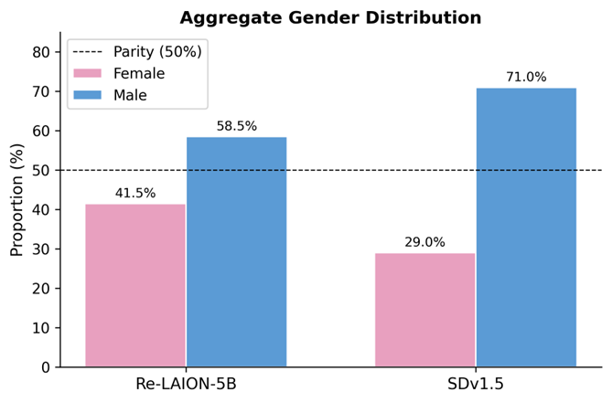
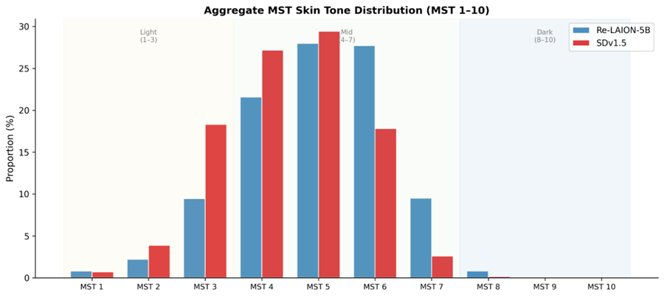
METHODOLOGY · DEMOGRAPHIC ANNOTATION FIGURES
Figure 4: Aggregate Monk Skin Tone (MST 1–10) distribution for Re-LAION-5B and Stable Diffusion v1.5 outputs. Skin tone annotations are derived using the VGG-16 MST10 regression model and binned across the full 10-point scale. Both datasets exhibit a strong concentration in mid-range tones (MST 4–6), with reduced representation at the lightest (MST 1–2) and darkest (MST 8–10) extremes. Stable Diffusion shows a slight shift toward lighter tones and reduced diversity at higher MST values, indicating distributional compression and amplification of existing biases present in the training data.
Figure 3: Aggregate gender distribution across Re-LAION-5B and Stable Diffusion v1.5 outputs. Gender proportions are computed over the filtered 200,000-image corpus using the Realistic GC classifier. While Re-LAION-5B exhibits a moderate male skew (58.5% male, 41.5% female), Stable Diffusion outputs amplify this imbalance to 71.0% male and 29.0% female. The dashed line indicates parity (50%), highlighting that the generative process introduces additional demographic bias beyond the training distribution, rather than reproducing it faithfully.

Slide 11
METHODOLOGY · TRANSFORMATION PIPELINE · 15 TRANSFORMATIONS · 5 FAMILIES
FREQUENCY
SPATIAL
SEMANTIC
STRUCTURAL
OCCLUSION
High-pass filter
(FFT, r=40)
Pixel Shuffle
Semantic Segmentation
(Mask2Former ADE20K)
Depth Map
(Depth-AnythingV2 small)
Full / Full - No Background
Low-pass filter
(FFT, r=40)
Patch Shuffle
(2x2 / 4x4 / 8x8 16x16)
Object Detection
(YOLOv8x OpenImagesV7)
Canny Edge Detection
Mask Segmentation /
Mask Segm – No Bg
Mean RGB
Image Captioning
(BLIP Large)
Pose Keypoints
(YOLOV8l-Pose)
Rectangular Mask /
Rect Mask - No Bg
VAE
(SDv1.5 KL-VAE)
Classical / deterministic — no comparative selection
Classical / deterministic — no comparative selection
Captioning & OD: comparative model selection — see Slide 7
Depth adopted from Zeng et al. Canny: deterministic
Person segmentation: Mask2Former — comparative selection
Two objectives: (1) Dataset classification — ConvNeXt-Tiny 3-class (Re-LAION-5B / SDv1.5 / COCO) (2) Demographic probing — AUC-based gender & skin tone separability per transformation
Why COCO? Added as a third class to enable per-class accuracy attribution — to pinpoint which dataset carries the spurious features. In practice, all three datasets were separable with high accuracy across every transformation (min. 64.19% vs 33.3% chance), making the attribution less discriminative than anticipated — acknowledged as a limitation.

Slide 12
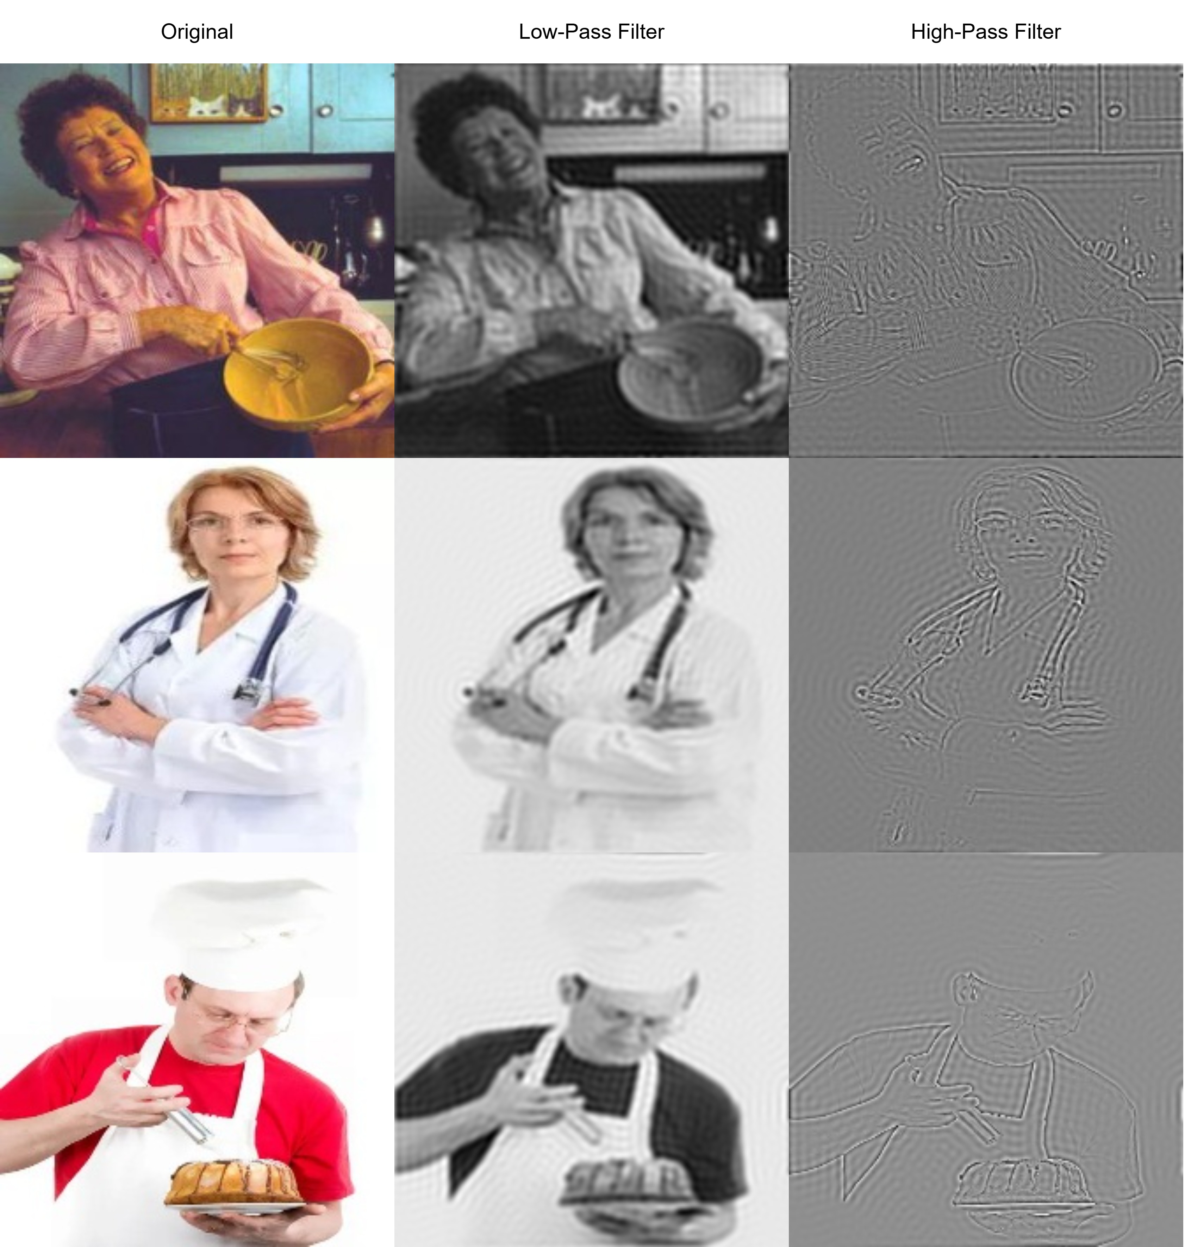
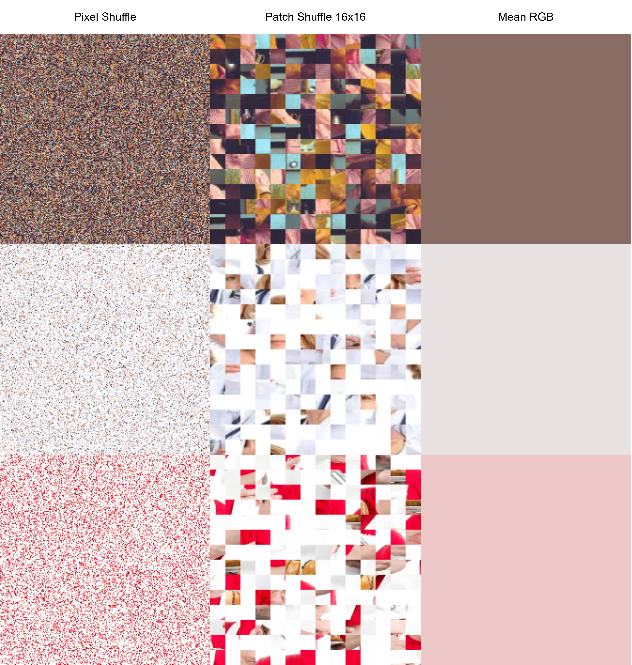
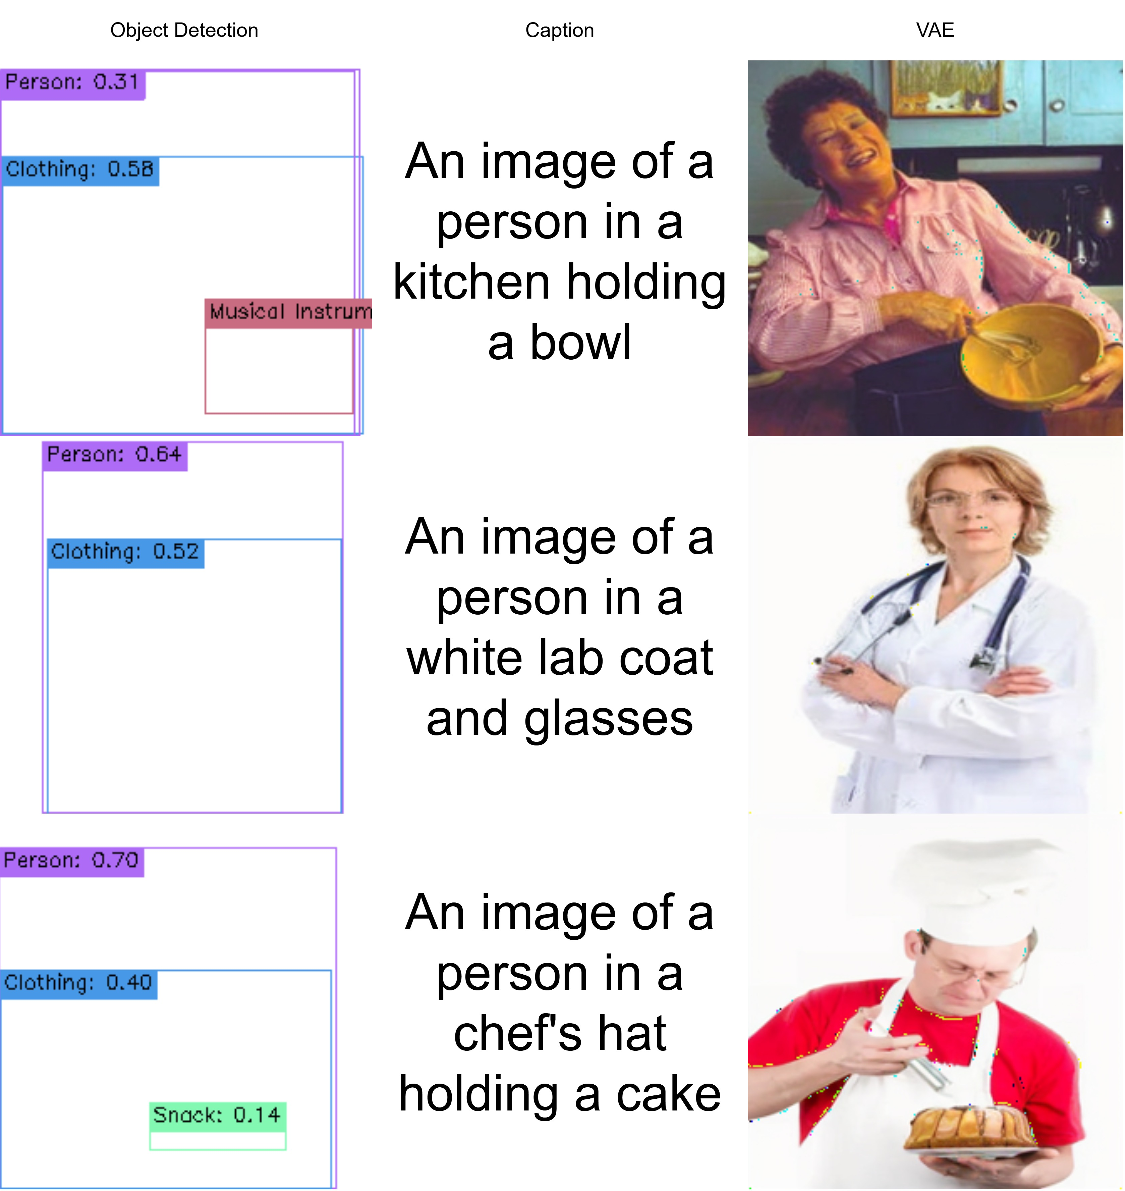
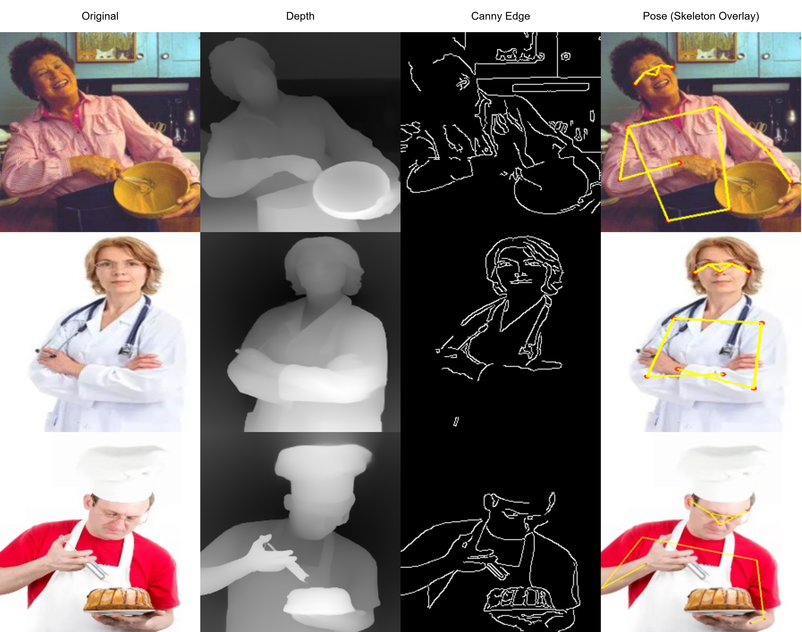
METHODOLOGY · TRANSFORMATION FIGURES (1/2)
Figure 5: Transformation pipeline output examples applied to three profession-conditioned images, illustrating controlled feature ablation across multiple representation domains.

Slide 13
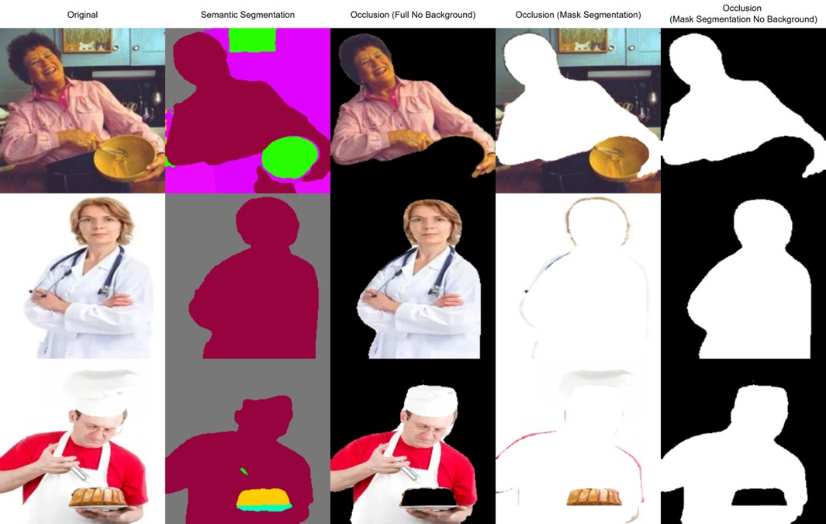

METHODOLOGY · TRANSFORMATION FIGURES (2/2)
Figure 6: Additional transformation pipeline output examples applied to three profession-conditioned images, illustrating controlled feature ablation across multiple representation domains.

Slide 14
EVALUATION · DEMOGRAPHIC DISTRIBUTIONS
GENDER DISTRIBUTION · 200 PROFESSIONS · 200,000 IMAGES EACH
SKIN TONE DISTRIBUTION · MST 1–10 · THREE-BIN GROUPING
Re-LAION-5B
41.5% Female
58.5% Male
Light (1–3)
Mid (4–7)
Dark (8–10)
Stable Diffusion v1.5
29.0% Female
71.0% Male
Re-LAION-5B
12.45%
86.74%
0.81%
Gap (F%)
−12.5 pp
amplified by SDv1.5
SDv1.5
22.87%
76.99%
0.14%
Top 5 most skewed professions — SDv1.5
Change
+10.4 pp ↑
−9.8 pp ↓
−83% collapse ↓
Logger
97.5% M
MST 1–10 modal shift
Nurse
97.5% F
Re-LAION-5B peaks at MST 5–6 (~28% each). SDv1.5 peaks at MST 4–5 — a leftward shift toward lighter tones. MST 9–10 effectively absent in both datasets (near-zero). 175 of 200 professions (87.5%) show higher Light-bin proportion in SDv1.5.
Receptionist
97.3% F
Farmer
97.0% M
Compared against US BLS 2024 and ILO global reference markers: Re-LAION-5B already under-represents women in 6 of 10 ISCO-08 groups. SDv1.5 widens nearly every gap without exception.
Dietitian
96.9% F
178 of 200 professions (89.0%) show greater skew in SDv1.5 than in Re-LAION-5B. 167 of 200 (83.5%) agree in skew direction.
Skin tone comparison against real-world reference not conducted — race-to-MST reference mapping abandoned (all groups collapsed to Mid bin in FairFace corpus). Parity baseline used instead.
§4.1.1 Aggregate Gender and Skin Tone Distributions · §4.1.2 Per-Profession and Per-ISCO-Group Analysis · Tables 4.1 & 4.2

Slide 15
EVALUATION · DATASET CLASSIFICATION · 3-CLASS · 15 TRANSFORMATIONS
ConvNeXt-Tiny trained per-transformation on Re-LAION-5B / SDv1.5 / COCO · Chance = 33.3% · Table 4.3
Transformation | Test Acc. | Test AUC
Base (unmodified) | 99.42% | 0.9996
VAE reconstruction | 99.15% | 0.9992
High-pass filter | 98.64% | 0.9988
Patch shuffle 8×8 | 97.91% | 0.9983
Patch shuffle 16×16 | 97.69% | 0.9983
Low-pass filter | 96.99% | 0.9969
Depth estimation | 96.78% | 0.9965
Patch shuffle 4×4 | 94.38% | 0.9949
Edge detection (Canny) | 93.62% | 0.9905
Semantic segmentation | 91.36% | 0.9837
Captions (logistic probe) | 90.99% | 0.9820
Patch shuffle 2×2 | 89.91% | 0.9766
Object detection | 88.62% | 0.9728
Pixel shuffle | 80.67% | 0.9430
Mean RGB | 64.19% | 0.8207
1
All 15 transformations exceed 33.3% chance
Every transformation retains dataset-discriminating signal — even mean RGB at 64.19%. Dataset identity is embedded in multiple correlated visual cues simultaneously, not any single isolated artefact.
2
VAE result (99.15%) ≈ unmodified (99.42%)
A drop of only 0.27 pp after VAE reconstruction rules out simple acquisition artefacts (compression differences, file-format shortcuts) as the dominant source of discriminating signal.
3
Patch-level local statistics are highly discriminative
2×2 patch shuffle → 89.91%; 16×16 → 97.69%. Dataset-specific signatures are embedded at fine spatial scales, not only in global scene layout.
4
Both frequency bands carry strong signal (High 98.64%, Low 96.99%)
Visual bias spans the full frequency spectrum — not concentrated in either texture detail or smooth structure alone.
5
Semantic representations match structural ones (Captions 90.99%)
Dataset identity survives compression to natural language. Stereotyping is not confined to pixel statistics but extends into semantic content.
6
Accuracies exceed Zeng et al. by 15–25 pp
Attributable to the inclusion of SDv1.5, whose generative pipeline imposes highly consistent visual priors — making it far more internally homogeneous and easier to identify as a class than purely web-scraped corpora.
§4.2 Dataset Classification · Table 4.3 · §4.3.3 Connections to Dataset Classification Results

Slide 16
EVALUATION · DEMOGRAPHIC PROBING · GENDER SEPARABILITY
AUC-based gender probing per transformation · Chance = 0.500 · Table 4.4 · Replicates & extends Meister et al. to SDv1.5 and Re-LAION-5B
Transformation | Probe | Re-LAION-5B | SDv1.5
Base (unmodified) | ResNet-50 | 0.986 | 0.946
Occlusion — full, no background | ResNet-50 | 0.499 ≈ chance | 0.948
Occlusion — segm. mask | ResNet-50 | 0.501 ≈ chance | 0.852
Occlusion — segm. mask, no bg | ResNet-50 | 0.501 ≈ chance | 0.834
Occlusion — rect. mask | ResNet-50 | 0.501 ≈ chance | 0.747
Occlusion — rect. mask, no bg | ResNet-50 | 0.499 ≈ chance | 0.587
Pose keypoints (34-dim) | MLP | 0.697 | 0.680
Captions | SentenceT5 | 0.901 | 0.771
Object detection | Logistic Reg. | 0.692 | 0.608
Object det. (restricted vocab) | Logistic Reg. | 0.615 | 0.608
Mean RGB | Logistic Reg. | 0.600 | 0.579
Depth at pose keypoints | Logistic Reg. | 0.559 | 0.592
THE CENTRAL FINDING
Re-LAION-5B: no background signal
All person-hidden variants collapse to chance — background carries no independent gender signal. Full-person-no-background also collapses to chance, though this result is ambiguous
SDv1.5: scene-distributed
Background alone (MaskRect) → 0.747. Person silhouette alone (MaskSegm NoBg) → 0.834. Captions → 0.771. Demographic signal persists cross-modally.
Background is the primary SDv1.5 carrier
Removing the background (MaskRect NoBg) drops from 0.747 to 0.587 — the sharpest single reduction. Scene context is the dominant carrier, not person geometry.
Mean RGB replicates Meister et al.
Re-LAION-5B 0.600, SDv1.5 0.579 — comparable to Meister et al.'s 0.580 on COCO, confirming photometric stereotyping at scale.
§4.3.1 Gender Artifact Analysis · Table 4.4 · Replicates Meister et al. occlusion protocol — applied to profession-conditioned imagery · Extended to SDv1.5

Slide 17
EVALUATION · DEMOGRAPHIC PROBING · SKIN TONE SEPARABILITY
Macro-averaged AUC across MST 1–8 (MST 9–10 absent from both corpora) · Chance = 0.500 · Table 4.5
Transformation | Probe | Re-LAION-5B | SDv1.5
Base (unmodified) | ResNet-50 | 0.968 | 0.900
Occlusion — full, no background | ResNet-50 | 0.514 ≈ chance | 0.899
Occlusion — segm. mask | ResNet-50 | 0.514 ≈ chance | 0.774
Occlusion — segm. mask, no bg | ResNet-50 | 0.515 ≈ chance | 0.704
Occlusion — rect. mask | ResNet-50 | 0.514 ≈ chance | 0.728
Occlusion — rect. mask, no bg | ResNet-50 | 0.515 ≈ chance | 0.660
Captions | SentenceT5 | 0.749 | 0.673
Object detection | Logistic Reg. | 0.611 | 0.663
Pose keypoints | MLP | 0.596 | 0.666
Depth at pose keypoints | Logistic Reg. | 0.598 | 0.655
Object det. (restricted vocab) | Logistic Reg. | 0.591 | 0.626
Mean RGB | Logistic Reg. | 0.563 | 0.543
KEY FINDINGS
Same structural asymmetry as gender
Re-LAION-5B: all occlusion variants at chance (0.514–0.515) — background carries no independent skin tone signal. Full-person-no-background result is ambiguous. SDv1.5: contextual signal retained across every masking strategy (0.660–0.899).
Caption reversal — Re-LAION-5B stronger
Re-LAION-5B captions → 0.749 vs SDv1.5 → 0.673. The only probe where the real corpus outperforms the generative one. Suggests richer linguistic skin-tone stereotyping in web-scraped data.
Tonal extremes drive contextual signal
MST 1 and MST 8 achieve the highest per-class AUCs across all SDv1.5 occlusion variants; MST 4–5 remain close to chance. Strongest contextual priors at the tonal extremes.
Mean RGB weaker for skin tone than gender
0.563 / 0.543 vs gender's 0.600 / 0.579. Averaging across the full image dilutes the localised skin tone signal more severely than the broader gender-correlated colour variation.
§4.3.2 Skin Tone Artifact Analysis · Tables 4.5 & 4.6 · §4.3.3 Connections to Dataset Classification Results

Slide 18
EVALUATION · INFERENCE-TIME DEBIASING · DOCTOR CORPUS · 10,000 IMAGES
Pipeline: ITI-GEN demographic conditioning + ControlNet OpenPose structural conditioning + Chamfer latent-space colour alignment · Guidance scale s = 7.0 · 50 inference steps (no LCM-LoRA) · Labels from generation config, not automated annotation
Gender Probing AUC — SDv1.5 standard vs debiased (Table 4.7)
Skin Tone Probing Macro-AUC — SDv1.5 vs debiased (Table 4.8)
Representation | SDv1.5 | Debiased
Base (unmodified) | 0.946 | ≈1.000
Occlusion — full no bg | 0.948 | 0.998
Occlusion — segm. mask | 0.852 | 0.999
Occlusion — segm. mask NB | 0.834 | 0.985
Occlusion — rect. mask | 0.747 | 0.995
Occlusion — rect. mask NB | 0.587 † | 0.701
Mean RGB | 0.579 | 0.507 ≈ chance
Object detection | 0.608 | 0.449 ≈ chance
Pose keypoints | 0.680 | 0.475 ≈ chance
Depth at pose keypoints | 0.592 | 0.454 ≈ chance
Captions | 0.771 | 0.530
Representation | SDv1.5 | Debiased
Base (unmodified) | 0.900 | 0.861
Occlusion — full no bg | 0.899 | 0.823
Occlusion — segm. mask | 0.774 | 0.729
Occlusion — segm. mask NB | 0.704 | 0.663
Occlusion — rect. mask | 0.728 | 0.632
Occlusion — rect. mask NB | 0.660 | 0.543
Mean RGB | 0.543 | 0.482 ≈ chance
Object detection | 0.663 | 0.439 ≈ chance
Pose keypoints | 0.666 | 0.483 ≈ chance
Depth at pose keypoints | 0.655 | 0.443 ≈ chance
Captions | 0.673 | 0.490 ≈ chance
Success: Every non-person probe → chance (gender & skin tone). Mean RGB ST → 0.482 (Chamfer confirmed). Captions −24pp (gender) −18pp (skin tone). Limitation: Rect. mask NoBg AUC 0.701 / 0.632 — background partially entangled. † SDv1.5 rect. mask NoBg (0.587) reflects majority-class collapse — not directly comparable.
§4.4 Debiasing Evaluation · §4.4.1 Demographic Distribution Shift · §4.4.2 Probing Accuracy on the Debiased Corpus · Tables 4.7 & 4.8

Slide 19
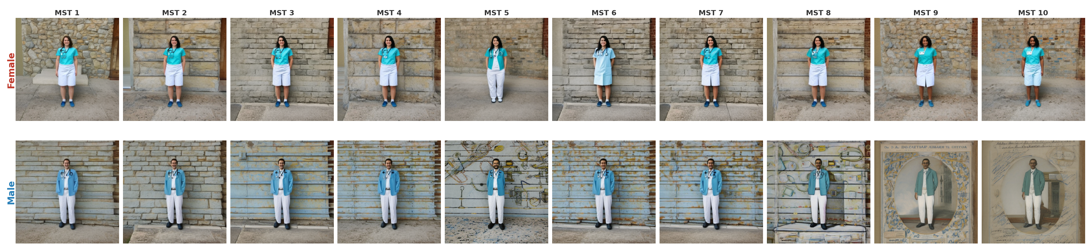
EVALUATION · INFERENCE-TIME DEBIASING FIGURES
Figure 7: Controlled generation grid illustrating uniform demographic conditioning across Monk Skin Tone (MST 1–10) and binary gender. Images are generated using the debiasing pipeline (ITI-GEN + ControlNet OpenPose + Chamfer colour alignment) under fixed pose and composition constraints. Rows correspond to gender (female, male), while columns represent increasing MST values from light (1) to dark (10). The grid demonstrates successful control over primary demographic attributes; however, consistent background structure and scene composition across samples highlight residual entanglement, indicating that inference-time interventions do not fully eliminate spurious correlations.

Slide 20
CONCLUSIONS & FUTURE WORK
O1
Dataset Acquisition & Annotation
FUTURE WORK
200K images per dataset across 200 ISCO-08 occupations. Structural validation pipeline developed from scratch (CLIP + YOLO + FaceMesh). Demographic annotation on the full 10-point MST scale — extending prior binary/Fitzpatrick approaches.
§5.1, Objective 1
Background conditioning — target scene composition directly; adversarial background debiasing or UCE weight editing
O2
Spurious Feature Detection
Extend debiasing evaluation across all 10 ISCO-08 groups — not only doctor
15 transformations, all exceeding 33.3% chance (min. mean RGB 64.19%). Extended Zeng et al. to 3-class design enabling per-class attribution. Dataset identity embedded in multiple correlated cues — not a single isolated artefact.
§5.1, Objective 2 · §4.2
O3
Validated automated skin tone annotation on debiased corpus to confirm photometric fidelity
Demographic Correlation Assessment
Fundamental asymmetry identified: Re-LAION-5B localises all signal within the person; SDv1.5 projects it onto background, silhouette, objects, and language. Gender AUC from background alone: 0.747. Skin tone: 0.728.
§5.1, Objective 3 · §4.3.1–4.3.2
Larger shard sample (>4 of 128) to verify spurious feature profiles hold corpus-wide
O4
Inference-Time Debiasing
ITI-GEN + ControlNet + Chamfer pipeline eliminates low-level spurious correlations across all non-person probes. Mean RGB skin tone → 0.482 (chance). Background AUC persists at 0.701 (gender) / 0.632 (skin tone).
§5.1, Objective 4 · §4.4
Larger probe backbones — test whether separability ceiling reflects genuine dataset differences or ConvNeXt-Tiny limits
O5
Synthesis of Bias Mechanisms
Two-stage propagation: Re-LAION-5B under-represents women but background context carries no independent signal. SDv1.5 amplifies and transforms this — projecting priors coherently onto scene, object layout, and semantic content.
§5.1, Objective 5 · §4.6
Key limitations: 4 of 128 shards (3.1% of corpus) · Automated annotation (not ground truth) · Debiasing on one profession only · Residual background signal unresolved
§5.1 Conclusions · §5.2 Future Work · §4.5 Limitations · §4.6 Synthesis of Evaluation Findings

Slide 21
MODEL SELECTION EVIDENCE · FACE DETECTION
SUPPLEMENTARY
WIDER Face Validation Set (Table 3.1) · AP@0.5 overall and by face size · mAP@0.50:0.95 = COCO-style average across IoU thresholds
Model | AP@0.5 | mAP@0.50:0.95 | Small AP | Medium AP | Large AP
YOLOv12l-Face ★ | 0.905 | 0.556 | 0.783 | 0.915 | 0.948
SCRFD | 0.844 | 0.478 | 0.614 | 0.884 | 0.954
RetinaFace ‡ | 0.319 | 0.176 | 0.011 | 0.376 | 0.712
MediaPipe | 0.117 | 0.040 | 0.000 | 0.015 | 0.497
‡ RetinaFace: Tested via the batch_face deployment library, which ships its own checkpoint and preprocessing pipeline. The 0.319 AP@0.5 reflects practical deployment performance relevant to the pipeline decision — not the published model's capability under its original implementation.
Why face detection is the critical gating step: Any systematic failure — particularly on small faces — introduces filtering bias into the entire downstream annotation pipeline, skewing the final 200,000-image corpus before a single demographic label is assigned.
Decision: YOLOv12l-Face — highest overall AP@0.5 (0.905) and best small-face AP (0.783 vs 0.614 for SCRFD), with the widest high-precision recall range sustaining near-perfect precision to ~0.8 recall. The small-face advantage is decisive: scale-dependent filtering bias would propagate irreversibly through the pipeline.

Slide 22
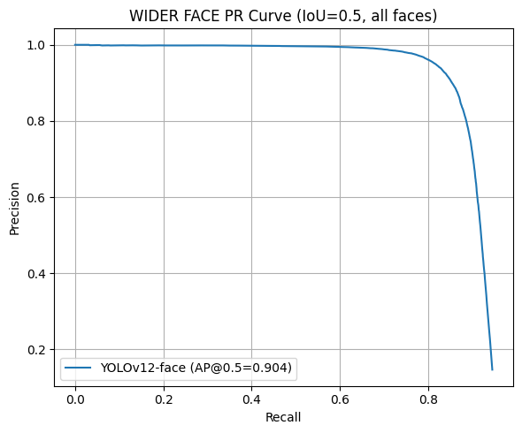
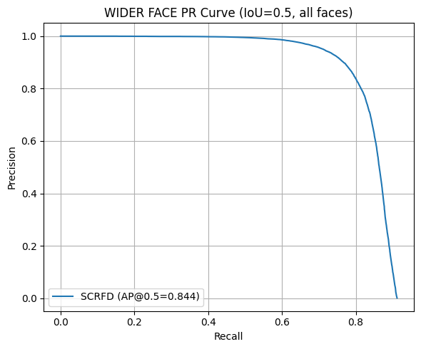
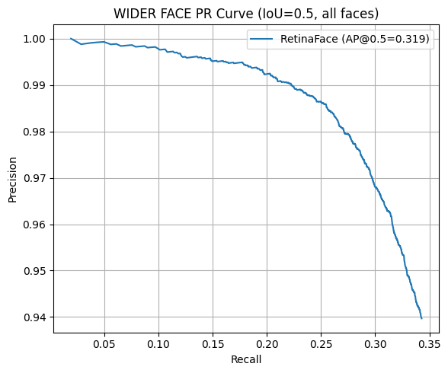
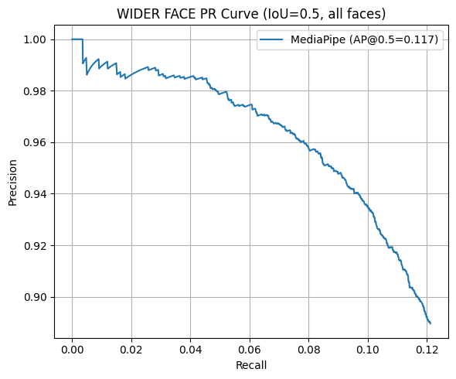
MODEL SELECTION EVIDENCE · FACE DETECTION FIGURES
SUPPLEMENTARY
Figure 8: Precision‐recall curves at IoU= 0.5 on the WIDER Face validation set for all four evaluated face detection models. RetinaFace and MediaPipe both exhibit a recall ceiling below 0.35 at near‐perfect precision, indicating systematic detection suppression. SCRFD maintains high precision to approximately 0.6 recall before degrading. YOLOv12l‐Face achieves the widest high‐precision operating range, sustaining near‐perfect precision to approximately 0.8 recall, consistent with its superior AP@0.5 and small‐face detection performance.

Slide 23
MODEL SELECTION EVIDENCE · GENERATIVE MODEL (1/2)
SUPPLEMENTARY
Two selection criteria applied in sequence: (1) Training lineage traceable to Re-LAION-5B · (2) Throughput sufficient for 200,000 images within compute budget
Step 1 — Traceability Filter
Model | Training Corpus | Traceable?
SDv1.5 | LAION-Aesthetics v2 5+ | Yes ✓
SDv1.5 + LCM-LoRA | LAION-Aesthetics v2 5+ (same) | Yes ✓
SDv1.2 | LAION-Aesthetics v2 5+ (same) | Yes ✓
SDXL | Proprietary — undisclosed | No ✗
Stable Diffusion 3 | Proprietary — undisclosed | No ✗
SSD-1B / PixArt / Segmind Vega | Various — not Re-LAION-5B | No ✗

Slide 24
MODEL SELECTION EVIDENCE · GENERATIVE MODEL (2/2)
SUPPLEMENTARY
Two selection criteria applied in sequence: (1) Training lineage traceable to Re-LAION-5B · (2) Throughput sufficient for 200,000 images within compute budget
Step 2 — Throughput Evaluation (Table 3.2) · 3 qualifying configurations · NVIDIA RTX 3060 Ti · 512×512 resolution
Model | Time (s/image) | Projected 200K time | Feasible?
SDv1.5 + LCM-LoRA ★ | 1.5 | ~83 hours | Yes ✓
SDv1.5 standard | 5.6 | ~311 hours | Borderline
SDv1.2 | 9.1 | ~505 hours | No ✗
Decision: SDv1.5 + LCM-LoRA — the only configuration satisfying both criteria. LCM-LoRA's consistency distillation is purely geometric; it does not alter the model's learned demographic prior, making it appropriate for bias analysis of the base SDv1.5 distribution.

Slide 25
MODEL SELECTION EVIDENCE · GENDER ANNOTATION (1/2) · Classifier Comparison
SUPPLEMENTARY
Five classifiers evaluated on background-removed FaceMesh face crops · CCv2 face-only = primary benchmark (participant self-reported labels) · FACET = secondary validation (Table 3.3)
Model | CCv2 F-O Overall | CCv2 Male | CCv2 Female | M–F Gap | FACET Overall | FACET Male | FACET Female
Realistic GC (SigLIP) ★ | 0.886 | 0.924 | 0.862 | 6.2 pp | 0.823 | 0.875 | 0.695
FairFace | 0.801 | 0.983 | 0.687 | 29.6 pp | 0.834 | 0.906 | 0.653
InsightFace | 0.771 | 0.784 | 0.763 | 2.1 pp | 0.772 | 0.821 | 0.643
HF Gender Clf. | 0.715 | 0.963 | 0.561 | 40.2 pp | 0.789 | 0.877 | 0.569
DeepFace | — | — | — | — | 0.780 | 0.938 | 0.384
Note: DeepFace had no batch inference interface — evaluated on FACET only. InsightFace's low gap (2.1 pp) arises from reduced male recall, not improved female recall — overall 11.5 pp below Realistic GC. FairFace (29.6 pp) and HF (40.2 pp) both systematically misclassify ambiguous or darker-toned faces as male.
Decision: Realistic GC — highest CCv2 face-only accuracy (88.6%) and smallest meaningful M–F gap (6.2 pp). The face-only crop condition is the most diagnostic benchmark since it isolates classifier capability from background context effects.

Slide 26
MODEL SELECTION EVIDENCE · GENDER ANNOTATION (2/2) · Per-Skin-Tone Performance
SUPPLEMENTARY
Realistic GC per-MST accuracy on CCv2 face-only segmented crops (Table 3.4) · Reveals known limitation: female accuracy degrades at darker tones
MST | N | Overall | Male Acc. | Female Acc. | MST | N | Overall | Male Acc. | Female Acc.
1 | 1,190 | 0.756 | 0.977 | 0.681 | 6 | 23,074 | 0.879 | 0.884 | 0.875
2 | 13,337 | 0.870 | 0.968 | 0.833 | 7 | 6,438 | 0.826 | 0.906 | 0.761
3 | 33,732 | 0.893 | 0.946 | 0.870 | 8 | 4,183 | 0.803 | 0.925 | 0.680
4 | 38,273 | 0.893 | 0.939 | 0.871 | 9 | 1,671 | 0.662 | 0.948 | 0.488
5 | 55,797 | 0.906 | 0.918 | 0.895 | 10 | 168 | 0.726 | 1.000 | 0.570
▸ Overall accuracy peaks at MST 5 (90.6%) — mid-range tones best classified overall.
▸ Male accuracy remains consistently high across all MST levels (0.884–1.000).
▸ Female accuracy degrades toward darker tones — falls to 48.8% at MST 9 (highlighted red). Intersectional disparity consistent with prior work (Buolamwini & Gebru 2018).
▸ Limitation documented in Table 3.4 and disclosed as a known constraint. No ground truth at this scale is available to correct it; results at MST 8–10 for female-labelled images should be interpreted with caution.
Decision: Despite the intersectional limitation, Realistic GC offered the best combination of overall accuracy, M–F balance, and throughput across all five evaluated models. The limitation is bounded and documented — it constrains interpretation at the darker end of the scale but does not invalidate the main analysis.

Slide 27
MODEL SELECTION EVIDENCE · SKIN TONE (1/3) · Baseline Models
SUPPLEMENTARY
Baseline skin tone models evaluated on CCv2, MSTE & FACET · E = exact · ±1 = within-one MST · B = three-bin (Table 3.5)
Model | MSTE E | MSTE ±1 | MSTE B | CCv2 E | CCv2 ±1 | CCv2 B | FACET E | FACET ±1 | FACET B
SkinTone Library | 0.112 | 0.281 | 0.425 | 0.084 | 0.298 | 0.603 | 0.073 | 0.239 | 0.421
RandomForest | 0.132 | 0.335 | 0.410 | 0.346 | 0.756 | 0.700 | 0.176 | 0.550 | 0.484
DenseNet-121 | 0.210 | 0.517 | 0.564 | 0.303 | 0.692 | 0.697 | 0.210 | 0.529 | 0.576
VGG-16 (best) ★ | 0.159 | 0.424 | 0.566 | 0.375 | 0.804 | 0.778 | 0.165 | 0.471 | 0.593
VGG-16 outperformed all baselines across the board and was advanced to a 16-variant ablation across 4 axes: output formulation (classification vs regression) · colour space (RGB vs LAB) · background fill (black vs avg. skin-tone bg). Results below — regression variants only, which were consistently superior to classification.

Slide 28
MODEL SELECTION EVIDENCE · SKIN TONE (2/3) · VGG-16 Ablation
SUPPLEMENTARY
VGG-16 MST10 Ablation — Regression Variants (Table 3.6, condensed) · BB = black background · AB = avg. skin-tone background
Space / BG | MSTE E | MSTE ±1 | CCv2 E | CCv2 ±1 | CCv2 B | FACET E | FACET ±1 | FACET B
RGB / BB ★ | 0.159 | 0.424 | 0.375 | 0.804 | 0.778 | 0.165 | 0.471 | 0.593
RGB / AB | 0.132 | 0.367 | 0.374 | 0.784 | 0.783 | 0.173 | 0.499 | 0.572
LAB / BB | 0.146 | 0.423 | 0.350 | 0.776 | 0.734 | 0.185 | 0.532 | 0.587
LAB / AB | 0.163 | 0.494 | 0.370 | 0.778 | 0.775 | 0.207 | 0.567 | 0.596
Decision: RGB / Black Background — leads on the two primary downstream metrics: CCv2 ±1 (0.804) and three-bin (0.778). Black background prevents the model exploiting surrounding skin-adjacent context; regression distributes prediction probability smoothly across adjacent MST classes.

Slide 29
MODEL SELECTION EVIDENCE · SKIN TONE (3/3) · Final Model Performance
SUPPLEMENTARY
Final selected model: VGG-16 MST10 Regression RGB Black-Background (Table 3.8)
Benchmark | Exact Accuracy | Within-One Accuracy | Three-Bin Accuracy
CCv2 (held-out) | 0.375 | 0.804 | 0.778
MSTE | 0.159 | 0.424 | 0.566
FACET | 0.165 | 0.471 | 0.593
KEY NUMBERS
Primary metric CCv2 ±1
0.804
Three-bin CCv2 B
0.778
Cross-dataset MSTE ±1
0.424
Cross-dataset FACET ±1
0.471
Interpreting the accuracy values
· Exact accuracy is low by design for a 10-class regression task: predicting MST 4 when the true label is MST 3 counts as wrong. Within-one (80.4%) and three-bin (77.8%) are the relevant metrics for downstream analysis.
· Lower cross-dataset figures (MSTE, FACET) reflect distributional shift: the model was trained on CCv2 without explicit lighting augmentation. MSTE is specifically designed to vary illumination while keeping ground truth fixed — the hardest test by design.
· Three-bin accuracy is the primary analysis metric: the Light/Mid/Dark grouping absorbs within-class prediction variance and is more robust to the imaging conditions present in web-scraped data.
Decision: VGG-16 MST10 Regression RGB Black-BG — best within-one and three-bin accuracy on CCv2. Selected as the annotation model for all 400,000 images across both datasets.

Slide 30
MODEL SELECTION EVIDENCE · OBJECT DETECTION (1/2)
SUPPLEMENTARY
Step 1 — Throughput Screening on 10,000-image subset at 640×640 (Table 3.9)
Model | Architecture | Time (10K imgs) | Viable
YOLOv8x (OIV7) ★ | CNN, closed-vocabulary | ~7 min 06 s | Yes ✓
YOLOv8m (OIV7) | CNN, closed-vocabulary | ~5 min 47 s | Yes
YOLOv8x-World | CNN, open-vocabulary | ~8 min 11 s | Yes
YOLOv8x-Worldv2 | CNN, open-vocabulary | ~7 min 23 s | Yes
RT-DETR-X | Transformer, end-to-end | ~6 min 24 s | No †
GroundingDINO | Vision-language model | >60 min | No ✗
ViTDet-Huge | Transformer backbone | >60 min | No ✗
† RT-DETR-X: available pretrained weights target COCO / Object365, not OpenImages V7 — incompatible vocabulary.

Slide 31
MODEL SELECTION EVIDENCE · OBJECT DETECTION (2/2)
SUPPLEMENTARY
Step 2 — Detection Performance on OpenImages V7 Validation Set (Table 3.10) · 4 viable candidates
Model | mAP@0.5 | mAP@0.5:0.95 | Precision | Recall
YOLOv8x (OIV7) ★ | 0.4345 | 0.3614 | 0.4786 | 0.4374
YOLOv8m (OIV7) | 0.4094 | 0.3336 | 0.4791 | 0.4007
YOLOv8x-World | 0.1370 | 0.1140 | 0.2044 | 0.2568
YOLOv8x-Worldv2 | 0.1403 | 0.1160 | 0.1847 | 0.2600

Slide 32
MODEL SELECTION EVIDENCE · IMAGE CAPTIONING (1/2)
SUPPLEMENTARY
Step 1 — Throughput Screening (Table 3.12) · Batch size 25 target on a single GPU
Model | Batch Size | Time (25 imgs) | Viable | Reason if excluded
LLaVA 1.5 7B | 2 | ~27.0 s | No | Autoregressive — batch size ceiling = 2
TinyLLaVA-Phi-2-3.1B | 2 | ~180 s | No | Autoregressive — batch size ceiling = 2
LLaVA-OneVision-0.5B | 2 | ~180 s | No | Autoregressive — batch size ceiling = 2
BLIP2-Flan-T5-XL | 25 | ~2.3 s | No | 8-bit quantisation constraint — no speed advantage
Moondream2 | 1 | N/A | No | No batch inference support
BLIP Large ★ | 25 | ~2.3 s | Yes ✓ | Advanced to quality evaluation
Florence 2 Base ★ | 25 | ~2.6 s | Yes ✓ | Advanced to quality evaluation
Kosmos 2 ★ | 25 | ~1.9 s | Yes ✓ | Advanced to quality evaluation
ViT-GPT2 ★ | 25 | ~2.1 s | Yes ✓ | Advanced to quality evaluation
Tiny ★ | 25 | ~2.2 s | Yes ✓ | Advanced — but failed quality gate (see overleaf)

Slide 33
MODEL SELECTION EVIDENCE · IMAGE CAPTIONING (2/2)
SUPPLEMENTARY
Step 2 — Quality Evaluation (Tables 3.13 & 3.14) · 5 viable models benchmarked on COCO 2014 & Flickr30k Karpathy test splits
Model | Dataset | CLIP-S | RefCLIP-S | 4-gram Diversity
BLIP Large ★ | COCO | 0.6646 | 0.7279 | 0.341
ViT-GPT2 | COCO | 0.6040 | 0.6951 | 0.325
Florence 2 | COCO | 0.5927 | 0.6163 | 0.298
Kosmos 2 | COCO | 0.5568 | 0.5861 | 0.333
Tiny | COCO | 0.4110 | 0.4853 | 0.055
BLIP Large ★ | Flickr30k | 0.6550 | 0.6868 | 0.455
ViT-GPT2 | Flickr30k | 0.5290 | 0.5867 | 0.494
Florence 2 | Flickr30k | 0.6059 | 0.5853 | 0.450
Kosmos 2 | Flickr30k | 0.5600 | 0.5619 | 0.449
Tiny | Flickr30k | 0.4777 | 0.5409 | 0.150
WHY TINY FAILED
4-gram diversity: 0.055 on COCO
Fewer than 6% of all 4-grams across generated captions were unique. This is template-based degenerate generation — captions collapse to near-identical syntactic patterns, destroying the semantic diversity required for meaningful dataset classification probing.
Decision: BLIP Large
Highest RefCLIP-S on both benchmarks. No template collapse.

Slide 34
MODEL SELECTION EVIDENCE · POSE ESTIMATION
SUPPLEMENTARY
Pose Estimation — COCO 2017 Validation Set (Table 3.15) · Standard mode uses integrated detector · FPS = end-to-end on single GPU
Model | AP | AP50 | AP75 | AR | FPS | Notes
YOLOv8l-Pose ★ | 0.659 | 0.871 | 0.735 | 0.717 | 39.7 | Integrated detector — no extra overhead
YOLOv8x-Pose | 0.674 | 0.871 | 0.747 | 0.730 | 27.9 | +0.015 AP vs l — not worth 30% FPS reduction
YOLOv8m-Pose | 0.633 | 0.860 | 0.704 | 0.691 | 33.0 | Integrated detector
YOLOv8s-Pose | 0.581 | 0.830 | 0.642 | 0.638 | 37.1 | Integrated detector
HRNet-W32 | 0.714 | 0.879 | 0.789 | 0.769 | 8.7 | Requires external person detector
HRNet-W48 | 0.723 | 0.880 | 0.793 | 0.778 | 7.9 | Excluded: <9 FPS prohibitive at corpus scale
MoveNet-Thunder | 0.548 | 0.779 | 0.594 | 0.584 | 4.1 | Oracle mode only — standard AP 0.419
MediaPipe-C2 | 0.243 | 0.405 | 0.255 | 0.333 | 3.6 | Excluded on accuracy

Slide 35
MODEL SELECTION EVIDENCE · SEGMENTATION
SUPPLEMENTARY
Segmentation / Occlusion — COCO 2017 Validation Set, single-person images (Table 3.16)
Model | Det. Rate | IoU | Precision | Throughput | Notes
Mask2Former COCO ★ | 0.965 | 0.829 | 0.899 | 1.28 it/s | Best detection rate + IoU combination
Mask R-CNN | 0.941 | 0.813 | — | 1.63 it/s | Lower IoU
Mask2Former ADE20K | 0.946 | 0.785 | — | 1.86 it/s | Semantic only — conflates all person pixels in multi-person images
Lang-SAM | 0.891 | 0.846 | 0.931 | 0.35 it/s | Highest IoU (0.846) but 3.7× slower — impractical at scale
YOLACT | 0.795 | 0.789 | — | 3.00 it/s | ~1 in 5 persons missed — unacceptable for occlusion protocol

