Slide 1
Graphs
Graph Terminology
Searching Graphs

Slide 2
Menu
Graph Terminology
Graph Modeling
Searching
Breadth First Search
Depth First Search

Slide 3
Graphs :: Terminology
A Graph is a set of vertices (nodes) and a set of unordered edges (linked between these nodes).
The order of a graph is the number of vertices and the size is the edge count. The degree of a vertex is the number of edges incident to the vertex. (In-degree + out-degree = degree of a digraph vertex.) If all degrees are the same, then the graph is said to have that degree.
A path is a set of edges connecting two nodes.
A digraph or directed graph has edges (arcs) that flow in only one direction. In an undirected graph, edges flow in either direction.

Slide 4
Graphs :: Terminology
Edges
Vertices
(nodes)
Still part of
graph, even
if not connected
An undirected graph

Slide 5
Graphs :: Terminology
A path
A directed graph

Slide 6
Graphs :: Contrasted to Simple Data Structures
Linked list
One ‘next’ node
No cycles
Binary tree
Two children
(for binary tree)
No cycles
Graph
Cycles allowed
Numerous adjacencies
per node

Slide 7
~Graphs :: Terminology
Review:
A Graph is a set of vertices (nodes) and a set of unordered edges (linked between these nodes).
The order of a graph is the number of vertices and the size is the edge count.
A path is a set of edges connecting two nodes.
A digraph or directed graph has edges (arcs) that flow in only one direction. In an undirected graph, edges flow in either direction.

Slide 8
Directed Graphs
B
C
D
A
E
G
F
Directed edges only allow movement in one direction.

Slide 9
Weighted Edges
B
7
5
C
9
D
A
4
1
9
1
3
3
E
2
G
F
2
Edge weights represent cost.

Slide 10
Weighted Directed Graphs
B
7
5
C
9
D
A
4
1
9
1
3
3
E
2
G
F
2
Directed edges only allow movement in one direction.

Slide 11
Representing Graphs
How do we represent a graph that has any number of children or connections?
Adjacency matrices
Nodes held in some structure (adjacency list)
Each node has list of children
Links held in some kind of structure
Each link points to two nodes
Which way is best?
Depends!

Slide 12
Adjacency Matrix
← To Nodes →
Initially empty
Each edge adds an entry
Undirected graph can
Put in 2 entries per edge
Use just upper or lower diagonal
Directed graph uses entire matrix
Unweighted graph inserts ‘1’
Weighted graph inserts the weight
← From Nodes →
Size is O(N²)
Memory is usually sparsely utilized

Slide 13
Undirected
A
B
C
D
E
F
G
A
-
5
.
.
1
3
.
B
5
-
7
.
4
.
1
C
.
7
-
9
.
.
.
D
.
.
9
-
9
.
3
E
1
4
.
9
-
2
2
F
3
.
.
.
2
-
.
G
.
1
.
3
2
.
-

Slide 14
Undirected
A
B
C
D
E
F
G
A
-
5
.
.
1
3
.
B
-
7
.
4
.
1
C
-
9
.
.
.
D
-
9
.
3
E
-
2
2
F
-
.
G
-

Slide 15
Directed
TO
A
B
C
D
E
F
G
FROM
A
-
.
.
.
.
3
.
B
5
-
7
.
4
.
.
C
.
.
-
9
.
.
.
D
.
.
.
-
.
.
.
E
1
.
.
9
-
.
2
F
.
.
.
.
2
-
.
G
.
1
.
3
.
.
-

Slide 16
Implementation with Linked Lists [ArrayList might be more appropriate]
NODE
Data
Edges
\\
Edges
With references to other nodes
Possibly with weights

Slide 17
A Low-level Diagram
data
Can be implemented as "standard" Linked List or ArrayList or ?
edges
nextEdge
nextEdge
nextEdge
toNode
toNode
toNode
data
data
data
edges
edges
edges
...
...
...

Slide 18
Linked list
3
1
2
4
Node 1
Node 2
Node 3
Node 4
edges
Node 2
Node 1
edges
This represents
a reference to node 3
Node 3
Node 2
edges
Node 4
Node 2
Node 3
edges

Slide 19
Representing Graph Nodes
public class GraphNode extends Node {
private LinkedList edges;
public GraphNode( Object data, LinkedList e ) {
super( data );
if( e == null )
edges = new LinkedList();
else
edges = e;
}
public void add_edge( Edge e ) {
edges.insert( e );
}
public LinkedList getEdges() {
return edges;
}
GraphNode
data
edges

Slide 20
Representing Graph Links
public class Edge {
private GraphNode toNode;
private int cost;
public GraphLink( GraphNode toNode, int cost ) {
setToNode( toNode );
setCost( cost );
}
public void setTo( GraphNode t ) { toNode = t; };
public void setCost( int c ) { cost = c; };
public GraphNode getTo() { return toNode; };
public int getCost() { return cost; };
}
Edge
toNode
cost
data
Classic LinkedList Node
next

Slide 21
But, where are the Nodes?
We could maintain a reference
to one node but is that enough?

Slide 22
In addition to...
...Information about edges connecting nodes
Might also maintain structure holding nodes?
List (Vector)
Tree
Array
Hash Table

Slide 23
Another Way of Representing Graph Links
public class GraphLink {
private Node from, to;
private int cost;
public GraphLink( Node from, Node to, int cost ) {
setFrom( from );
setTo( t );
setCost( c );
}
public void setFrom( GraphNode from ) { this.from = from; }
public void setTo( GraphNode to ) { this.to = to; }
public void setCost( int cost ) { this.cost = cost; }
public GraphNode getFrom() { return from; };
public GraphNode getTo() { return to; };
public int getCost() { return cost; };
}
GraphLink
from
to
cost

Slide 24
All reference arrows
not shown
3
1
1
2
4
from
to
2
1
3
4
3
1
4
3
1
2
2
1
Store the links
in a structure
Let the nodes
float
Problems?
4
2
4
3
2

Slide 25
The Graph Class
public class Graph {
private BST tree; // Any structure to store the nodes
public Graph() {
tree = new BST();
}
public void InsertNode( Comparable data) {
// Insert node into tree
}
public void InsertEdge( Comparable from, Comparable to, int cost) {
// Find reference (in tree) to "from" Node
// Find reference (in tree to "to" Node
// Create new Edge object pointing to “to” Node
// Insert edge object into “from” nodes linked list
}
// Other methods as needed...
}
Here, we use
a tree to hold
nodes; we could
also use other
data structures

Slide 26
A Typical Problem
How can this
be represented
using our Graph
class?
C
2
F
5
7
Start
11
3
5
A
3
7
E
B
D
End
6
7
14
6
G

Slide 27
Using our Graph Class
Graph grph = new Graph();
grph.InsertNode("A");
grph.InsertNode("B");
grph.InsertNode("C");
grph.InsertNode("D");
grph.InsertNode("E");
grph.InsertNode("F");
grph.InsertNode("G");
grph.InsertEdge("A", "C", 5);
grph.InsertEdge("A", "D", 3 );
grph.InsertEdge("A", "E", 14 );
grph.InsertEdge("C", "F", 2 );
grph.InsertEdge("C", "G", 3 );
grph.InsertEdge("D", "C", 11 );
grph.InsertEdge("D", "E", 6 );
grph.InsertEdge("D", "G", 7 );
grph.InsertEdge("E", "G", 7 );
grph.InsertEdge("E", "B", 6 );
grph.InsertEdge("F", "B", 7 );
grph.InsertEdge("G", "B", 5 );

Slide 28
Questions?

Slide 29
Graph Traversal

Slide 30
Graphs :: Searching
Let’s perform an inductive analysis of a search, and figure out how it works. We can then model this in code.
Given this graph:
A
B
C
F
E
Let’s see if there
exists a path from
A to G.
(Of course there’s a path.
We can see that. But how can a computer determine this?)
D
G

Slide 31
Graphs :: Searching
We will perform a BFS.
We are first given our
start node, A, which we
can designate as the
“current” node we are
visiting.
A
B
C
F
E
D
G
Current Node
A

Slide 32
Graphs :: Searching (BFS)
We have some way of
fetching the current
node’s adjacencies.
A
B
C
F
E
D
G
Current Node
A
Adjacencies
F
B

Slide 33
Graphs :: Searching (BFS)
In a linked list or tree,
we had a set number of
“links” or children, so
exploring them all was
easy--just write a line
of code to visit each child
or adjacent node.
A
B
C
F
E
D
G
But in a graph, each node has a variable number of nodes. We need a set or list to manage the nodes we discover, but have not explored
Current Node
A
Adjacencies
F
B

Slide 34
Graphs :: Searching (BFS)
So we use a queue,
since this is BFS. A
DFS would have used
a stack instead.
A
B
C
F
E
Open Nodes
D
F
B
G
Current Node
We place the current node’s adjacencies in this list of open, unexplored nodes
A
Adjacencies
F
B

Slide 35
Graphs :: Searching (BFS)
At this point, are done
with the current node,
and are ready to move
on to the first node in
the open list.
A
B
C
F
E
Open Nodes
D
F
B
G
Current Node
But wait! Maybe we should
keep a list of nodes we’ve
already visited, so we don’t
return to them again. Why
would we visit them again?
A

Slide 36
Graphs :: Searching (BFS)
Visited
A
B
A
C
F
E
Open Nodes
D
B
G
So we make a list to hold the nodes we’ve visited, and insert A into this list.
Our current node is now F. The
node F is not the goal...
Current Node
F

Slide 37
Graphs :: Searching (BFS)
Visited
A
B
A
C
F
E
Open Nodes
D
B
G
Current Node
... so, we fetch the
adjacencies to
our new current
node.
F
Adjacencies
D
E
A

Slide 38
Graphs :: Searching (BFS)
Visited
A
B
A
C
F
E
Open Nodes
D
B
D
E
A
G
Current Node
We prepare to
copy the new
adjacencies to
our queue of
open nodes . . .
F
Adjacencies
D
E
A

Slide 39
Graphs :: Searching (BFS)
Visited
A
B
A
C
F
E
Open Nodes
D
B
D
E
A
G
Current Node
BUT WAIT! We
already visited
node A. Don’t place it in the open queue.
F
Adjacencies
F
B
A

Slide 40
Graphs :: Searching (BFS)
Visited
A
B
A
F
C
F
E
Open Nodes
D
B
D
E
G
Current Node
All done with F. Move it up to the
visited list.
Let’s check out B, the next node on
our open queue.
F

Slide 41
Graphs :: Searching (BFS)
Visited
A
B
A
F
C
F
E
Open Nodes
D
D
E
G
Current Node
What can we discover from B?
We fetch its list of adjacent nodes.
B
Adjacencies
A
C

Slide 42
Graphs :: Searching (BFS)
Visited
A
B
A
F
C
F
E
Open Nodes
D
D
E
C
G
Current Node
Once again, our
list of visited nodes saves us from a cycle in our search
B
Adjacencies
A
C

Slide 43
Graphs :: Searching (BFS)
Visited
A
B
A
F
B
C
F
E
Open Nodes
D
D
E
C
G
Current Node
We’re done with B. Promote it to our visited list.
B

Slide 44
Graphs :: Searching (BFS)
Visited
A
B
A
F
B
C
F
E
Open Nodes
D
E
C
G
Current Node
We’re now at D.
D
Adjacencies
We’ve already
been to F. Nothing
new here.
F

Slide 45
Graphs :: Searching (BFS)
Visited
A
B
A
F
B
D
C
F
E
Open Nodes
D
E
C
G
Current Node
We’re done with D, so place a reference in our visited list.
E is next up.
D

Slide 46
Graphs :: Searching (BFS)
Visited
A
B
A
F
B
D
C
F
E
Open Nodes
D
C
G
Current Node
We find that
E is adjacent to
F, C, G.
E
Adjacencies
F
C
G

Slide 47
Graphs :: Searching (BFS)
Visited
A
B
A
F
B
D
C
F
E
Open Nodes
D
C
C
G
G
Current Node
We copy these
references to our
open queue. The F node is omitted, since we’ve seen it already.
E
Adjacencies
F
C
G

Slide 48
Graphs :: Searching (BFS)
Wait a minute. Can’t we quit yet?
Visited
A
B
A
F
B
D
C
F
E
Open Nodes
D
C
C
G
G
Current Node
Aren’t we done yet? No. We’re close, but a simple, plain-vanilla BFS would not check to see if the newly enqueued nodes include the goal node. We’ll find it soon enough.
E

Slide 49
Graphs :: Searching (BFS)
This is an important point: remember this!
Visited
A
B
A
F
B
D
C
F
E
Open Nodes
D
C
C
G
G
Question: Don’t we want to purge the duplicate C nodes?
Current Node
E
Answer: NO! Duplicates are harmless, since we check for cycles. Plus, these nodes were contributed by different nodes. As will be seen shortly, this is the key to returning a path.

Slide 50
Graphs :: Searching (BFS)
Visited
A
B
A
F
B
D
E
C
F
E
Open Nodes
D
C
C
G
G
Current Node
We’re done with E.
Promote it to the visited list.
E

Slide 51
Graphs :: Searching (BFS)
Visited
A
B
A
F
B
D
E
C
F
E
Open Nodes
D
C
G
G
Current Node
C
What does C
contribute?
Adjacencies
B
E
G

Slide 52
Graphs :: Searching (BFS)
Visited
A
B
A
F
B
D
E
C
F
E
Open Nodes
D
C
G
G
G
What does C
contribute?
Current Node
C
Adjacencies
Another link to G,
but from another
path; the rest cycle
B
E
G

Slide 53
Graphs :: Searching (BFS)
Visited
A
B
A
F
B
D
E
C
F
E
Open Nodes
D
C
G
G
G
Current Node
We’re done with C.
The next node up is C again.
C

Slide 54
Graphs :: Searching (BFS)
Visited
A
B
A
F
B
D
E
C
C
F
E
Open Nodes
D
G
G
G
Current Node
C has just been done,
so there’s nothing new it
can add . . .
The next node up is ...
C

Slide 55
Graphs :: Searching (BFS)
Visited
A
B
A
F
B
D
E
C
C
F
E
Open Nodes
D
G
G
Current Node
G
G, the goal node.
We’re done.
G

Slide 56
Observations
We used a queue for a BFS.
Open Nodes
D
B
C
If we instead had used a stack,
we would have performed a DFS.
This sometimes results in a different path, although both DFS and BFS are exhaustive searches. If there’s a path, either will find it.
C
B
D

Slide 57
BFS: Step-by-Step
BFS, because it uses a queue, will examine all nodes one step away, then two steps away, then three, etc.
A
B
C
F
E
D
G

Slide 58
Breadth-First Search BFS
Problem: It is another systematic way of visiting the vertices of a graph G. Start from a vertex, step forward all vertices adjacent to it, then step forward all vertices adjacent to its sons,...
The Breadth-First Search algorithm is quite the same algorithm as the iterative DFS, you simply replace the stack with a queue
BFS is classic method to find a path with the fewest nodes from source vertex v to target vertex u.

Slide 59
BFS Pseudo Code
bfs(s)
initialize Q to be a queue with one element s
while Q not empty
take a node u from Q
if explored[u]=false then
set explored[u]= true
for each edge (u,v) adjacent to u
add v to Q
end
end
end

Slide 60
BFS Example Traverse Graph G
O
queue
G
G
E
S
J
T
A
C
K
Output: G
Notes:
Start at G->O->J end; FIFO O-> nowhere dequeue O; back to J; J->A->C->K cycle pop CA; back to J; G->J->K->E->T->S; all vertices visited so pop STEKJG
Queue OJ, J, ACK, E, TS
Output: GOJACKETS

Slide 61
BFS Example Traverse Graph G
O
queue
G
E
S
J
T
A
C
K
Output: G
Notes:
Start at G->O->J end; FIFO O-> nowhere dequeue O; back to J; J->A->C->K cycle pop CA; back to J; G->J->K->E->T->S; all vertices visited so pop STEKJG
Queue OJ, J, ACK, E, TS
Output: GOJACKETS

Slide 62
BFS Example Traverse Graph G
O
queue
O
G
E
S
J
T
A
C
K
Output: G O
Notes:
Start at G->O->J end; FIFO O-> nowhere dequeue O; back to J; J->A->C->K cycle pop CA; back to J; G->J->K->E->T->S; all vertices visited so pop STEKJG
Queue OJ, J, ACK, E, TS
Output: GOJACKETS

Slide 63
BFS Example Traverse Graph G
O
queue
J
O
G
E
S
J
T
A
C
K
Output: G O J
Notes:
Start at G->O->J end; FIFO O-> nowhere dequeue O; back to J; J->A->C->K cycle pop CA; back to J; G->J->K->E->T->S; all vertices visited so pop STEKJG
Queue OJ, J, ACK, E, TS
Output: GOJACKETS

Slide 64
BFS Example Traverse Graph G
O
queue
J
G
E
S
J
T
A
C
K
Output: G O J
Notes:
Start at G->O->J end; FIFO O-> nowhere dequeue O; back to J; J->A->C->K cycle pop CA; back to J; G->J->K->E->T->S; all vertices visited so pop STEKJG
Queue OJ, J, ACK, E, TS
Output: GOJACKETS

Slide 65
BFS Example Traverse Graph G
O
queue
G
E
S
J
T
A
C
K
Output: G O J
Notes:
Start at G->O->J end; FIFO O-> nowhere dequeue O; back to J; J->A->C->K cycle pop CA; back to J; G->J->K->E->T->S; all vertices visited so pop STEKJG
Queue OJ, J, ACK, E, TS
Output: GOJACKETS

Slide 66
BFS Example Traverse Graph G
O
queue
A
G
E
S
J
T
A
C
K
Output: G O J A
Notes:
Start at G->O->J end; FIFO O-> nowhere dequeue O; back to J; J->A->C->K cycle pop CA; back to J; G->J->K->E->T->S; all vertices visited so pop STEKJG
Queue OJ, J, ACK, E, TS
Output: GOJACKETS

Slide 67
BFS Example Traverse Graph G
O
queue
C
A
G
E
S
J
T
A
C
K
Output: G O J A C
Notes:
Start at G->O->J end; FIFO O-> nowhere dequeue O; back to J; J->A->C->K cycle pop CA; back to J; G->J->K->E->T->S; all vertices visited so pop STEKJG
Queue OJ, J, ACK, E, TS
Output: GOJACKETS

Slide 68
BFS Example Traverse Graph G
O
queue
K
C
A
G
E
S
J
T
A
C
K
Output: G O J A C K
Notes:
Start at G->O->J end; FIFO O-> nowhere dequeue O; back to J; J->A->C->K cycle pop CA; back to J; G->J->K->E->T->S; all vertices visited so pop STEKJG
Queue OJ, J, ACK, E, TS
Output: GOJACKETS

Slide 69
BFS Example Traverse Graph G
O
queue
K
C
G
E
S
J
T
A
C
K
Output: G O J A C K
Notes:
Start at G->O->J end; FIFO O-> nowhere dequeue O; back to J; J->A->C->K cycle pop CA; back to J; G->J->K->E->T->S; all vertices visited so pop STEKJG
Queue OJ, J, ACK, E, TS
Output: GOJACKETS

Slide 70
BFS Example Traverse Graph G
O
queue
K
G
E
S
J
T
A
C
K
Output: G O J A C K
Notes:
Start at G->O->J end; FIFO O-> nowhere dequeue O; back to J; J->A->C->K cycle pop CA; back to J; G->J->K->E->T->S; all vertices visited so pop STEKJG
Queue OJ, J, ACK, E, TS
Output: GOJACKETS

Slide 71
BFS Example Traverse Graph G
O
queue
G
E
S
J
T
A
C
K
Output: G O J A C K
Notes:
Start at G->O->J end; FIFO O-> nowhere dequeue O; back to J; J->A->C->K cycle pop CA; back to J; G->J->K->E->T->S; all vertices visited so pop STEKJG
Queue OJ, J, ACK, E, TS
Output: GOJACKETS

Slide 72
BFS Example Traverse Graph G
O
queue
E
G
E
S
J
T
A
C
K
Output: G O J A C K E
Notes:
Start at G->O->J end; FIFO O-> nowhere dequeue O; back to J; J->A->C->K cycle pop CA; back to J; G->J->K->E->T->S; all vertices visited so pop STEKJG
Queue OJ, J, ACK, E, TS
Output: GOJACKETS

Slide 73
BFS Example Traverse Graph G
O
queue
G
E
S
J
T
A
C
K
Output: G O J A C K E
Notes:
Start at G->O->J end; FIFO O-> nowhere dequeue O; back to J; J->A->C->K cycle pop CA; back to J; G->J->K->E->T->S; all vertices visited so pop STEKJG
Queue OJ, J, ACK, E, TS
Output: GOJACKETS

Slide 74
BFS Example Traverse Graph G
O
queue
T
G
E
S
J
T
A
C
K
Output: G O J A C K E T
Notes:
Start at G->O->J end; FIFO O-> nowhere dequeue O; back to J; J->A->C->K cycle pop CA; back to J; G->J->K->E->T->S; all vertices visited so pop STEKJG
Queue OJ, J, ACK, E, TS
Output: GOJACKETS

Slide 75
BFS Example Traverse Graph G
O
queue
S
T
G
E
S
J
T
A
C
K
Output: G O J A C K E T S
Notes:
Start at G->O->J end; FIFO O-> nowhere dequeue O; back to J; J->A->C->K cycle pop CA; back to J; G->J->K->E->T->S; all vertices visited so pop STEKJG
Queue OJ, J, ACK, E, TS
Output: GOJACKETS

Slide 76
BFS Example Traverse Graph G
O
queue
S
G
E
S
J
T
A
C
K
Output: G O J A C K E T S
Notes:
Start at G->O->J end; FIFO O-> nowhere dequeue O; back to J; J->A->C->K cycle pop CA; back to J; G->J->K->E->T->S; all vertices visited so pop STEKJG
Queue OJ, J, ACK, E, TS
Output: GOJACKETS

Slide 77
BFS Example Traverse Graph G
O
queue
G
E
S
J
T
A
C
K
Output: G O J A C K E T S
Notes:
Start at G->O->J end; FIFO O-> nowhere dequeue O; back to J; J->A->C->K cycle pop CA; back to J; G->J->K->E->T->S; all vertices visited so pop STEKJG
Queue OJ, J, ACK, E, TS
Output: GOJACKETS

Slide 78
Now DFS: Leap then Look
Because it uses a stack, when the DFS discovers a new node, it races down that branch . . .
A
B
C
F
E
D
G
Only if it hits a dead end will it back up and examine other adjacent nodes.

Slide 79
Depth-First Search DFS
Problem Find a natural way to systematically visit every vertex and every edge of a graph :
Start from one vertex
Move forward all along one path (do not pass through a vertex already visited)
When stuck, turn back until you can step forward to an unvisited vertex
DFS finds some path from source vertex v to target vertex u.

Slide 80
DFS Pseudo Code
dfs(v)
visit(v)
for each neighbor w of v
if w is unvisited
dfs(w)
add edge vw to tree T
end
end
end

Slide 81
DFS Example Traverse Graph G
O
stack
G
G
E
S
J
T
A
C
K
Output: G
Notes:
Start at G->O end so pop O; back to G; G->J->A->C cycle pop CA; back to J; G->J->K->E->T->S; all vertices visited so pop STEKJG
Stack GO, GJAC, GJKETS, ←----G
Output: GOJACKETS

Slide 82
DFS Example Traverse Graph G
O
stack
O
G
G
E
S
J
T
A
C
K
Output: G O
Notes:
Start at G->O end so pop O; back to G; G->J->A->C cycle pop CA; back to J; G->J->K->E->T->S; all vertices visited so pop STEKJG
Stack GO, GJAC, GJKETS, ←----G
Output: GOJACKETS

Slide 83
DFS Example Traverse Graph G
O
stack
G
G
E
S
J
T
A
C
K
Output: G O
Notes:
Start at G->O end so pop O; back to G; G->J->A->C cycle pop CA; back to J; G->J->K->E->T->S; all vertices visited so pop STEKJG
Stack GO, GJAC, GJKETS, ←----G
Output: GOJACKETS

Slide 84
DFS Example Traverse Graph G
O
stack
J
G
G
E
S
J
T
A
C
K
Output: G O J
Notes:
Start at G->O end so pop O; back to G; G->J->A->C cycle pop CA; back to J; G->J->K->E->T->S; all vertices visited so pop STEKJG
Stack GO, GJAC, GJKETS, ←----G
Output: GOJACKETS

Slide 85
DFS Example Traverse Graph G
O
stack
A
J
G
G
E
S
J
T
A
C
K
Output: G O J A
Notes:
Start at G->O end so pop O; back to G; G->J->A->C cycle pop CA; back to J; G->J->K->E->T->S; all vertices visited so pop STEKJG
Stack GO, GJAC, GJKETS, ←----G
Output: GOJACKETS

Slide 86
DFS Example Traverse Graph G
O
stack
C
A
J
G
G
E
S
J
T
A
C
K
Output: G O J A C
Notes:
Start at G->O end so pop O; back to G; G->J->A->C cycle pop CA; back to J; G->J->K->E->T->S; all vertices visited so pop STEKJG
Stack GO, GJAC, GJKETS, ←----G
Output: GOJACKETS

Slide 87
DFS Example Traverse Graph G
O
stack
A
J
G
G
E
S
J
T
A
C
K
Output: G O J A C
Notes:
Start at G->O end so pop O; back to G; G->J->A->C cycle pop CA; back to J; G->J->K->E->T->S; all vertices visited so pop STEKJG
Stack GO, GJAC, GJKETS, ←----G
Output: GOJACKETS

Slide 88
DFS Example Traverse Graph G
O
stack
J
G
G
E
S
J
T
A
C
K
Output: G O J A C
Notes:
Start at G->O end so pop O; back to G; G->J->A->C cycle pop CA; back to J; G->J->K->E->T->S; all vertices visited so pop STEKJG
Stack GO, GJAC, GJKETS, ←----G
Output: GOJACKETS

Slide 89
DFS Example Traverse Graph G
O
stack
K
J
G
G
E
S
J
T
A
C
K
Output: G O J A C K
Notes:
Start at G->O end so pop O; back to G; G->J->A->C cycle pop CA; back to J; G->J->K->E->T->S; all vertices visited so pop STEKJG
Stack GO, GJAC, GJKETS, ←----G
Output: GOJACKETS

Slide 90
DFS Example Traverse Graph G
O
stack
E
K
J
G
G
E
S
J
T
A
C
K
Output: G O J A C K E
Notes:
Start at G->O end so pop O; back to G; G->J->A->C cycle pop CA; back to J; G->J->K->E->T->S; all vertices visited so pop STEKJG
Stack GO, GJAC, GJKETS, ←----G
Output: GOJACKETS

Slide 91
DFS Example Traverse Graph G
O
stack
T
E
K
J
G
G
E
S
J
T
A
C
K
Output: G O J A C K E T
Notes:
Start at G->O end so pop O; back to G; G->J->A->C cycle pop CA; back to J; G->J->K->E->T->S; all vertices visited so pop STEKJG
Stack GO, GJAC, GJKETS, ←----G
Output: GOJACKETS

Slide 92
DFS Example Traverse Graph G
O
stack
S
T
E
K
J
G
G
E
S
J
T
A
C
K
Output: G O J A C K E T S
Notes:
Start at G->O end so pop O; back to G; G->J->A->C cycle pop CA; back to J; G->J->K->E->T->S; all vertices visited so pop STEKJG
Stack GO, GJAC, GJKETS, ←----G
Output: GOJACKETS

Slide 93
DFS Example Traverse Graph G
O
stack
T
E
K
J
G
G
E
S
J
T
A
C
K
Output: G O J A C K E T S
Notes:
Start at G->O end so pop O; back to G; G->J->A->C cycle pop CA; back to J; G->J->K->E->T->S; all vertices visited so pop STEKJG
Stack GO, GJAC, GJKETS, ←----G
Output: GOJACKETS

Slide 94
DFS Example Traverse Graph G
O
stack
E
K
J
G
G
E
S
J
T
A
C
K
Output: G O J A C K E T S
Notes:
Start at G->O end so pop O; back to G; G->J->A->C cycle pop CA; back to J; G->J->K->E->T->S; all vertices visited so pop STEKJG
Stack GO, GJAC, GJKETS, ←----G
Output: GOJACKETS

Slide 95
DFS Example Traverse Graph G
O
stack
K
J
G
G
E
S
J
T
A
C
K
Output: G O J A C K E T S
Notes:
Start at G->O end so pop O; back to G; G->J->A->C cycle pop CA; back to J; G->J->K->E->T->S; all vertices visited so pop STEKJG
Stack GO, GJAC, GJKETS, ←----G
Output: GOJACKETS

Slide 96
DFS Example Traverse Graph G
O
stack
J
G
G
E
S
J
T
A
C
K
Output: G O J A C K E T S
Notes:
Start at G->O end so pop O; back to G; G->J->A->C cycle pop CA; back to J; G->J->K->E->T->S; all vertices visited so pop STEKJG
Stack GO, GJAC, GJKETS, ←----G
Output: GOJACKETS

Slide 97
DFS Example Traverse Graph G
O
stack
G
G
E
S
J
T
A
C
K
Output: G O J A C K E T S
Notes:
Start at G->O end so pop O; back to G; G->J->A->C cycle pop CA; back to J; G->J->K->E->T->S; all vertices visited so pop STEKJG
Stack GO, GJAC, GJKETS, ←----G
Output: GOJACKETS

Slide 98
DFS Example Traverse Graph G
O
stack
G
E
S
J
T
A
C
K
Output: G O J A C K E T S
Notes:
Start at G->O end so pop O; back to G; G->J->A->C cycle pop CA; back to J; G->J->K->E->T->S; all vertices visited so pop STEKJG
Stack GO, GJAC, GJKETS, ←----G
Output: GOJACKETS

Slide 99
Dijkstra’s Shortest Path
Problem Find the shortest path problem for weighted directional graphs:
Start from one vertex, choose stop vertex
Move forward all along shortest path (do not pass through a vertex already visited) using BFS
Keep track of the distance of the path as compared to other paths.
If you do not reach stop vertex, the path is disregarded

Slide 100
Dijkstra’s Pseudo Code
Dijk(g)
initialize distance to source vertex, s, to zero for all v ∈ V–{s} set all other vertices’ distances to infinity do dist[v] ←∞
create empty set, S, to hold the visited populate the queue Q initially with all vertices while Q is not empty do select an element of Q with the min. distance), u add u to list of visited vertices) for all v ∈ neighbors[u] do if dist[v] > dist[u] + w(u, v) (if new shortest path found) then d[v] ←d[u] + w(u, v) (set new value of shortest path)
return dist

Slide 101
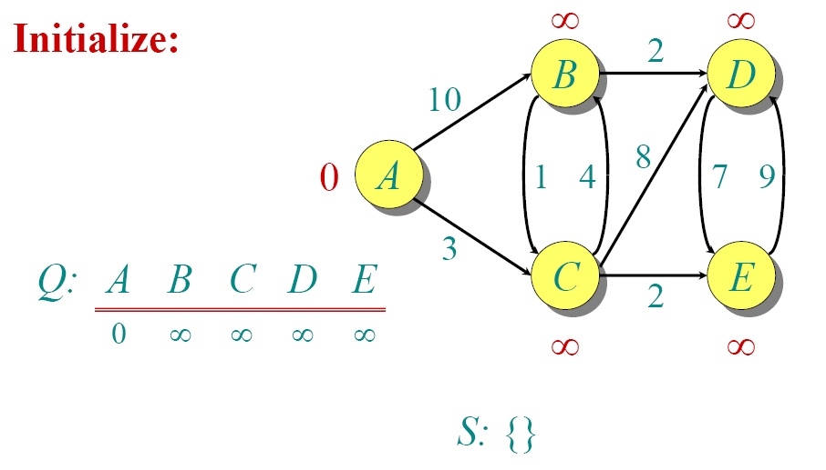
Dijkstra Animated Example

Slide 102
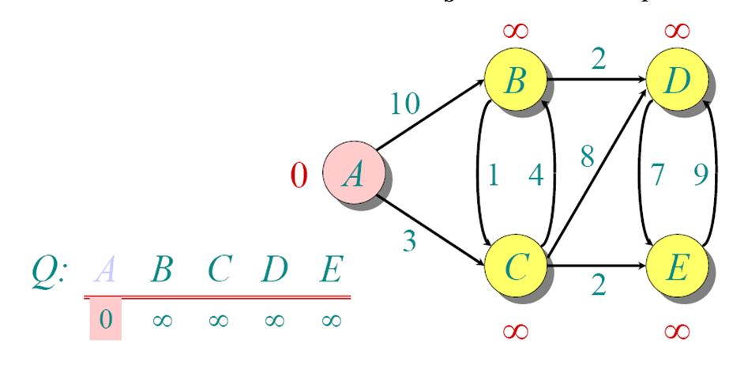

Slide 103
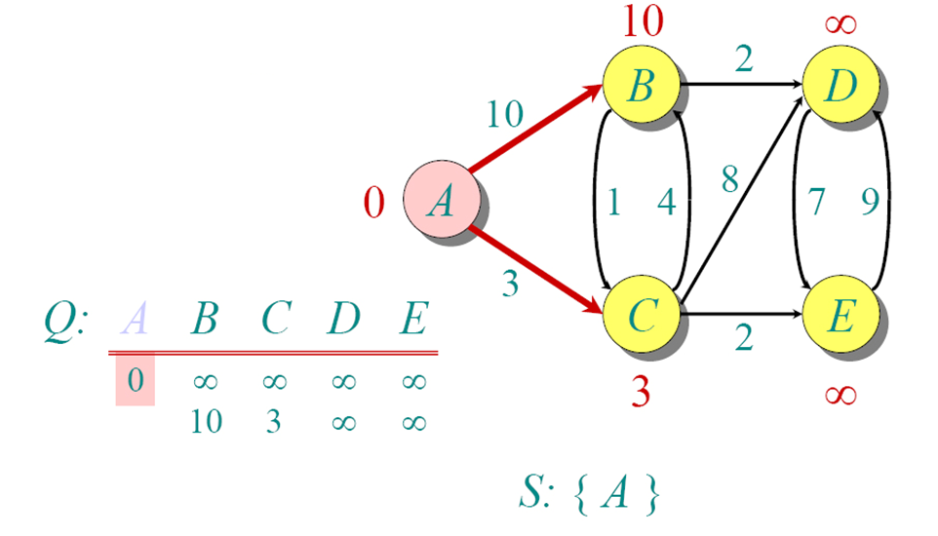

Slide 104
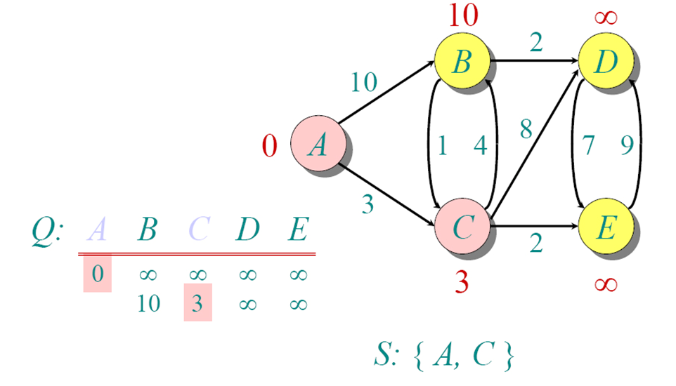

Slide 105
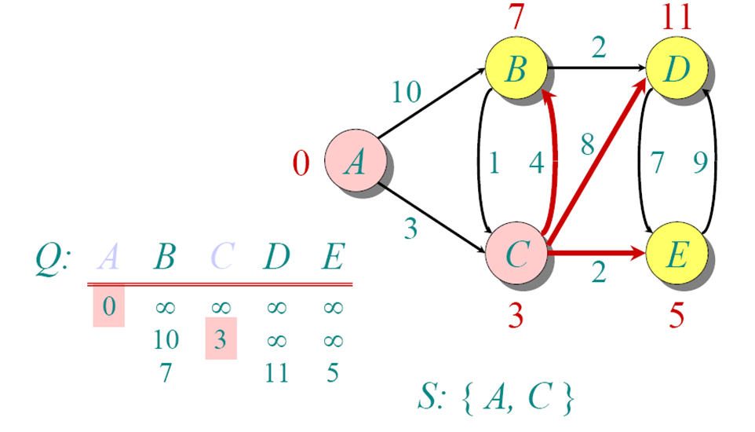

Slide 106
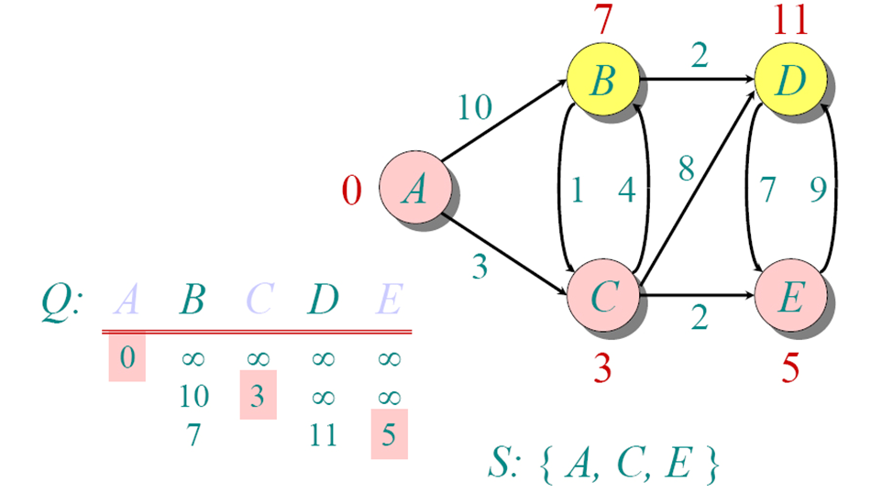

Slide 107
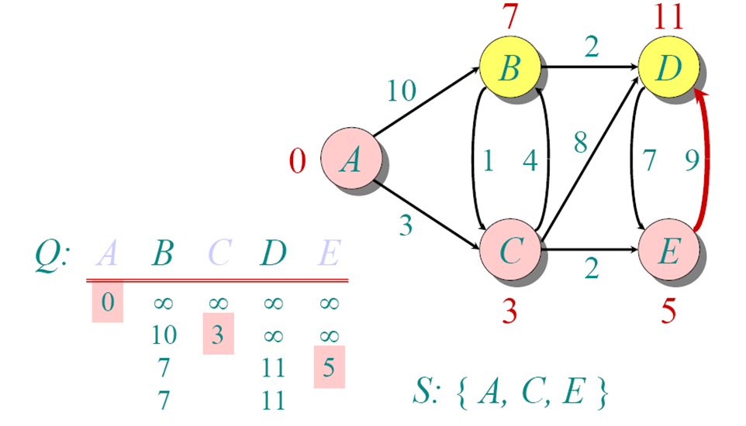

Slide 108
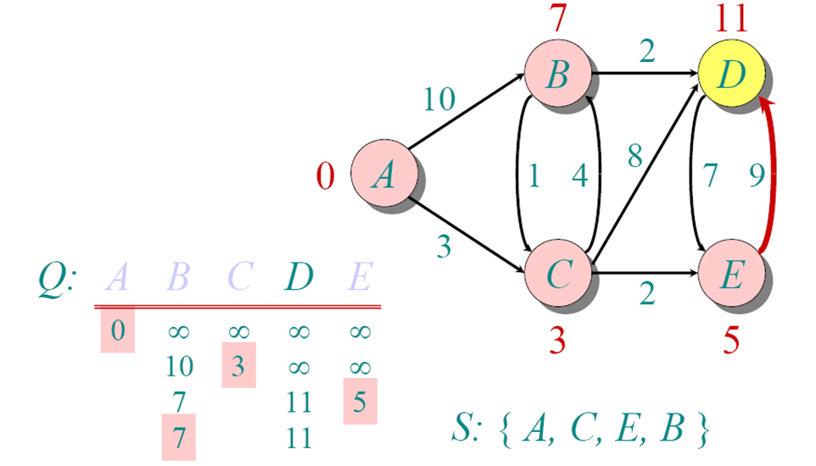

Slide 109
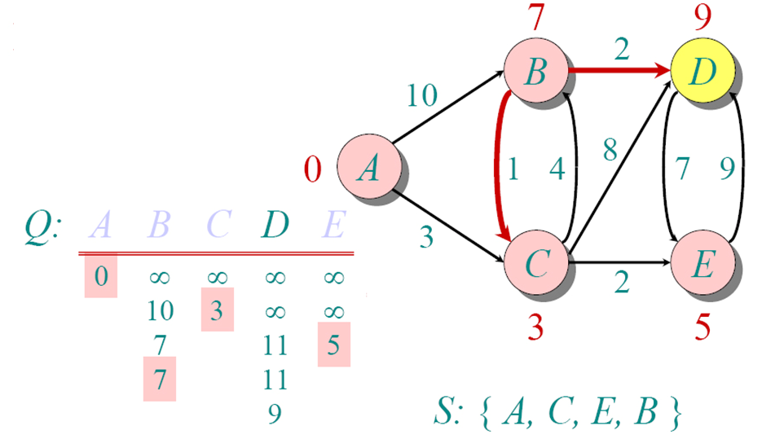

Slide 110
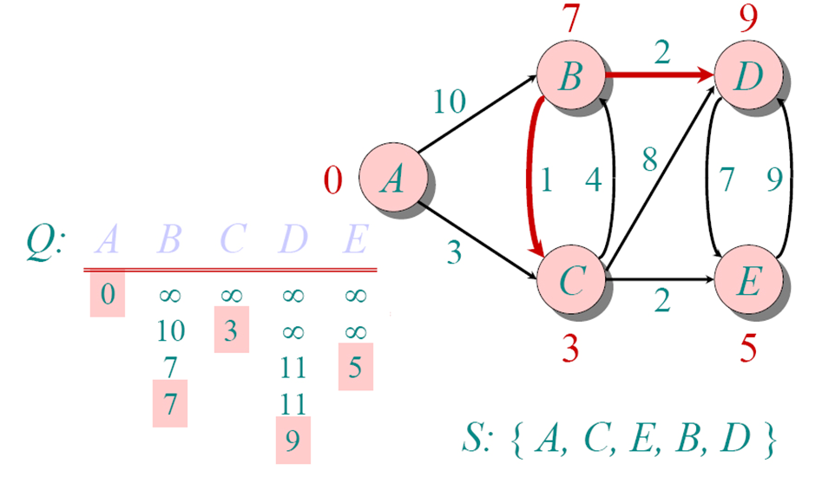

Slide 111
Shortest Path Tree from A to all other nodes

Slide 112
Searching Observations
We could code a method in Java. It’s easy to see that some of our structures correspond to Java classes.
Visited
Vector visited =
new Vector();
A
F
B
D
C
Open Nodes
Vector openQueue =
new Vector();
G
E
Current Node
NodeType current;
C

Slide 113
However . . .
Our search only determined if there WAS a
path from a node to a goal, not WHAT that path
was.
There’s a way to save HOW to get to a node,
in addition to determining WHETHER two nodes
have a path.

Slide 114
Searching for a Path
Recall the point in our
BFS where we found
two identical references
in our open node queue.
In fact, the references
could be considered different, because they were contributed to the open queue by different nodes.
But we didn’t save WHICH node contributed the reference to the open queue.
We need to keep track of where the nodes came from.

Slide 115
Thinking INSIDE the Box
FIRST
Let’s consider what
a Node really is.
A
B
C
F
E
D
D
G
In a general sense,
a node is just a box.
We can place data in it,
like an Object or a Comparable.

Slide 116
Thinking INSIDE the Box
SECOND,
Let’s consider
what a “Path”
really is.
A
B
C
F
A path is
a collection
of nodes.
E
D
G
Hey, wait a minute!
A PATH IS (LIKE) A LINKED LIST!

Slide 117
Wow – things are coming together.
In a sense,
we can think of
a graph as a bunch of linked lists. Finding a path is just a matter of finding the right linked list that walks the graph.
A
B
C
F
E
D
G
Keep thinking:
“There is no Big O”
“There is no Big O”

Slide 118
So?
To form a path from start node to goal node, we must therefore make a “linked list” to record where we came from.
A
B
C
F
E
D
It’s like leaving
a trail of bread
crumbs to mark
our trail
G
(This is actually going to build the backwards path, but we can fix this.)

Slide 119
Thinking INSIDE the Box
Thus, we don’t add graph nodes to our open queue...
Visited
A
B
A
F
B
D
C
F
E
Open Nodes
D
G
E
G
We instead add
Path objects, that contain a node, and a reference to where they came from
Current Node
C
Adjacencies
G
E
B

Slide 120
public class Path {
private Path previous;
private Node node;
public Path (Path previous, Node node) {
setNode(node);
setPrevious(previous);
}
public Node getNode(){return node;}
public void setNode (Node n){
this.node = n;
}
public Path getPrevious(){
return previous;
}
public void setPrevious(Path p){
this.previous = p;
}
} // class Path
The term “Path” is misleading
It’s actually a step or link node in
the overall path.
Path
Node

Slide 121
This Path thing can be a little startling at first
Imagine we have Nodes: a, b, c, d, e
Here is the typical sequence as we traverse down these nodes in order
Path p = new Path(null, a);
prev
node
a
p

Slide 122
This Path thing can be a little startling at first
Imagine we have Nodes: a, b, c, d, e
Here is the typical sequence as we traverse down these nodes in order
Path p = new Path(null, a);
p = new Path(p, b);
prev
node
a
prev
node
b
p

Slide 123
This Path thing can be a little startling at first
Imagine we have Nodes: a, b, c, d, e
Here is the typical sequence as we traverse down these nodes in order
Path p = new Path(null, a);
p = new Path(p, b);
p = new Path(p, c);
prev
node
a
prev
node
b
prev
p
node
c

Slide 124
This Path thing can be a little startling at first
Imagine we have Nodes: a, b, c, d, e
Here is the typical sequence as we traverse down these nodes in order
Path p = new Path(null, a);
p = new Path(p, b);
p = new Path(p, c);
p = new Path(p, d);
prev
node
a
prev
node
b
prev
prev
node
c
p
node
d

Slide 125
This Path thing can be a little startling at first
Imagine we have Nodes: a, b, c, d, e
Here is the typical sequence as we traverse down these nodes in order
Path p = new Path(null, a);
p = new Path(p, b);
p = new Path(p, c);
p = new Path(p, d);
p = new Path(p, e);
prev
node
a
prev
node
b
prev
prev
prev
node
c
p
node
e
node
d

Slide 126
public Path findPathWithBFS( Node start, Node goal ){
Vector vVisited = new Vector();
Vector vOpen = new Vector();
Path curr = new Path(null, start);
Node n = null;
vOpen.addElement(curr);
while (vOpen.size() != 0) {
curr = (Path) vOpen.elementAt(0);
vOpen.removeElementAt(0);
vVisited.addElement(curr);
n = curr.getNode();
if (n.equals(goal))
return curr; // Found path
Vector vNext = getAdjacencies(n);
for (int i =0; i < vNext.size(); i++)
if (! vVisited.contains( vNext.elementAt(i)))
vOpen.addElement
(new Path (curr, vNext.elementAt(i)));
}
return null; // NO path found!
}
Note: This only returns the reversed path.

Slide 127
Analysis
public Path findPathWithBFS( Node start, Node goal ){
Vector vVisited = new Vector();
Vector vOpen = new Vector();
Path curr = new Path(null, start);
Node n = null;
vOpen.addElement(curr);
Visited
A
F
B
D
C
These declare variables and structures, with one notable change. We don’t use a Node as our “current” reference, but instead a Path that holds a node.
Open Nodes
G
E
Current Node
C
Our first Path has “null” as its
previous, since it holds the start node.
A

Slide 128
Analysis
In the loop!
We start by removing the first Path from the adjacency list.
curr = (Path) vOpen.elementAt(0);
vOpen.removeElementAt(0);
vVisited.addElement(curr);
n = curr.getNode();
if (n.equals(goal))
return curr; // Found path
If the Path object contains the goal node, we’re done

Slide 129
Analysis
If the current Path is not the goal, we check each node adjacent to the current. If we’ve not visited it before, we add it to our open queue.
Vector vNext = getAdjacencies(n);
for (int i =0; i < vNext.size(); i++)
if (! vVisited.contains( vNext.elementAt(i)))
vOpen.addElement
(new Path (curr, vNext.elementAt(i)));
If the ‘while’ loop exhausts the open queue, we have not found a Path to the goal. So, return null.
}// while
return null; // NO path found!

Slide 130
Study Guide
Know the basic parts of a graph
Trace the code for finding a path
BFS: Queue
DFS: Stack
Understand why the different data structures yield different results

Slide 131
Summary – you should now …
Graphs
Searching
Breadth-First Search (BFS)
Depth-First Search (DFS)

