Slide 1
cs2340:Agile Development
Fall 2016
Agile Development

Slide 2
Readings In Book
Chapter 1, 2
Chapter 40
Links off the syllabus to additional readings

Slide 3
Software Development Life Cycle (SDLC)
Conceptual Model
  Waterfall, Evolutionary Prototyping, Spiral, Staged Delivery, etc.
Management of Risk
Sequence of Activities
Agile Development

Slide 4
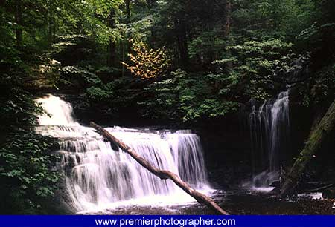
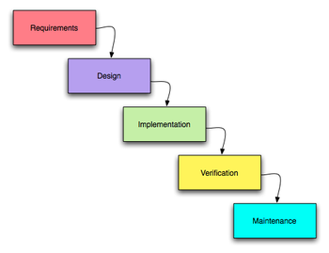
In the beginning was….
The Waterfall
Agile Development

Slide 5

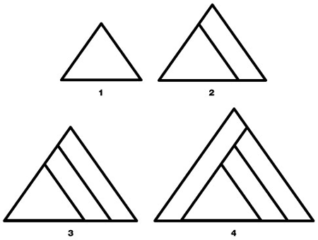
Two Ways to Build a Pyramid
(John Mayo-Smith)
Agile Development

Slide 6
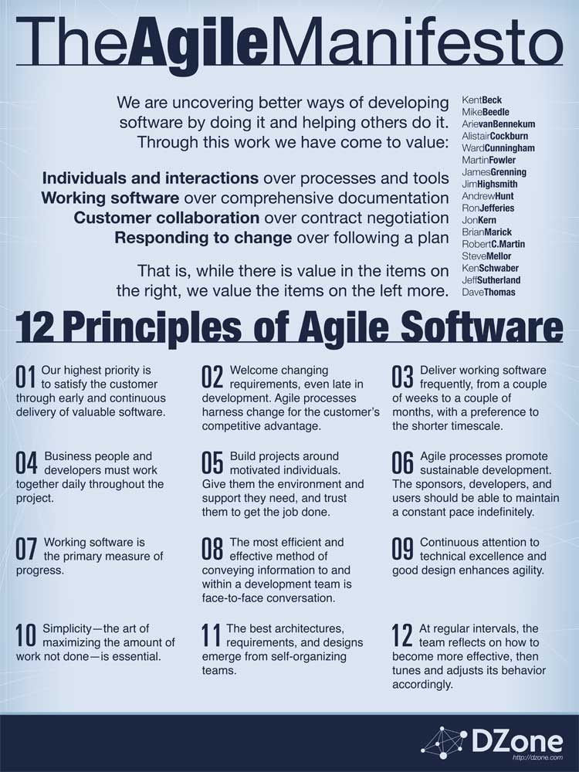
Thus was
Born:
Agile Development

Slide 7
Iterative Delivery
Project divided in pieces called iterations
At end of iteration something is delivered
No schedule slip (timeboxing)
Each iteration nominally 4 weeks (but can be as short as 1 week in XP, or 6 weeks in RUP)
In RUP, each iteration has 4 phases:
  Inception
  Elaboration
  Construction
  Transition
Agile Development

Slide 8
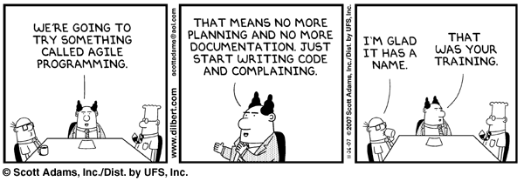
DANGER DANGER WILL ROBINSON
Agile Development

Slide 9
Some Agile Processes
SCRUM
Extreme Programming (XP)
EVO
RUP Dx
Agile Development

Slide 10
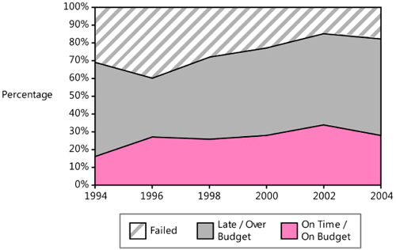
Industry Estimation
Agile Development

Slide 11
SCRUM
Focuses mainly on management of software product development
Timeboxed iterations called sprints
Project planned through use of 2 spreadsheets (Product and Sprint)
Daily Meeting (Pigs and Chickens)
Each sprint ends with “ready” deliverable
Agile Development

Slide 12
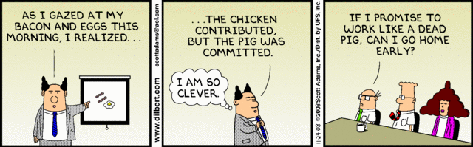
Agile Development

Slide 13
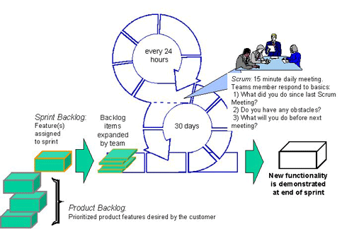
SCRUM
Agile Development

Slide 14
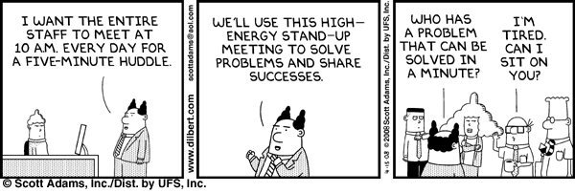
The Standup Meeting
Agile Development

Slide 15
Product Backlog
Product backlog shows prioritized tasks, and hours to go by sprint
Work Items | Initial Estimate | Adjust Factor | Adjust Estimate | 1 | 2 | 3
Hide/Display burndown window | 3 | .2 | 3.6 | 3.6 | 3.6 | 0
Automatic recalculation of row/column values | 3 | .2 | 3.6 | 3.6 | 2.4 | 0
Display Product Burndown Graph | 3 | .2 | 3.6 | 3.6 | 0 | 0
Display Sprint Burndown Graph | 4 | .2 | 4.8 | 4.8 | 2.4 | 2.4
More Items here for complete project | --- | --- | --- | -- | --- | ---
Total Remaining | 650 | 0 | 725 | 725 | 550 | 320
Its not how many hours you work, its how many you have to go.
Agile Development

Slide 16
Sprint Backlog
Focus is on each persons estimate of how much work they have to go on tasks, not how much they have done in past.
Tasks | Responsible | Status | 1 | 2 | 3 | 4
Move Calculations out of Excel | Jim | Not Started | 10 | 10
Store PDF files in structure | Sally | In Progress | 15 | 8
Switch to JDK1.5 | Pete | Completed | 10 | 0 | 0 | 0
Install Cruise Control on Team Server | Jim | Completed | 5 | 0 | 0 | 0
LTCS Disk | Jim | In Progress | 10 | 10
More Sprint items to account for all required items
Total |  |  | 200 | 140
Agile Development

Slide 17
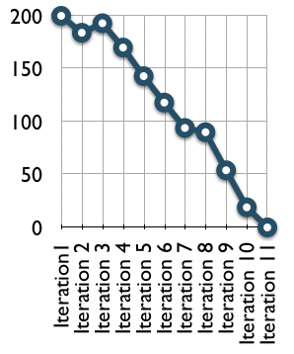
Burndown Charts
Tracks project accomplishment to completion
Provides a visual representation for project completion
Goes down when progress made, Up when estimates revised
Sharp drop usually means reduction of features.
Agile Development

Slide 18
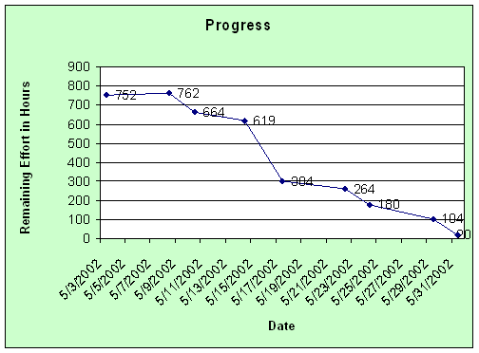
Sprint Burndown
Agile Development

Slide 19
Estimating Time
A good estimate is an estimate that provides a clear enough view of the project reality to allow the project leadership to make good decisions about how to control the project to hit its targets.
Steve McConnell
Agile Development

Slide 20
How Good an Estimator are You?
Low Estimate – High Estimate] Description
[ ______ – ________ ] Surface temperature of the Sun
[ ______ – ________ ] Latitude of Shanghai
[ ______ – ________ ] Area of the Asian continent (sq mi)
[ ______ – ________ ] The year of Alexander the Great's birth
[ ______ – ________ ] Total value of U.S. currency in circulation in 2004
[ ______ – ________ ] Total volume of the Great Lakes (gal)
[______ – ________ ] Worldwide box office receipts for the movie Titanic
[ _____ – _________ ] Total length of the coastline of the Pacific Ocean (mi)
[ _____ – _________ ] Number of book titles published in the U.S. since 1776
[ _____ – _________ ] Heaviest blue whale ever recorded (lbs)
90% Confidence that number is in range
Agile Development

Slide 21
Answers
Surface temperature of the Sun 10,000°F/6,000°C
Latitude of Shanghai 31 degrees North
Area of the Asian continent 17,139,000 square miles
The year of Alexander the Great's birth 356 BC
Total value of U.S. currency in circulation in 2004 $719.9 billion
Total volume of the Great Lakes 1.8x 10^23 U.S. gallons
Worldwide box office receipts for the movie Titanic $1.835 billion
Total length of the coastline of the Pacific Ocean 84,300 miles
Number of book titles published in the U.S. since 1776 22 million
Heaviest blue whale ever recorded 380,000 pounds
Agile Development

Slide 22
Industry Estimation
Agile Development

Slide 23
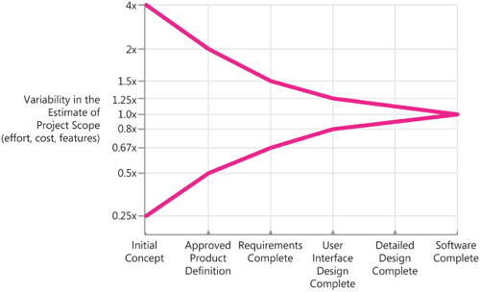
Recognize Uncertainty
Agile Development

Slide 24
Estimation Rules
Count if at all possible. Compute when you can't count. Use judgment alone only as a last resort
Collect historical data that allows you to compute an estimate from a count. (Size, Effort, Defects, Time)
To create the task-level estimates, have the people who will actually do the work create the estimates.
Agile Development

Slide 25
Warning
In general –
Your developers are OPTIMISTS!!!!!
(Best Case + Most Likely * 4 + Worst Case) / 6
Agile Development

Slide 26
Estimate
By Analogy
By Computation (COCOMO, Function Points)
By Proxy (PROBE)
By Group (Wideband Delphi)
Agile Development

Slide 27
Extreme Programming
A set of engineering processes:
  Test-Driven Development
  Pair Programming
  Collective Code Ownership
  Aggressive Refactoring
  On-Site Customer
  Iterative Development
  Continuous Integration
Agile Development

Slide 28
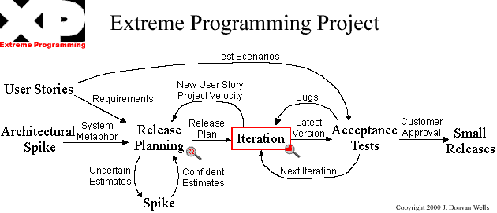
XP Top Level
Agile Development

Slide 29
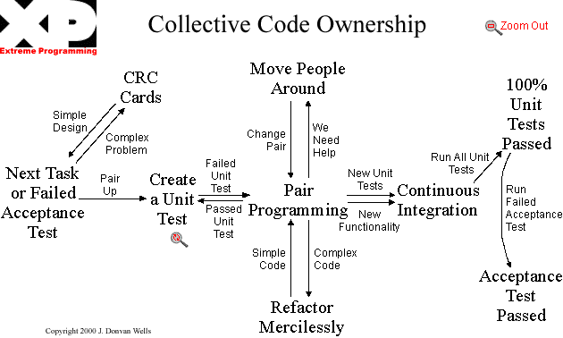
Daily Iteration
Agile Development

