Slide 1
Senior Project
Mini Spotify-like
Music Recommendation
System
Objective:
Which recommendation strategy works best for music recommendation, and what trade-offs does each model have?
Jerry Wu 12 Ne
Popular
->
Similar users
->
Similar songs
Notes:
Open with the core question: what should a music platform recommend next? Explain that the project compares globally popular songs, songs liked by similar users, and songs similar to a user's history. Emphasize that recommendation systems shape discovery, not only prediction.

Slide 2
02
Mini Spotify-like Music Recommendation System
Dataset
5,199
8,640
751,531
users
music items
interactions
Top-K ranking protocol
- Each interaction is marked as 1: observed behavior, not satisfaction.
- Does not tell us whether the user gave it a high rating, disliked it, skipped it, or listened to it many times.
- The model ranks candidate songs instead of predicting ratings.
Partial user
history
->
Rank unseen
candidate songs
->
Top-K
recommendations
KGRec-music is an implicit-feedback ranking problem
Source: KGRec-music preprocessing summary and final_report.txt
Notes:
I used the KGRec-music dataset, which contains user-item interactions, item tags, and item descriptions. The main interaction file has 751,531 implicit interactions, covering 5,199 users and 8,640 music items. Each interaction is marked as 1, which means the dataset only tells us that a user interacted with a music item; it does not tell us whether the user gave it a high rating, disliked it, skipped it, or listened to it many times. Because of this, my project is an implicit-feedback recommendation problem. In an explicit-feedback system, the model might predict a star rating, but in this project the model ranks songs instead. The task is not to predict whether a user would rate a song 4.5 stars. The task is to ask: given part of a user’s interaction history, can the model rank songs that the user interacted with later near the top of the recommendation list?

Slide 3
03
Mini Spotify-like Music Recommendation System
Step 2: Dataset Preprocessing Pipeline
- Map raw user and item IDs into continuous internal indices, which is needed for the content-based model.
Users
raw user IDs
->
0-5198
->
matrix rows
- For example, users can be mapped from 0 to 5198, and items from 0 to 8639.
Items
raw item IDs
->
0-8639
->
matrix columns
- Build item feature vectors for both content scoring and diversity evaluation.
Forward maps make training efficient; reverse maps make outputs explainable and usable.
ID maps
Senior Project Presentation
Notes:
Before training the models, I had to turn the raw dataset into a clean experimental setup. Preprocessing is not just a cleaning step; it defines the entire environment in which the models are trained and evaluated. One important step was ID mapping. Raw user IDs and item IDs are not always convenient for matrix-based models, so they need to be map needed consistent user and item IDs, clean train/validation/test splits, and item feature representations that could be used by the content-based model and by the diversity metric. ped into continuous internal indices. For example, users can be mapped from 0 to 5198, and items from 0 to 8639. This allows models like ALS to build a clean user-item matrix. At the same time, the system must preserve the mapping back to the original KGRec item IDs, because the model’s internal item index is not meaningful to a user by itself.

Slide 4
04
Mini Spotify-like Music Recommendation System
A fair per-user split
- Train: 80% of each user's interactions.
- Validation: 10% for model development and reporting.
- Test: 10% reserved for final evaluation.
- All three models share the same split and candidate rules.
80% train
10% val
10% test
Evaluation asks how well the model understands known users from partial histories.
Senior Project Presentation
Notes:
Because the dataset does not provide time information, I used a per-user random split instead. For each user, I split that user’s interactions into 80% training, 10% validation, and 10% test. This means the model sees part of each user’s history and then tries to recover the hidden held-out interactions. This is important because the evaluation is asking whether the model can understand known users’ preferences from partial histories, not whether it can handle completely new users in the research evaluation. The split also makes the comparison fair. All three models use the same training data, the same validation data, the same test data, and the same candidate-pool logic. This means that when ALS performs better than popularity or content-based recommendation, the result is meaningful because the rules are the same for all models.

Slide 5
05
Mini Spotify-like Music Recommendation System
Leakage control keeps the results honest
- In recommendation systems, leakage can make a model look better than it really is because it has indirectly seen information that should have been hidden.
Training data
fit models + TF-IDF
Held-out data
evaluate only
||
- TF-IDF (Term Frequency-Inverse Document Frequency) vocabulary and tag weights are fitted without using held-out interactions.
The boundary prevents the model from indirectly seeing the answers.
- Validation/test data are used only as ground truth during evaluation.
TF-IDF is a numerical statistic used in information retrieval to measure a word's importance to a document within a collection.
Senior Project Presentation
Notes:
A key concern in preprocessing is avoiding data leakage, which happens when information from validation or test data accidentally influences the training process. In recommendation systems, leakage can make a model look better than it really is because it has indirectly seen information that should have been hidden. In my project, this was especially important for the tag TF-IDF features. TF-IDF learns a vocabulary and weighting structure from item tags, so I fit the TF-IDF vectorizer only on training items and then applied it to validation and test items. This keeps the validation and test data as held-out data and makes the experiment more honest.

Slide 6
06
Mini Spotify-like Music Recommendation System
Candidate pool and top-K evaluation
- For each user, the recommender should not recommend items the user already interacted with in the training set.
- Start from the training catalog.
Training
catalog
- seen
Candidate
pool
rank
Top-K
list
- Remove items the user already interacted with in training to the pool.
- Rank the remaining candidates for K = 5, 10, and 20.
#1
#2
#3
...
#K
- Compare the recommendation list with validation or test ground truth.
The system ranks unseen candidate items, then checks whether held-out interactions appear in the top K.
Validation / test
held-out items
compare
Credit only comes from retrieving songs hidden from the model.
Senior Project Presentation
Notes:
For each user, the recommender should not recommend items the user already interacted with in the training set. If the model simply recommends songs the user has already seen, it is not solving the real recommendation problem. So during evaluation, I created a candidate pool by taking the training catalog and removing each user’s already-seen training items. The model then ranks the remaining candidate items, and the validation or test split is used as ground truth. In other words, the evaluation asks: among the songs this user has not already seen in training, can the model place the user’s held-out interactions near the top? This setup turns the project into a top-K ranking problem, where the model recommends the top 5, 10, or 20 items for each user.

Slide 7
07
Mini Spotify-like Music Recommendation System
Model 1: Popularity baseline
Mental model
- simply counts how many times each item appears in the training set and ranks items by global popularity.
"I do not know your specific taste, so I will recommend what many people already interacted with."
- Filter each user's already-seen training items.
- Almost the same ranking for every user, so not personalized.
simple
deterministic
low novelty
- Useful baseline, but weak personalization and narrow exposure.
A simple deterministic floor: recommend what received the most training interactions.
Senior Project Presentation
Notes:
The first model is the popularity-based baseline. This model does not try to understand individual taste. It simply counts how many times each item appears in the training set and ranks items by global popularity. For each user, it then removes songs that the user already interacted with in training and recommends the most popular remaining items. Technically, the popularity score for an item is just the number of training interactions that item received. This means the ranking is almost the same for every user, except that each user’s already-seen items are filtered out. The model is simple, deterministic, and useful because it gives a performance floor. If a more complex model cannot beat popularity, then the complex model is probably not adding real value. The weakness is that popularity is barely personalized. It tends to recommend the same small group of mainstream items again and again. This creates low catalog coverage and low novelty because many items in the catalog almost never get recommended. The mental model is simple: popularity says, I do not know your specific taste, so I will recommend what many people already interacted with.

Slide 8
08
Mini Spotify-like Music Recommendation System
Model 2: ALS collaborative filtering
ALS learns hidden user and item vectors from the interaction matrix.
- Uses behavior patterns rather than song tags or titles.
R
X
Y^T
- learns hidden vectors for users and hidden vectors for items, then scores a user-item pair by how well those vectors align.
~
x
For example, one dimension might roughly capture preference for mainstream music, another might capture a certain genre or listening style, but the model does not directly label these dimensions. Instead, it learns them from patterns like: users who interacted with item A also often interacted with item B.
The strongest model in my research, and performs well when the data is implicit feedback.
item factors
user-item interactions
user factors
new user
vector x_u
dot
item
vector y_i
=
score(u, i)
Senior Project Presentation
Notes:
The second model is ALS collaborative filtering, which is the strongest model in my project. ALS uses the user-item interaction matrix rather than song tags or titles. Rows represent users, columns represent music items, and observed interactions become positive signals. The model learns hidden vectors for users and hidden vectors for items, then scores a user-item pair by how well those vectors align. The main idea is latent factors. These are hidden dimensions learned from behavior patterns. For example, one dimension might roughly capture preference for mainstream music, another might capture a certain genre or listening style, but the model does not directly label these dimensions. Instead, it learns them from patterns like: users who interacted with item A also often interacted with item B. A higher score means the user and item are closer in the learned latent space. Because the data is implicit feedback, ALS does not treat missing interactions as strong dislikes. Missing data usually means the user may never have seen the song. So implicit ALS treats observed interactions as positive evidence with higher confidence, while unobserved interactions are lower-confidence unknowns. The reason ALS performed best is that KGRec-music contains strong collaborative structure. In plain language, user behavior patterns reveal more about music preference than global popularity or tag similarity alone. ALS can find connections between songs even if their tags are incomplete or not obviously similar. Its weakness is that it is less naturally explainable and needs interaction history, which creates cold-start problems for new users or new items.

Slide 9
09
Mini Spotify-like Music Recommendation System
Model 3: Content-based recommendation using tags
- Convert item tags into TF-IDF vectors, giving higher weights to tags that appears more specifically in the songs, and lower weight to generic tags that appear everywhere.
seed songs
with tags
->
TF-IDF
item vectors
->
mean user
tag profile
->
cosine
similarity
- Build a user profile from interacted songs during training.
indie
mellow
80s
- Then scores candidate items by how similar their tag vectors are to the user’s tag profile, often using cosine similarity.
Clear explanation: recommend songs sharing high-weight tags.
Trade-off: similar tags can create a narrow list.
- More explainable and novel, but tag similarity is not always user preference.
The model recommends songs whose tag vectors are close to the user's tag profile.
Senior Project Presentation
Notes:
The third model is content-based recommendation using tags. This model does not depend mainly on what similar users did. Instead, it looks at the features of the items themselves. In my project, those features are item tags. The preprocessing step converts each item’s tags into a TF-IDF vector. TF-IDF gives more weight to tags that are meaningful and less common, and less weight to generic tags that appear everywhere. This creates a tag-space representation for each music item. Then, for each user, the model builds a user profile by combining the tag vectors of songs the user interacted with in training. The model then scores candidate items by how similar their tag vectors are to the user’s tag profile, often using cosine similarity. The basic logic is: if a user interacted with songs that have certain tag patterns, recommend other songs with similar tag patterns. This model is more explainable than ALS because the recommendation can be connected back to tags. It can also recommend more niche songs because it does not only follow global popularity. That explains why the content-based model had the highest novelty in my results. However, content-based recommendation also has clear weaknesses. Tag similarity is not the same as actual user preference. Two songs may share tags but still appeal to very different listeners. Also, if tags are missing, noisy, or too generic, the model has weak item features. In my results, content-based recommendation had lower accuracy and lower diversity because it often recommended obscure but semantically similar items from the same narrow tag neighborhood.

Slide 10
10
Mini Spotify-like Music Recommendation System
Metrics: accuracy plus discovery
Accuracy metrics
Beyond-accuracy metrics
- Precision@K: how many recommendations were relevant.
- Coverage: how much of the catalog is ever recommended.
- Recall@K: how many held-out items were recovered.
- Novelty: whether recommendations are less obvious.
- NDCG@K: whether relevant items appear near the top.
- Diversity: how different items are within one list.
- Hit Rate@K: whether at least one relevant item appears.
Accuracy alone does not tell us what listening experience the model creates.
Senior Project Presentation
Notes:
I evaluated the models using both accuracy metrics and beyond-accuracy metrics. The accuracy metrics measure whether the model ranks relevant held-out items near the top. Precision@K asks what fraction of the top K recommendations were relevant. Recall@K asks what fraction of the user’s held-out items were recovered. NDCG@K measures whether relevant items appear closer to the top of the ranking. Hit Rate@K asks whether the user received at least one relevant item in the top K. But accuracy alone is not enough for music recommendation. A recommender also shapes what users discover. So I also used beyond-accuracy metrics. Catalog coverage measures how much of the catalog gets recommended across users. Novelty measures whether the model recommends less obvious and less popular items. Diversity measures whether the items within one recommendation list are different from each other. This matters because a music recommender should not only guess what users already know. It should also help users discover new music in a useful way.

Slide 11
11
Mini Spotify-like Music Recommendation System
Results at K = 10
Metric
Popularity
CF (ALS)
Content-Based
Winner
Interpretation
Precision@10
0.0338
0.1120
0.0269
CF
- ALS is the best overall ranking model.
Recall@10
0.0227
0.0793
0.0198
CF
- Popularity is useful but concentrates exposure on a tiny catalog slice.
Hit Rate@10
0.2679
0.6544
0.2283
CF
- Content-based recommendation reaches the long tail, but loses accuracy.
Coverage@10
0.0035
0.3949
0.1235
CF
Novelty@10
2.4491
4.4614
6.2362
CB
- Novelty and diversity are different: A model can recommend novel songs while still recommending many songs that are similar to each other.
Diversity@10
0.8382
0.8794
0.6706
CF
ALS wins the main accuracy metrics and also broadens catalog exposure; content-based wins novelty.
CF wins accuracy
CB wins novelty
Validation results at K = 10 from artifacts/results/final_report.txt and comparison_table.md
Notes:
At K = 10, ALS performed best overall. It had the highest precision, recall, NDCG, hit rate, coverage, and diversity. This means ALS was not only more accurate, but also exposed users to a broader part of the catalog compared with the popularity baseline. The popularity baseline was useful but narrow. It recommended globally popular items and achieved some accuracy, but its catalog coverage was extremely low because it concentrated recommendations on a tiny group of popular songs. The content-based model had the highest novelty, which means it recommended less obvious and more long-tail items. However, it had lower accuracy and lower diversity. This shows an important distinction: novelty does not automatically mean diversity. A model can recommend obscure songs while still recommending many songs that are similar to each other. The main conclusion is that ALS worked best because user-item behavior was the richest signal in this dataset. Popularity captured mainstream attention, content-based tags captured semantic similarity, but ALS captured personalized co-listening patterns.

Slide 12
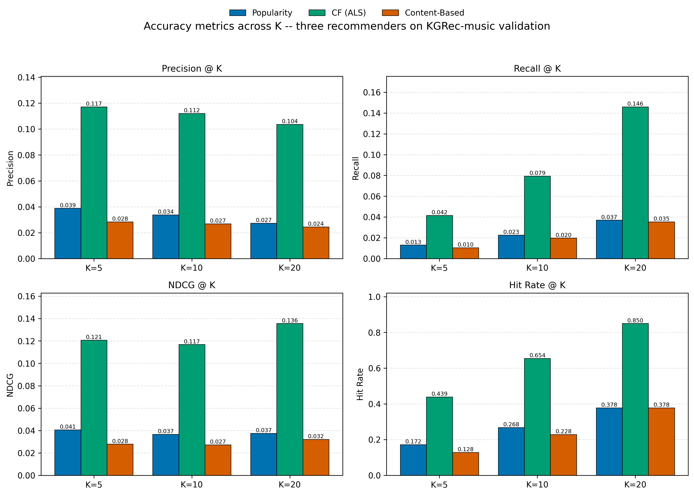
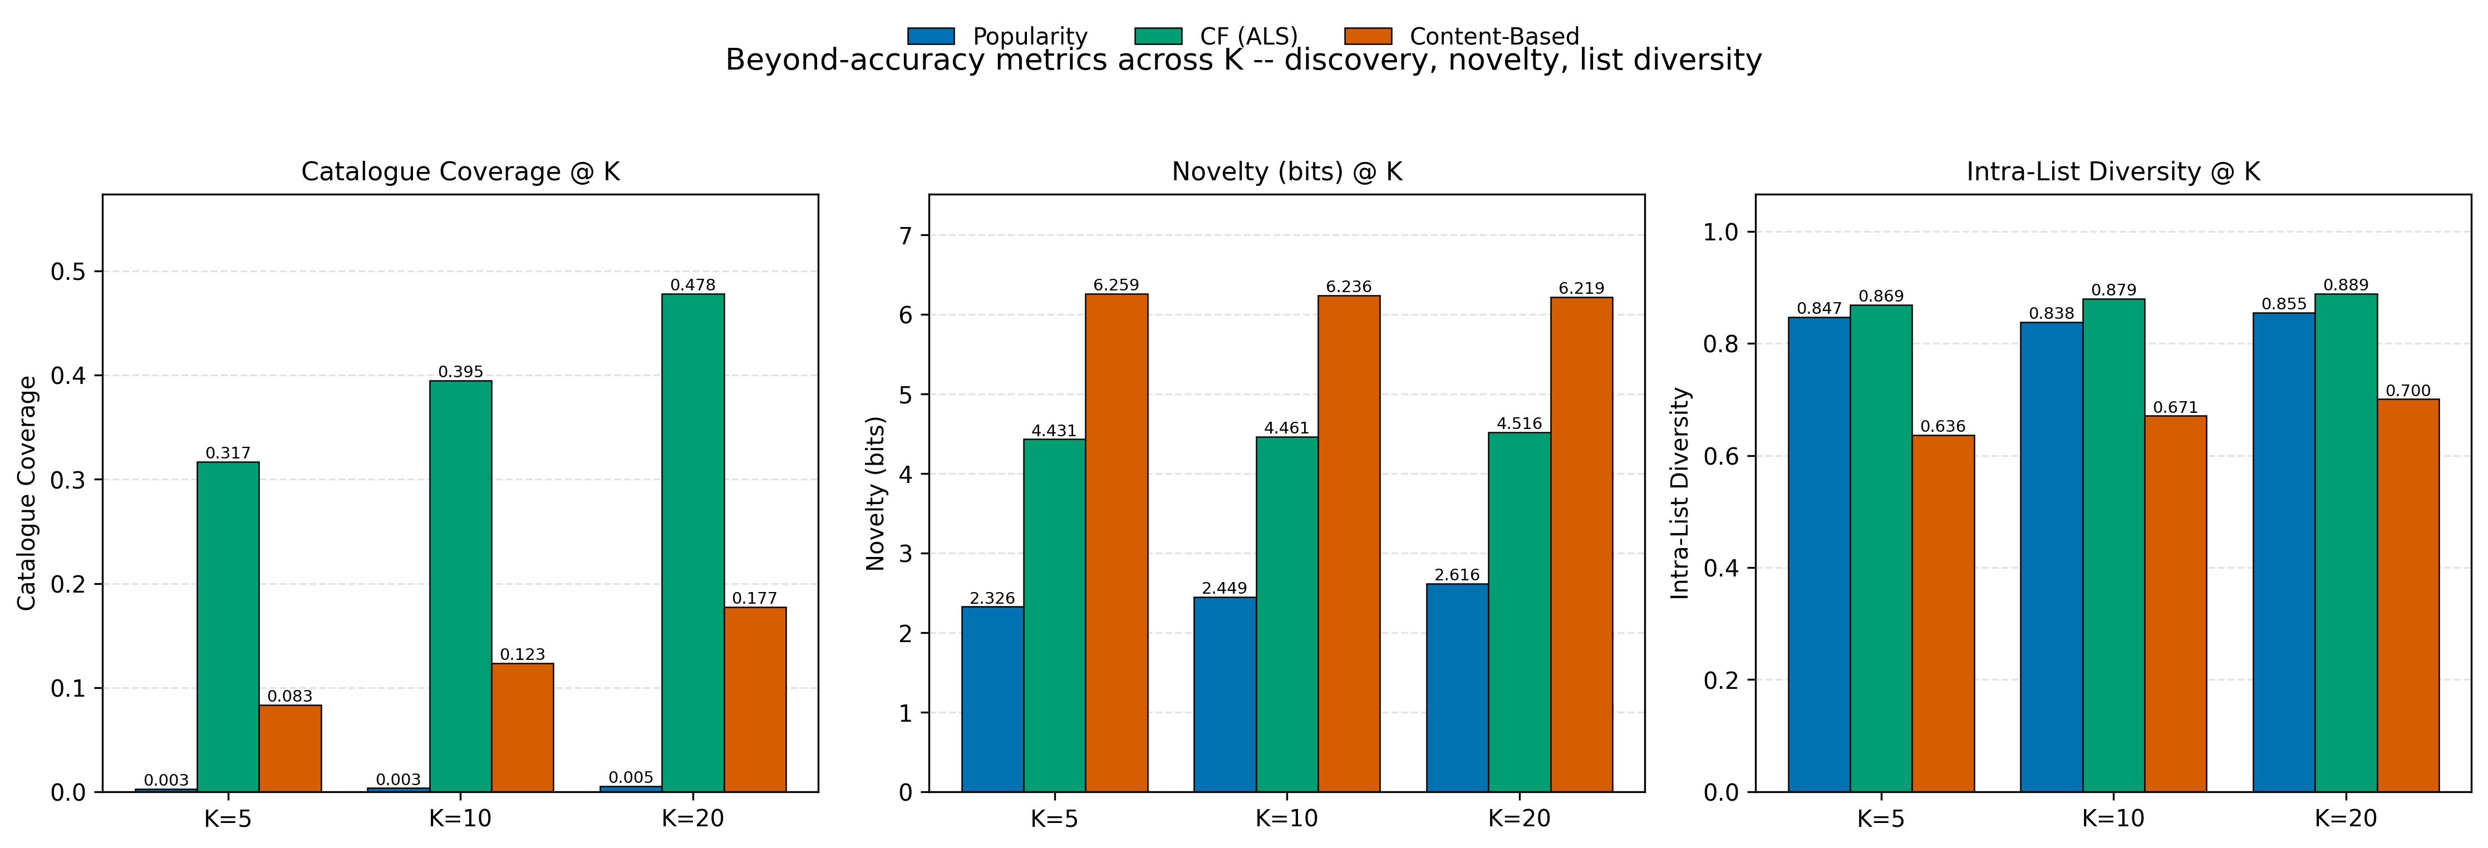
Results at K = 10
Senior Project Presentation
Notes:
Close by connecting the research and product work. Popularity is simple and safe, content-based recommendation can improve discovery but may be narrow, and ALS performed best because user-item behavior was the richest signal. The broader takeaway is that a recommender is a pipeline, not only a model.

Slide 13
12
Mini Spotify-like Music Recommendation System
Product extension: live demo layer
The demo turns the research pipeline into an interactive music recommendation prototype.
- New website users are not original KGRec training users.
- NetEase enrichment api: https://github.com/NeteaseCloudMusicApiEnhanced/api-enhanced
Product layer: SongRecDemo README; NetEase enrichment is display-side only
Notes:
After completing the research comparison, I built a personalized demo layer on top of the trained system. This part is not a fourth model in the original experiment. It is a product extension that makes the recommender usable for a new interactive user. The challenge is that a new website user is not one of the original 5,199 users in the training matrix. So the demo cannot simply look up a trained user vector. Instead, the system uses fold-in, which estimates a temporary user vector based on the new user’s seed songs, favorite songs, and tag preferences while keeping the trained item factors fixed. The demo also allows controls for content weight, novelty, and diversity. Content weight adjusts how much tag similarity matters. Novelty pushes the system away from only obvious popular items. Diversity helps avoid recommending many songs that are too similar to each other.

Slide 14
13
Mini Spotify-like Music Recommendation System
Final conclusion
The project became a full pipeline for understanding music recommendation from data to model to demo.
Main lesson
Recommendation systems are not only about maximizing accuracy; different algorithms create different discovery experiences.
- Popularity captures mainstream attention.
- Content-based tags push into niche areas but can become narrow.
- ALS learns hidden co-listening patterns and performed best overall.
Senior Project Presentation
Notes:
Close by connecting the research and product work. Popularity is simple and safe, content-based recommendation can improve discovery but may be narrow, and ALS performed best because user-item behavior was the richest signal. The broader takeaway is that a recommender is a pipeline, not only a model.

