Slide 1
IIOT Portfollio
Jeran Kilpack

Slide 2
Github link
Everything in this repo and this presentation are about the practical lab assignments. Learn more about the conceptual and documentation in the repo.
https://github.com/JeranKilpack/IIOTportfollio/tree/main

Slide 3
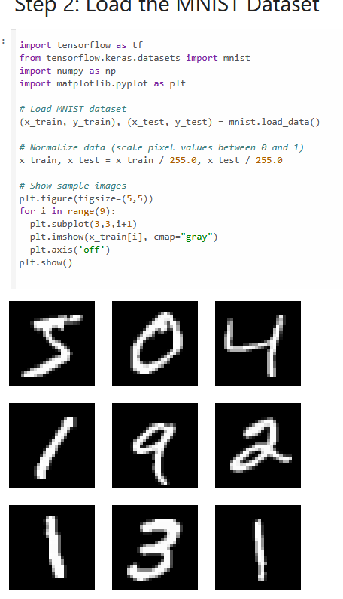
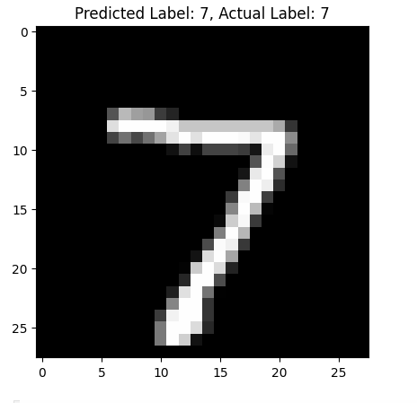
Converting and Deploying AI models using Tensorflow lite
Using tensorflow and visualizing with matplotlib we trained and showed the sample images
After remodeling we converted and inference the image and properly predicted the right labeled image.

Slide 4

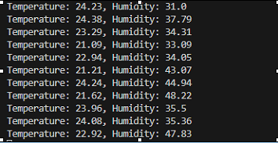
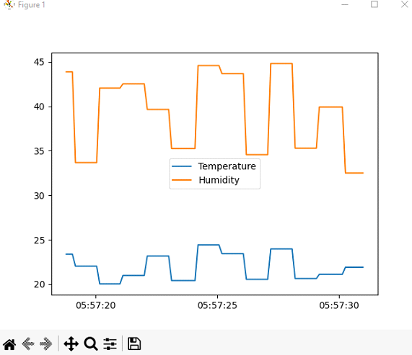
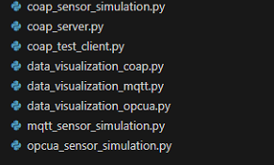
Conceptual Design of an IIoT Sensor Network & Protocol Experimentation
Using mqtt sensor I worked with vscode to host a server running 3 scripts along with their visualization to predict humidity and temperature.

Slide 5
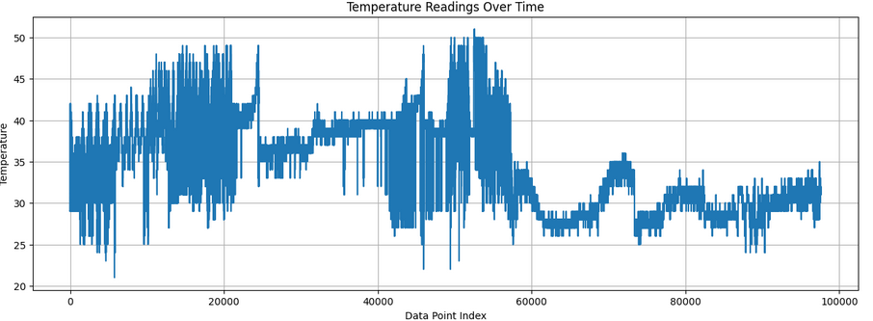
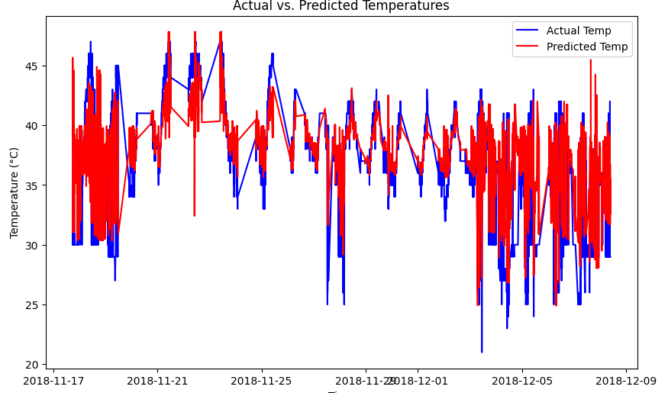

AI-Driven Data Analytics for IIoT
The trickiest part here was making sure the dataset was properly cleaned and tuned for us to test out different scoring metrics.
I used nixtla for training the actual vs predicted temperatures. This model was very expensive and timely to run all the epochs
The model also needed tuning to achieve a better MAE, RMSE, and rsquard score

Slide 6
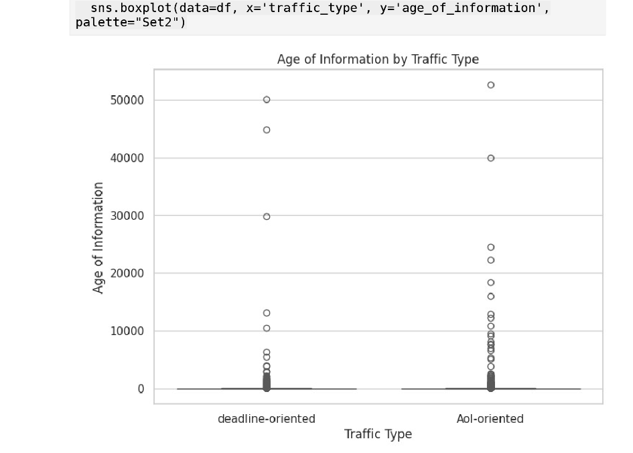
IIoT Network Analysis: Age of Information and Reliability Trade-offs
This was a half conceptual, half practical assignment comparing deadline oriented versus AoI oriented
From what I learned and gathered. Deadline oriented means you need to achieve something asap, where AoI is constant with tons of information. AoI example: cloud based environmental monitoring.
Deadline example: robotic manufacturing.

Slide 7
Thanks for reading!!!

