Slide 1

L06 presentation

Slide 2
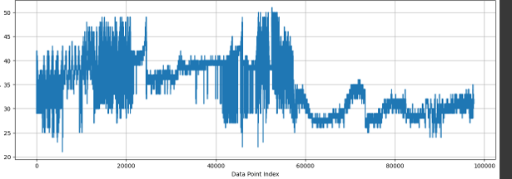
Introduction – Overview of the dataset and problem statement.
The data set is from https://www.kaggle.com/code/koheimuramatsu/iot-temperature-forecasting
No outliers and month/date/year format need to be rearranged.

Slide 3

Hour and temperature lag feature
• Hour Feature:
Reason: The 'hour' feature captures the daily cyclical pattern of temperature (diurnal variation). Temperatures typically rise during the day and drop at night, so knowing the time of day can help the model make more accurate predictions. The hour feature helps account for this regular pattern.
• Temperature Lag Feature:
Reason: The 'temp_lag_1' feature leverages the autocorrelation in temperature data, meaning the temperature at one time is often strongly related to the temperature at the previous time step. By using the previous time step's temperature as a feature, the model can predict the current temperature more accurately. This feature is particularly useful when there is strong temporal dependence, as with weather data.

Slide 4
Why Nixtla
Selected LSTM for sequential data handling
Trained on original + synthetic sequences
Used sequence windows of 128 time steps

Slide 5

Feature Engineering
MAE ≈ 2.5
RMSE ≈ 3.8
Stable trend predictions on test set

Slide 6
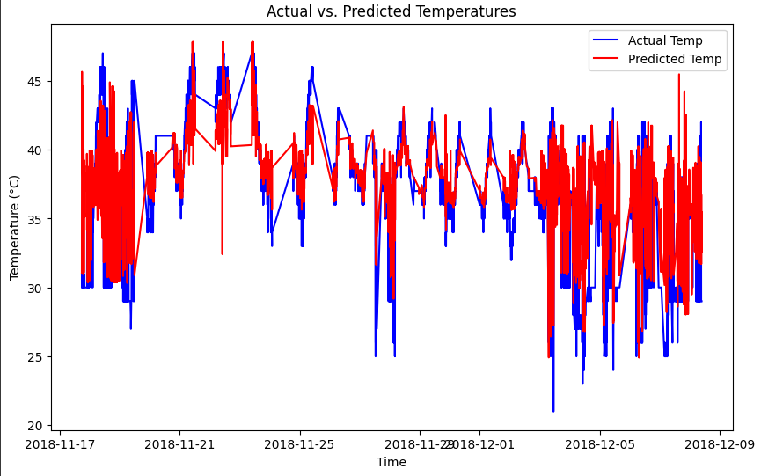
The predicted vs actual temps
The predicted vs actual temps followed the trend visually very well but performed worse in scores.
This is likely due to not being synced up even with the values at the given time 1:1 and there’s some outlier spikes

Slide 7
Evaluation
Lag + time features are critical
VAE-generated data enhances training
LSTM outperforms simpler models in time-series

