Slide 1

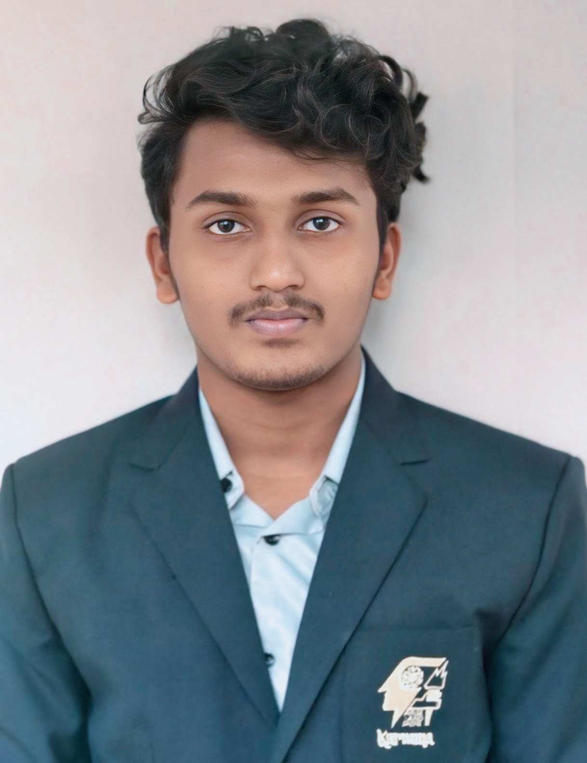
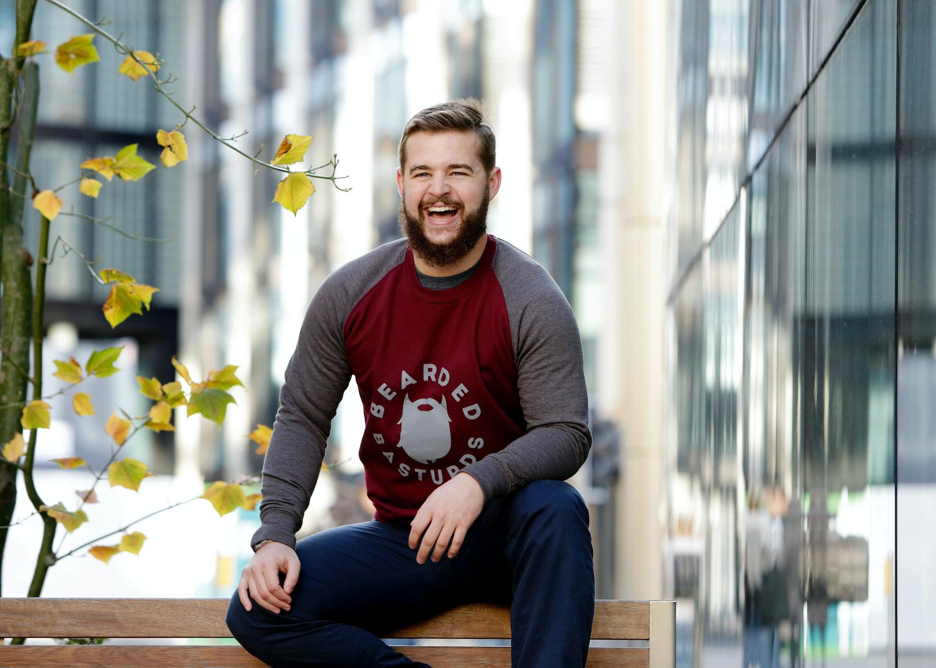


Jerbin M
Education:
KARUNYA INSTITUTE OF TECHNOLOGY AND SCIENCE(KITS)
2024-2028
Bachelor of Technology in Computer Science and Engineering
Profile:
EXPECTED GRADUATION: MAY 2028
Creative and analytical student with a passion for technology. Proven ability to work independently and collaboratively, with strong communication, problem-solving, and time-management skills.
Skills:
• Proficient in programming languages such as C, C++,
and Python.
• Strong understanding of algorithms.
• Experience with web development using technologies such as HTML, CSS, and JavaScript.
• Improved problem-solving and coding skills by actively participating in HackerRank challenges and contests.
• Excellent problem-solving and critical thinking skills.
Contact Information:
Email: jerbin.tech@gmail.com
Phone: 9789316433
Location: Marthandam,
Kanyakumari district,
Tamil Nadu,
India.
Languages:
• English
• Tamil

