Slide 1
READING MAP
The reading connects models, attacks and trust
MODEL INTRODUCTIONS
SURVEYS / REPORT
METHODS / STUDIES
Otter Weather: Skillful and Computationally Efficient Medium-Range Weather Forecasting
How Deep Learning Sees the World: A Survey on Adversarial Attacks & Defenses
Atmospheric Predictability Beyond 30 Days with Machine Learning
Deterministic + probabilistic
Mainly image classification
Reduce error; fixed probabilistic GraphCast
A foundation model for the Earth system (Aurora)
Adversarial Attacks and Defences: A Survey
Adversarial Observations in Weather Forecasting
Deterministic; multiple tasks
Mainly image classification
Probabilistic GenCast attacks
End-to-end data-driven weather prediction (Aardvark)
Explainability and Adversarial Vulnerability in AI-Based Weather Forecasting Systems
FABLE / Forecasting Fails
Deterministic; observations → forecast
Weather security and explainability
Deterministic weather attacks
Boosting Adversarial Attacks with Momentum
Classification; transfer attacks
Reading review • Jerry Meng • 20 October 2026
01
Notes:
The two surveys and MI-FGSM focus mainly on classification.
MI-FGSM: a paper introducing momentum term to FGSM
Otter covers deterministic and probabilistic variants.
Adversarial Observations attacks probabilistic GenCast.
Aurora and Aardvark supply model and evaluation context;
the ECMWF report motivates operational trust.

Slide 2
OTTER WEATHER
Otter offers an accessible bridge to a larger model
Processed ERA5 history • four states • six-hour prediction
Weather fields
→
Swin Transformer U-Net
→
Predicted change + latest state
DETERMINISTIC
PROBABILISTIC
One forecast; weighted RMSE
MC-dropout samples; training using CRPS
QUESTION
Do attacks behave differently for deterministic and probabilistic forecast?
Otter Weather: Skillful and Computationally Efficient Medium-Range Weather Forecasting • arxiv.org/abs/2606.26421
02
Notes:
Otter lowers the computational barrier for competitive weather-model training. Its 87 = 6x13 + 4 + 5input channels include 82 changing fields and five static features.
The newer paper supports deterministic pretraining, CRPS fine-tuning, and CRPS training from scratch. Rollout fine-tuning grows the horizon from 24 to 72 hours. We have reviewed the architecture and local code but have not attacked Otter.

Slide 3
BEYOND 30 DAYS
The same input gradients can reduce or increase error
DETERMINISTIC GRAPHCAST • PROCESSED ERA5 • WEIGHTS FIXED
Their study
Our project
Adjust two ERA5 states to reduce later forecast error.
Adjust allowed inputs to increase forecast error.
Growing optimisation window
2 days → 5 days → 8 days → …
QUESTION
How does attack damage grow beyond one six-hour step?
Atmospheric Predictability Beyond 30 Days with Machine Learning • arxiv.org/abs/2504.20238
03
Notes:
A very useful starting point
Deterministic GraphCast receives two processed ERA5 states.
Adam updates those initial states through repeated forecasts, using known future ERA5 verification.
This is retrospective input optimisation, not model retraining.
Corrections partly transfer to Pangu-Weather; their sample mean resembles strengthened Hadley circulation.
They are not constrained adversarial attacks. Information error and noise error help distinguish forecast information from reduced variability.

Slide 4
ADVERSARIAL OBSERVATIONS
Approximate gradients can target diffusion probabilistic forecasts
Choose a region, then optimise its forecast towards the desired outcome.
S selects the forecast region; V scores it. Minimise V(S(forecast)).
FABRICATE
Maximise regional wind speed, temperature or rainfall.
S: London. V = −minimum wind speed across London.
CONCEAL
Minimise rainfall for a cyclone, or temperature for a heatwave.
S: cyclone region. V = mean predicted rainfall there.
REDIRECT
Minimise: wind at old landfall − wind at chosen landfall.
S: old + chosen landfall. V = wind(old) − wind(chosen).
Extreme-event anomalies: deviations from local seasonal expectations; 99th-percentile threshold.
Detection (§5): assimilated grid = true state + background noise + attack change.
Assumed independent Gaussian terms: variance σᵦ² + ε²; χ² tests against known σᵦ².
Adversarial Observations in Weather Forecasting • arxiv.org/abs/2504.15942
04
Notes:
Propose a novel way to attack probabilistic diffusion model, difficulty with back propagation in diffusion model
Transferability to Otter unsure/unneeded. Aardvark is also currently deterministic.
Interesting way to define target attack.
S: a regional selection function chooses where forecast changes are desired
V: a variable objective specifies the outcome.
Fabrication increases predicted wind, temperature or precipitation. In the explicit wind example, they maximise the minimum wind speed over the selected region.
Concealment minimises predicted rain for a cyclone or temperature for a heatwave.
Redirection minimises wind at the original storm landfall while maximising wind at a selected alternative, expressed as minimising old-site wind minus new-site wind.

Slide 5
FABLE
Target local forecast changes through wavelet penalties
Desired effect: match a regional target; preserve forecasts elsewhere.
Deterministic CLCRN / adapted FourCastNet • processed gridded inputs
1D HAAR EXAMPLE • L = LOW; H = HIGH (FABLE USES TIME + TWO SPATIAL AXES)
[2, 4] → L = (2 + 4)/√2, H = (2 − 4)/√2 → [2, 4]
Minimise: RMSE(target, forecast) + λ ∑_{f} ω_{f} ‖C′_{f} − C_{f}‖₂
FIRST TERM → FAITHFULNESS
SECOND TERM → CLOSENESS / REALISM
Match the regional target; preserve forecasts elsewhere.
Encourage spatial/temporal similarity via coefficient-change penalties.
LLL: broad spatial/temporal structure
HHH: fine spatial/temporal differences
Example: large weight → resist changes here.
Example: small weight → allow changes here.
Separate bound: ‖X′ − X‖∞ ≤ ε caps each input change.
FABLE: A Localized, Targeted Adversarial Attack on Weather Forecasting Models • arxiv.org/abs/2505.12167v2
05
Notes:
FABLE uses deterministic and adapted FourCastNet with processed data.
Localized primarily means a localized desired forecast effect; inputs need not change only in the output target region.
A 3D Haar transform acts over time and space.
The loss combines target RMSE with weighted L2 changes in coefficients; reconstructed inputs are clipped to a Linf bound. Section III evaluates In-AE, Out-AE, input closeness, Moran’s I and temporal autocorrelation. These are plausibility indicators, not proof of atmospheric consistency.

Slide 6
FORECASTING FAILS
Weather Adaptive Adversarial Perturbation Optimization (WAAPO) separates input masks from trajectory penalties
Deterministic FourCastNet • processed ERA5 • white-box
LOSS
Squared target error + L∞ penalty + TV penalty
SOFT PENALTIES
L∞: forecast magnitude; total variation (TV): roughness
HARD RESTRICTIONS
Apply custom spatial and variable-channel masks
Gradient update → custom spatial/channel masks → repeat
Forecasting Fails: Unveiling Evasion Attacks in Weather Prediction Models • arxiv.org/abs/2512.08832
06
Notes:
WAAPO attacks deterministic FourCastNet on ERA5.
The primary term matches a targeted forecast;
Channel and geographical masks are hard restrictions on the initial disturbance
One example makes a 24-hour forecast resemble a five-day state;

Slide 7
AARDVARK
Two routes from grided data attacks to observations
Deterministic model • observations → encoder → weather state → processor → forecast
01
Attack the processor, then search
Find an attacked initial state → search for observations that encode to it.
A matching observation set may not exist within realistic limits.
02
Attack encoder + processor together
Optimise observation changes through the full forecast calculation.
Both routes keep model weights fixed and constrain observation changes.
End-to-end data-driven weather prediction • doi:10.1038/s41586-025-08897-0 • Proposed research, not paper results
11
Notes:
Official paper: End-to-end data-driven weather prediction, Allen et al., Nature2025. This is later research after understanding basic attacks on state-input forecasters. Route1: freeze the processor and optimise its initial weather-state input against a forecast objective. Then search allowed observation changes so the frozen encoder output approximates that attacked state. The encoder is not generally invertible; there may be many solutions or no attainable solution. Route2: compose encoder and processor and differentiate the forecast objective directly with respect to allowed observations, keeping every model weight fixed. The station decoder may also be included if the objective concerns station predictions. Both routes require realistic access, units, budgets and source masks; pre-gridding and quality control must be considered. These are proposals inspired by Aardvark, not adversarial results reported in the paper.

Slide 8
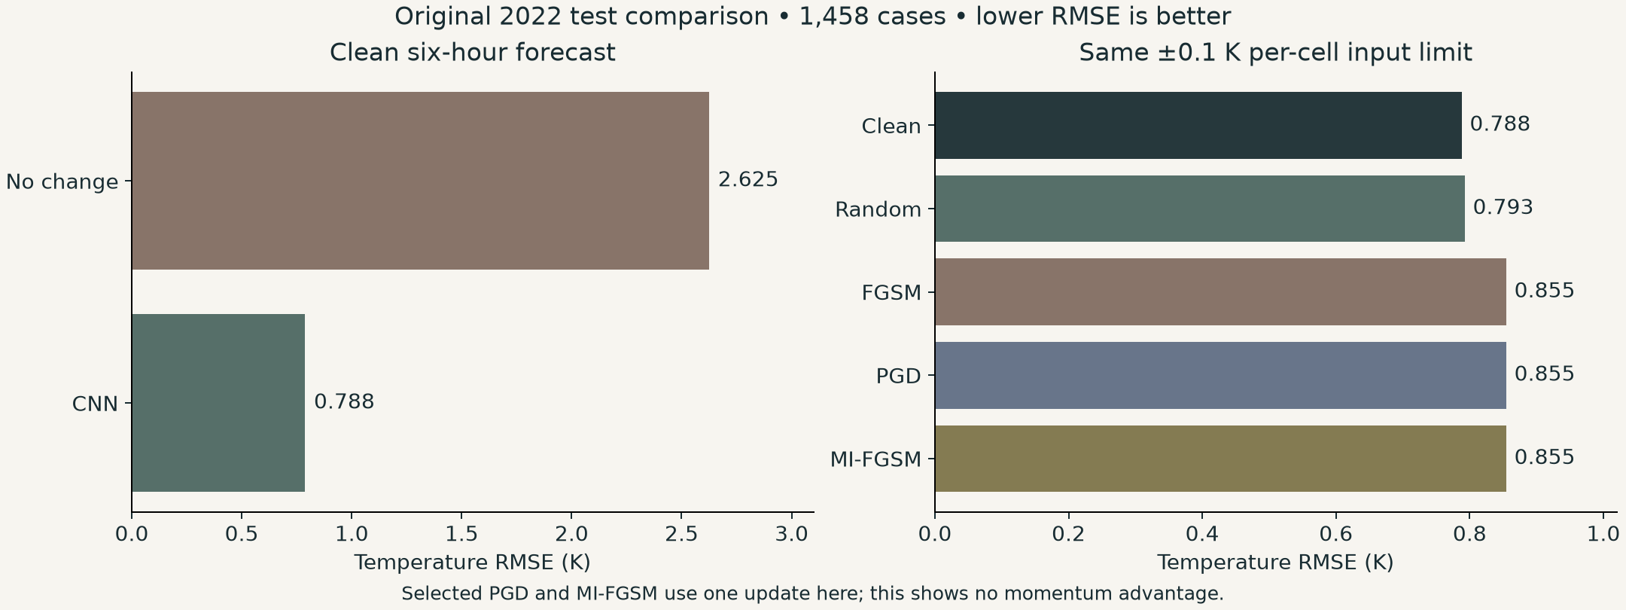
OUR CNN • SIX-HOUR FORECAST
A small five-variable CNN beats no change
Two weather states + four clock maps: [B,14,16,16] → five future maps [B,5,16,16]
5 convolution layers · 64 internal features · predict a correction + current state · 122k weights
40 training epochs · train 2015–20 · validation 2021 · test 2022 · same frozen weights for attacks
Own experiments • test_metrics.json; tuned_attacks_steps/results.csv • exploratory 2022 test
07
Notes:
Five-layer CNN predicts five variables six hours ahead from two weather states plus time channels. Train2015–2020; validation2021; test2022. Clean temperature RMSE .788087 K versus persistence2.625192 K. On1458 test cases, Linf0.1K random noise mean of3 trials scores .792730 K; selected directed attack .854726 K. One-step PGD and MI-FGSM equal FGSM here; no momentum benefit demonstrated. Validation selects effort. Across norms, report maximum cell change and RMS; equal numeric budgets are not equal disturbance sets.2022 had been inspected earlier, so conclusions remain exploratory.

Slide 9
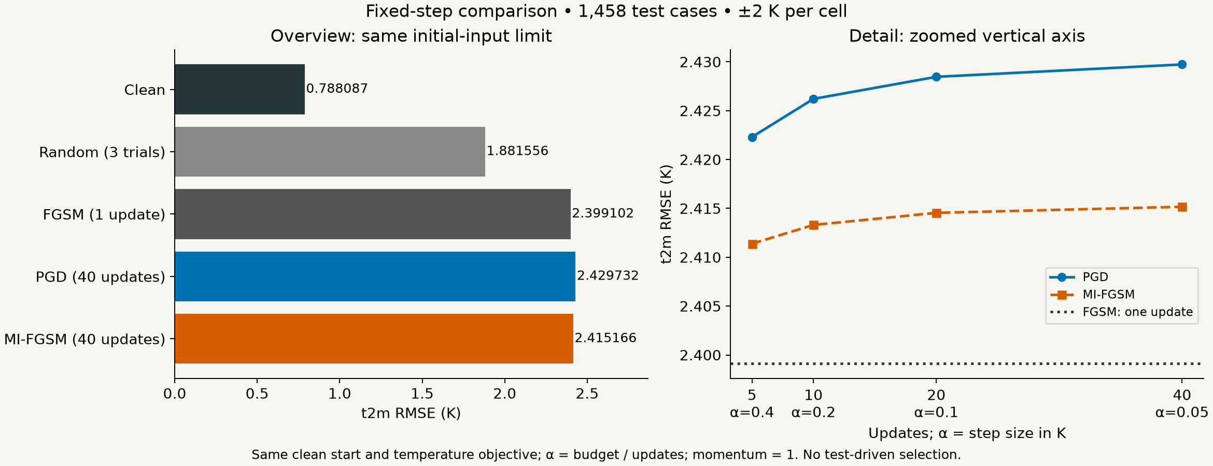
OUR CNN • FIXED-STEP ATTACK COMPARISON
Repeated attacks separate at a looser ±2 K limit
40 updates: PGD adds 0.031 K above FGSM; MI-FGSM adds 0.016 K. Limit is 20× the original.
Own experiments • fixed_step_attacks_2K/ • 1,458 test cases; budget chosen on validation
08
Notes:
All fixed update counts retained: 5/10/20/40, alpha=2/N K, clean starts, one attempt, momentum=1, same T2m six-hour loss. FGSM=2.399101958113472, PGD40=2.4297319862677678, MI40=2.415165611559362 K. Budget selected from 0.25/0.5/1/2 K on 32 validation cases before test scoring. The smallest shared budget meeting predeclared visibility criteria was 2 K; 1K narrowly missed six-hour criterion. This is a 20-fold increase, not a small or physically justified perturbation. All pilot scores retained. Momentum is not guaranteed to outperform PGD.
Earlier notes (original ±0.1 K experiment):
FGSM uses one full-budget sign-gradient update.
PGD and MI-FGSM use 5/10/20/40 updates with alpha=0.1/updates K, same clean starts and temperature-only six-hour loss.
The small budget is a plausible contributor to similar scores:
further updates must stay inside the cell-wise limits and can only adjust the perturbation pattern.
One budget alone does not establish causation; a budget sweep is needed. Momentum provides no benefit over PGD in this run. All 1458 test examples are included; no test-derived setting selection. Exact scores: FGSM 0.8547260917 K,

Slide 10
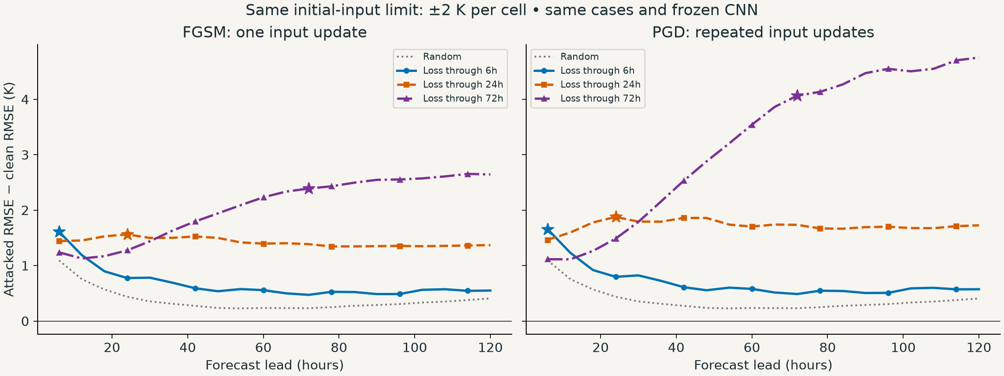
OUR CNN • FORECAST-LOSS WINDOWS
Longer loss windows reveal a larger PGD advantage
Same frozen CNN · ±2 K on initial current T2m only · loss windows: 6 / 24 / 72h
Both panels share the same vertical scale. Stars mark loss-window ends; forecasts continue to 120h.
Own experiments • rollout_windows_2K/ • same 1,439 complete 2022 cases
09

Slide 11
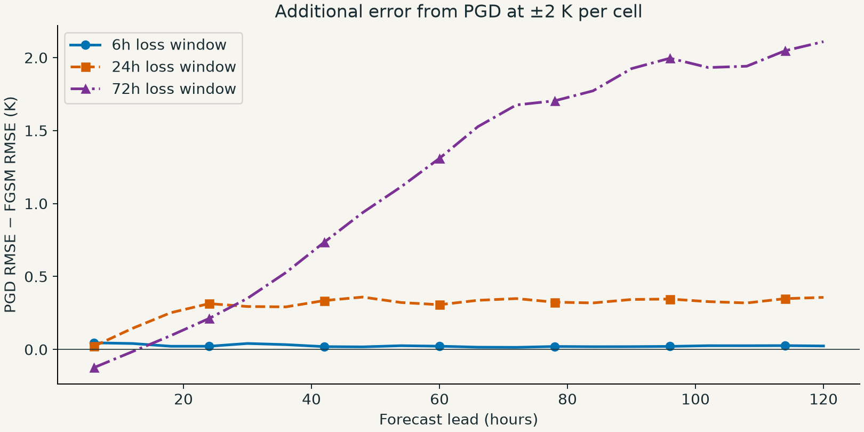
OUR CNN • METHOD DIFFERENCE THROUGH TIME
PGD’s added effect depends on the forecast horizon
72h loss: pooled window RMSE
FGSM: 4.069 K
PGD: 4.923 K
At 120h: PGD − FGSM 2.109 K
Positive = PGD caused more error. The attack optimises a window average, not every lead separately.
Clean 120h RMSE: 4.269 K vs 2.984 K for no change. This CNN was trained only one step ahead.
Own experiments • rollout_windows_2K/window_objective_scores.csv; lead_time_metrics.csv
10

Slide 12
QUESTIONS → NEXT EXPERIMENT
01
Attack based on longer period of loss objective & Targeted attack
02
Physical reasonableness: wavelet transform, additional term in loss function and regional limitation mask
03
Do attacks transfer across models or forecast types?
FIRST
Direct regional target on our CNN
THEN
Compare wavelets / smoothness → prepare Otter
Research plan • inspired by FABLE, Forecasting Fails, Otter and Beyond 30 Days
12
Notes:
Propose a target such as a two-degree warmer forecast at a specified place/time, while preserving the forecast elsewhere. Begin with a simple constrained targeted-loss baseline. Then compare wavelet and smoothness variants under stated input allowances and computational effort. Longer forecast horizons, cross-model transfer and probabilistic CRPS objectives are subsequent questions. No new experiments on these directions are claimed completed.

