Slide 1

LandSlide Detection
Embedded Systems
By
JEREMIAH(URK23CS1218)
NITHISHKUMAR(URK23CS1201)
MAHA DEEPAK(URK23CS1220)

Slide 2
PROBLEM STATEMENT:
Landslides are a significant natural hazard that can cause severe damage to infrastructure, disrupt communities, and result in loss of life. They are often triggered by factors such as heavy rainfall, seismic activity, and human activities, making them unpredictable and challenging to manage. Early detection of landslides can significantly reduce their impact by providing timely warnings and enabling preventative measures.

Slide 3
Objective:
Landslides are a widely recognized phenomenon, causing huge economic and human losses worldwide. The detection of spatial and temporal landslide deformation, together with the acquisition of precursor information, is crucial for hazard prediction and landslide risk management. Advanced landslide monitoring systems based on remote sensing techniques (RSTs) play a crucial role in risk management and provide important support for early warning systems (EWSs) at local and regional scales. The purpose of this article is to present a review of the current state of knowledge in the development of RSTs used for identifying landslide precursors, as well as detecting, monitoring, and predicting landslides. Almost 200 articles from 2010 to 2024 were analyzed, in which the authors utilized RSTs to detect potential precursors for early warning of hazards. The applications, challenges, and trends of RSTs, largely dependent on the type of landslide, deformation pattern, hazards posed by the landslide, and the size of the area of interest, were also discussed. Although the article indicates some limitations of the RSTs used so far, integrating different techniques and technological developments offers the opportunity to create reliable EWSs and improve existing ones. Through comprehensive analysis of multisource data, it enhances understanding of the active landslide process, ultimately contributing to the mitigation of casualties and property damage.

Slide 4
Methodology
This project focus on the development of low cost and efficient IoT based system for the landslide detection and warning system. The system shown here is prototype and number of nodes can be use to cover large area. Arduino board is used in the development of the system along with the vibration sensors, soil moisture sensors and WiFi module. WiFi enables the sensors and board connect to the Internet Service Provider (ISP). All the sensors collect the real time data and with the help of Arduino development board the data is send to the cloud storage ThingSpeak. ThingSpeak by Mathworks uses MATLAB as a powerful tool to analyze the data and present it in the form of graph that can be easily readable. ThingSpeak can act when threshold values reaches and can commute with the third party. The alert is send in the form of SMS to the end user via registered mobile number. There are defined parameters for the threshold values based on the Vibration, Tilt and the moisture present in the soil. It observed that most of the landslides are cause due to the excess pore water pressure present in the soil during heavy rainfall. The expansion and contraction in the soil causes it to fall apart the material on slope due to the gravity and vibrations. These vibrations can be in form of Natural like Earthquakes and can be Human induced like blasting.

Slide 5
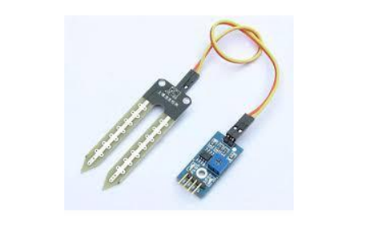
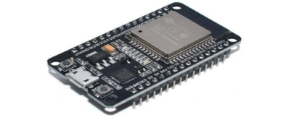
Soil moisture sensor
ESP8266 Node MCU

Slide 6
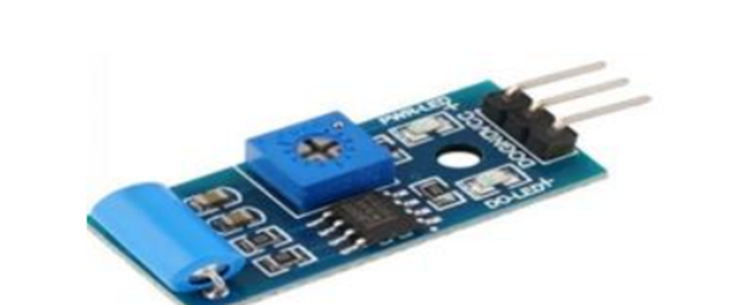
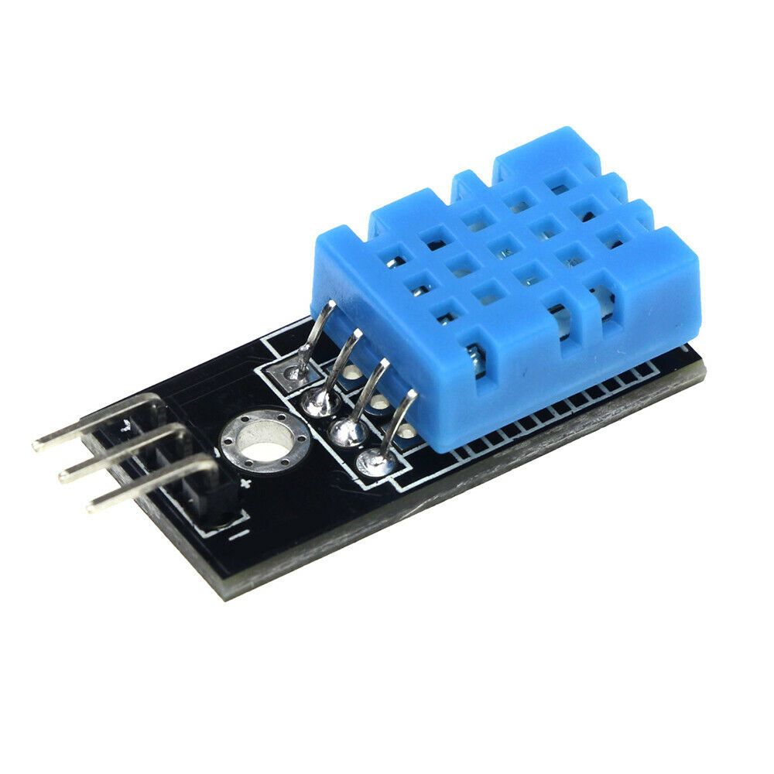
Vibrating sensor
DHT11 TEMP/HUM Sensor

Slide 7
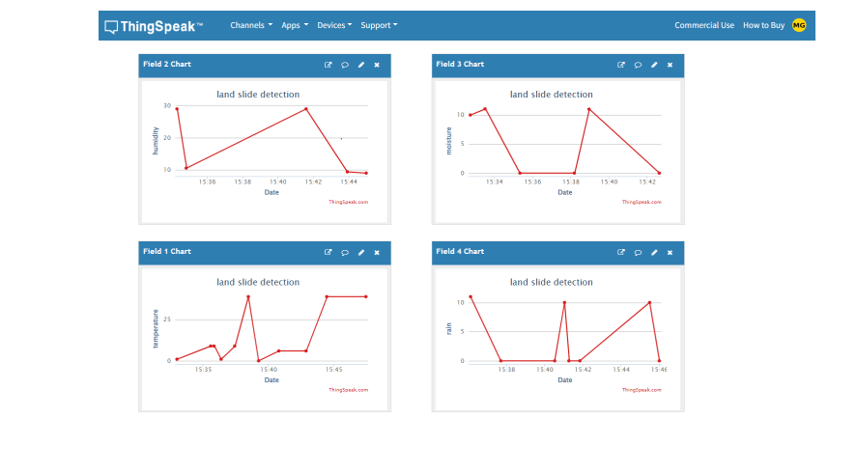
Expected Outcome Envisaged

Slide 8
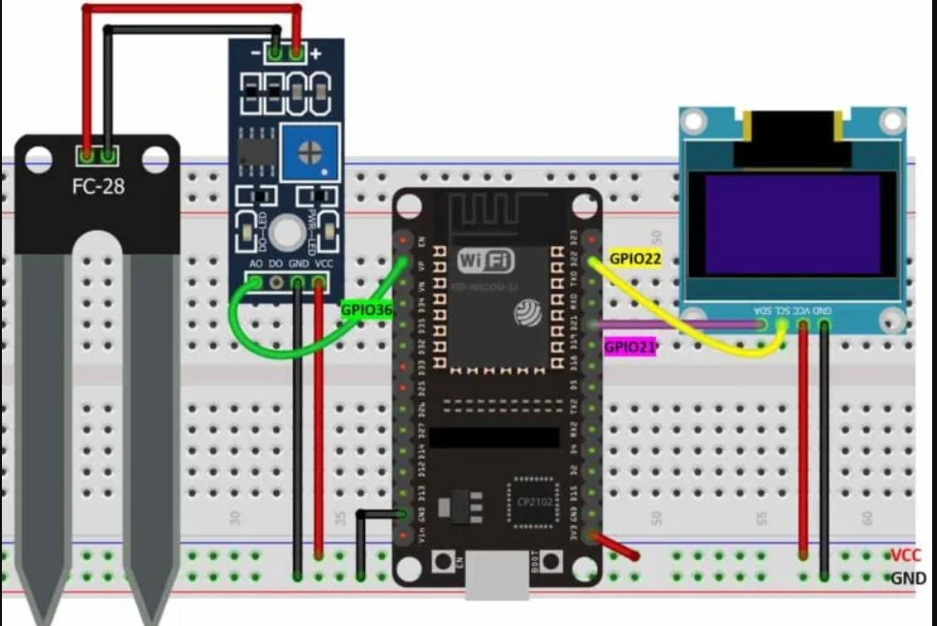
Workplan
Moisture sensors, Tilt sensors as well as vibration sensors connected to the site. These sensors are connected to the arduino development board which is connected to the ThinkSpeak cloud service for monitoring the real time data. These sensors are adjusted to the programmed threshold values with the potentiometer available on the sensor boards. After turning ON the system the sensors on board Wi-Fi module get connected to the Wi-Fi router. After that the sensors get connected to the ThingSpeak cloud service for IoT based projects. ThingSpeak provides a powerful graphic tools that help you to analyze data and can also comute with the third party app from where it can send alerts to the end user. These alerts are sent in the form of SMS to the registered mobile number on the end user mobile phone. The test shows that the system, is working properly and is able to detect the earthquake vibrations as well as moistures present in the soil and can act according to the threshold values.

Slide 9
THANK YOU
By
JEREMIAH(URK23CS1218)
NITHISH KUMAR(URK23CS1201)
MAHA DEEPAK(URK23CS1220)

