Slide 1
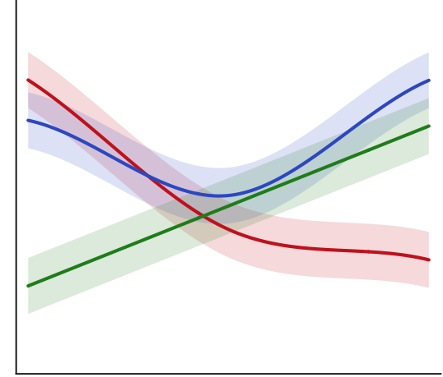
Chunk text | Generation | Control | Dimension n
Wait, I need to be careful here. | 0 | 57 | 78
They’re not blood relatives, so it may be ethical? | 42 | 0 | 0
Hey but if he has a widow, he is not alive! | 60 | 82 | 12
Speech-to-text
transcription
Verbal transcript:
“Wait, I need to be careful here. They’re not blood relatives, so it may be ethical? Hey but if he has a widow, he is not alive!”
LLM chunking
and scoring
Statistical modeling
Reasoning question:
Would it be ethical for a man to marry the sister of his widow?
Human validation
Time

