Slide 1
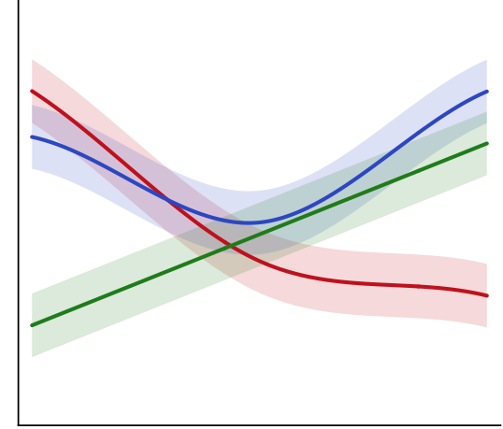
Speech-to-text
transcription
Reasoning question:
Would it be ethical for a man to marry the sister of his widow?
Verbal transcript:
“Wait, I need to be careful here. They’re not blood relatives, so it may be ethical? Hey but if he has a widow, he is not alive!”
LLM chunking and scoring
Chunk text | Generation | Control | Dimension n
Wait, I need to be careful here. | 0 | 57 | 78
They’re not blood relatives, so it may be ethical? | 42 | 0 | 0
Hey but if he has a widow, he is not alive! | 60 | 82 | 12
Statistical modeling
Time
Human validation

