Slide 1
An quick introduction to MLFLOW

Slide 2
What is MLflow?
MLflow is an open source platform to manage the ML lifecycle, including experimentation, reproducibility, deployment, and a central model registry. MLflow currently offers four components:
Tracking: saving parameters and results for each run.
Model: Deploy and serve your model
Project: Package your model so that it can be run on any platform
Registry: MLflow's registry to store and manage models

Slide 3
TABLE OF CONTENTS
MLFLOW UI
01
02
ARTIFACTS
PLOTS
03
04
MODEL VERSIONING
An interactive UI to track your runs
Metrics plots

Slide 4
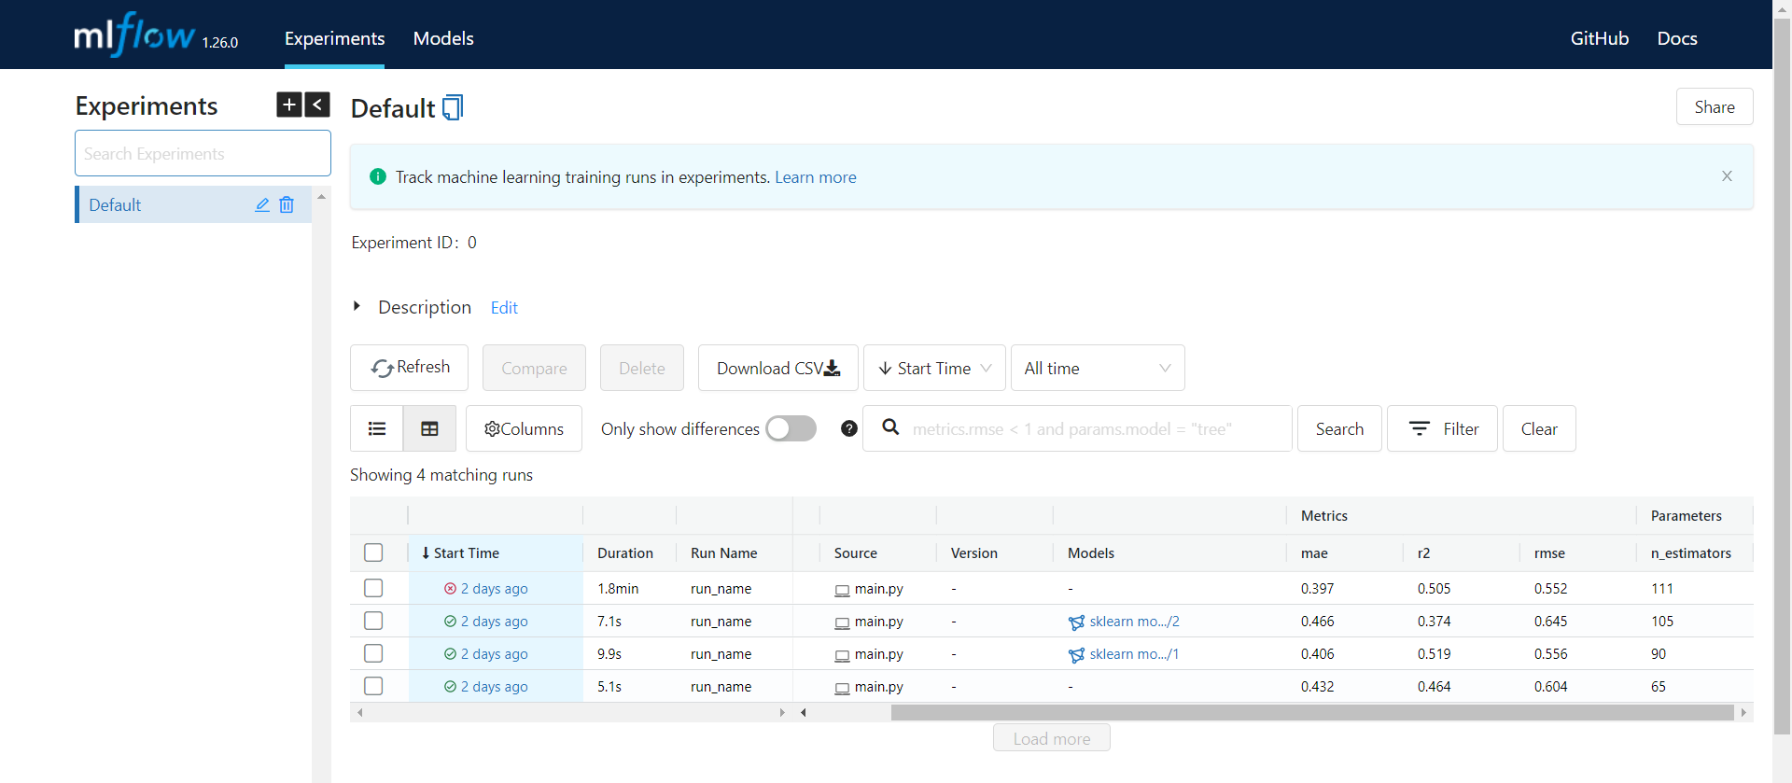
MLflow UI

Slide 5
Artifacts
Artifacts are additional files that you can log and save on the server along with the run (e.g. text, images, or the model itself).

Slide 6

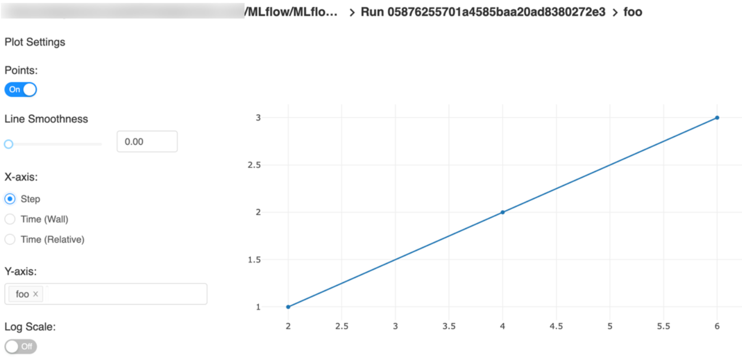
Plots

Slide 7
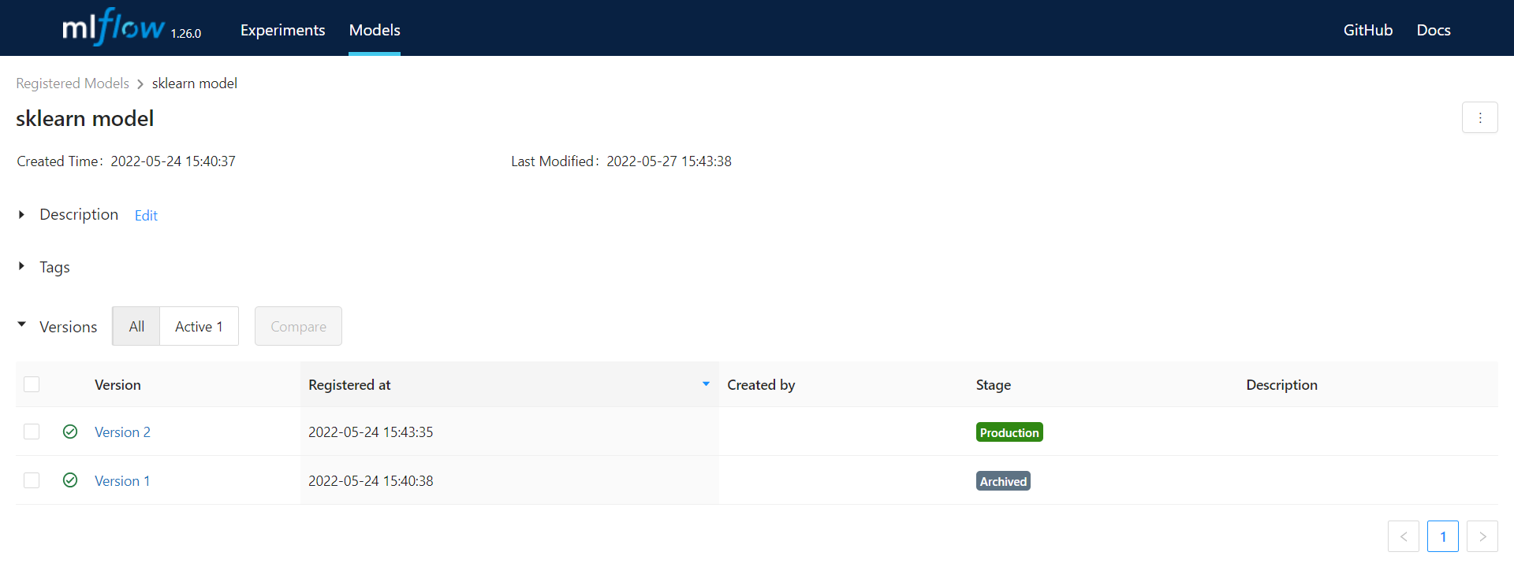
Model versioning

