Slide 1
Design Space Exploration for Power-Efficient Mixed-Radix Ling Adders
Chung-Kuan Cheng
Computer Science and Engineering Depart. University of California, San Diego

Slide 2
Outline
Prefix Adder Problem
  Background & Previous Work
  Extensions: High-radix, Ling
Our Work
  Area/Timing/Power Models
  Mixed-Radix (2,3,4) Adders
  ILP Formulation
Experimental Results
Future Work

Slide 3
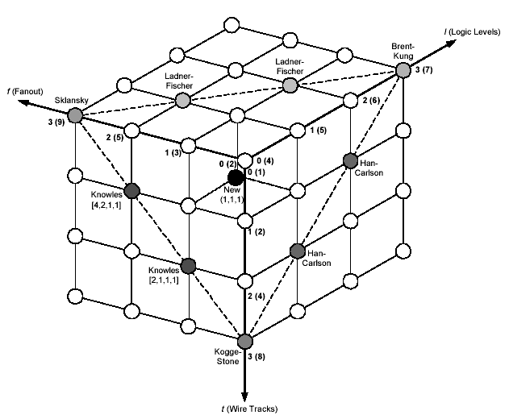
Prefix Adder – Challenges
Increasing impact of physical design
and concern of power.
Power
Power gating
Dynamic power
New Design Scope
Activity Probability
Static power
Logical Levels
Fanouts
Gate Cap
Wire Cap
Wire Tracks
Input arrival time
Output require time
Physical placement
Buffer insertion
Gate sizing
Detail routing
Signal slope
Area
Timing

Slide 4



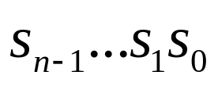

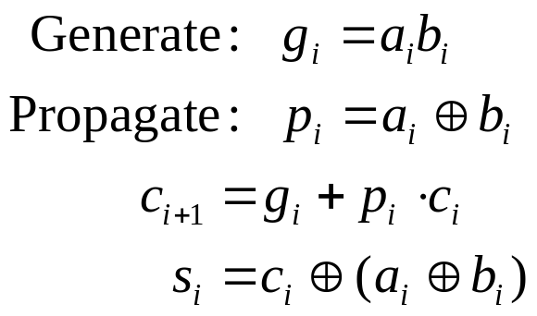
Binary Addition
Input: two n-bit binary numbers and , one bit carry-in
Output: n-bit sum and one bit carry out
Prefix Addition: Carry generation & propagation

Slide 5
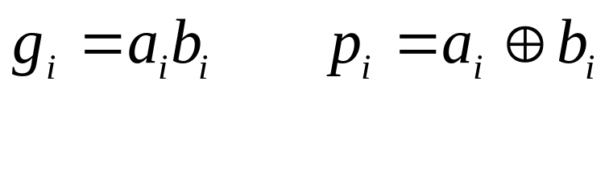
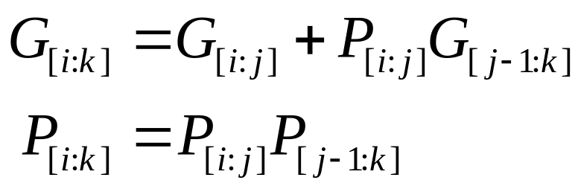
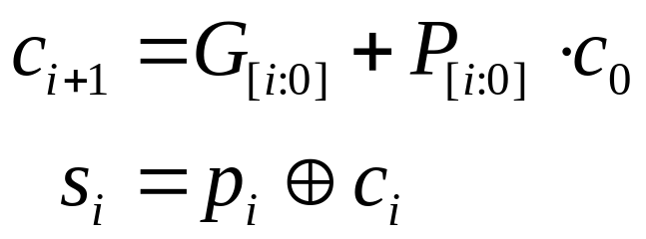
Prefix Addition – Formulation
Pre-processing:
Prefix Computation:
Post-processing:

Slide 6
Prefix Adder – Prefix Structure Graph
4
3
2
1
a_{i}
b_{i}
Pre-processing
gp_{i}
gp generator
GP_{[i, j]}
GP_{[j-1, k]}
Prefix Computation
GP_{[i, k]}
GP cell
G_{[i:0]}
Post-processing
p_{i}
4:1
3:1
2:1
1
s_{i}
sum generator

Slide 7
Previous Works – Classical prefix adders
8
7
6
5
4
3
2
1
8
7
6
5
4
3
2
1
8
7
6
5
4
3
2
1
8:1
7:1
6:1
5:1
4:1
3:1
2:1
1
8:1
7:1
6:1
5:1
4:1
3:1
2:1
1
8:1
7:1
6:1
5:1
4:1
3:1
2:1
1
Brent-Kung:
Logical levels: 2log₂n–1
Max fanouts: 2
Wire tracks: 1
Sklansky:
Logical levels: log₂n
Max fanouts: n/2
Wire tracks: 1
Kogge-Stone:
Logical levels: log₂n
Max fanouts: 2
Wire tracks: n/2

Slide 8
High-Radix Adders
Each cell has more than two fan-in’s
Pros: less logic levels
  6 levels (radix-2) vs. 3 levels (radix-4) for 64-bit addition
Cons: larger delay and power in each cell

Slide 9
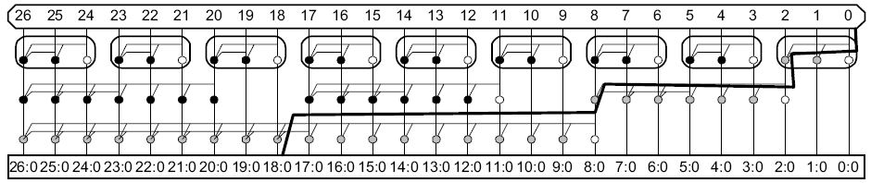
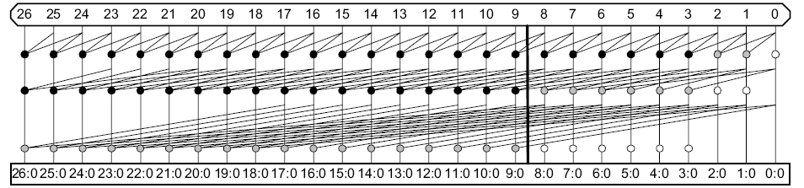
Radix-3 Sklansky & Kogge-Stone Adder
David Harris, “Logical Effort of Higher Valency Adders”

Slide 10
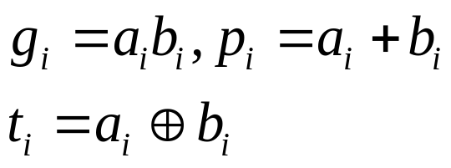
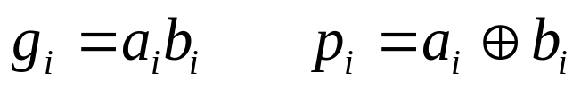



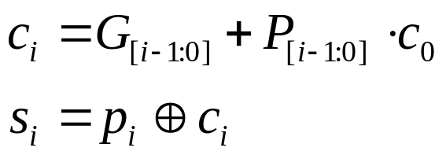


Ling Adders
Prefix
Ling
Pre-processing:
Prefix Computation:
Post-processing:

Slide 11
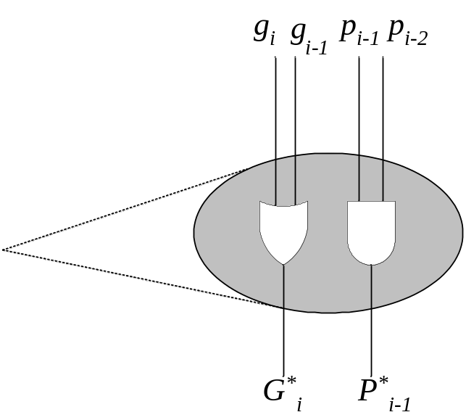
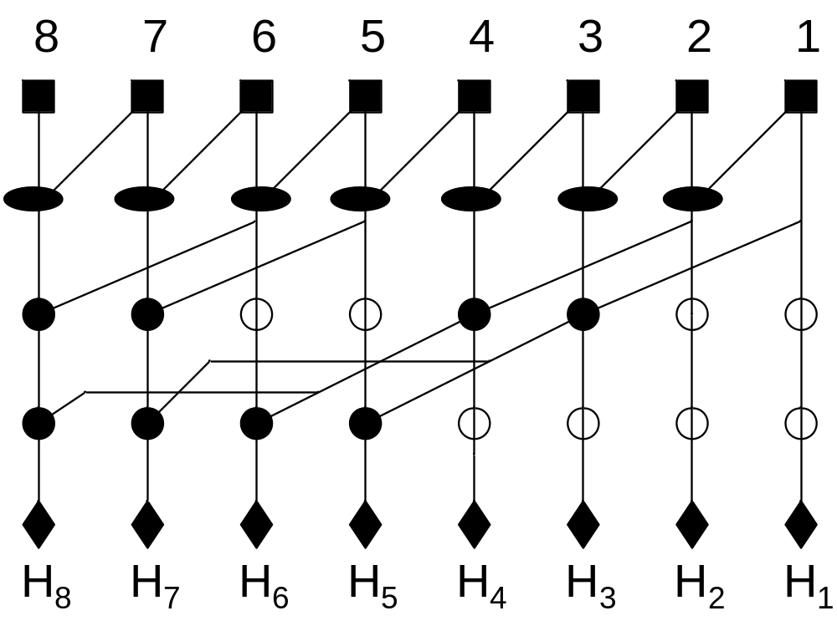
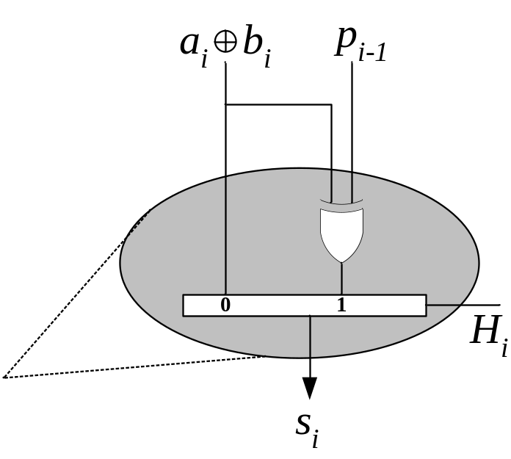
An 8-bit Ling Adder

Slide 12
Area Model
Distinguish physical placement from logical structure, but keep the bit-slice structure.
Bit position
Bit position
Logical level
8
7
6
5
4
3
2
1
8
7
6
5
4
3
2
1
Physical level
Logical view
Physical view
Compact placement

Slide 13
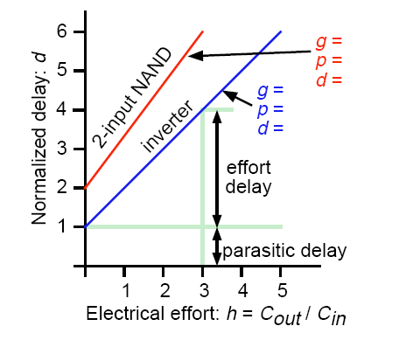
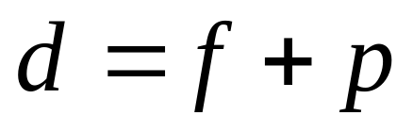
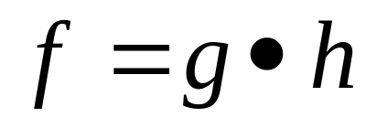
Timing Model
Cell delay calculation:
Effort Delay
Intrinsic Delay
Electrical Effort = Cout/Cin
= (fanouts+wirelength) / size
Logical Effort
Intrinsic properties of the cell

Slide 14
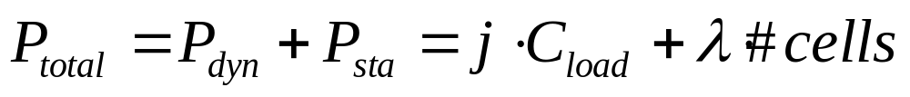
Power Model
Total power consumption:
Dynamic power + Static Power
Static power: leakage current of device
P_{sta} = λ*#cells
Dynamic power: current switching capacitance
P_{dyn} = ρ × C_{load}
ρ is the switching probability
ρ = j (j is the logical level*)
* Vanichayobon S, etc, “Power-speed Trade-off in Parallel Prefix Circuits”

Slide 15
ILP Formulation Overview
Structure variables:
GP cells
Connections (wires)
Physical positions
Capacitance variables:
Gate cap
Vertical wire cap
Horizontal wire cap
ILP
Power Objective
ILOG CPLEX
Timing variables:
Input arrival time
Output arrival time
Optimal Solution

Slide 16
Integer Linear Programming (ILP)
ILP: Linear Programming with integer variables.
Difficulties and techniques:
  Constraints are not linear
    Linearize using pseudo linear constraints
  Search Space too large
    Reduce search space
  Search is slow
    Add redundant constraints to speedup

Slide 17
ILP – Integer Linear Programming
Linear Programming: linear constraints, linear objective, fractional variables.
Integer Linear Programming: Linear Programming with integer variables.
Constraints
LP Optimal
ILP Optimal

Slide 18
ILP – Pseudo-Linear Constraint
A constraint is called pseudo-linear if it’s not effective until some integer variables are fixed.
Problem:
ILP formulation:
Minimize: x₃
Subject to: x₁ ≥ 300
x₂ ≥ 500
x₃ = min(x₁, x₂)
Minimize: x₃
Subject to: x₁ ≥ 300
x₂ ≥ 500
x₃ ≤ x₁
x₃ ≤ x₂
x₃ ≥ x₁ – 1000 b₁ (1)
x₃ ≥ x₂ – 1000 (1 – b₁) (2)
b₁ is binary
LP objective: 0
ILP objective: 300
Pseudo-linear constraints mostly arise from IF/ELSE scenarios
  binary decision variables are introduced to indicate true or false.

Slide 19
ILP Solver Search Procedure
Minimize F(b₁, b₂, b₃, b₄, f₁,…) b_{i} is binary
Root (all vars are fractional)
0
‘0’
‘1’
Cut
2
4
4
b₁
‘0’
‘1’
‘0’
‘1’
infeasible
2
5
5
b₂
‘0’
‘1’
3
2
2
Bound
(Smallest candidate)
b₃
‘0’
‘1’
feasible
(current best)
3
infeasible
b₄
It is VERY helpful if ILP objective is close to LP objective

Slide 20
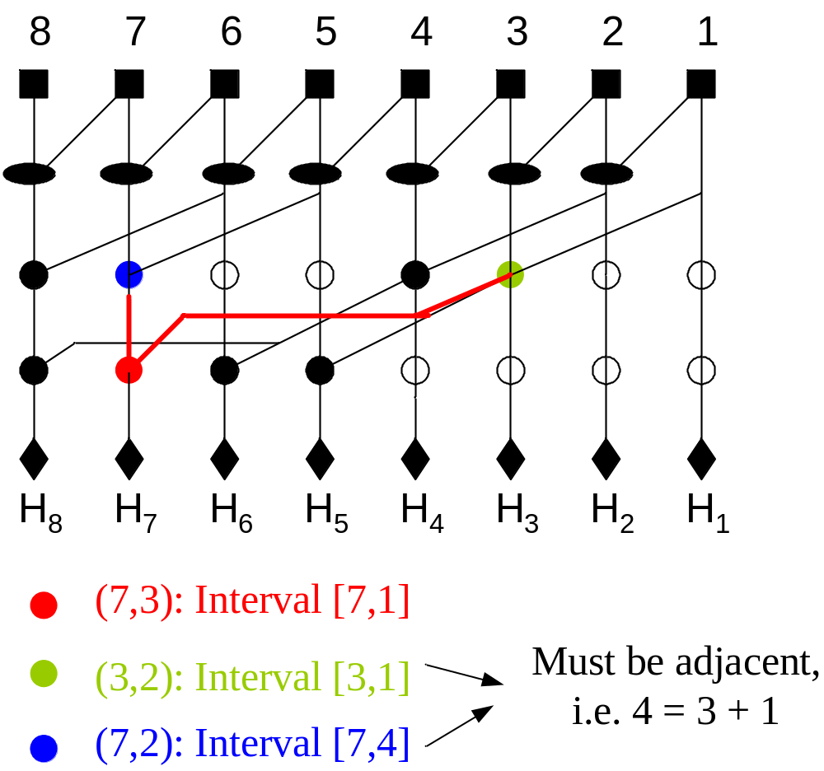
Interval Adjacency Constraint
(column id, logic level)

Slide 21




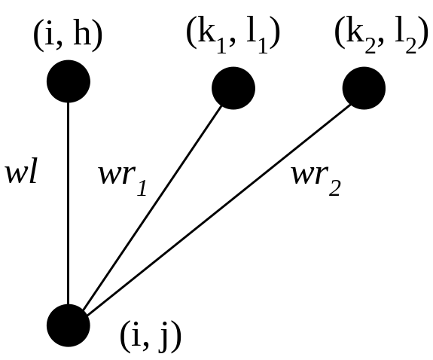
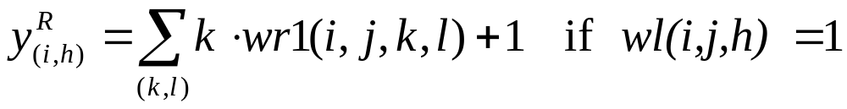
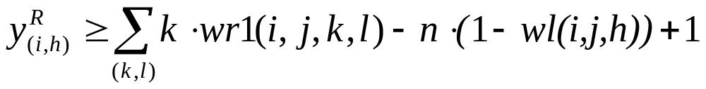
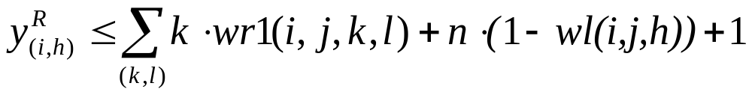

Linearization for Interval Adjacency Constraint
Left interval bound equal to column index
Linearize
Pseudo Linear

Slide 22
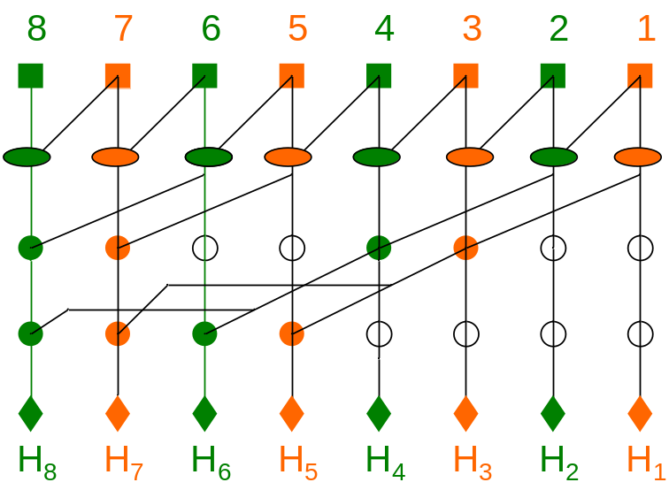
Search Space Reduction
Ling’s adder: separate odd and even bits
Double the bit-width we are able to search

Slide 23
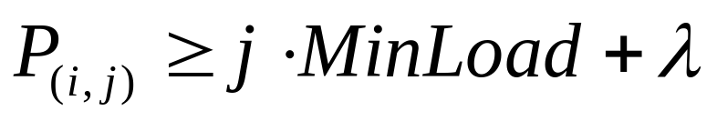
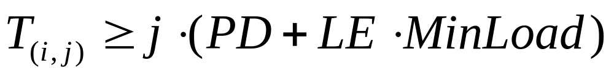
Redundant Constraints
Cell (i,j) is known to have logic level j before wire connection
Assume load is MinLoad (fanout=1 with minimum wire length):
Cell (i,j) has a path of length j-1
Assume each cell along the path has MinLoad

Slide 24
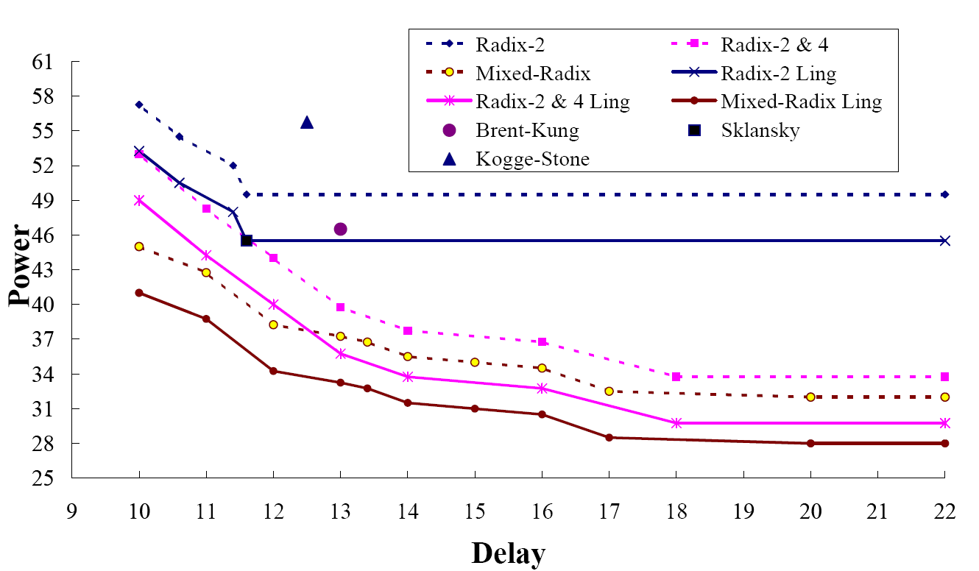
Experiments
– 16-bit Uniform Timing

Slide 25
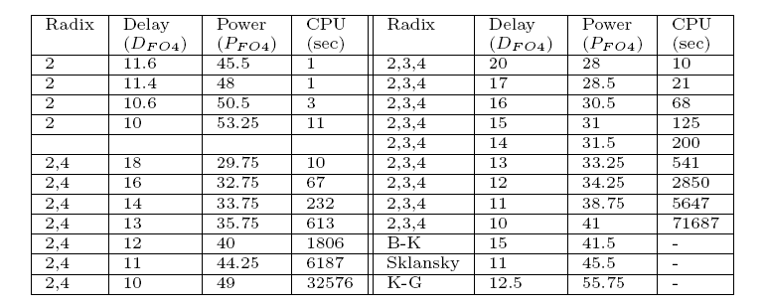
Experiments
– 16-bit Uniform Timing

Slide 26
Min-Power Radix-2 Adder (delay= 22, power = 45.5FO4 )
16
15
14
13
12
11
10
9
8
7
6
5
4
3
2
1
16
15
14
13
12
11
10
9
8
7
6
5
4
3
2
1

Slide 27
Min-Power Radix-2&4 Adder (delay=18, power = 29.75FO4 )
16
15
14
13
12
11
10
9
8
7
6
5
4
3
2
1
16
15
14
13
12
11
10
9
8
7
6
5
4
3
2
1
Radix-2 Cell
Radix-4 Cell

Slide 28
Min-Power Mixed-Radix Adder (delay=20, power = 28.0FO4)
16
15
14
13
12
11
10
9
8
7
6
5
4
3
2
1
16
15
14
13
12
11
10
9
8
7
6
5
4
3
2
1
Radix-2 Cell
Radix-3 Cell
Radix-4 Cell

Slide 29
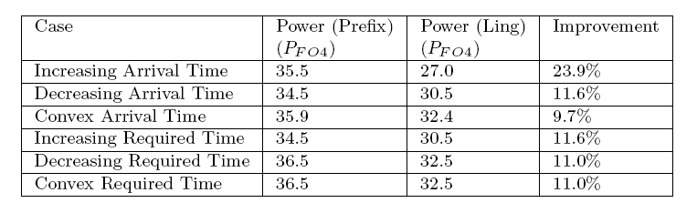
Experiments – 16-bit Non-uniform Time (Mixed Radix)
ILP is able to handle non-uniform timings
Ling adders are most superior in increasing arrival time
– faster carries

Slide 30
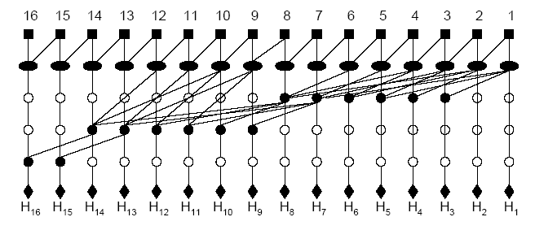
Increasing Arrival Time
(delay=35.5, power = 27.0FO4 )

Slide 31
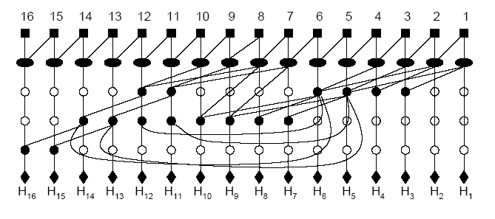
Decreasing Arrival Time (delay=34.5, power = 30.5FO4)

Slide 32
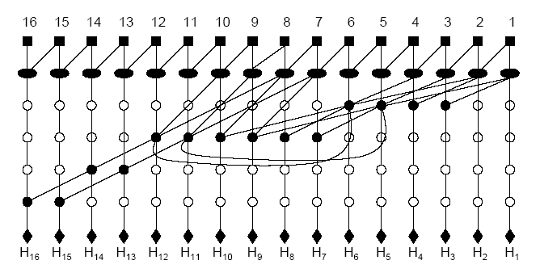
Convex Arrival Time
(delay=35.9, power = 32.4FO4 )

Slide 33
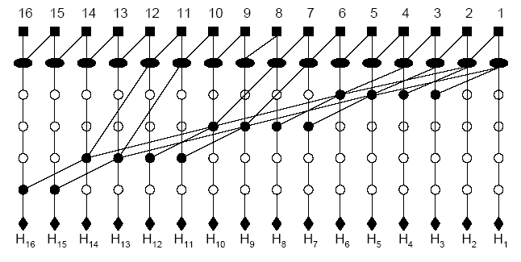
Increasing Required Time (delay=34.5, power = 30.5FO4)

Slide 34
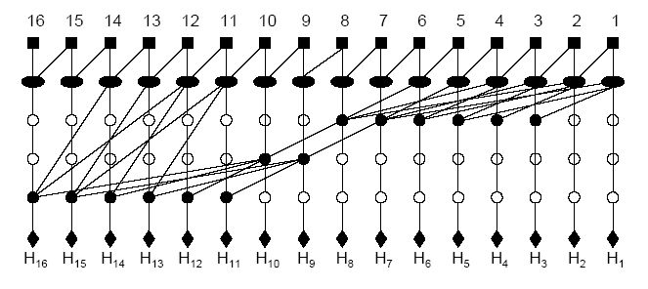
Decreasing Required Time (delay=36.5, power = 32.5FO4)

Slide 35
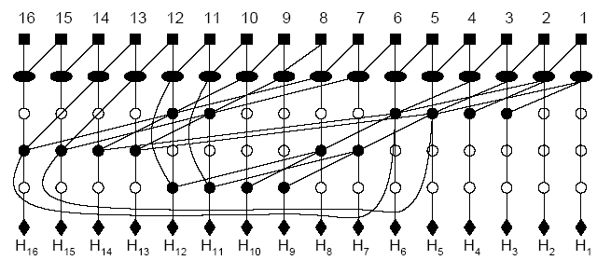
Convex Required Time
(delay=36.5, power = 32.5FO4)

Slide 36
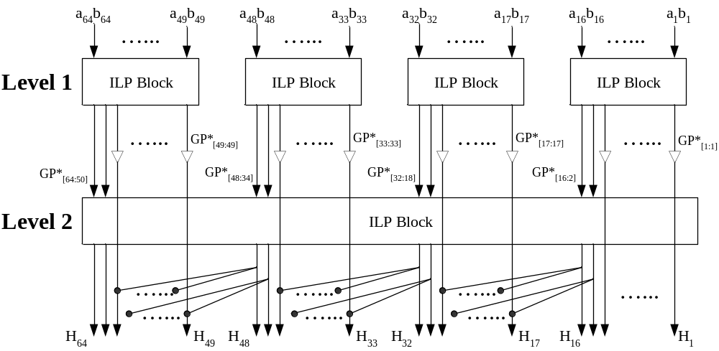
Experiments – 64-bit Hierarchical Structure (Mixed-Radix)
Handle high bit-width applications
16x4 and 8x8

Slide 37
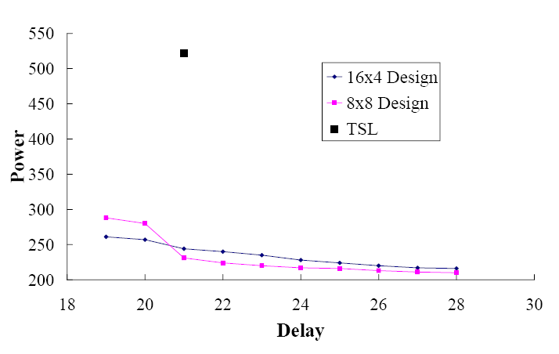
Experiments – 64-bit Hierarchical Structure
TSL: a 64-bit high-radix three-stage Ling adder
V. Oklobdzija and B. Zeydel, “Energy-Delay Characteristics of CMOS Adders”,
in High-Performance Energy-Efficient Microprocessor Design, pp. 147-170, 2006

Slide 38
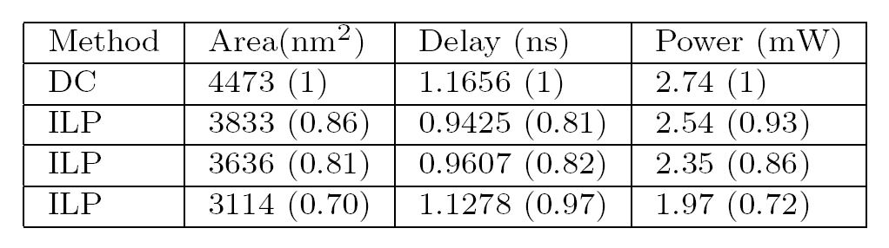
ASIC Implementation - Results
64-bit hierarchical design (mixed-radix) by ILP vs. fast carry look-ahead adder by Synopsys Design Compiler
TSMC 90nm standard cell library was used

Slide 39
Future Work
ILP formulation improvement
  Expected to handle 32 or 64 bit applications without hierarchical scheme
Optimizing other computer arithmetic modules
  Comparator, Multiplier

Slide 40
Q & A
Thank You!

