Slide 1
Patterning Aware Design Optimization of Selective Etching in N5 and Beyond
Yibo Lin¹, Peter Debacker², Darko Trivkovic²,
Ryoung-Han Kim², Praveen Raghavan², David Z. Pan¹
¹ECE Department, University of Texas at Austin
²IMEC, Leuven, Belgium
Notes:
Hi everyone, my presentation is about …
I’m Yibo Lin from …
1

Slide 2


Conventional Blocks v.s. Self-Aligned Blocks (SAB)
Two approaches to obtain equivalent patterns
Conventional blocks
SAB enabled by selective etching
Process variation
EPE margin $=\frac{1}{4}P$
EPE margin $=\frac{3}{4}P$
EPE margin: margin to tolerate edge placement error
Notes:
In this work, we focus on the manufacturing of blocks/cuts with/without selective etching. We denote blocks without selective etching as conventional blocks and those with selective etching as SAB. Here are two block patterns that will result in the equivalent printed lines. You may be familiar with conventional blocks which trim off lines. In SAB, lines are manufactured with alternative materials A and B, which can only be trimed off by their own specific blocks. In other words, the light blue blocks only trim off material A and the light green blocks only trim off material B.
Due to process variation, the block end may shift. %to trim off neighboring lines or fail to trim off the target lines completely.
Thus it is necessary to leave enough margin for block end variation.
We define EPE margin as the maximum tolerance to the block end variation.
For conventional blocks, the best EPE margin can be 1/4 P if we leave the block end at the middle of two lines, while for SAB the EPE margin can go up to 3/4 P due to the selectivity over materials.

Slide 3
Problem Formulation
How large is the design space for SAB?
How to enable fast design closure for SAB?
Design rule exploration
Given lithography options of SAB and technology definitions
e.g., pitches and lithography spacing for blocks
Define design rules with maximum solution space for design closure
SAB mask optimization
Given a set of design rules and designs
Optimize blocks by redistribution to remove design rule violations
Perform layout decomposition of blocks
Minimize cost of redistribution, such as total line end extension
Notes:
Despite the benefit in EPE margin, it is not yet clear that how large is the design space for SAB? How to enable fast design closure for SAB? In other words, by utilizing the large EPE margin of SAB, whether we can relax some design rules to enable larger design space and faster design closure.
We first need to explore the possible design rules to satisfy existing technology definitions such as pitches and lithography spacing.
Then we need to evaluate the design space of proposed rules.
This is done by adding a post optimization stage for SAB to the existing physical design flow to see how many violations left.
%as we can remove design rule violations in post stages by line end extension.

Slide 4
Patterns That Cause Conflicts
4 types of patterns that may result in conflicts
Spacing rules
Parallel
Abutting
Stacking
Diagonal
Notes:
To develop design rules, we first examine all the possible patterns that may cause conflicts. We take SABs for material A as an example. All conflicts come from 4 types of patterns. We name them as parallel, abutting, stacking, and diagonal.
Each type of patterns has a corresponding distance requirement. The design rule exploration focuses on how large these required distances dp, da, ds, dh need to be to satisfy current technology definitions, say line pitch, lithography resolution, minimum area constraints, etc.

Slide 5

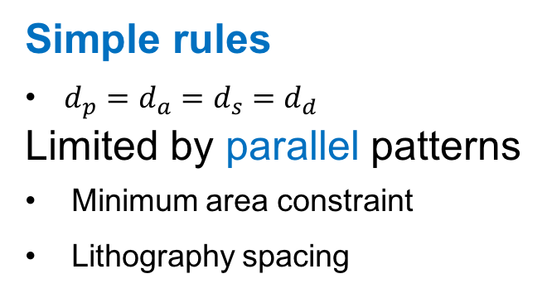
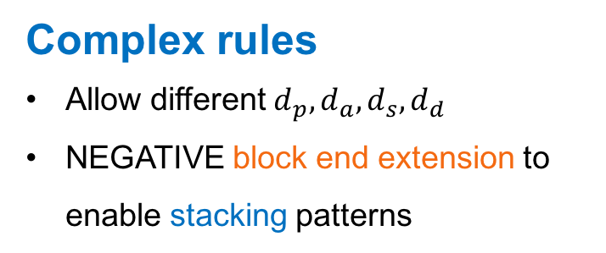
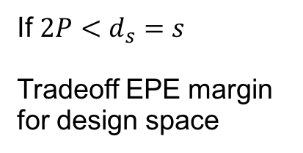
Simple and Complex Rules for SAB
Link design rules to line pitch $P$ and lithography spacing $s$
Simple rules
$d_{p}=d_{a}=d_{s}=d_{d}$
Limited by parallel patterns
Minimum area constraint
Lithography spacing
Complex rules
Allow different $d_{p},d_{a},d_{s},d_{d}$
NEGATIVE block end extension to enable stacking patterns
Minimum area constraint
If $2P<d_{s}=s$
Tradeoff EPE margin for design space
Parallel
Stacking
Notes:
%We try to link our rules to technology definitions, such as line pitch P and lithography spacing s.
A straight-forward rule is to set identical distances for different types of patterns, which means all the distances should be large enough. In such a configuration, the minimum distance is limited by parallel patterns in N7/N5, since both minimum area constraint and lithography spacing need to be satisfied.
However, if we allow different required distances according to different patterns. The required distances for other patterns like abutting patterns, stacking patterns and diagonal patterns can be even reduced. Furthermore, as SAB enables larger EPE margin, we can tradeoff some margin for design space. That is, if 2P < ds where stacking patterns cause conflicts, we allow to push back block end to resolve the conflicts. We call it block end extension. Be aware that this is negative extension. This set of rules is named as complex rules.

Slide 6
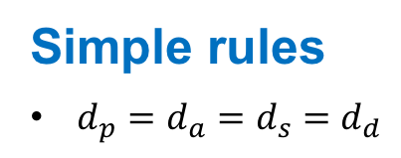
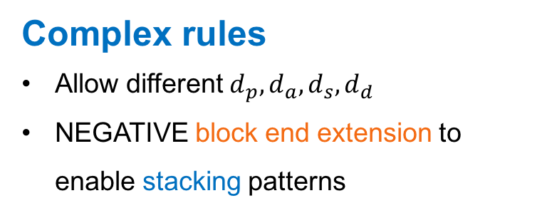
Simple and Complex Rules for SAB
Link design rules to line pitch $P$ and lithography spacing $s$
Simple rules
$d_{p}=d_{a}=d_{s}=d_{d}$
Complex rules
Allow different $d_{p},d_{a},d_{s},d_{d}$
NEGATIVE block end extension to enable stacking patterns
Assume 8nm EPE margin required [Han+,SPIE2016]
Approx. N5
Can complex rules enable larger design space than simple rules?
Notes:
With these two sets of rules, we can quickly evaluate their impacts on EPE margin with different pitches and lithography spacing. We consider the pitch ranges from 36nm to 24nm and lithography spacing ranges from 84nm to 80nm. According to the previous work, assume that 8nm EPE margin is required under current lithography technology. All margins satisfy minimum EPE margin are highlighted. We can see for both simple and complex rules, SAB has a wider range of acceptable margin than that of conventional blocks. Conventional blocks stop to satisfy 8nm margin at 28nm pitch, while SAB can go further. Complex rules result in smaller margin than do simple rules due to block end extension. But in the pitch around 32nm, it is still a viable solution.
Next, we will evaluate how much more design space can be achieved by complex rules.

Slide 7
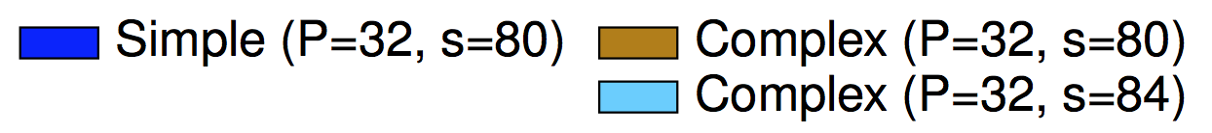
SAB Optimization
SAB redistribution to resolve conflicts
A post optimization stage in existing physical design flow
Simple rules v.s. complex rules
Simple rules results in 22x more final conflicts than complex rules
Relaxing lithography spacing results in 10% more final conflicts
#icn: # of initial conflicts
#cn: # of final conflicts
Notes:
A post block mask optimization is developed and integrated in the existing physical design flow to evaluate the design space. We compare simple and complex rules with different lithography spacing under 32nm pitch, which is a promising setting for N5. The figure plots the average initial conflicts and final conflicts in the designs. While the optimization reduces the amount of conflicts effectively, complex rules enable much fewer conflicts than do simple rules, i.e., 22x fewer. Also, smaller lithography spacing like 80nm achieves 10% fewer conflicts for complex rules.

Slide 8
Conclusion
Design space exploration for SAB
Design rules scalable with pitches and lithography spacing
Post optimization for SAB
Impacts of design rules to design closure
SAB is a promising and feasible option for N5 and beyond
Provide insights to the further advancement of manufacturing process
Future work
SAB friendly design flow
Early stage consideration of SAB rules

Slide 9
Thank you

Slide 10
Outline
8/31/15
10
Introduction
Problem Formulation
SAB Design Rule Exploration
SAB Optimization
Conclusion
Notes:
10

Slide 11

1-D Gridded Layout – Lines and Blocks
Conventional blocks (cuts)
Process variation
$$=\frac{1}{4}P$$
EPE margin: margin to tolerate edge placement error

Slide 12
1-D Gridded Layout – SAB Lines and Blocks
Self-aligned blocks (SAB)
EPE margin$=\frac{3}{4}P$

Slide 13
Manufacturing Process of SAB
Non-selective etching v.s. selective etching
Conventional blocks
SAB

Slide 14
SAB Optimization
SAB redistribution to resolve conflicts
A post optimization stage in existing physical design flow
Simple rules v.s. complex rules
Simple rules results in 22x more final conflicts than complex rules
Relaxing lithography spacing results in 10% more final conflicts
#icn: # of initial conflicts
#cn: # of final conflicts
ext: line end extension
bext: block end extension

